Slide 1

Chapter 1
Critical review on the sources, sinks and budget of ozone in the troposphere
First Draft Review
Yasin Elshorbany
Chapter Writing Team: A. T. Archibald., Y. Elshorbany, M. Coyle, R. Derwent, A. Finco, I. Galbally, G. Gerosa, P. Griffiths, R. Hossaini, L. Hu, A. Lefohn, M. Naja, J. Neu, S. Oltmans, A. Saiz-Lopez, P. Saxena, M. G. Schultz, I. Shahid, D. Shallcross, T. Wallington, T. Wang, H. Worden, P. Young
Notes:
I am presenting the chapter 2 draft on behalf of the chapter writing team

Slide 2
Chapter 1 Layout
Original Layout
Formatted as book/report type review, which allows for greater details.
2 New / projected layout (based on Owen’s suggestion)
To be reformatted as a review paper and to address a targeted scientific question. i.e, the paper will be focused around this questions. For example, Owen suggested: How is the global tropospheric ozone budget likely to evolve over the next 20 years?
Obviously, several parts of the original layout will be used in the new one.
Notes:
Sections and subsections name may vary from the original draft on the wiki.
e.g., how ozone trends are expected to be in the next 20-50 years or 10-20 years, how climate-chemistry feedbacks assuming linear chemistry may affect
Important: the chapter review is restricted to present a new view of ozone formation and trends, e.g., targeting policy makers, based on published articles, i.e., no new data evaluation.

Slide 3
Original 1 Layout
Historical Background
The Sources and Sinks of Tropospheric O₃
The Dynamics of Ozone in the Troposphere
Impacts of Tropospheric Ozone on Human Health, Vegetation and Climate
Summary
Notes:
Sections and subsections name may vary from the original draft on the wiki.

Slide 4
Historical Background
Chronological description of ozone story. For example, it describe the early discovery of ozone in 1839 (Schönbein 1845), first ozone long measurements (Fabry, 1950), stratospheric ozone by Regener (1938), tropospheric ozone by Haagen-Smit, 1954.
Include also the first Levy model (9 primary chemical reactions).
Notes:
Historical Background (Ian Galbally and Tim Wallington):

Slide 5
The Sources and Sinks of Tropospheric O₃
  Ozone Photochemical Formation
  The role of Nitryl chloride photolysis in ozone formations
  The contribution of biomass burning to ozone formations
  Diagnostics of ozone production and loss
  Ozone Production Efficiency (OPE)
  Controlling ozone – VOC reactivity
  Model budgets of tropospheric ozone – consensus over time

Slide 6
Ozone formation reactions
O₃
Alkenes + O₃
hυ
O₃ + hv
O₂
HCHO + hv
NO₂
NO
HONO + hv
OH
HO₂
carbonyl product(s)
VOC
O₂
RO₂
RO
rxn with O₂,
decomposition or
isomerisation.
NO
NO₂
O₂
O₃
hυ
P(O₃) = [NO] {k [HO₂]+ ∑ k_{i} [RO_{2i}]}
Notes:
Here we have three possible scenarios:1. VOC>NOx, NOx limited conditions (OH wll not be copletely recycled (net OH loss). „. NO>VOC, VOC sensitive (high recyling efficincy).VOC/NOx ratio may not corrctly predict this sensitivity. Nono-linear chemistry…, VOC reactivity…,

Slide 7
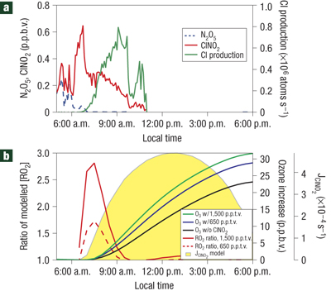
  The role of Nitryl chloride photolysis in ozone formations
HCl(aer)+N₂O₅(g) _{het}→ ClNO₂(g)+HNO₃(aq)
ClNO₂ + hν → Cl · + NO₂
  Measured mixing ratios of ClNO2 and N2O5 and the Cl atom production rate resulting from the photolysis of ClNO2 on 2 September 2006, while the ship was stationary in an inlet off Galveston Bay.
  Master chemical mechanism results for a representative modestly polluted marine air mass, to which 650 and 1,500 p.p.t.v. of ClNO2 have been added. Note that b is not intended as a model for the specific conditions in a, but rather to provide a general representation of the effect of ClNO2 chemistry, adopted from Osthoff et al. 2008).
Notes:
Cl* will react with VOCs, similar to OH, to produce peroxide radicals.
–The peroxide radicals, in turn, will convert NO to NO2.
•This new NO2 photolyzes producing O3.
NO + O3 → ?NO2 + O2
•NO2 + O3 → ?NO3 + O2
•NO3 + NO → ?2NO2
•NO3 + NO2  ?N2O5
•NO3 + VOC → ?Organic Nitrate Products
•N2O5 + AER:H2O (het) → ?2HNO3(aq)
•N2O5 + AER:HCl (het) → ?HNO3(aq) + ClNO2

Slide 8
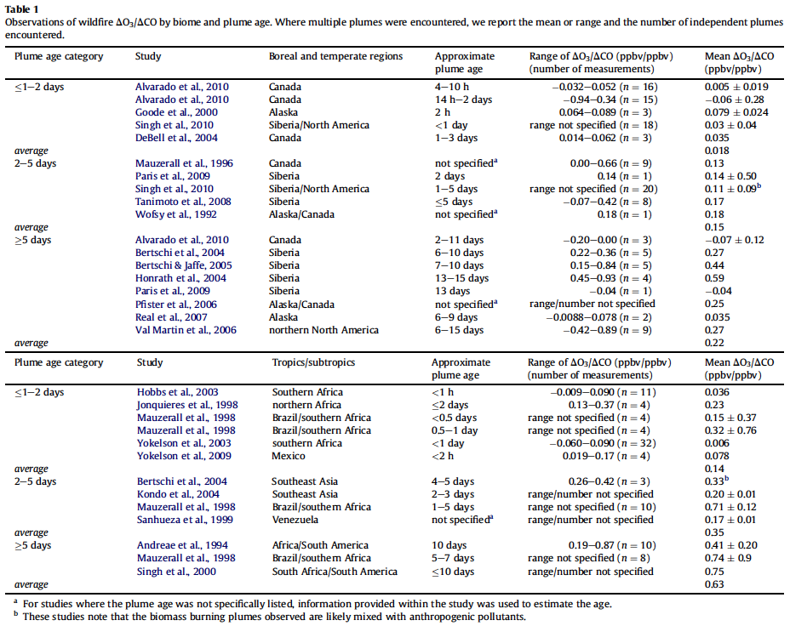
The Contribution of Biomass Burning to Ozone Formations
Notes:
Observations of wildfire DO3/DCO by biome and plume age. Where multiple plumes were encountered, we report the mean or range and the number of independent plumes encountered. Adopted from Jaffe and Wigder, 2012.
This calculation yields a value that is 3.5% of the global in-situ tropospheric O3 production of approximately 5000 Tg year1 (Bey et al., 2001).

Slide 9
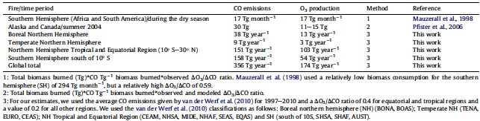
The Contribution of Biomass Burning to Ozone Formations
Global and regional estimates of O3 production from wildfires. Adopted from Jaffe and Wigder, 2012
Notes:
Observations of wildfire DO3/DCO by biome and plume age. Where multiple plumes were encountered, we report the mean or range and the number of independent plumes encountered. Adopted from Jaffe and Wigder, 2012.
This calculation yields a value that is 3.5% of the global in-situ tropospheric O3 production of approximately 5000 Tg year1 (Bey et al., 2001).

Slide 10
  Model budgets of tropospheric ozone – consensus over time
Notes:
A number of studies have been performed where models have been used to diagnose the tropospheric ozone budget. Stevenson et al., (2006), provide data from an ensemble of 26 chemical transport models. These give a stratospheric-tropospheric exchange rate (STE) of 550 ± 170 Tg (O₃) yr⁻¹ and a surface destruction term of 1000 ± 200 Tg (O₃) yr⁻¹. A summary of these and selected other estimates is presented in Table 1. Overall the estimates of STE and dry deposition have remained within a factor of two over a thirty year period with dry deposition being anything up to a factor of two larger than STE and both having uncertainties of around ± 30%.

Slide 11
The Dynamics of Ozone formation
  Ozone chemistry in the urban boundary layer (update text?)
  Ozone chemistry in the free troposphere (text?)
  Wintertime Ozone Chemistry (update text?)
  Ozone chemistry in polar boundary layer (text?)
  Ozone chemistry over the marine boundary layer – the role of halogens (text?)
  Ozone chemistry over tropical forests (text?)

Slide 12
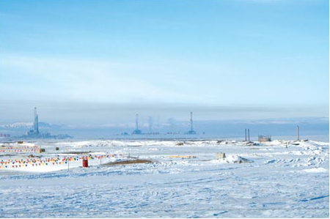
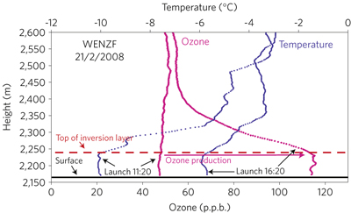
Wintertime Ozone Photochemical Production
Diurnal photochemical production of ozone during air temperatures as low as -17 ºC, in the rural Upper Green River Basin, Wyoming, in the vicinity of the Jonah–Pinedale Anticline natural gas field. They found that hourly
average ozone concentrations rise from 10–30 p.p.b. at night to >140 p.p.b.
Ozonesonde profile 10 km north of the gas field showing ozone and temperature profiles, surface to 2,600 m, 21 February 2008. Adopted from Schnell et al., 2009.
Upper Green River Basin, Wyoming, in the vicinity of the Jonah–Pinedale Anticline natural gas field.
Adopted from Joseph Pinto, 2009. JENNIFER FRAZIER, WDEQ

Slide 13
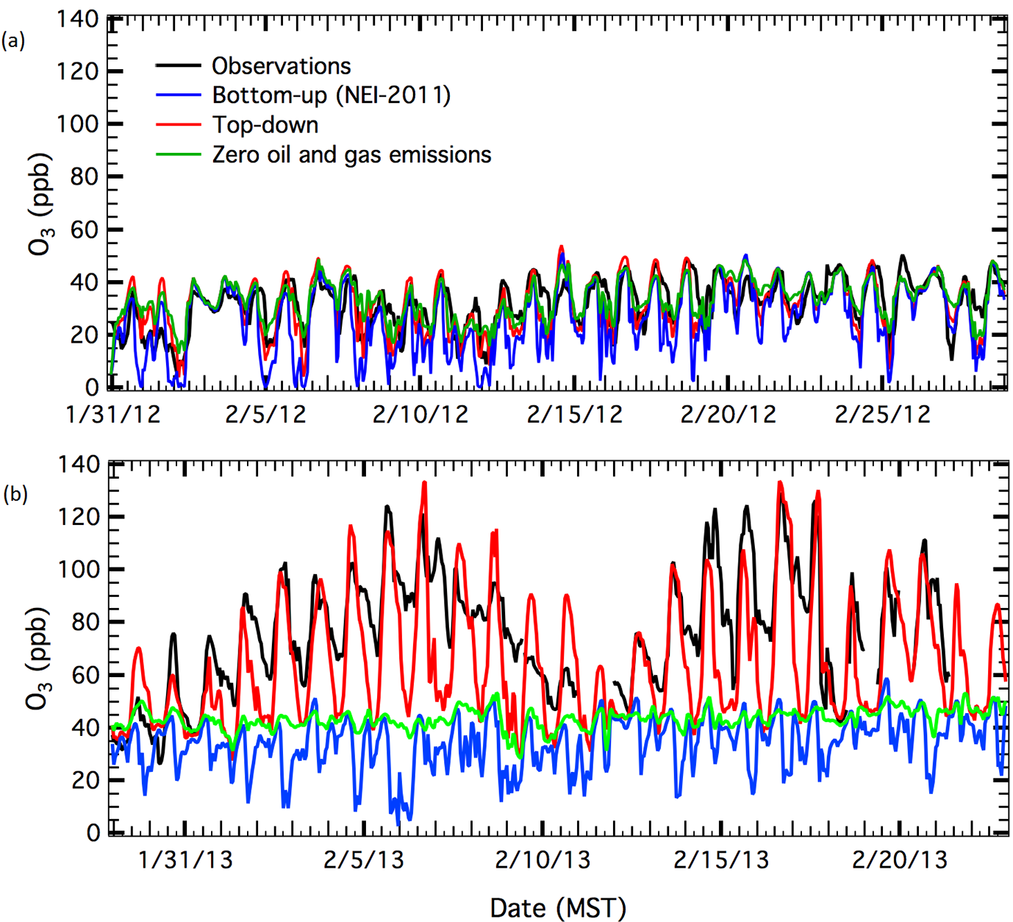
Wintertime Ozone Photochemical Production
Time series of the measured and modeled hourly O3 mixing ratios at Horse Pool in (a) 2012 and (b) 2013. Adopted from Ahmadov et al., 2015, understanding high wintertime ozone pollution events in an oil- and natural gas-producing region of the western US
Notes:
First, we present O3 modeling results for UBWOS-2012. Figure 3a shows time series of measured and modeled O3 concentrations during 31 January–28 February 2012 at the Horse Pool site. There are three modeling cases here, which were performed in the same way, except for different emission scenarios – bottom-up, top-down, and top-down without any oil/gas emissions in the UB. Observed hourly O3 mixing ratios at the site reach 40 ppb during afternoon hours, while the variability of daytime O3 from one day to another is small, and none of the emission cases differs markedly. The variability of O3 within the UB is dominated by transport of background O3 into the basin rather than by local chemistry. As noted before, the meteorological conditions did not result in any O3 exceedances during the 2012 field campaign. Maximum O3 values during daytime are reasonably well simulated by both the bottom-up and top-down cases, while the bottom-up inventory shows stronger O3 depletion due to NOx titration during nighttime. The model case without the oil/gas emissions is slightly different than the top down case, indicating a small contribution of the oil/gas sector to O3 production in the UB for 2012.
Figure 3b demonstrates measured and modeled time series of O3 at Horse Pool for 29 January–21 February 2013. The sharp contrast in hourly O3 concentrations between the
2 years is clear. Daytime O3 concentrations on most days exceeded the O3 concentrations observed in 2012 by 2–3 times.
Unlike the 2012 time period, model results with the three emission scenarios for 2013 differ considerably. The simula tion using the bottom-up emission set cannot capture any of the O3 enhancements observed at Horse Pool in 2013. However, the modeling case using the top-down emissions is able to simulate the high O3 episodes, the multi-day buildup of O3 in the UB, and the removal of O3 from the UB due to meteorological forcing between each high O3 episode. When all the oil/gas emissions are removed from the top-down inventory, model O3 is very close to the background mixing ratios of 40 ppb, indicating a significant contribution of the local oil/gas emissions to high O3 production in the UB in the winter of 2013. We refer to the model simulation for 2013 using the top-down emission scenario as the “base case”.

Slide 14
Impacts of Tropospheric Ozone on Human Health, Vegetation and Climate
  Ozone impacts on human health (Text?)
  Ozone driven vegetation damage (Text updates?)
  Ozone as a greenhouse gas (Text updates?)

Slide 15
  Ozone driven vegetation damage
Changes in Gross Primary Productivity between 1901-2100 due to O3 effects at fixed pre-industrial [CO2] under low (c) and high (d) ozone plant sensitivity.
Recent work in India (Ghude et al., 2014) suggests that the current levels of O3 present across the country lead to losses of ~10%, enough to feed ~ 94 million people .
Notes:
The ozone sensitivity of plants greatly varies among species and to some extent on different cultivars of the same species (US EPA, 1986; Monga et al., 2015; Gonzalez-Fernandez et al., 2010, Feng et al. 2011). However important crops such as wheat, beans and potatoes (Emberson et al., 2009; Gerosa et al.,2008; Pleijel et al., 2007) show a marked sensitivity to ozone with a potential negative consequences on food security (Mills and Harmens, 2011a), crop quality (Piikki et al., 2008) and agricultural economy (Vlachokostas et al., 2010; Kaliakatsou et al., 2010). A meta-analysis performed by Feng et al. (2008) on common wheat, for example, highlighted a grain yield decrease of 29% at ozone concentrations between 31 and 200 ppb, and a similar decrease of 18% at concentrations between 31 and 59 ppb. Recent work in India (Ghude et al., 2014) suggests that the current levels of O3 present across the country lead to losses of ~10%, enough to feed ~ 94 million people .
We should also refer to the paper by Sinha et al. who found rather different ozone sensitivities among different wheat crops which might be highly relevant for impact assessments in India and elsewhere in South(East)Asia.

Slide 16
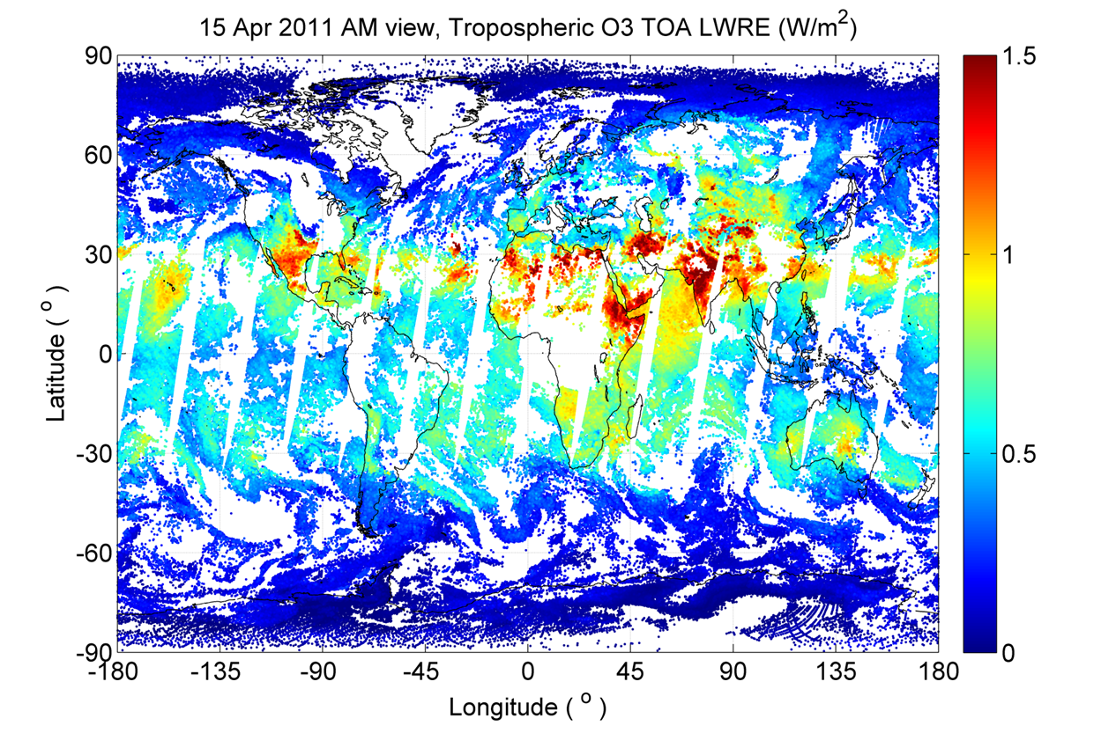
  Ozone as a greenhouse gas
Clear-sky ozone top-of-atmosphere (TOA) long-wave radiative effect (LWRE) (W/m²) measured by Infrared Atmospheric Sounding Interferometer (IASI) 15 April, 2011 shows the spatial variability in the greenhouse effect of ozone .
Notes:
The ozone sensitivity of plants greatly varies among species and to some extent on different cultivars of the same species (US EPA, 1986; Monga et al., 2015; Gonzalez-Fernandez et al., 2010, Feng et al. 2011). However important crops such as wheat, beans and potatoes (Emberson et al., 2009; Gerosa et al.,2008; Pleijel et al., 2007) show a marked sensitivity to ozone with a potential negative consequences on food security (Mills and Harmens, 2011a), crop quality (Piikki et al., 2008) and agricultural economy (Vlachokostas et al., 2010; Kaliakatsou et al., 2010). A meta-analysis performed by Feng et al. (2008) on common wheat, for example, highlighted a grain yield decrease of 29% at ozone concentrations between 31 and 200 ppb, and a similar decrease of 18% at concentrations between 31 and 59 ppb. Recent work in India (Ghude et al., 2014) suggests that the current levels of O3 present across the country lead to losses of ~10%, enough to feed ~ 94 million people .
We should also refer to the paper by Sinha et al. who found rather different ozone sensitivities among different wheat crops which might be highly relevant for impact assessments in India and elsewhere in South(East)Asia.

Slide 17
New Layout (draft to be discussed)
Introduction
Ozone Photochemical Formations and Dynamics
Impacts of Tropospheric Ozone on Human Health, Vegetation and Climate
Ozone evolution in the last decades based on model and observations studies
Future scenarios for ozone evolution. Also, how non-linear chemistry may impact climate and how climate feedbacks on ozone (e.g., via changes in Temp.), both one- and two-way feedbacks.
In the above two sections, the ozone evolution can be discussed in terms of its chemical formation/chemical regimes/OPE and dynamics, so, some sections from the old format may be incorporated here.
How uncertainties in known/unknown chemistry and emission may affect the current and projected ozone evolution.
Executive Summary to Policy makers
Summary
Notes:
Sections and subsections name may vary from the original draft on the wiki.

Slide 18
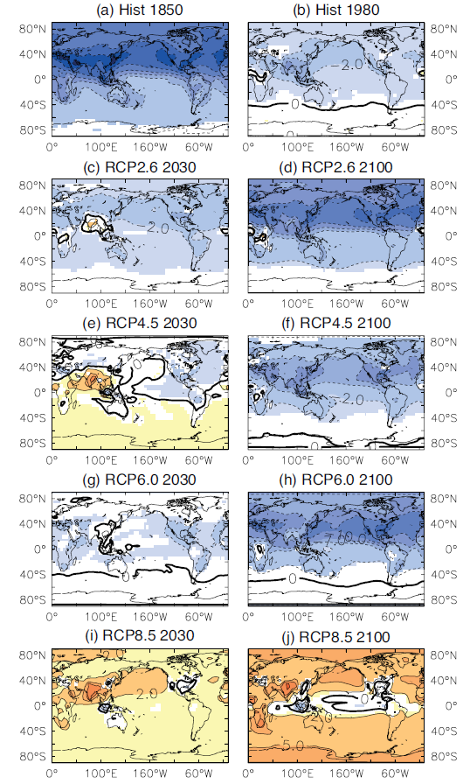
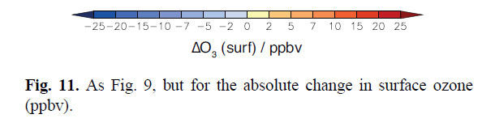
The ensemble ACCMIP projection for surface ozone indicates an increase of 2 ppbv across the North Pacific Ocean during 2000-2030 based on a business as usual RCP8.5 emissions scenario.
Young et al. (2013), Pre-industrial to end 21st century projections of tropospheric ozone from the Atmospheric Chemistry and Climate Model Intercomparison Project (ACCMIP), ACP.
Notes:
For example, to get an impression about the new suggested focus of chapter 1, Owen sent us these slides.

Slide 19
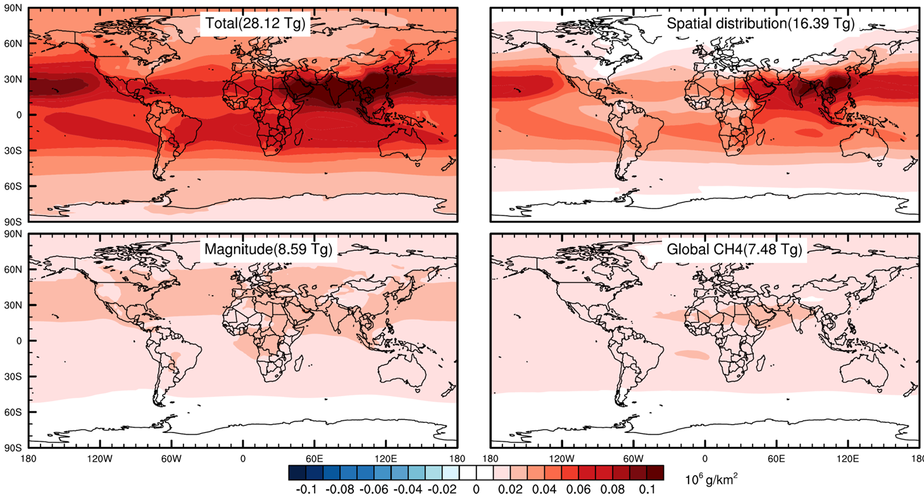
A recent study presented at the AGU 2015 Fall Meeting, and soon to be submitted to Nature Geoscience, indicates that half of the tropospheric ozone burden increase since 1980 is due to increases in emissions. The other half of the increase is due to emissions shifting equatorward where ozone production efficiency is much greater. This finding is of major importance and implies that even if ozone precursor emissions do not increase globally over the coming years, ozone will still increase globally if the emissions continue to shift equatorward.
Top left – increase in global tropospheric ozone burden over 1980-2010 due to the actual increase in emissions and the actual equatorward shift in emissions.
Top right - increase in global tropospheric ozone burden over 1980-2010 when 1980 emissions are given the 2010 spatial distribution, i.e equatorward shift.
Bottom left - increase in global tropospheric ozone burden over 1980-2010 when emissions are allowed to increase but are kept in their 1980 locations.
Bottom right - increase in global tropospheric ozone burden over 1980-2010 due to methane increases alone.
Zhang, Y., O. R. Cooper and J. J. West (2016), Southward redistribution of emissions dominates the 1980 to 2010 tropospheric ozone change, in preparation for Nature Geoscience.

Slide 20
If this science question is adopted for the paper:
“How is the global tropospheric ozone budget likely to evolve over the next 20 years?”
…and if we believe the world is on track to follow the RCP8.5 scenario and that the ozone burden will likely increase, then the paper would address the following aspects of the ozone budget:
Stratospheric source: what is the most likely estimate of the present day flux of ozone from the stratosphere into the troposphere, and do we expect this component of the ozone budget to increase over the next 20 years?
Ozone production: What is the most likely estimate for present day ozone production and how do we expect production to change over the next 20 years?
Ozone loss: What is the most likely estimate for present day ozone loss and how do we expect loss to change over the next 20 years?
Emissions (anthropogenic and biomass burning)…same approach as above
This approach allows us to review all the important processes related to emissions, STE, production and loss, but also allows us to look forward and give our best assessment of what is most likely to unfold.

Slide 21
Given the following:
Methane is increasing globally
fossil fuel combustion is increasing globally (and perhaps NOx emissions as well)
Emissions are shifting equatorward where ozone production efficiency is greater
Of the 4 RCP scenarios, we appear to be following RCP8.5
Therefore, we should expect an increase in the tropospheric ozone burden.
Next, let’s look at ozone observations and see if this is indeed the case….

Slide 22
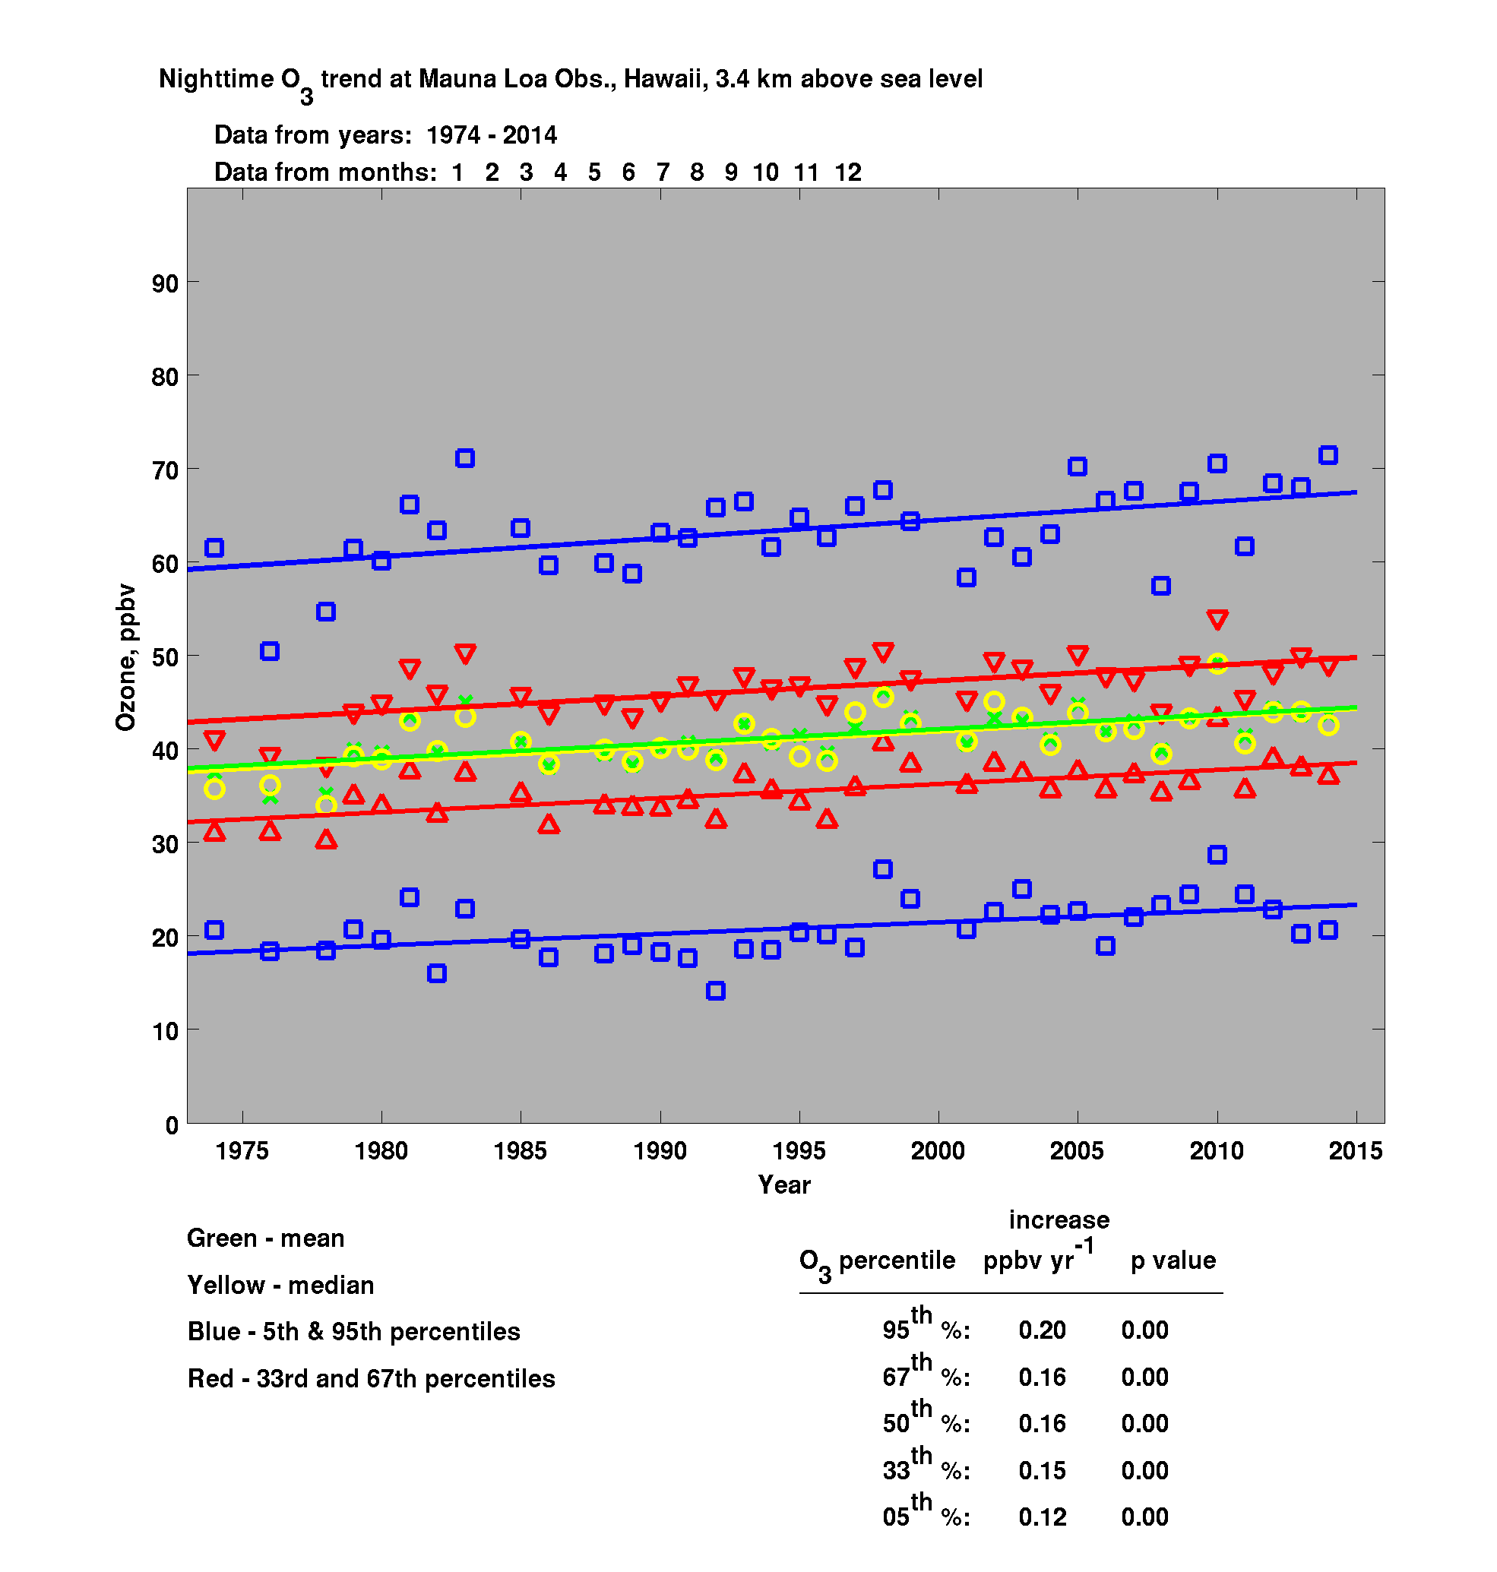
Ozone has increased steadily since 1974 at the rate of 0.16 ppbv yr⁻¹. Applying this rate of increase to 2000-2015 yields an ozone increase of ~2 ppbv. This equals the ACCMIP projected increase in surface ozone over the North Pacific Ocean for the 2000-2030 time period (for RCP8.5).
So the ACCMIP projection has come true in just 15 years, rather than 30.
95%
67 %
50%
33%
5 %
Annual mean ozone has increased
by 17% during 1974-2014.
Data collected by NOAA Global Monitoring Division

Slide 23
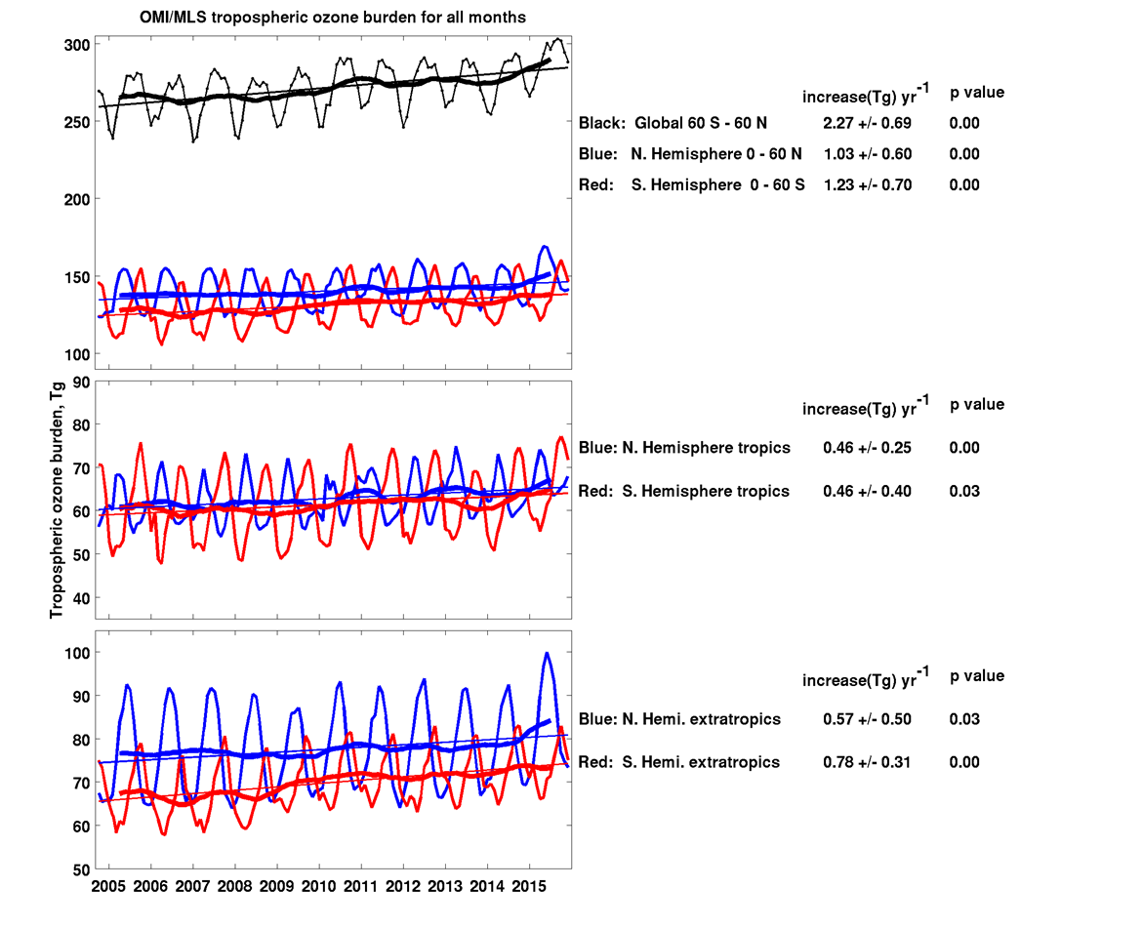
The figure to the right shows Jerry Ziemke’s OMI/MLS tropospheric ozone product updated for October 2004 through December 2015. Thin lines indicate monthly values and thick lines are 12-month running means.
The global tropospheric ozone burden has increased significantly by 9% during 2005-2015. The trend is significant in both hemispheres.

Slide 24
Introduction
Ozone Tropospheric Chemistry
Ozone photostationary state
Ozone formation reactions
Ozone suppression reaction
Ozone control strategy
Notes:
In hypothetical atmosphere, containing only NO, NO2 and O3. No organics.

Slide 25
Introduction
Ozone photostationary state (Lighton, 1961)
NO + O₃ → NO₂ + O₂
NO₂ + hν (λ ≤ 420 nm) → O(³P) + NO
O(³P) + O₂ (M) → O₃ (M)
[O₃] = j_{NO2} [NO₂] / K_{NO+O3} [NO]
However, this is a do-nothing cycle as long as (new) ozone formation is concerned.
Notes:
In hypothetical atmosphere, containing only NO, NO2 and O3. No organics.

Slide 26
Ozone suppresion
Introduction
Under high NO_{x} conditions:
OH + NO₂ + M → HNO₃ +M
Under low NO_{x} conditions:
HO₂ + HO₂ → H₂O₂ + O₂
HO₂ + RO₂ → ROOH + O₂
RO₂ + RO₂ → Products
Ozone may be even also destroyed due to its reaction with HO₂:
HO₂ + O₃ → OH + 2O₂
Notes:
Reduction in OH levels will suppress the radical propagation process and thus ozone formation

Slide 27
Introduction
Ozone Control Strategy
“how much reductions in VOC or NO_{x} or both would be required to reduce the peak O₃ concentrations to the air quality standards”
  Ozone sensitivity
Determine the chemistry of the air matrix as VOC-sensitive or NO_{x}-sensitive.
  Ozone formation potential
Determine the contribution of the different VOCs to the ozone
formation considering their kinetic and mechanistic point of view.
Yasin Elshorbany Physikalische Chemie

