Slide 1
Free Troposphere data sets
Acknowledgement
G. Ancellet, O. R. Cooper, J. Cuesta, G. Dufour, F. Ebojie, G. Huang, S. S. Kulawik, B. Latter, T. Leblanc, J. Liu, X. Liu, J. Neu, H. Petetin, I. Petropavlovskikh, A. McClure, D. Tarasick, V. Thouret, C. Wespes, H. Worden, C. Vigouroux, J. Ziemke
TOAR Workshop 1.03, Beijing, January 25th 2016

Slide 2
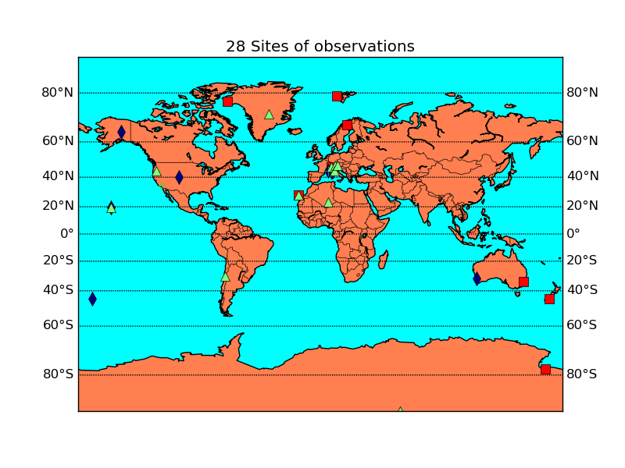
Free Troposphere data sets
Square: FTIR
Triangle: mountain sites
Diamond: Umkehr
Circle: IAGOS
Cross: lidar

Slide 3
Free Troposphere data sets
Square: FTIR
Triangle: mountain sites
Diamond: Umkehr
Circle: IAGOS
Cross: lidar

Slide 4
Free Troposphere data sets
Satellite
Products
Tropospheric Ozone Column (TOC) = surface-tropopause
OMI/MLS (60N-60S)
IASI/TES (80N-80S)
GOME/GOME2 (90N-90S)
OMI (60N-60S)
SCIAMACHY (60N-60S)
Lower troposphere: GOME2/IASI (Regions)
Files already provided for the database
OMI/MLS: 7 latitude bands =
60N-60S
0-60N
0-60S
0-30N
0-30S
30N-60N
30S-60S
Units
ppbv, DU, Tg
Metrics
Monthly mean

Slide 5
Free Troposphere data sets
FTIR and Umkehr
Products
FTIR: 8 sites between 80N and 80S
TOC = surface-8km
Umkehr: 5 sites between 65N and 45S
3 layers =
surface-250hPa
surface-500hPa
500hPa-250hPa
Files already provided for the database
Umkehr: 3 layers, average and percentiles
Units
ppbv, DU
Metrics
Seasonal mean and percentiles
Stat: 4profiles * 3months

Slide 6
Free Troposphere data sets
IAGOS, Ozonesondes, TOST, lidar
Products
IAGOS: profiles over Frankurt, North America, Asia, Middle East
TOST: Global tropospheric ozone with resolution = 5°x5°x1km
Ozone sondes: 12 sites with more than 20yrs of data without changing instrument
Lidar: Profiles over OHP, France and Table Mountain, California, USA
Files already provided for the database
IAGOS: Frankfurt ozone profile average and percentiles with vertical resolution of 25hPa
Units
ppbv, DU
Metrics
Seasonal and monthly mean
Stat: 4profiles per day
or 4-5profiles per month

Slide 7
Free Troposphere data sets
Files Format description
filename: Site_o3_instrument_metric_period.dat

Slide 8
Free Troposphere data sets
Files Format description
Header for Satellite
Header for FTIR and Umkehr

Slide 9
Free Troposphere data sets
Files Format description
Header for ozone sondes, IAGOS, lidar

