Slide 1
Status of TOAR Database and JOIN Web Interface Prioritizing Further Analysis and Development Needs
Brief introduction for newcomers
Experiences with adding new datasets
Dataset status and open issues
surface ozone datasets
other datasets
JOIN development status and outlook
TOAR collaboration tools (optional)
Martin G. Schultz – IEK-8, Forschungszentrum Jülich, Germany (m.schultz@fz-juelich.de)
with contributions from Owen Cooper – NOAA, Boulder

Slide 2
Acknowledgements
First and foremost to everyone who supplied data to TOAR!
Ayako Aoyagi, Sabine Braun, José A. Carnero, Limseok Chang, Tony Colavecchia, Owen Cooper, Ute Dauert, Paul Eckhardt, Yasin Elshorbany, Helmut Feigenspahn, Clarissa Figura, Ian Galbally, Francois Gheusi, Rob Gillett, John Hee, Ohnmar Ting Hlaing, Lee Hojoon, Ulas Im, Dan Jaffe, Hiroshi Koide, Gary Lear, Haeyoung Lee, Meehye Lee, Nick Mangus, Audra McClure, Raeesa Molla, Suzy Molloy, Manish Naja, Monica Navarro, Irina Petropavlovskikh, Ynon Rudich, Keiichi Sato, James Schwab, Rodrigo J. Seguel, Bärbel Sinha, Vinayak Sinha, Hiroshi Tanimoto, Thomas Trickl, Shanju Xie, …
Database and JOIN work: Sabine Schröder, Snehal Waychal, Olga Lyapina, and Michael Decker

Slide 3
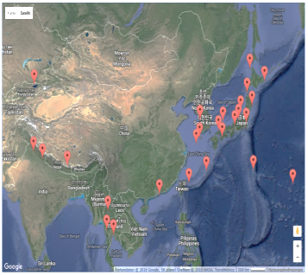
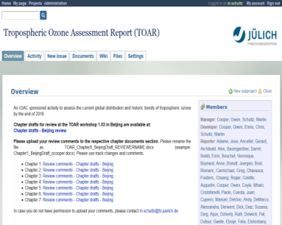
Brief Introduction for newcomers
Data
Documents
TOAR free troposphere
datasets
(no central management)
information
ftp, scp, etc.
TOAR website
REST interface
(metadata)
TOAR chapter drafts
TOAR surface ozone
datasets
+ auxilliary data
(central database)
web interface for plotting,
metadata and data downloads
(only statistics and metrics)
Redmine
collaboration tool

Slide 4
The TOAR surface ozone database
Brief Introduction for newcomers
Relational Postgresql database (= fast!)
Physical copy of data downloaded from regional network archives
Extensive metadata to describe stations and „parameter series“
Relatively flexible data model (multi-parameter, several series per parameter and station, etc.)
Primary access via Python library (also used in JOIN)
REST interface for metadata extraction (to be extended)
networks
parameter
stations
parameter
series
o3_hourly
o3_hourly
o3_hourly
o3_hourly

Slide 5
Station and series metadata
Brief Introduction for newcomers
Stations
numid
network_name
station_id
station_local_id
station_type
station_type_of_area
station_category
station_name
station_country
station_state
station_lon
station_lat
station_alt
station_timezone
station_population_density
(station_nighttime_light_intensity)
(station_climatic_zone)
(station_crop_types)
Parameter_series
id
station_numid
parameter_label
parameter_name
parameter_attribute
parameter_sampling_type
parameter_measurement_method
parameter_original_units
parameter_calibration
parameter_contributor_shortname
parameter_contributor
parameter_contributor_country
parameter_dataset_type
parameter_status
comments
creation_date
modification_date
data_start_date
data_end_date
parameter_pi
parameter_pi_email

Slide 6
Explanation of parameter_label
Brief Introduction for newcomers
Unique combination of
parameter_name,
parameter_attribute,
and parameter_contributor_shortname
Used to allow multiple ozone series at one station
Shortened to essential information
Examples:
o3 simplest form, only one series
o3 - filtered a filtered ozone series
o3 - - kma ozone data from KMA
(o3-filtered-kma) filtered ozone data from KMA

Slide 7
The JOIN web interface
Brief Introduction for newcomers
https://join.fz-juelich.de
You register yourself and manage your own account!
After login:

Slide 8
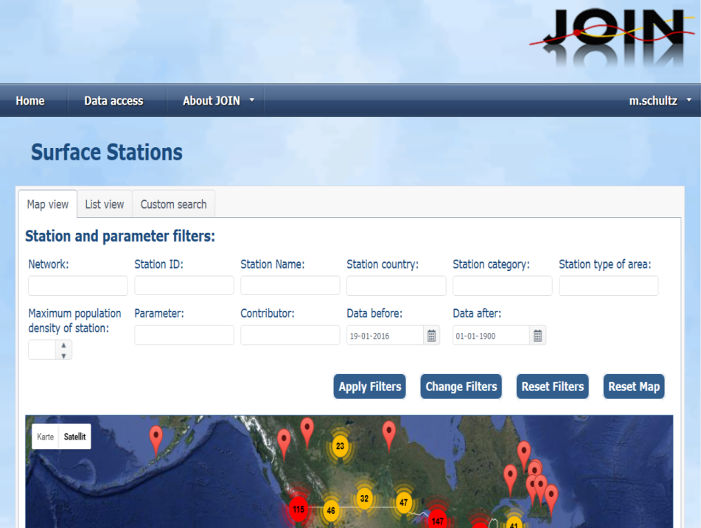
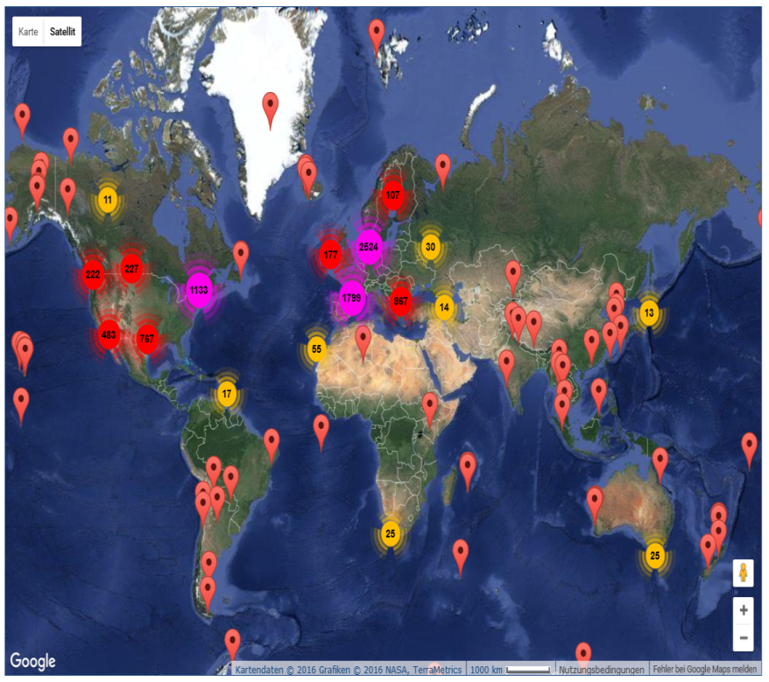
Brief Introduction for newcomers

Slide 9
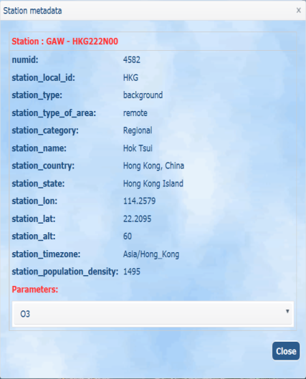
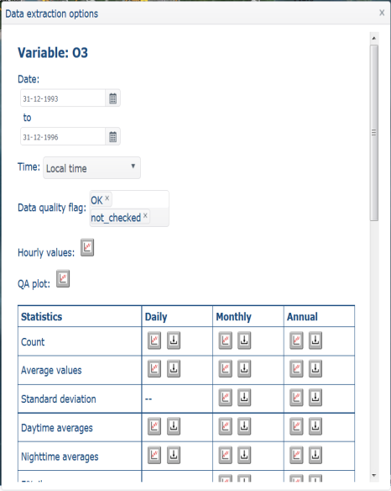
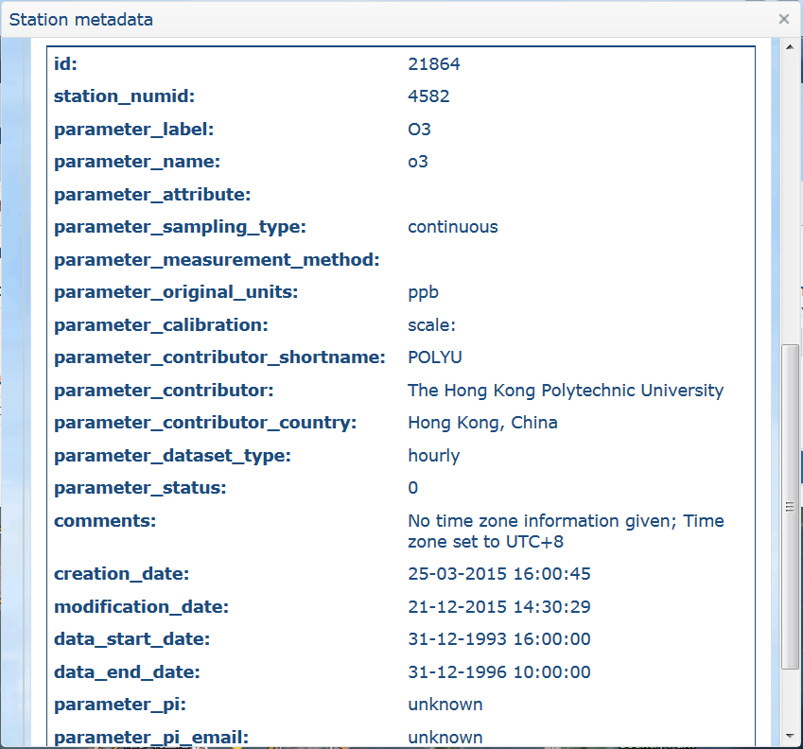
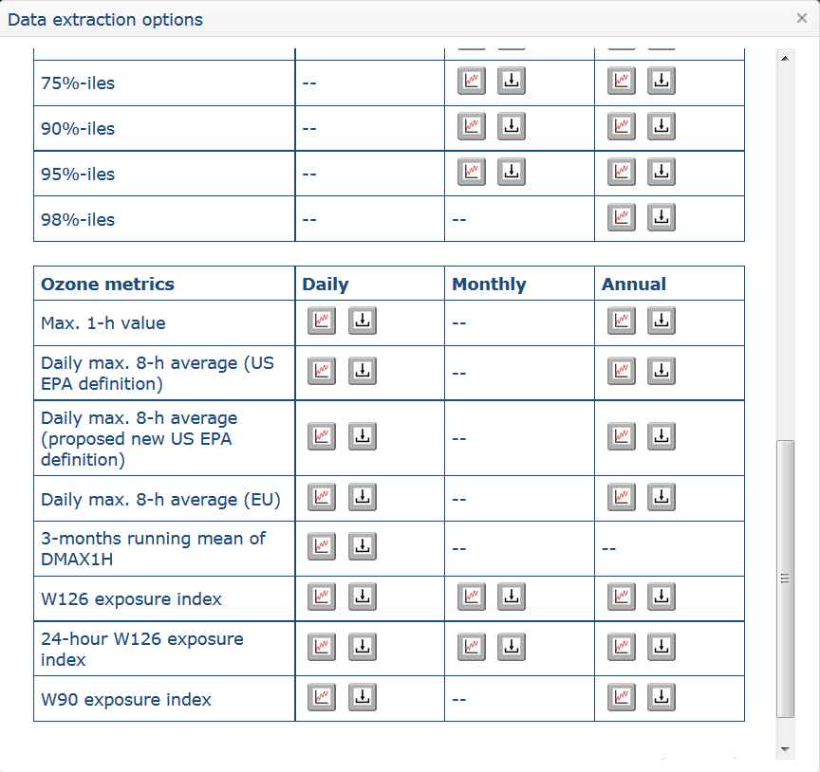
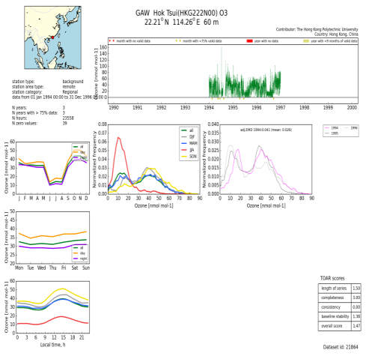
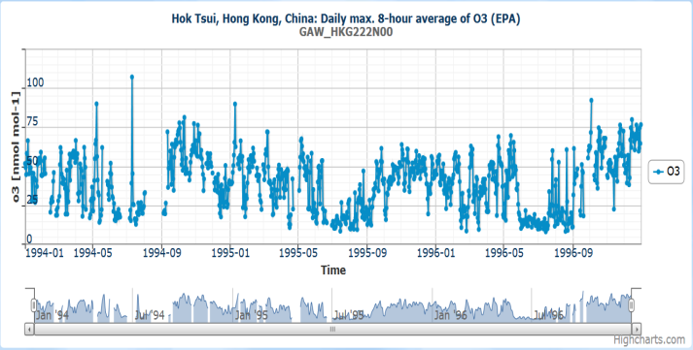
Brief Introduction for newcomers

Slide 10
JOIN REST interface
Brief Introduction for newcomers
Access to metadata (and data) without having to point and click
So far only limited services implemented:
https://join.fz-juelich.de/databases/obssurfacedata/stations/networks/ (list of networks)
https://join.fz-juelich.de/databases/obssurfacedata/stations/ (list of essential metadata for all stations)
https://join.fz-juelich.de/databases/obssurfacedata/stations/UBA/DENW057/ (complete metadata for one station)
Output is in JSON format.
Example output (networks):
["NIES","EANET","UBA","AQS","RSA","AIRBASE","CAPMON","OTHER",
"AUSAQN","CASTNET","ISRAQN","EMEP","GAW","NAPS","AIRMAP"]

Slide 11
Experiences with adding new datasets
In spite of TOAR data submission guidelines, there is still substantial manual re-formatting necessary before data can be integrated into the TOAR database.

Slide 12
Most common issues
Experiences with adding new datasets
date format: We like YYYY-MM-DD hh:mm; we get MM/DD/YYYY hh:mm, DD-MM-YYYY hh:mm, or others (and sometimes they change within a file)
1-24 h instead of 0-23 h (and sometimes „end of interval“)
value separator: We like ; ; we get , or blanks
metadata problems: blanks or long names as station_id, wrong „original units“, wrong metadata tags (e.g. „station id“), wrong or imprecise coordinates, etc.
Sabine can deal with most issues, but this takes extra time. Please try to follow rules to the letter and ask if uncertain!

Slide 13
Dataset status and open issues - Surface ozone data
Total datasets in database: 7374 data series at 7365 stations
Added since 1 May 2015 (after Madrid meeting): 1767 (4211*)
Regional statistics:
* includes updates of AQS and CASTNET
Asia (w/o Russia) | 1288 records
Oceania and Indonesia | 54 records
Africa and Middle East | 98 records
South and Central America | 35 records
North America | 2858 records
Europe | 4303 records
total: 8636 ozone records, ~400 mio hourly values
Notes:
Asia: 60 .. 170 E, 5 .. 70 N
Australia&Oceania: 90..180 E, -60 .. 5 N
Africa&MiddleEast: -30 .. 60 E, -40 .. 35 N
South&CentralAmerica: -110 .. -30 E, -60 .. 25. N
NorthAmerica: -180 .. -30 E, 20 .. 80 N (includes Greenland)
Europe: -30 .. 60 E, 35 .. 85 N

Slide 14
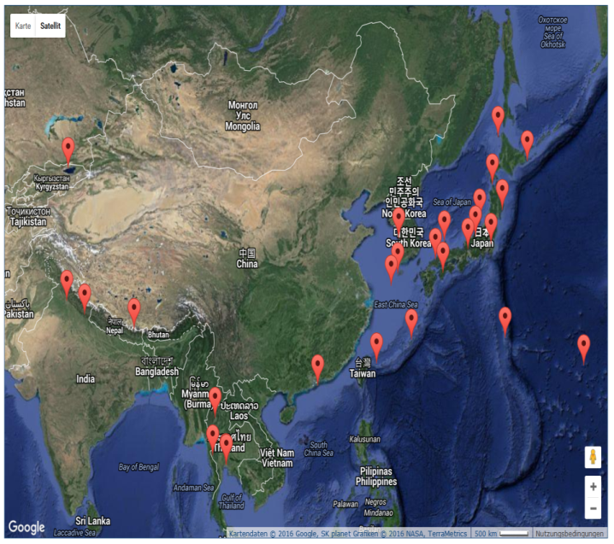
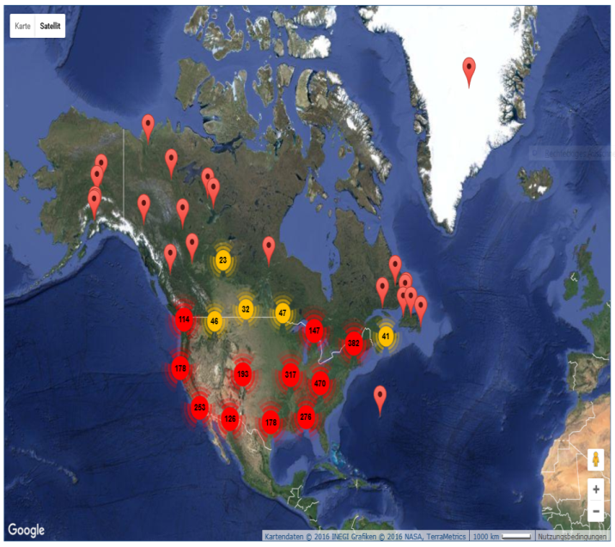
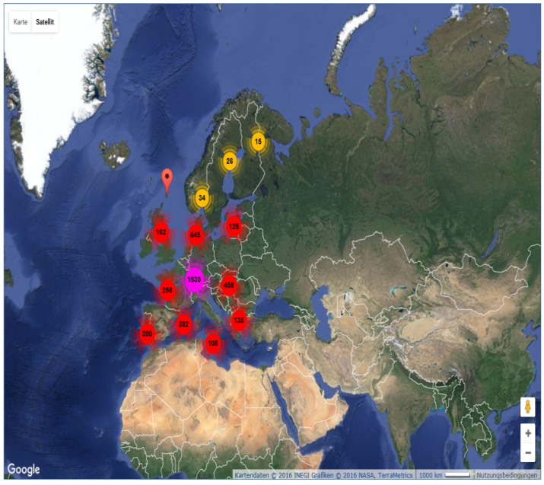
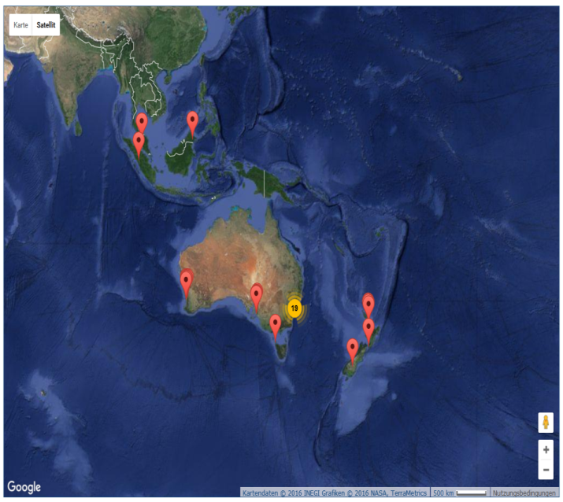
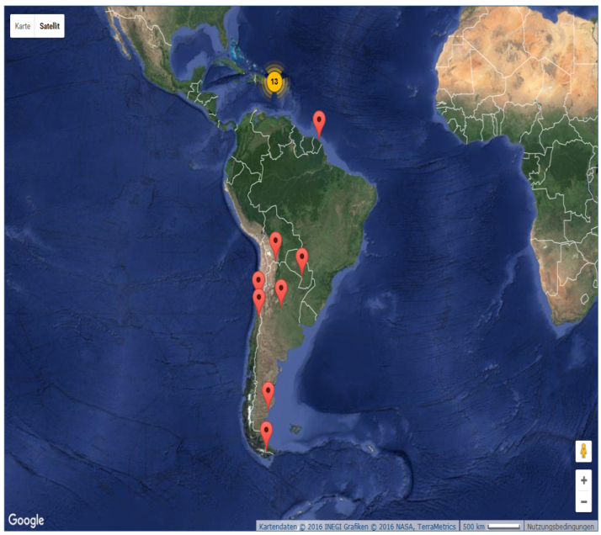
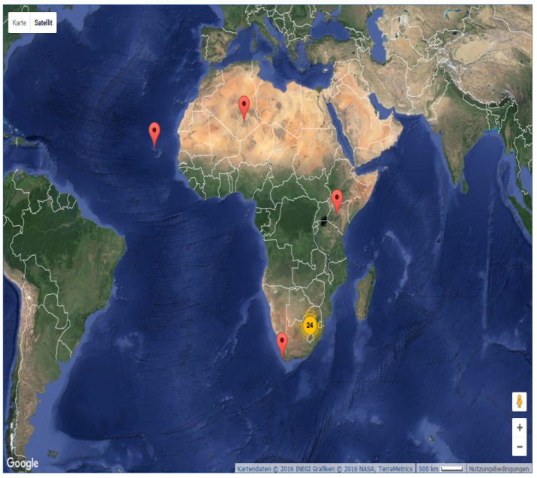
Dataset status and open issues

Slide 15
„Duplicate series“
Dataset status and open issues
Some stations report to more than one network, sometimes data series are interrupted, the instrument changes, etc.
→ Need to identify most suitable data set (possibly a merge)
Cannot be fully automated → a lot of work for Olga
Step 1: identify identical sites (Station_id identical? Coordinates very close? …)
Step 2: find out what should be used in TOAR (length of time series, „trustworthy data“, …)
Step 3: create a „TOAR access table“
use 7253 until 5th July 1998, then 10122
series_ids | merge_instructions
10121, 10122, 7523, 7524 | (ʺ01-01-1990ʺ, ʺ05-07-1998ʺ, 7253), (ʺ01-08-1998ʺ, None, 10122)
534, 8724 | (ʺ04-03-2002ʺ, None, 8724)
only use 8724, discard 534

Slide 16
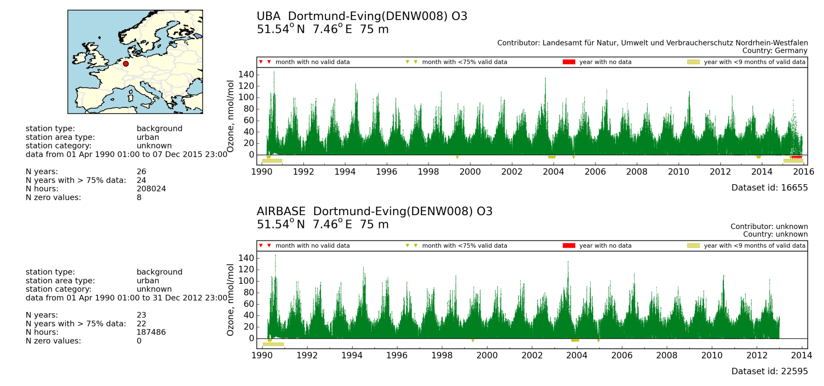
Dataset consistency
Dataset status and open issues
Impact on metrics?
98%-ile in 2002:
52.13 vs 52.88 ppbv
(could be larger elsewhere)
UBA - Airbase

Slide 17
Planned data additions and updates
Dataset status and open issues
Three stations missing from South Africa (format problems)
Processing of Japanese stations pending (mostly Ox instead of O3)
Mt. Bachelor data (US) in progress
Updated records from EMEP to be included
Updates of CASTNET, NAPS, EANET, Airbase to be done
Extension of Nainital data for 2012/13
More Indian stations?
Nepal?
South Korea AQ data (Seoul)?
Chinese data?
Other datasets?
Planned freeze date of TOAR database is 30 April 2016
No more data submissions after this date

Slide 18
Dataset status and open issues - Other data
Ongoing activities:
adding proxies for urban/rural classification of TOAR surface monitoring sites
adding 6 km COSMO reanalysis met. data (Europe only)
adding ozone precursor measurements (initial focus on GAW and Europe data)

Slide 19
Proxies for urban/rural classification of TOAR surface monitoring sites
Compiled and processed by Owen Cooper
University of Colorado/NOAA ESRL
owen.r.cooper@noaa.gov
Updated for all 10,122 monitoring sites in the TOAR database as of December 17, 2015

Slide 20
Human population proxy for urban/rural classification
The TOAR database provides the human population for the year 2010 at each TOAR ozone monitoring site in the TOAR database. These data are also available in JOIN. Population values are in units of humans per square km at 5 km resolution and 0.2x0.2 degree resolution.
Data source:
Gridded Population of the World: Future Estimates, for the year 2010, at a resolution of 2.5 arc minutes, or 4.6 km (~5 km). Data produced by Center for International Earth Science Information Network (CIESIN), Columbia University.
Data downloaded from http://sedac.ciesin.columbia.edu/gpw on October 19, 2011
SUGGESTED CITATION
Center for International Earth Science Information Network (CIESIN), Columbia
University; United Nations Food and Agriculture Programme (FAO); and Centro
Internacional de Agricultura Tropical (CIAT). 2005. Gridded Population of the
World: Future Estimates (GPWFE). Palisades, NY: Socioeconomic Data and Applications
Center (SEDAC), Columbia University.
Available at : http://sedac.ciesin.columbia.edu/gpw October 19, 2011

Slide 21
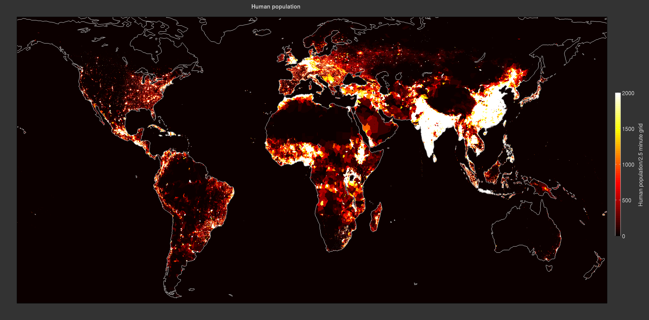
Global human population in 2010
Gridded Population of the World: Future Estimates, for the year 2010, at a resolution of 2.5 arc minutes, or 4.6 km

Slide 22
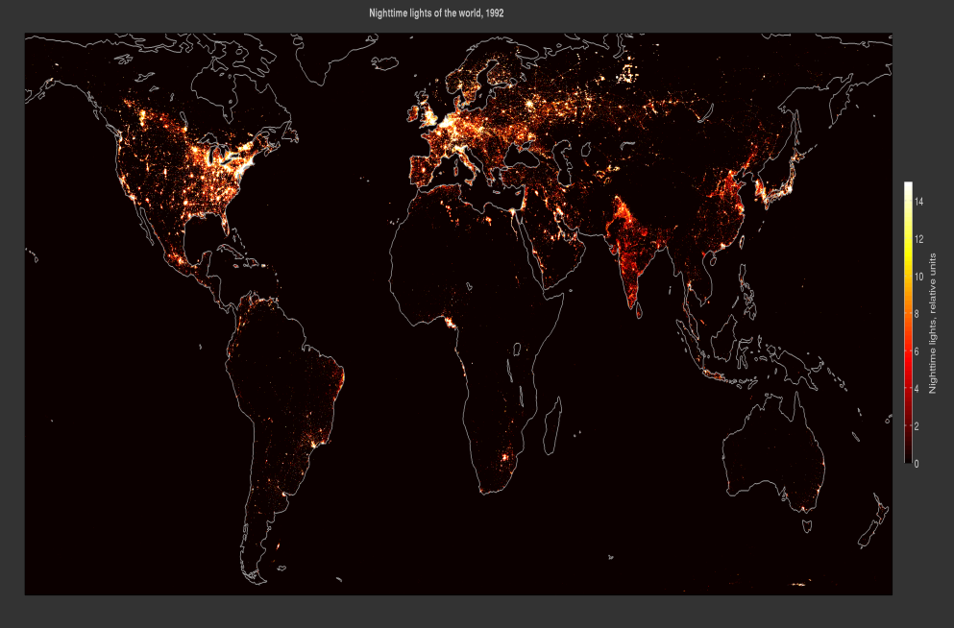
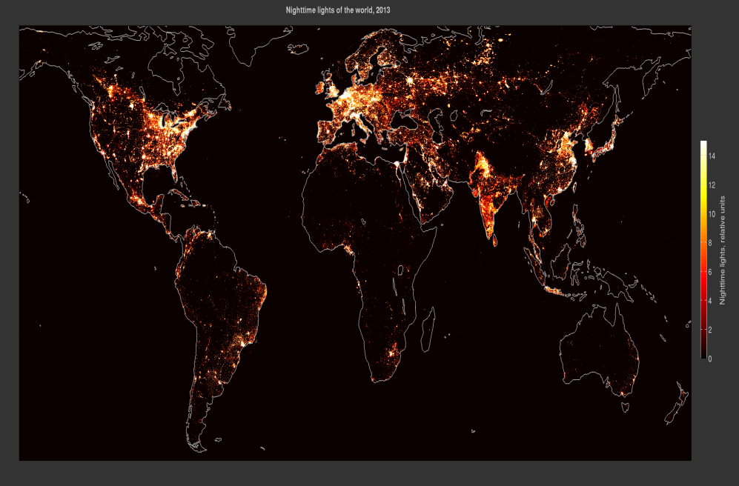
Nighttime lights of the world proxy for urban/rural classification
The brightness values are produced from nighttime lights from cities, towns, and other sites with persistent lighting, including gas flares. Ephemeral events, such as fires have been discarded. The background noise was identified and replaced with values of zero. Data values range from 1-63.
1992
Global population 5.5 billion people
2013
Global population 7.2 billion people

Slide 23
Nighttime lights of the world proxy for urban/rural classification
Data source:
The DMSP-OLS nighttime lights of the world (V4) dataset detected by The Defense Meteorological Satellite Program (DMSP) Operational Linescan System (OLS). Image and data processing by NOAA National Geophysical Data Center. DMSP data collected by US Air Force Weather Agency.
Processing:
The nighttime lights brightness values (for the year 2013) are extracted from gridded products at 5 km resolution and 0.2x0.2 degree resolution at each TOAR ozone monitoring site in the TOAR database. The original data were produced and provided at a resolution of 30 arc seconds, equal to 0.925 km. This dataset (with over 900 million data points for a single year) was too large to manipulate so the resolution was smoothed by Owen Cooper to a resolution of 2.5 arc minutes, or 4.625 km.
Data downloaded from: http://ngdc.noaa.gov/eog/dmsp/downloadV4composites.html

Slide 24
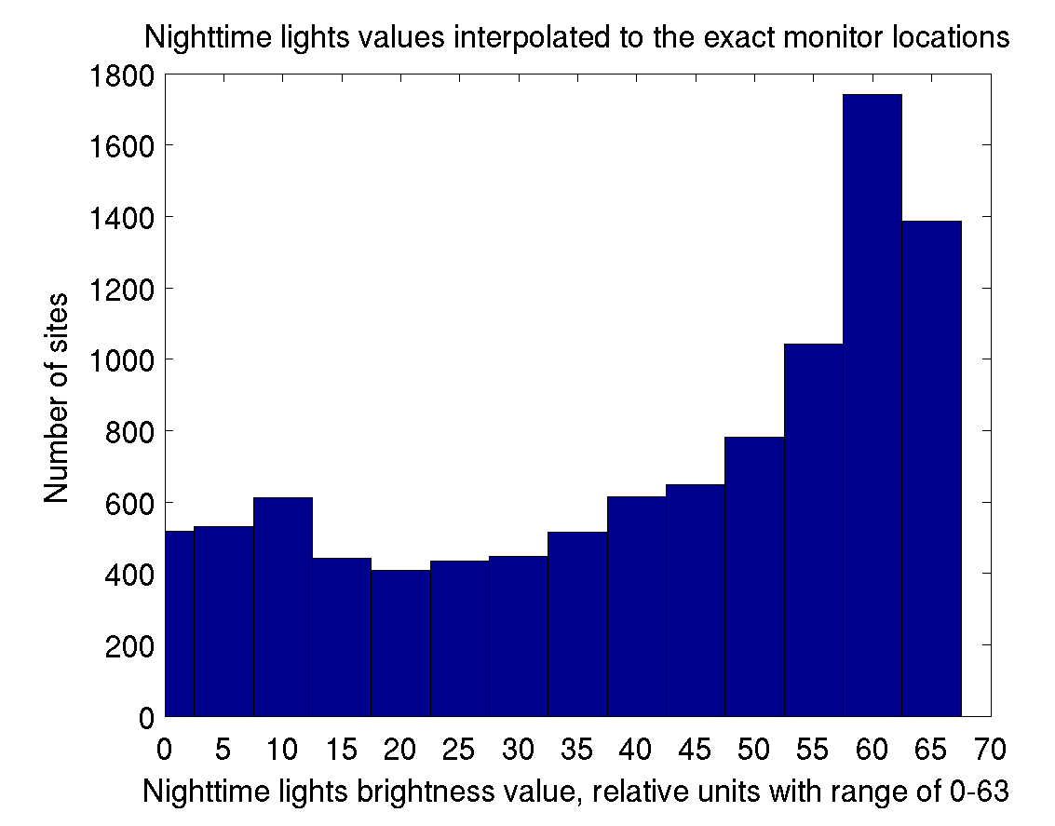
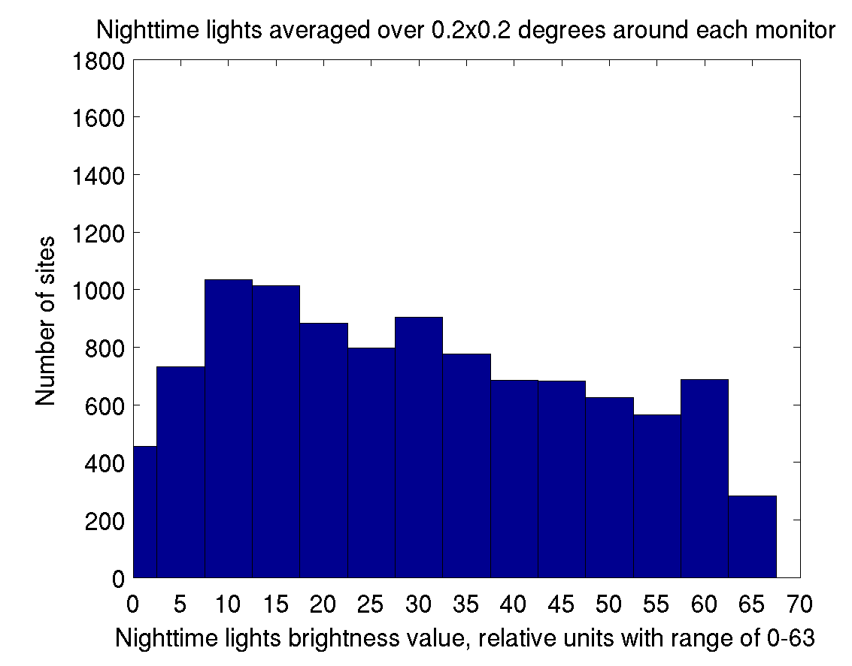
Nighttime lights of the world proxy for urban/rural classification
Comparison of the nighttime lights brightness values (from 2013) at all 10,122 monitoring sites in the TOAR database, as of December 17, 2015. The two histograms show that when the brightness values at 5 km resolution are interpolated to the exact location of each monitoring site the distribution is skewed towards very bright lights. But when the brightness values are degraded to 0.2x0.2 degree resolution the distribution is skewed towards darker skies. These histograms can be used as a guide to determine a brightness value that can distinguish between rural and urban monitors.

Slide 25
Climatic zones for monitoring site classification
The TOAR database classifies each TOAR ozone monitoring site in the TOAR database (as of December 17, 2015) as being located in 1 of 12 climatic zones. Gridded climatic zone data were provided at a resolution of 9 km. Sites located in the ocean or the Antarctic are unclassified.
The climatic zones are defined based on the classification of IPCC (IPCC, 2006), according to: annual mean daily temperature, total annual precipitation, total annual potential evapo-transpiration and elevation.
0 unclassified
1 Warm Temperate Moist
2 Warm Temperate Dry
3 Cool Temperate Moist
4 Cool Temperate Dry
5 Polar Moist
6 Polar Dry
Data source:
European Commission’s Renewable Energy Directive, coordinated by the European Soil Data Centre at the Joint Research Centre, http://eusoils.jrc.ec.europa.eu/projects/RenewableEnergy
7 Boreal Moist
8 Boreal Dry
9 Tropical Montane
10 Tropical Wet
11 Tropical Moist
12 Tropical Dry

Slide 26
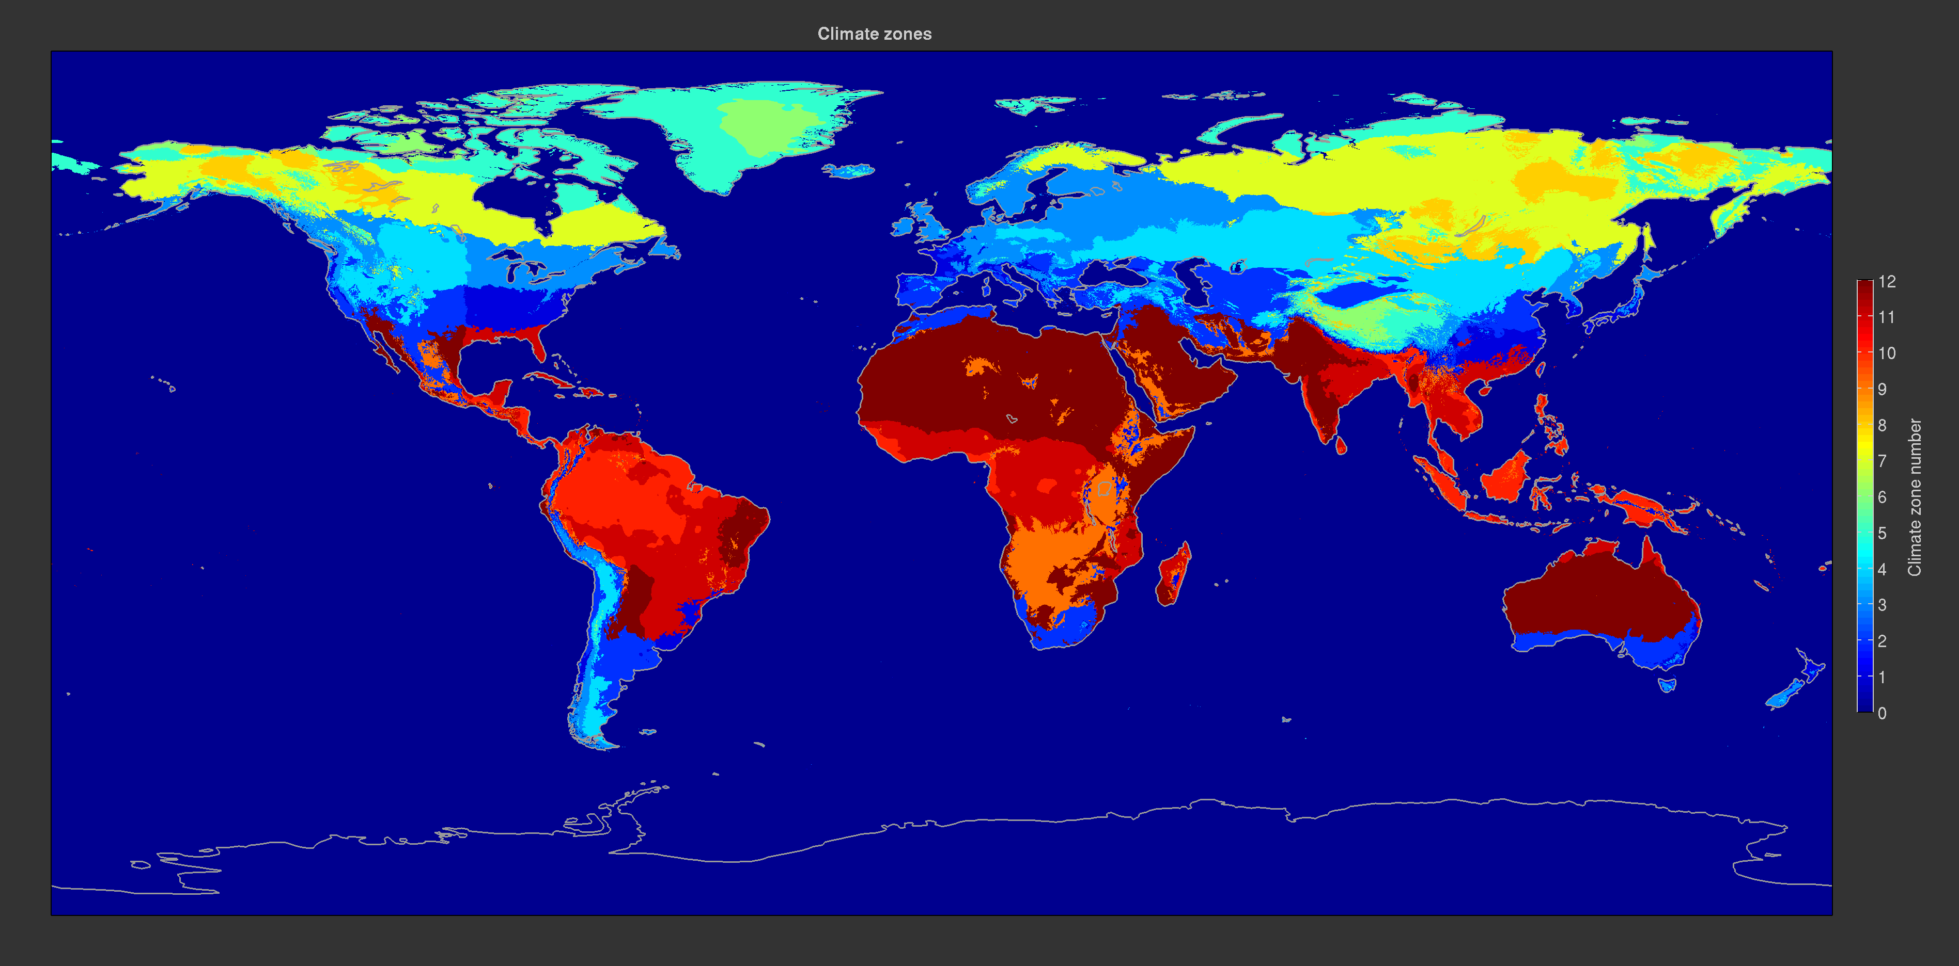
Climatic Zones

Slide 27
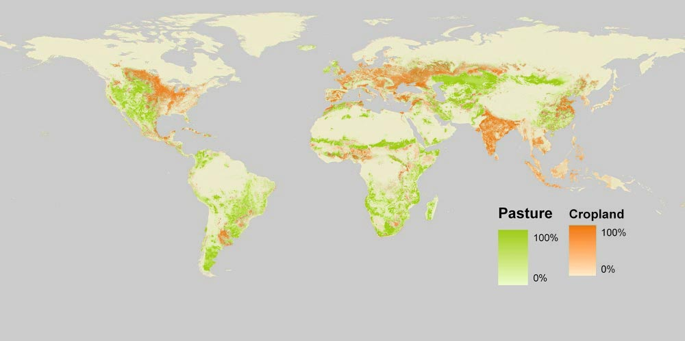
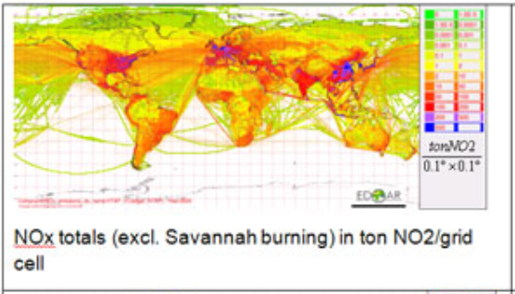
Further proxy datasets identified
vegetation type, cropland area
Example from http://ourworldindata.org/wp-content/uploads/2013/10/world-map-of-cropland-and-pastureland-sage0.png
(emissions)
Example from http://edgar.jrc.ec.europa.eu/national_reported_data/htap.php

Slide 28
JOIN development status and outlook
Slow progress between summer 2015 and now due to lack of programmer (interviews scheduled in February)
Database access mostly implemented, but:
data filter settings not preserved after plotting
several TOAR metrics still missing
no option to plot multiple lines on one panel or several plots at once
code needed to accomodate non-hourly data of ozone precursors
access to other datasets needs to be improved and made more robust
various additional plot options to be implemented

Slide 29
TOAR data analysis workshop
Scheduled in Jülich, 25-28 April 2016 (week after EGU)
Objectives:
explore and define use of proxy data for site classification
define and agree on site selection for various analyses in TOAR
define and develop Python scripts for massive data analyses
define look&feel of TOAR plots(?)
Set-up:
everyone to meet in one room during the entire week
come & go meeting
hands-on work (bring someone who knows Python!)
Note: participation in this workshop is the only way to get direct access to the database (at least until further REST services are available in JOIN)

Slide 30
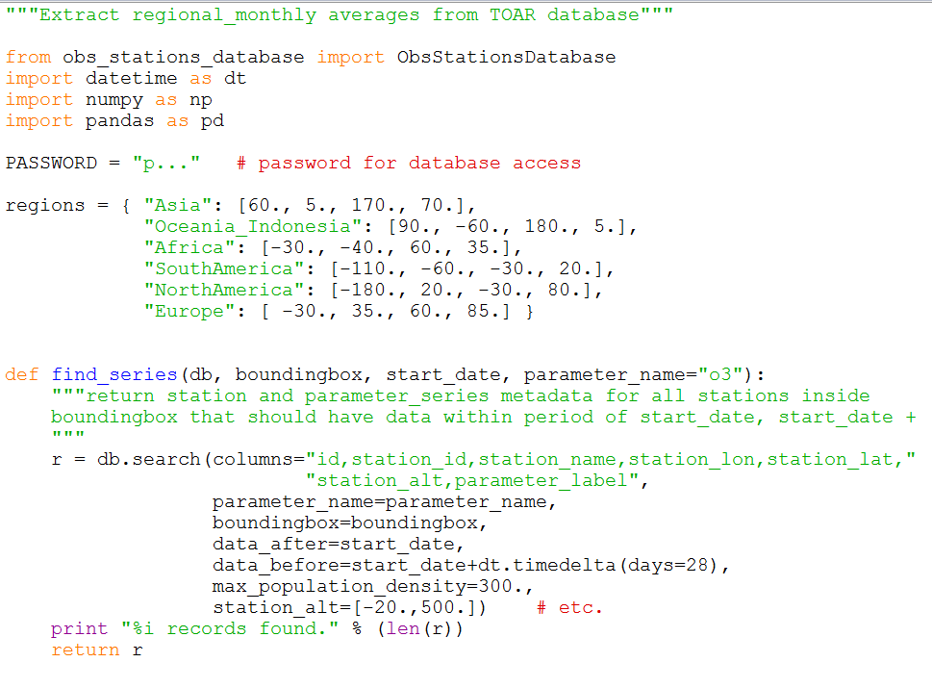
Example script (1)
TOAR data analysis workshop

Slide 31
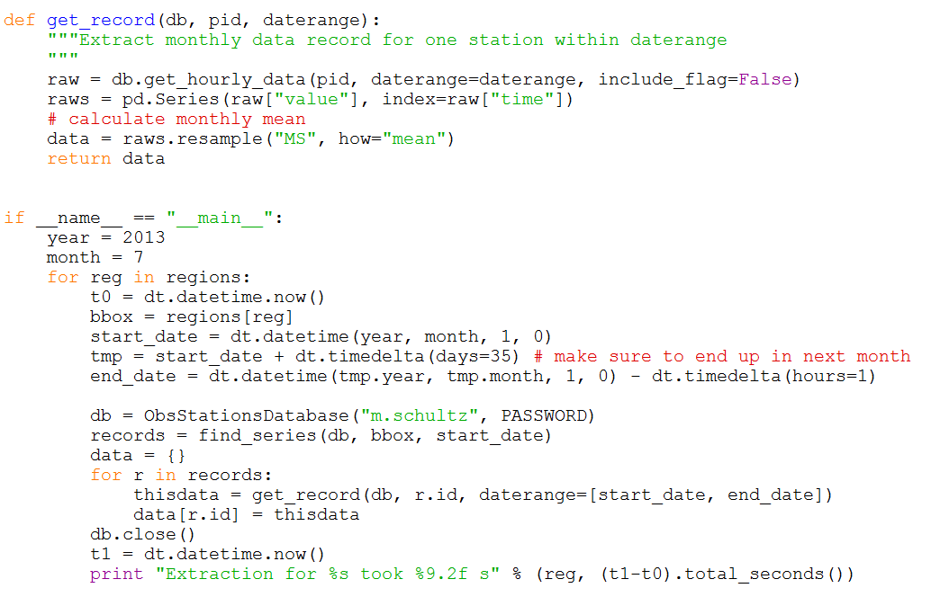
Example script (2)
TOAR data analysis workshop

Slide 32
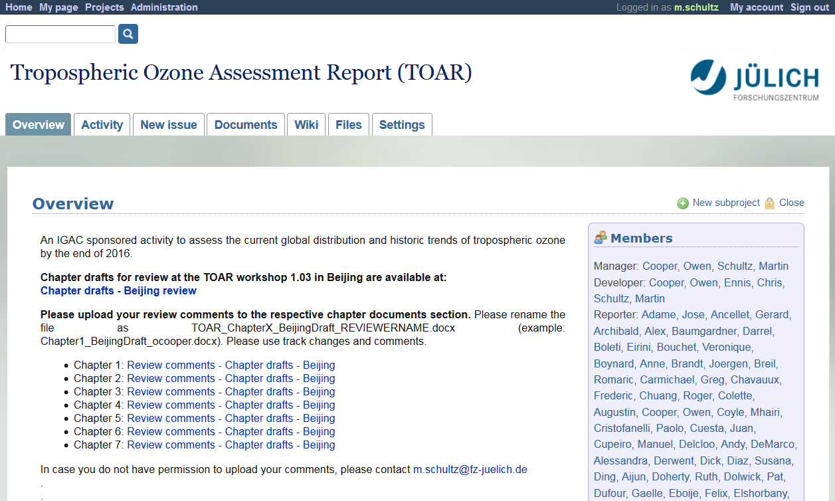
TOAR collaboration tools
http://redmine.iek.fz-juelich.de/projects/toar

Slide 33
User registration on Redmine
TOAR collaboration tools
If you don‘t have an account yet, you can register yourself, but I need to activate your account and add you to the „toar-member“ user group before you can access the site and the TOAR documents. Please use f.lastname as username! (email about registered users will be sent to Chris Ennis for maintaining TOAR mailing list)
If you forget your password you can generate a new one and have it sent to the email address you provided during the registration.
In case of problems, contact me (m.schultz@fz-juelich.de)

Slide 34
User rights and collaboration options
TOAR collaboration tools
Every „toar-member“ can view the main TOAR project pages (including the wiki) and access the TOAR documents (i.e. the chapter drafts). You can also upload edited Word files onto the respective chapter documents pages.
If you are a chapter author, you can also edit the wiki in that chapter, create and edit issues, and more. Please contact me if you are a chapter author, but don‘t seem to have the correct permissions. The authorative list of chapter authors is maintained by Chris Ennis.
I encourage all chapter authors to use the chapter wiki for communication and the chapter documents section for drafts (much better than email!)

Slide 35
Plans for this meeting
Consolidate status of TOAR database
are we missing something?
are there more opportunities to enlarge the database?
any problems experienced?
Start reflecting on site classification and site selection
Develop ideas for TOAR analyses to be developed during Jülich workshop
→ Report-out on prioritizing further needs for TOAR database and JOIN web interface Wednesday, 11:00 am

Slide 36
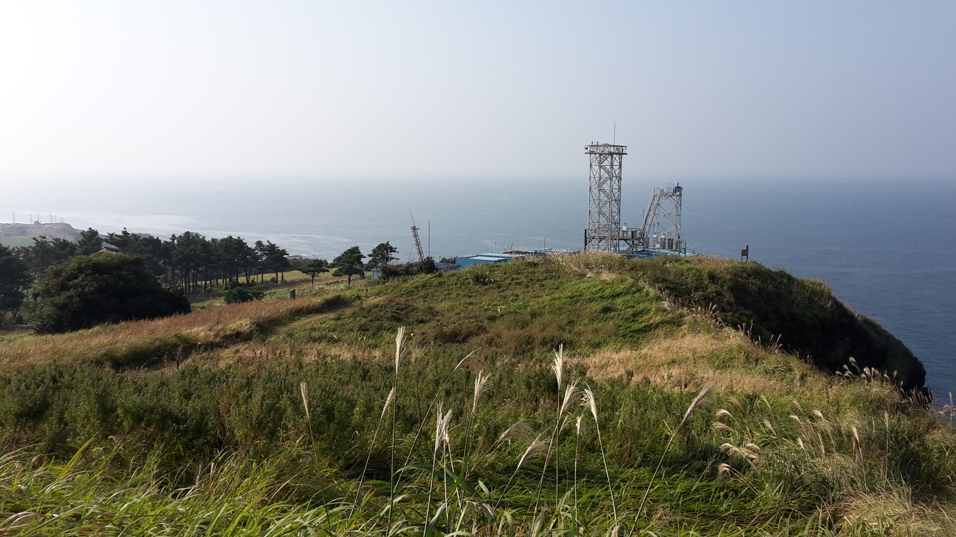
THANK YOU!
Gosan station, Jeju island, South Korea

