Slide 1
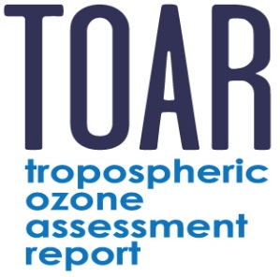
TOAR Workshop 1.03
January 25-27, 2016
Xijiao Hotel, Beijing, China
Research Center for
Eco-Environmental Sciences, Chinese Academy of Sciences

Slide 2
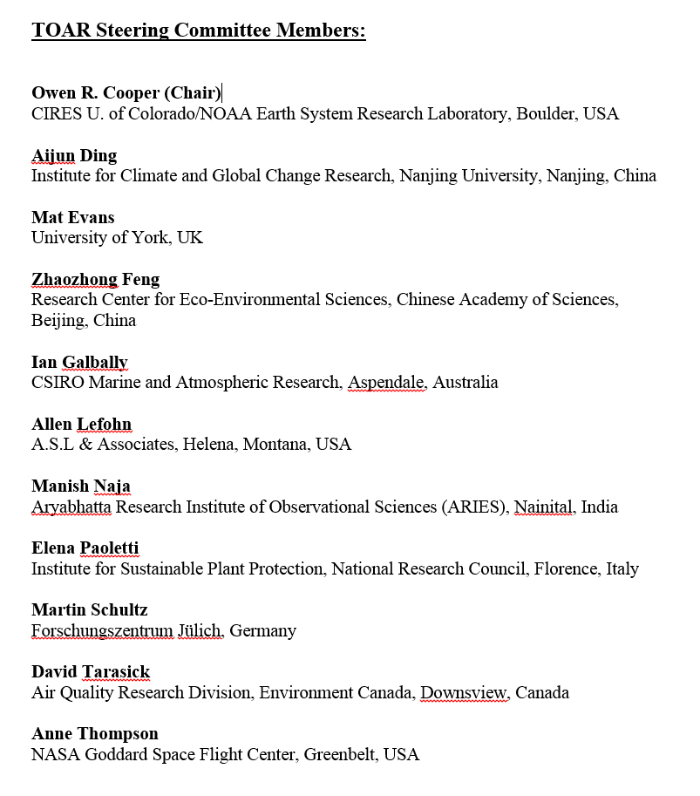
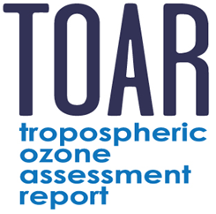
Welcome to TOAR Workshop 1.03!
On behalf of:
IGAC and The TOAR Steering Committee
Research Center for Eco-Environmental Sciences, C.A.S
Nanjing University
NOAA Earth System Research Laboratory
Forschungszentrum Juelich
WMO – GAW

Slide 3
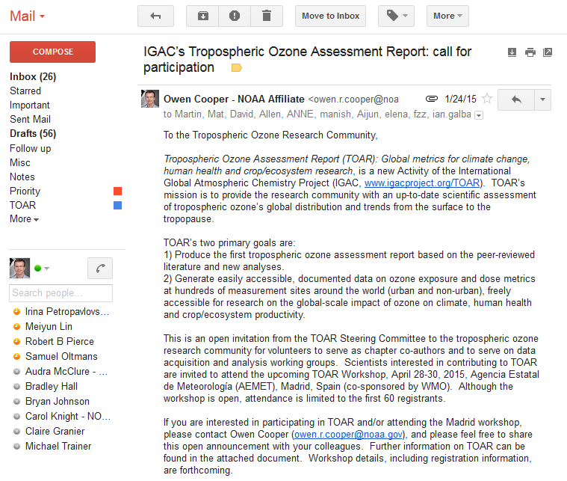
TOAR was first announced to the scientific community at:
7:12 AM Beijing time, Jan. 25, 2015
How far have we come in exactly 365 days and 90 minutes?

Slide 4
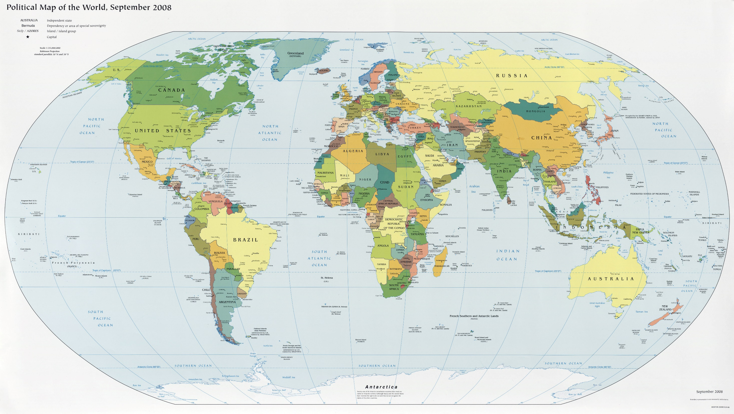
TOAR membership: 206 scientists from 36 nations
16

Slide 5
TOAR timeline
January 25, 2015: TOAR is officially announced
Feb-March, 2015: Formation of working groups and chapter teams
April 28-30, 2015: Workshop 1.02 in Madrid
September 2015: TOAR database goes live
December 2015: First drafts of TOAR Chapters available for comment
Jan. 25-27, 2016: Workshop 1.03 in Beijing
April-June 2016: Big Data analysis of TOAR database
September 2016: Second drafts of chapters due
December 2016: Submit chapters to a journal for peer-review

Slide 6
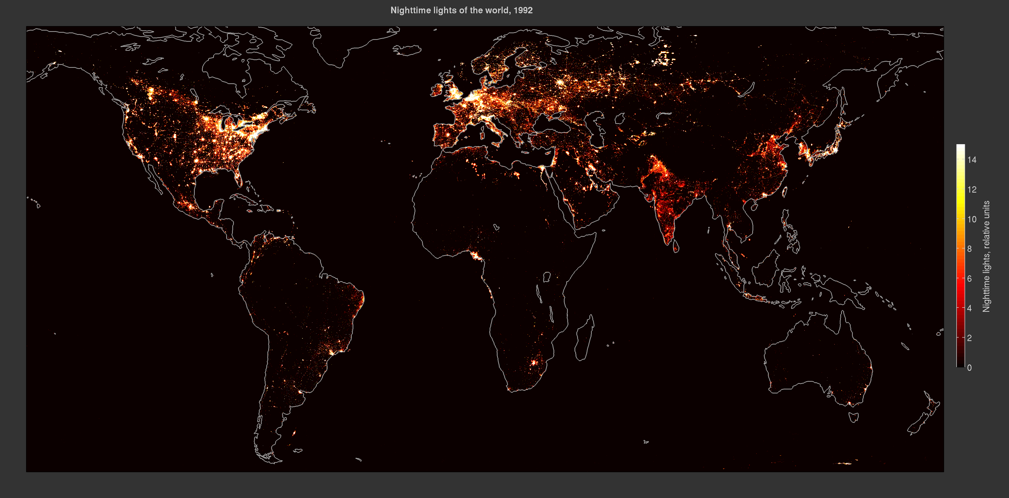
Nighttime lights of the world in 1992
Global population (United Nations): 5.5 billion
DMSP-OLS nighttime lights (V4) detected by The Defense Meteorological Satellite Program: http://ngdc.noaa.gov/eog/dmsp/downloadV4composites.html
Data collected by US Air Force Weather Agency, processed by NOAA NGDC and plotted by Owen Cooper, CIRES, U. of Colorado/NOAA ESRL

Slide 7
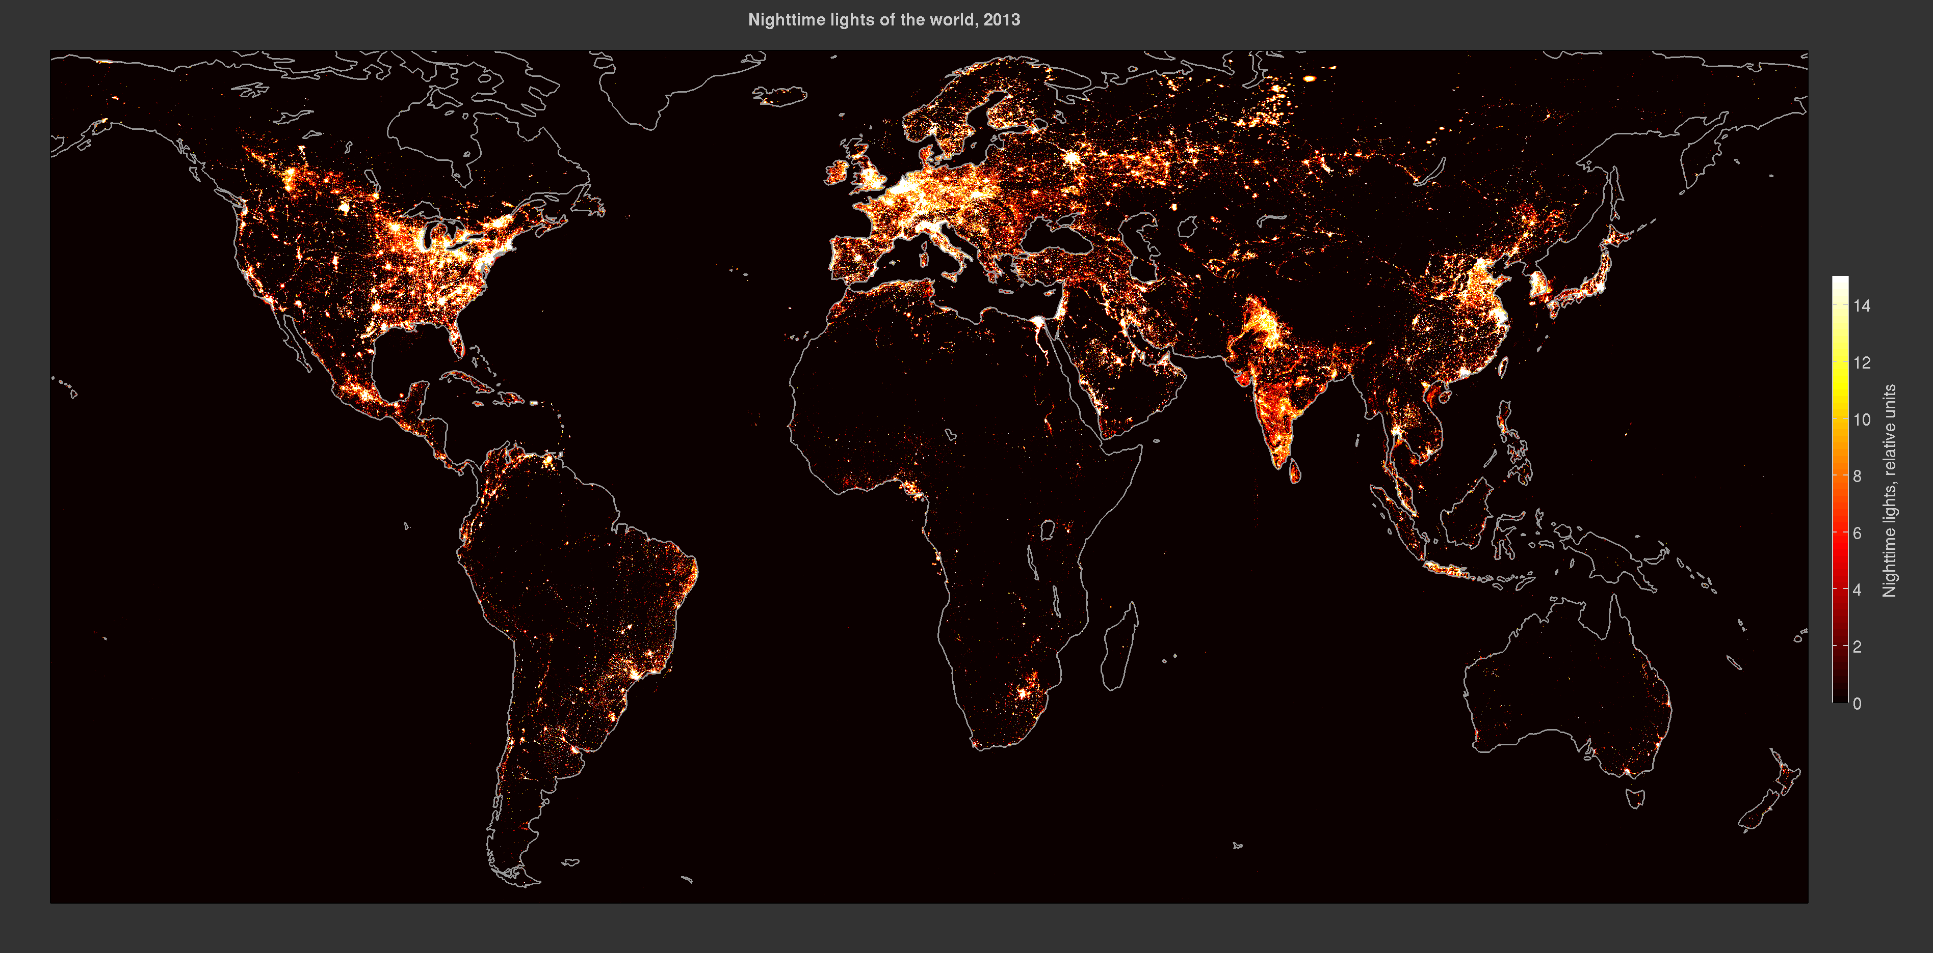
Nighttime lights of the world in 2013
Global population (United Nations): 7.2 billion (30% increase)
DMSP-OLS nighttime lights (V4) detected by The Defense Meteorological Satellite Program: http://ngdc.noaa.gov/eog/dmsp/downloadV4composites.html
Data collected by US Air Force Weather Agency, processed by NOAA NGDC and plotted by Owen Cooper, CIRES, U. of Colorado/NOAA ESRL

Slide 8
Nighttime lights of the world: 1992-2013
DMSP-OLS nighttime lights (V4) detected by The Defense Meteorological Satellite Program: http://ngdc.noaa.gov/eog/dmsp/downloadV4composites.html
Data collected by US Air Force Weather Agency, processed by NOAA NGDC and plotted by Owen Cooper, CIRES, U. of Colorado/NOAA ESRL

Slide 9
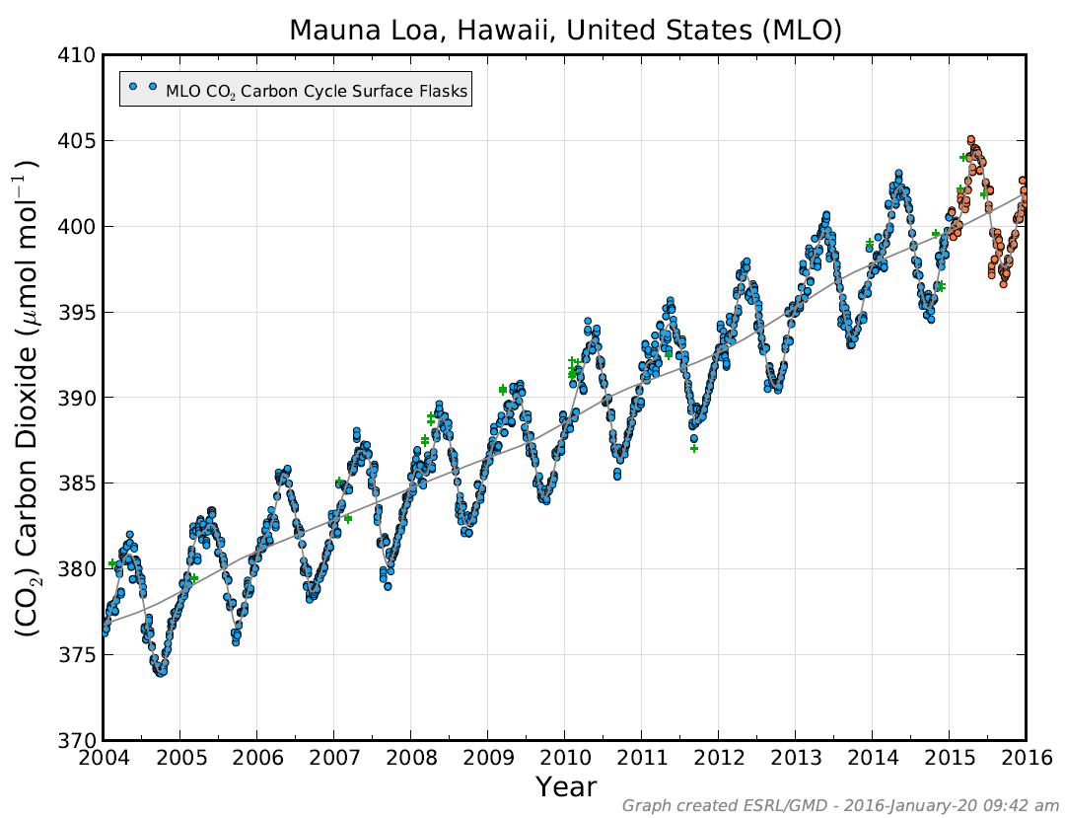
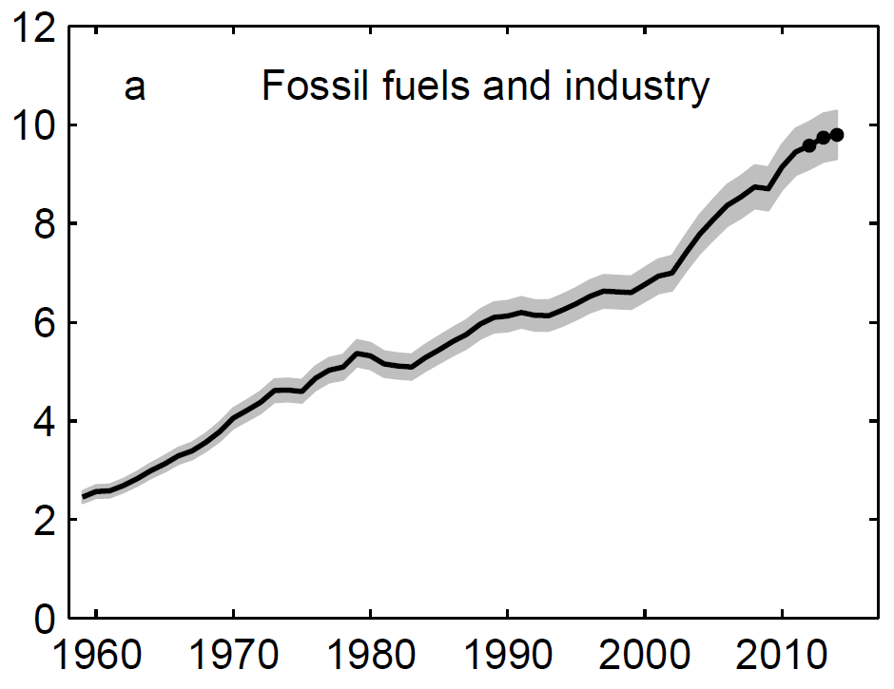
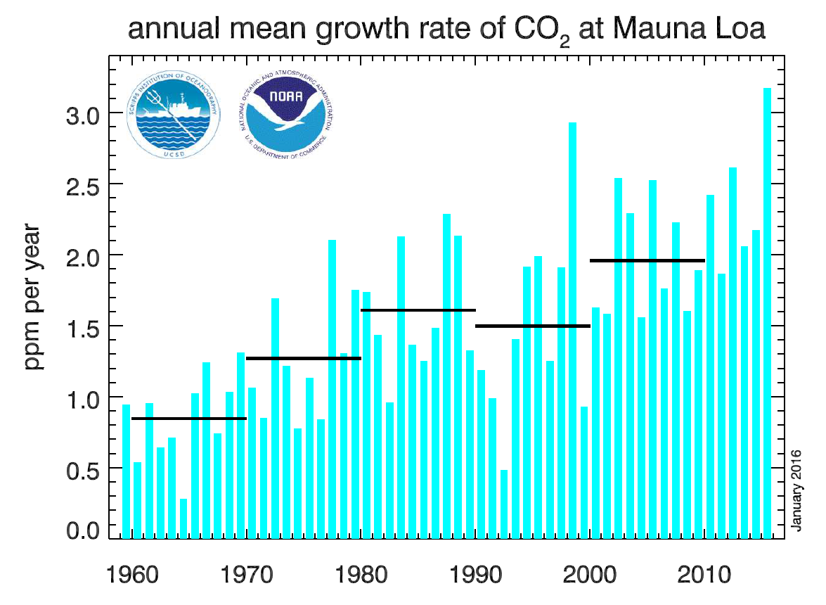
Global CO₂ emissions:
increased by 25% over the past 10 years (2004-2014)
This bottom-up estimate is consistent with the increasing CO₂ growth rate at Mauna Loa
Global CO₂ emissions through 2014
Le Quéré et al., Global Carbon Budget 2015, Earth Syst. Sci. Data, 7, 349–396, 2015.

Slide 10
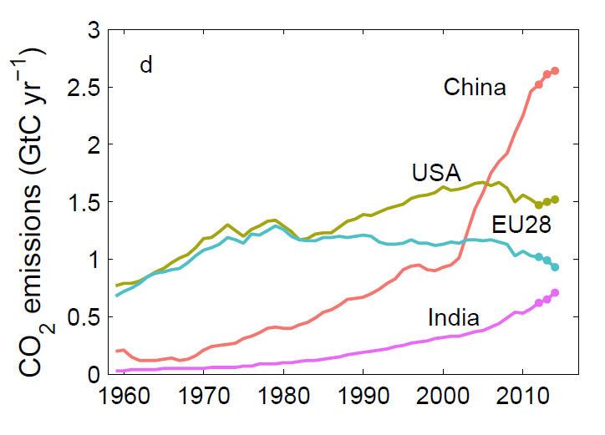
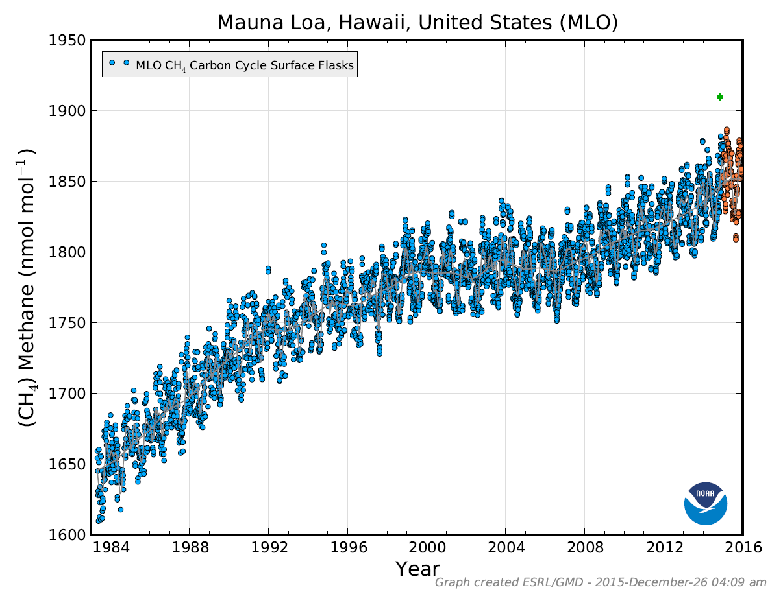
Global CO₂ emissions:
Strongest increases are in China and India
Methane:
concentrations have increased by 4% over the past 10 years
Global CO₂ emissions through 2014
Le Quéré et al., Global Carbon Budget 2015, Earth Syst. Sci. Data, 7, 349–396, 2015.

Slide 11
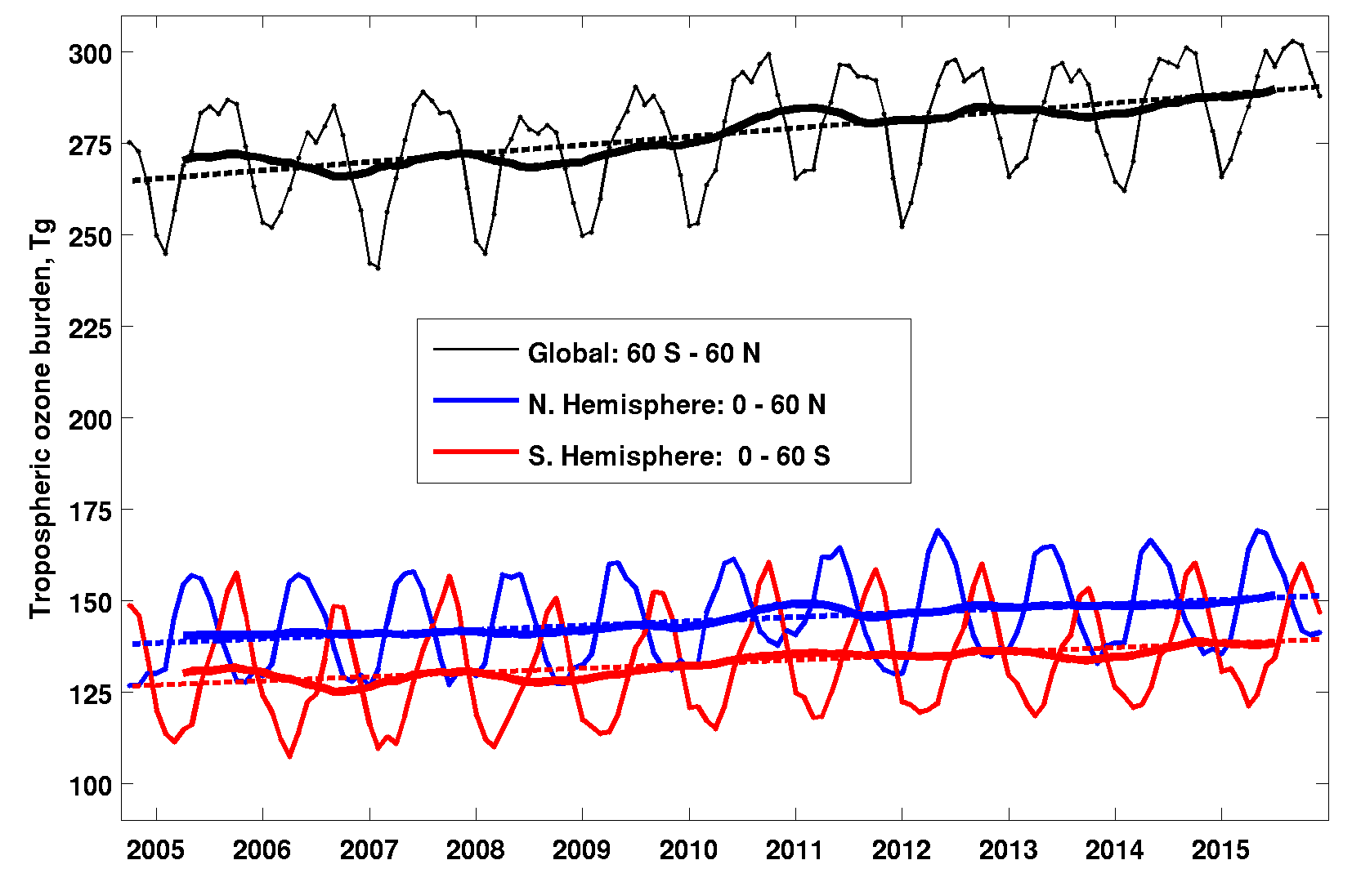
OMI/MLS tropospheric ozone burden
2005-2015
Data produced by Jerry Ziemke
Morgan State U./NASA Goddard
The global (60°N – 60°S) tropospheric ozone burden has increased by 9% (25 Tg) over 11 years (2005-2015).
Ziemke, et al., Tropospheric ozone variability in the tropics from ENSO to MJO and shorter timescales, Atmos. Chem. Phys., 15, 8037-8049, doi:10.5194/acp-15-8037-2015, 2015.

Slide 12
OMI/MLS tropospheric column ozone and trends, 2005-2015: Annual

Slide 13
OMI/MLS tropospheric column ozone and trends, 2005-2015: Annual
Lower panel: White dots indicate grid cells with statistically significant trends

Slide 15
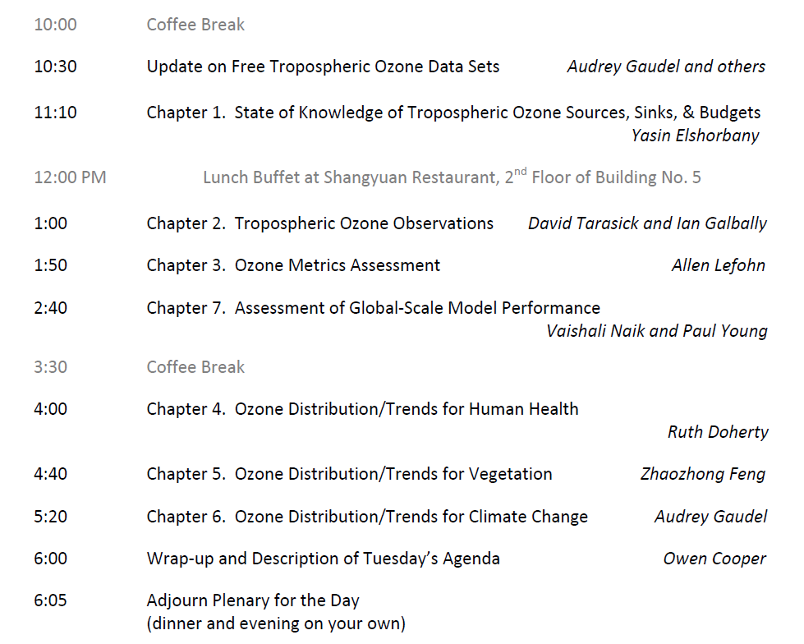

Slide 17
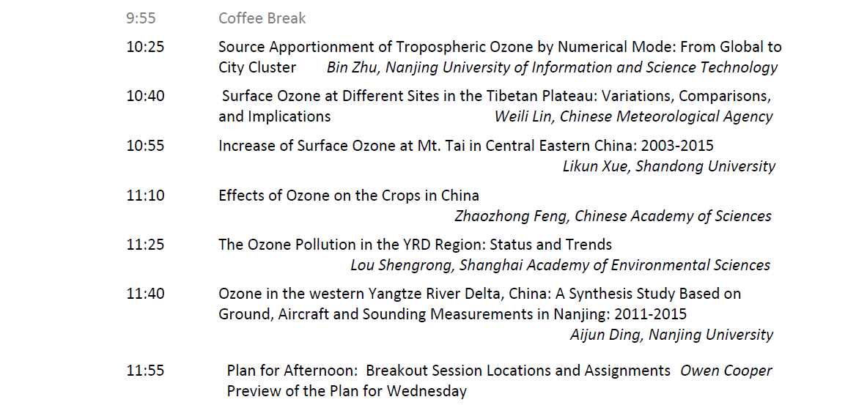

Slide 21
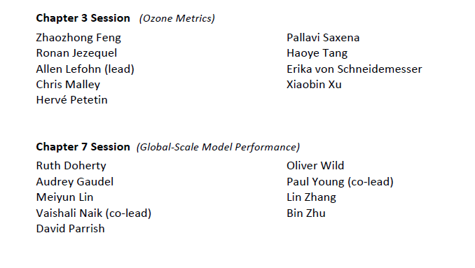

Slide 22
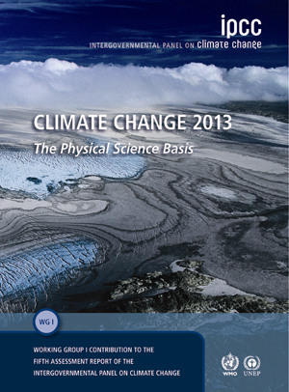
Design of the assessment report
Modelled after IPCC Working Group I:
Focused on assessing the current scientific understanding of tropospheric ozone.
Does not assess impacts (IPCC WG2) or adaptation strategies (IPCC WG3)
Publication format:
- Each chapter is a stand-alone peer reviewed publication
- All chapters are linked through the TOAR special issue of the host journal

Slide 23
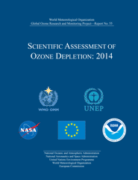
The Assessment Process, as implemented every 4-years by the WMO/UNEP Scientific Assessment of Ozone Depletion
Important factors:
Relies upon the expertise of the authors
Provides critical reviews by experts
What an assessment is:
State of the science: Clearly states what we know and what we don’t.
Policy relevant and framed in policy-useful terms.
Highlights what is new and significant.
Assessed viewpoints: an update of what is most important, not a review, and not an encyclopedia.
Well-identified “customers”: Science community (atmospheric and biological), Policy makers, Public
What an assessment is not:
Does not make policy recommendations.
Is not a research-planning document, nor does it “push” research projects or needs.
(but does identify gaps in information that may limit informed decision-making)
An assessment report is not the “final word.”

Slide 24
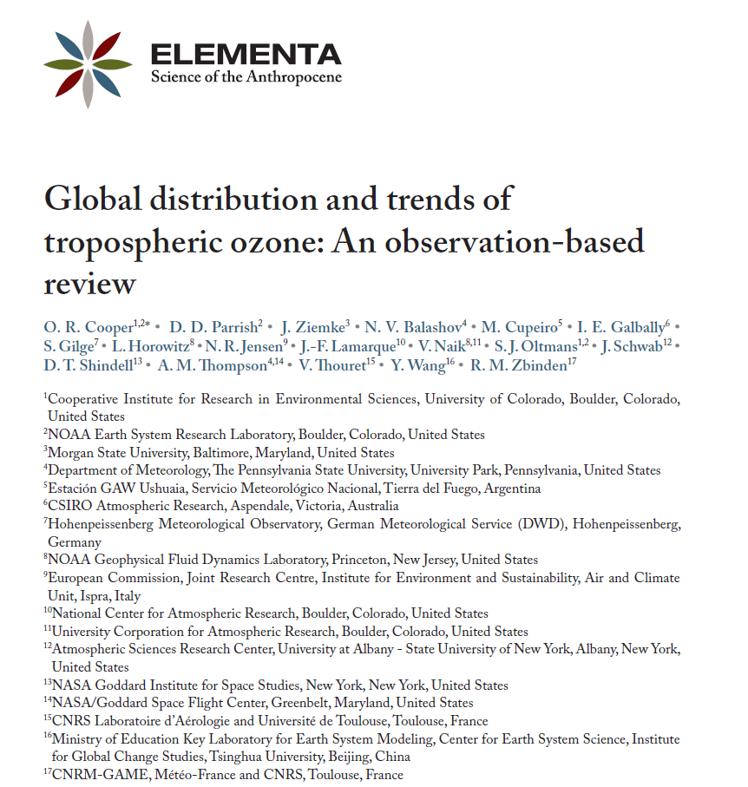
Guidance on chapter length
Cooper et al. 2014: 28-page ozone review paper in Elementa
23 pages of text with 14 figures and 2 tables, plus 5 pages of references.
12,700 words in the main text (not including author names/affiliations, references, tables or figure captions)

Slide 25
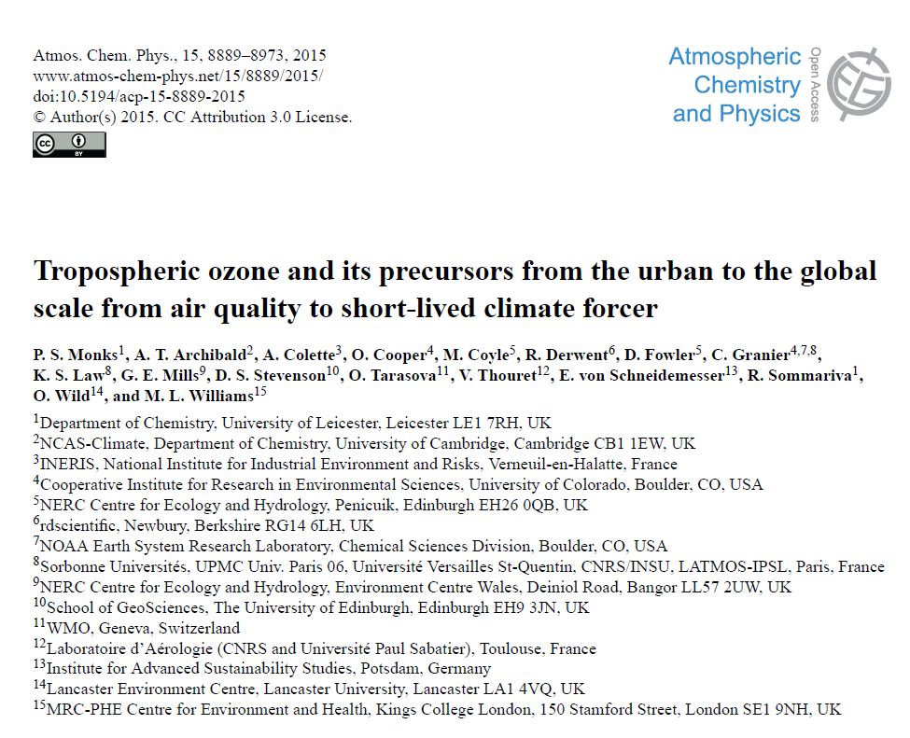
Guidance on chapter length
Monks et al. 2015: 85-page ozone review paper in ACP
54 pages of text with 44 figures and 3 tables, plus 31 pages of references.
37,400 words in the main text (not including author names/affiliations, references, tables or figure captions)

Slide 27
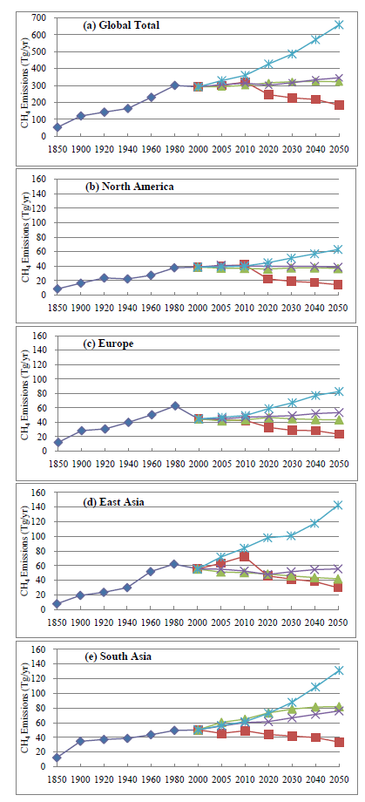
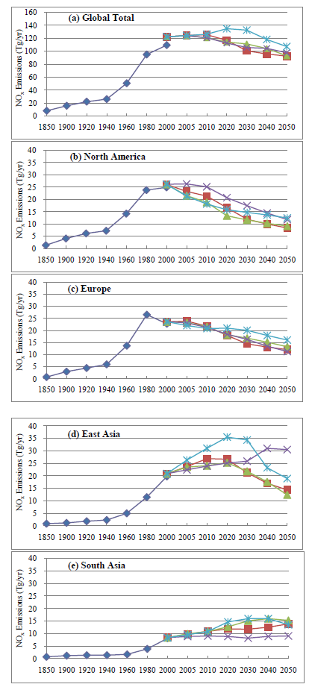
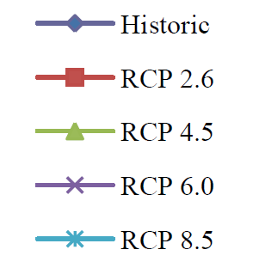
Historical and future emissions of anthropogenic methane and NOx, according to the four RCP scenarios.
Methane emissions only increase globally under RCP8.5.
NOx emissions only increase globally under RCP8.5, with regional decreases in N. America and Europe, and regional increases in Asia.
Dentener F., T. Keating and H. Akimoto (eds.) Hemispheric Transport of Air Pollution 2010, Part A: Ozone and Particulate Matter, Air Pollution Studies No. 17, United Nations, New York and Geneva, ISSN 1014-4625, ISBN 978-92-1-117043-6.

Slide 28
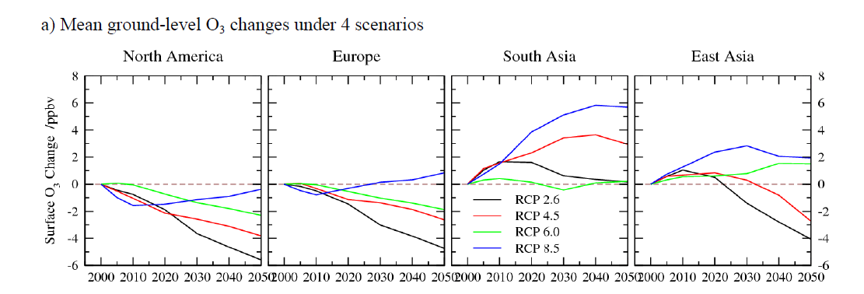
Under RCP8.5 ozone in N. America and Europe reaches a minimum in 2010 but increases thereafter. Under this scenario ozone in South and East Asia will be greater in 2030-2040 than in 2015.
Mean surface O3 changes over the four HTAP receptor regions following the four RCP scenarios from 2000 to 2050, based on linearization of the six models that contributed results to all SR simulations in the HTAP multi-model experiments.
Dentener F., T. Keating and H. Akimoto (eds.) Hemispheric Transport of Air Pollution 2010, Part A: Ozone and Particulate Matter, Air Pollution Studies No. 17, United Nations, New York and Geneva, ISSN 1014-4625, ISBN 978-92-1-117043-6.

Slide 29
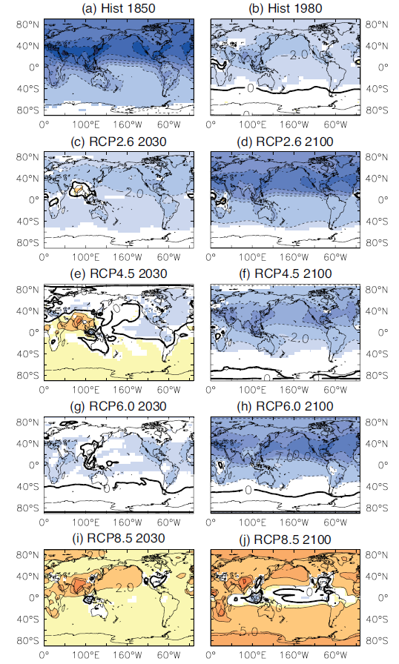
The ensemble ACCMIP projection for surface ozone indicates an increase of 2 ppbv across the North Pacific Ocean during 2000-2030 based on a business as usual RCP8.5 emissions scenario.
Young et al. (2013), Pre-industrial to end 21st century projections of tropospheric ozone from the Atmospheric Chemistry and Climate Model Intercomparison Project (ACCMIP), ACP.

Slide 30
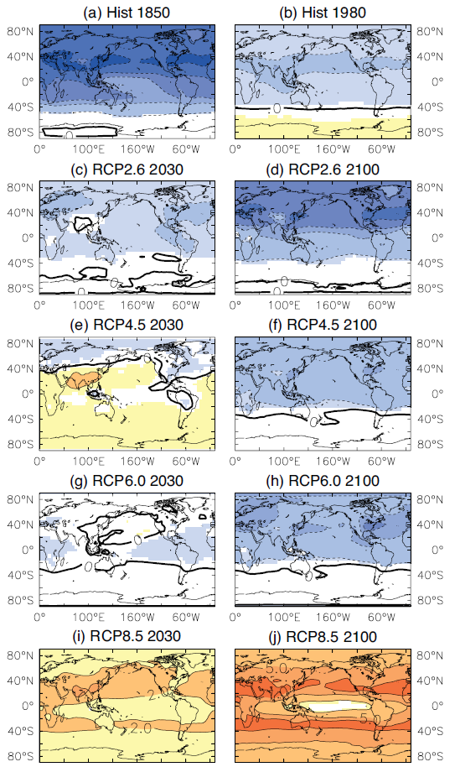
The ensemble ACCMIP projection for tropospheric column ozone indicates an increase of 2-5 DU across the North Pacific Ocean and 5-7 DU across India and south China during 2000-2030, based on a business as usual RCP8.5 emissions scenario.
Young et al. (2013), Pre-industrial to end 21st century projections of tropospheric ozone from the Atmospheric Chemistry and Climate Model Intercomparison Project (ACCMIP), ACP.

Slide 31
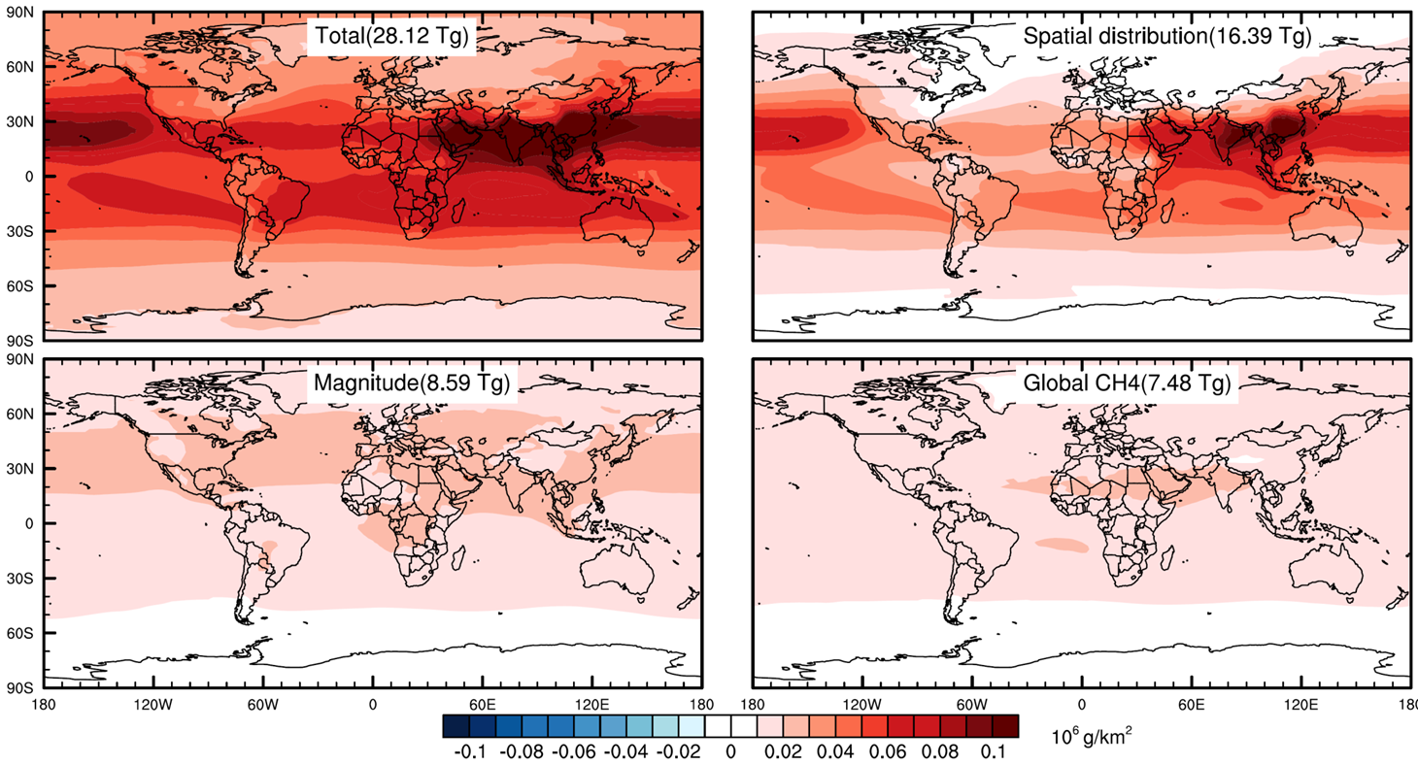
A recent study presented at the AGU 2015 Fall Meeting indicates that half of the tropospheric ozone burden increase since 1980 is due to increases in emissions. The other half of the increase is due to emissions shifting equatorward where ozone production efficiency is much greater. This finding is of major importance and implies that even if ozone precursor emissions do not increase globally over the coming years, ozone will still increase globally if the emissions continue to shift equatorward.
The study used the CAM-Chem model with horizontal resolution of 1.9°×2.5°, and 56 vertical levels. NASA Goddard GMAO GEOS-5 meteorology was used to drive the model as a chemical transport model. Results were averaged over the years 2009-2012.
Top left – increase in global tropospheric ozone burden over 1980-2010 due to the actual increase in emissions and the actual equatorward shift in emissions.
Top right - increase in global tropospheric ozone burden over 1980-2010 when 1980 emissions are given the 2010 spatial distribution, i.e equatorward shift.
Bottom left - increase in global tropospheric ozone burden over 1980-2010 when emissions are allowed to increase but are kept in their 1980 locations.
Bottom right - increase in global tropospheric ozone burden over 1980-2010 due to methane increases alone.
Zhang, Y., O. R. Cooper and J. J. West (2016), Southward redistribution of emissions dominates the 1980 to 2010 tropospheric ozone change, in preparation for Nature Geoscience.

Slide 32
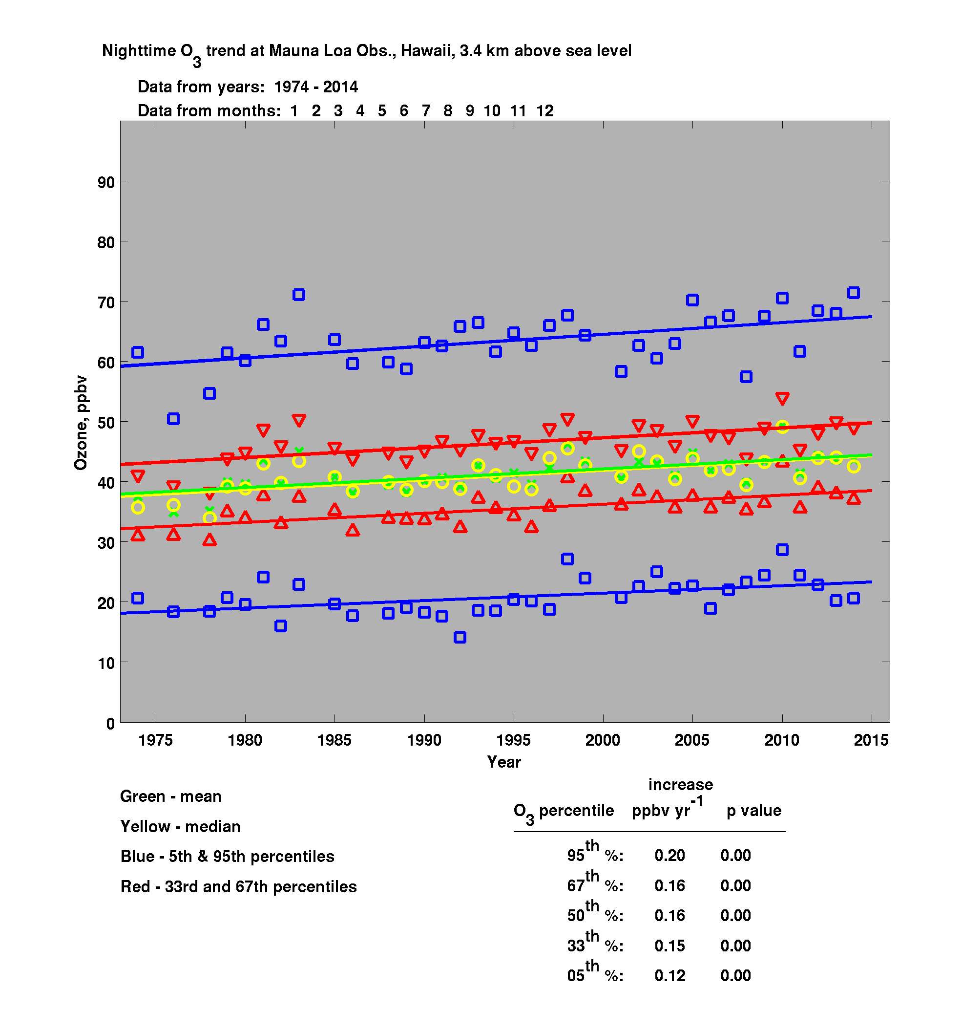
Mauna Loa is the best site for documenting the change in Northern Hemisphere ozone because it has a 40-yr record and samples the lower free troposphere (when using nighttime data).
Ozone has increased steadily since 1974 at the rate of 0.16 ppbv yr⁻¹.
95%
67 %
50%
33%
5 %
Annual mean ozone has increased
by 17% during 1974-2014.
Data collected by NOAA Global Monitoring Division

Slide 33
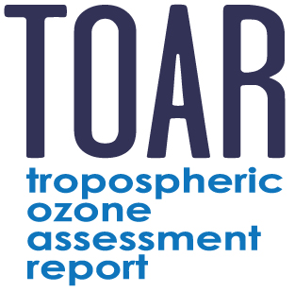
IGAC’s newest Activity:
Tropospheric Ozone Assessment Report (TOAR)
Global metrics for climate change, human health and
crop/ecosystem research
Mission:
Provide the research community with an up-to-date global assessment of tropospheric ozone’s distribution and trends from the surface to the tropopause.
Facilitate access to the ozone metrics necessary for quantifying ozone’s impact on human health and crop/ecosystem productivity.
>200 scientists from 36 nations, representing all 7 continents
Stakeholders:

Slide 34
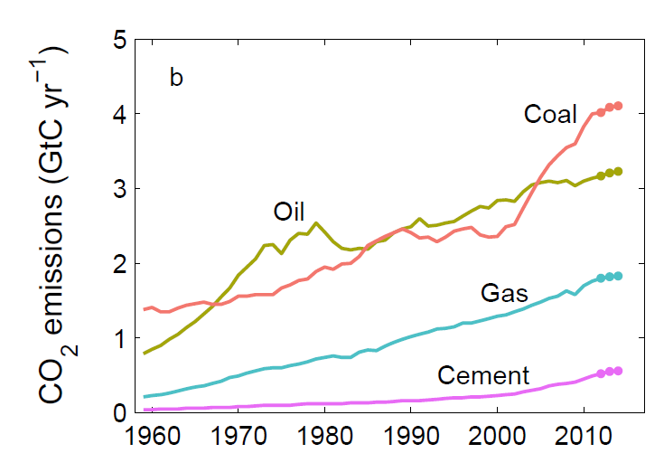
Global CO2 emissions through 2014.
Le Quéré et al., Global Carbon Budget 2015, Earth Syst. Sci. Data, 7, 349–396, 2015.

