Slide 1
Surface Ozone at different sites in the Tibetan Plateau (TP):
Variations, Comparisons, and Implications
Lin Weili,
linwl@camscma.cn
Centre for Atmosphere Watch And Services
Meteorological Observation Centre
China Meteorological Administration

Slide 2
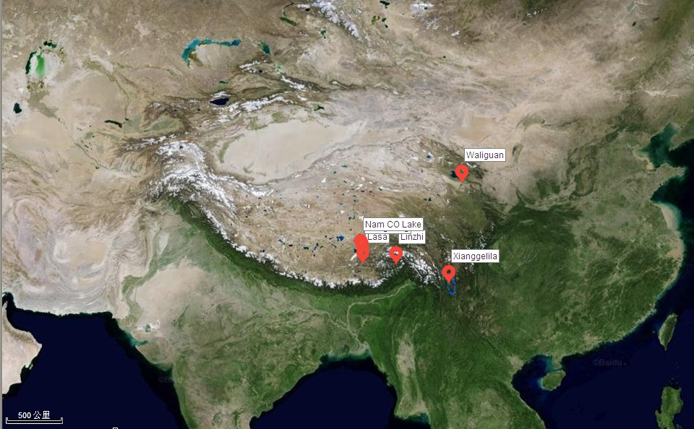
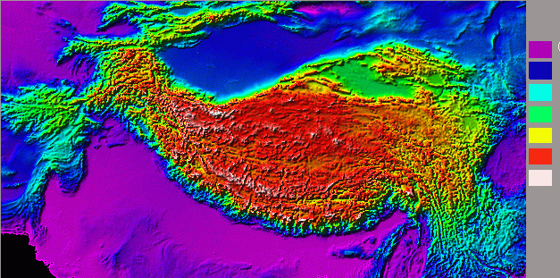
Ozone observation in Tibetan Plateau (TP)
sea level
1000m
2000m
3000m
4000m
5000m
6000-
Tibetan Plateau
Huge Area (2,500,000 km²)
High average altitude (>4000 m)
Remote and Clean
Important snow cover in North Hemisphere
Strong solar radiation

Slide 3
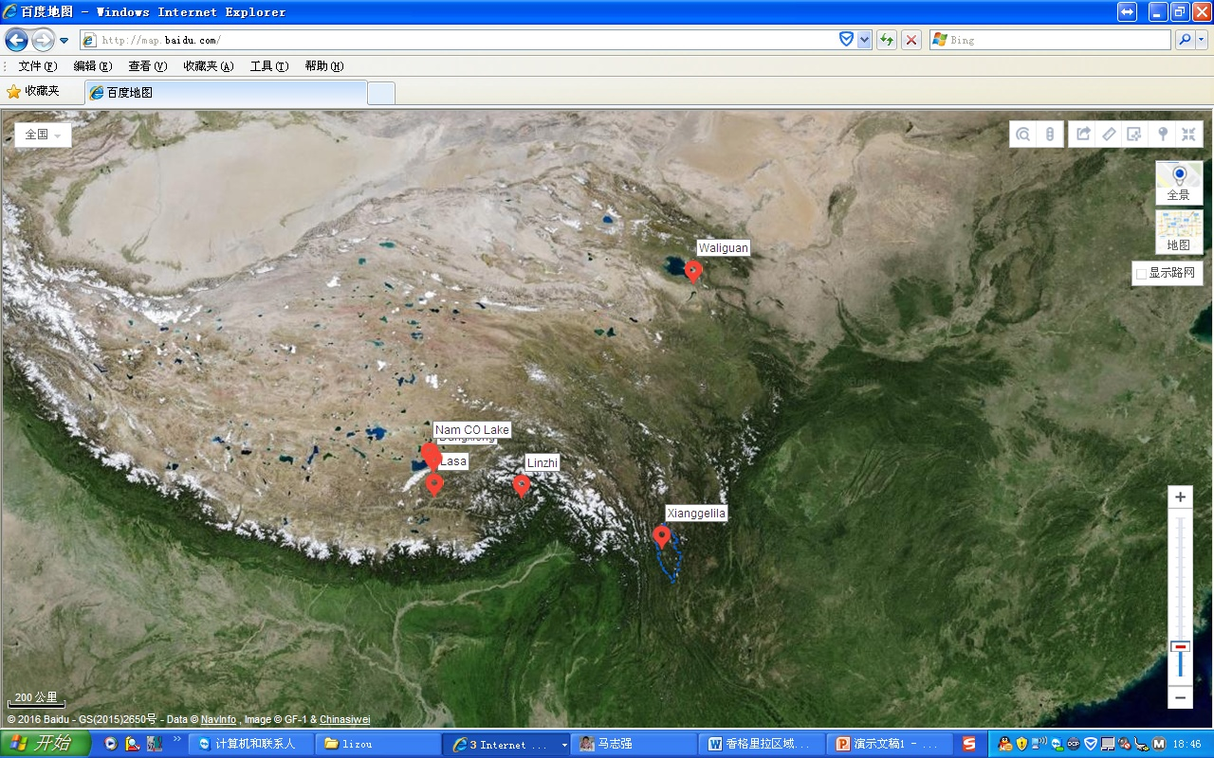
Surface ozone datasets (>1year)
Waliguan, 3800 m a.s.l., 1994-2015
Nam Co lake,4750 m a.s.l., 2011-2012
Dangxiong,4200 m a.s.l., 2009-2011
Linzhi 3000 m a.s.l., 2014-2015
Lhasa urban city, 3650 m a.s.l., 2012-2015
Xianggelila, 3600 m a.s.l., 2004-2005, 2008-2015

Slide 4
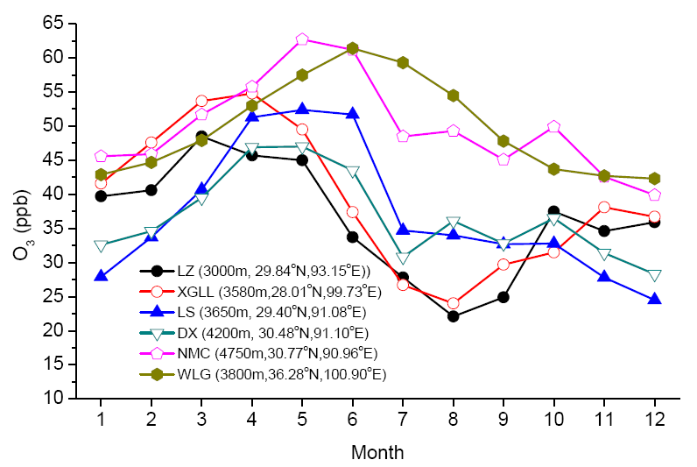
Seasonal variations of ozone at different sites in the Tibetan plateau
Spring O₃ maximum phenomena in the Northern Hemisphere
Asian monsoon season
Month

Slide 5
O₃ mixing ratio increase with the increase of altitude
汤洁等，2002

Slide 6
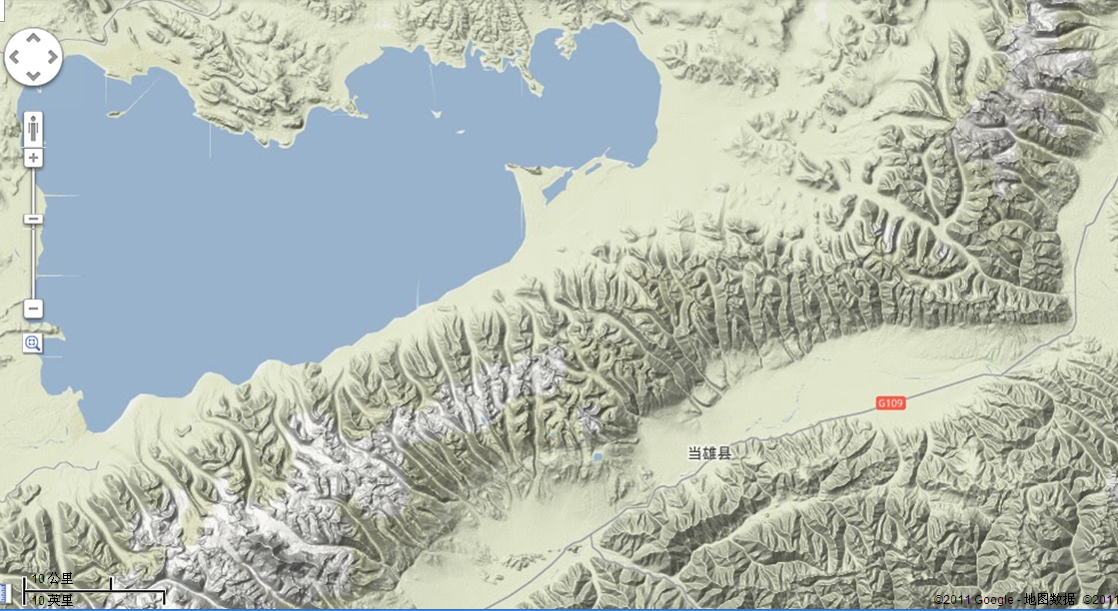
NMC(30.77ºN,90.96ºE, 4748m )
Nam Co Lake
Nyainqêntanglha Mountains
DX (30.48ºN, 91.10ºE, 4187m)

Slide 7
Comparison of O₃ variations between DX and NMC
Similar day-to-day and week-to-week temporal fluctuations suggest that the sites are experiencing the same regional-scale background patterns in air quality and meteorology.
O_{3-NMC} = (1.02±0.04)*O_{3-DX} + (11.3±1.7), (R²=0.83, P<0.0001)

Slide 8
Diurnal variations of O₃ at NMC and Mixing layer height at a nearby site Naqu (~50km away)
Vertical mixing associated with surface strong wind speeds
Mixing height data from Dr. He Qianshan

Slide 9
Relationships between surface O₃ and wind speeds at DangXiong (DX)

Slide 10
Similar diurnal change of O₃ and wind speed at Xianggelila (XGLL)

Slide 11
Surface O₃ at TP has more features of free atmosphere
The diurnal ozone pattern seems very similar with the typical diurnal O₃ pattern in urban or polluted area, at which photochemical product of O₃ can accumulated after the noon.
The peak O₃ at daytime is strongly associated with the wind speed and the mixing layer height.
Strong wind speed may destroy the photochemical accumulation of O₃, in the clean remote area.
Therefore, the transport and deposition will be the key factors than the local photochemical process influencing the diurnal variations of surface O₃ at the remote and clean sites at the Tibetan plateau.

Slide 12
Long-term surface ozone trend?

Slide 13
WLG: 3800 m a.s.l., 1994-2015
Xianggelila: 3600 m a.s.l., 2004-2005, 2008-2015

Slide 14
Surface O₃ trend at Xianggelila site

Slide 15
Surface O₃ trend at Waliguan site

Slide 16
Similar long-term trends between WLG and XGLL
Waliguan: +0.25 ppb/yr
(36.28◦N, 100.90◦E, 3810 m a.s.l.)
Xianggelila: +0.20 ppb/yr
(28.006 N, 99.726 E; 3580ma.s.l.)

Slide 17
How about the long-term change of surface ozone at urban city in TP
Such as Lhasa city? When it is
Under the strong solar (UV) radiation, and
A quick expansion of urban area with a factor of 10 since 1949;
An increase of tourist people about 200,000 in 1998 to 6,500,000 in 2012;
An increase of vehicle from 10,000 in 1998 to more than 150,000 in 2012;
GDP of 2.9 billion RMB in 1998, and 26.2 billion RMB in 2012.

Slide 18
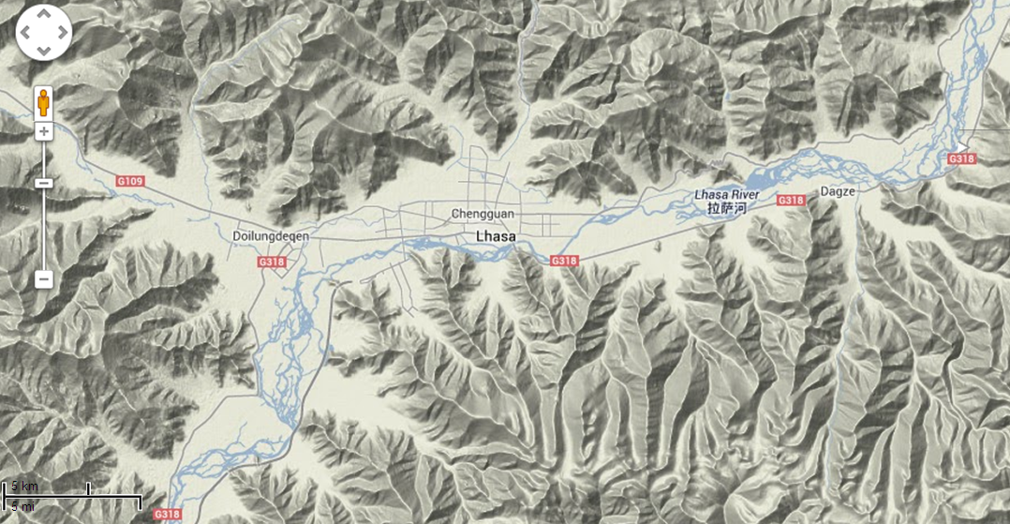
Lhasa surface O₃ measurement
Observation site
Lhasa urban city: 3650 m a.s.l., June-August, 1998; 2012-2015

Slide 19
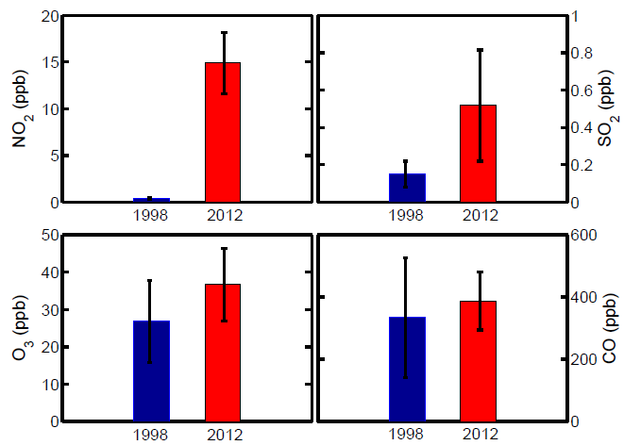
Summer data in 1998 vs. in 2012
Impact of rapid urbanization on air pollution in Lhasa

Slide 20
In 1998,
汤洁等，2002

Slide 21
From 1998 to 2012, O₃ behavior has change a lot at urban Lasa
2012-2014
1998

Slide 22
Frequently occurring of high spikes of O₃
STE? No!
Highly spatial inhomogeneity in air pollution
(5-min time resolution data)

Slide 23
Summary
Surface ozone at TP has a more feature of free atmosphere.
Surface ozone has an increasing trend of more than 2ppb/10yr both at WLG and XGLL .
Surface ozone in summer at Lhasa urban city has an extreme increase (>10ppb) in the afternoon when compared with those in 1998, and it may be due to the significant increase of precursor emission under strong solar radiation.
In cold season, ozone spikes in Lhasa are more frequent than that in warm season, with a potential for winter photochemical pollution.

Slide 24
Publications
W. Y. Xu, W. L. Lin, X. B. Xu*, J. Tang, J. Q. Huang, H. Wu, and X. C. Zhang. Long-term trends of surface ozone and its influencing factors at the Mt. Waliguan GAW station, China – Part 1: Overall trends and characteristics. Atmos. Chem. Phys. Discuss., 15, 30987-31024, doi:10.5194/acpd-15-30987-2015, 2015.
Ma, J., Lin, W. L.*, Zheng, X. D., Xu, X. B., Li, Z., and Yang, L. L: Influence of air mass downward transport on the variability of surface ozone at Xianggelila Regional Atmosphere Background Station, southwest China, Atmos. Chem. Phys., 14, 5311-5325, doi:10.5194/acp-14-5311-2014, 2014.
L. Ran, W. L. Lin*, Y. Z. Deji, B. La, P. M. Tsering, X. B. Xu, and W. Wang. Surface gas pollutants in Lhasa, a highland city of Tibet: current levels and pollution implications. Atmos. Chem. Phys., 14, 10721-10730, doi:10.5194/acp-14-10721-2014, 2014.
Lin W., T. Zhu*, Y. Song, H. Zou, M. Tang, X. Tang, and J. Hu, Photolysis of surface O₃ and production potential of OH radicals in the atmosphere over the Tibetan Plateau, J. Geophys. Res., 113, D02309, doi:10.1029/2007JD008831, 2008.
W. L. Lin, X. B. Xu*, X. D. Zheng, Jaxi Dawa, Ciren Baima, J. Ma.Two-year measurements of surface ozone at Dangxiong, a remote highland site in the Tibetan Plateau. Journal of Environmental Science, 31C: 133-145, 2015
Tong Zhu*, Weili Lin, Yu Song, Xuhui Cai, Han Zou, Ling Kang, Libo Zhou, and Hajime Akimoto, Downward transport of ozone-rich air near Mt. Everest. Geophysical Research Letters, 33, L23809, doi:10.1029/2006GL027726, 2006.

Slide 25
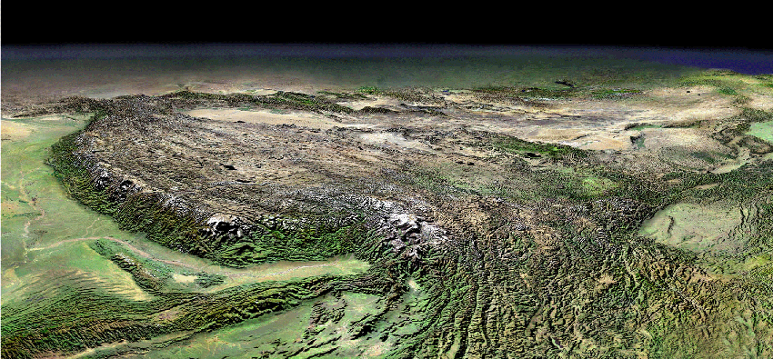
Thanks for your patience!

Slide 26
O₃+NO → NO₂ +O₂

Slide 27
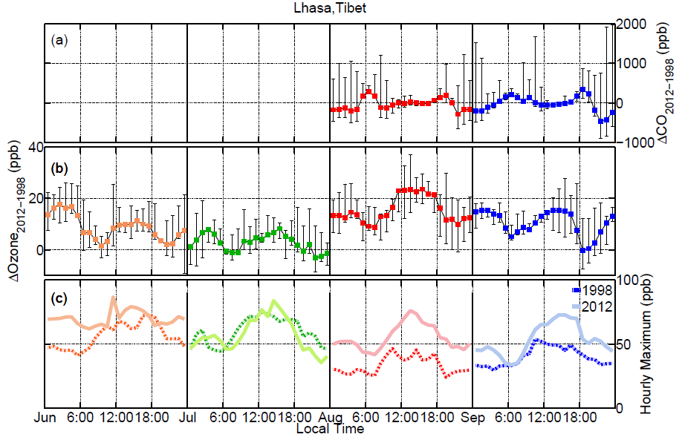
拉萨1998夏季vs.2012年夏季

Slide 28
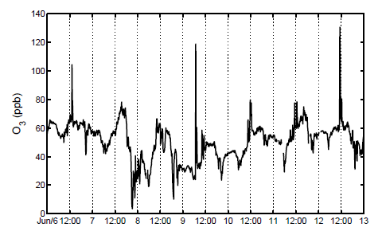
夏季，地面臭氧浓度受光化学生成和对流混合输送的影响十分显著，午后臭氧可出现4-5小时的高值，特别也出现在一些短暂的高达100-200ppb的过程（几十分钟内）臭氧浓度，观测到O3小时均值可超过160ppb，存在大面积光化学污染的潜势。
highly spatial inhomogeneity in air pollution

Slide 29
秋、冬季白天太阳辐射依然强烈，短时的臭氧高值现象出现的频率比夏季更多。这与东部平原地区有显著的差别。

