Slide 1
Ozone in Yangtze River Delta Region: Status
Shengrong Lou, Li Li, Hongli Wang, Qian Wang, Changhong Chen, Dongfang Wang
Shanghai Academy of Environment Sciences

Slide 2
CONTENTS
YRD Region Background
Ozone Pollution Status in YRD
Ozone in megacity of YRD
Summary

Slide 3
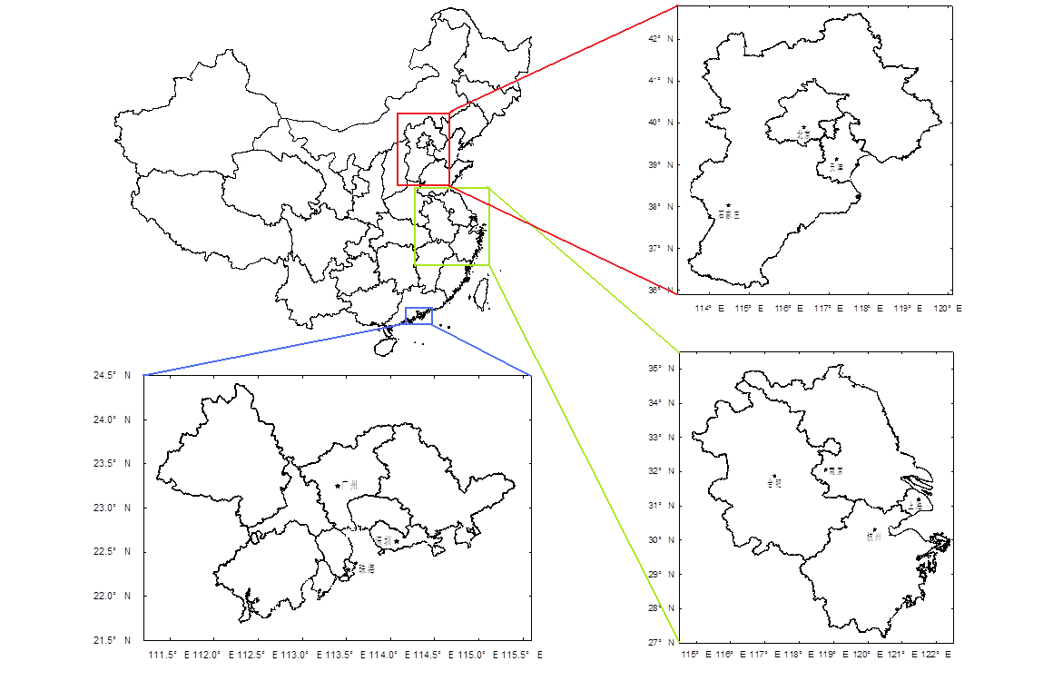
Yangze River Delta Region
  YRD Data:
  Land area: 3.5%
  Polulation: 16.1%
  National GDP: 24.3%
  Coal Consumption:
  17.7%
  Power generation(T):
  22.1%
  Car Parc: 19.1%
Beijing-Tianjing-Hebei
The Pearl River Delta Region(PRD)
The Yangtze River Delta Region(YRD)
One of the largest city clusters

Slide 4
Yangze River Delta Region
Summer 2013
Summer 2015
Notes:
Stronger regional synchronization
More widely range

Slide 5
CONTENTS
YRD Region Background
Ozone Pollution Status in YRD
Ozone in megacity of YRD
Summary

Slide 6
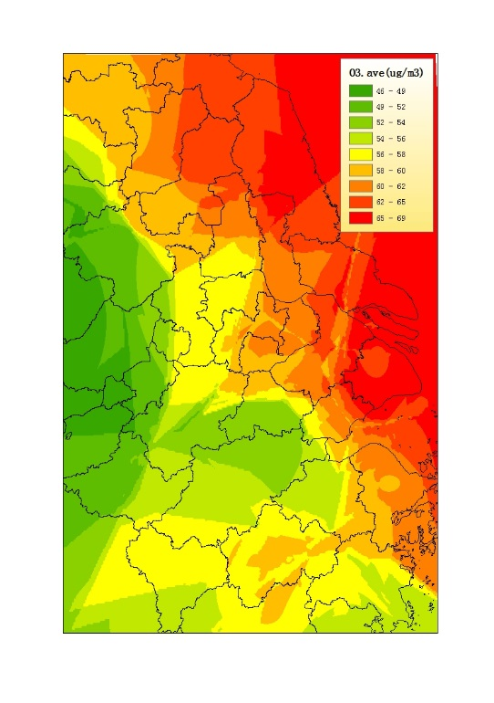
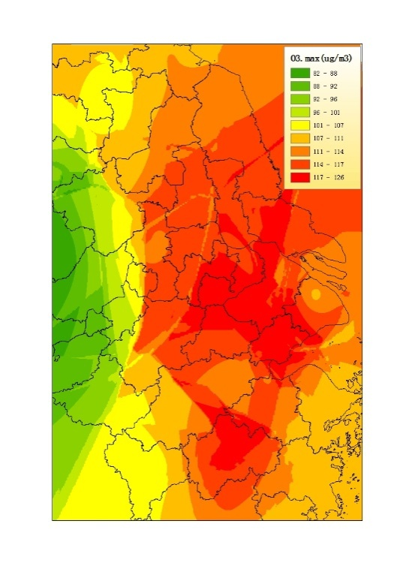
Ground ozone in YRD
Day-Average O₃
Day-Max O₃
Annual Average O₃ mixing ratio of YRD region (2014)
Notes:
2014年长三角地区O₃年均浓度及最大值浓度分布如图3-4所示。上海及江苏东部O₃年均浓度较高，一般在58-69μg/m³左右，浙江省浓度相对较低，年均浓度在54-58μg/m³左右。安徽省在长三角地区O₃污染水平最低，年均浓度在46-54μg/m³左右。O₃年均最大浓度的分布与年均浓度略有不同，长三角地区中部高值浓度较高，一般在111-126μg/m³左右，外围浓度逐步降低。上海市东北部浓度相对较低(107-114μg/m³)，西南部偏高，在114-126μg/m³左右。安徽省年均臭氧日最大浓度依然为长三角地区中最低，约在92-101μg/m³之间

Slide 7
Ground ozone in YRD
Day-Average O₃
8h-max O₃
Month Average O₃ mixing ratio of 25 cities in YRD region (2014)
Notes:
2014年长三角地区O₃年均浓度及最大值浓度分布如图3-4所示。上海及江苏东部O₃年均浓度较高，一般在58-69μg/m³左右，浙江省浓度相对较低，年均浓度在54-58μg/m³左右。安徽省在长三角地区O₃污染水平最低，年均浓度在46-54μg/m³左右。O₃年均最大浓度的分布与年均浓度略有不同，长三角地区中部高值浓度较高，一般在111-126μg/m³左右，外围浓度逐步降低。上海市东北部浓度相对较低(107-114μg/m³)，西南部偏高，在114-126μg/m³左右。安徽省年均臭氧日最大浓度依然为长三角地区中最低，约在92-101μg/m³之间

Slide 8
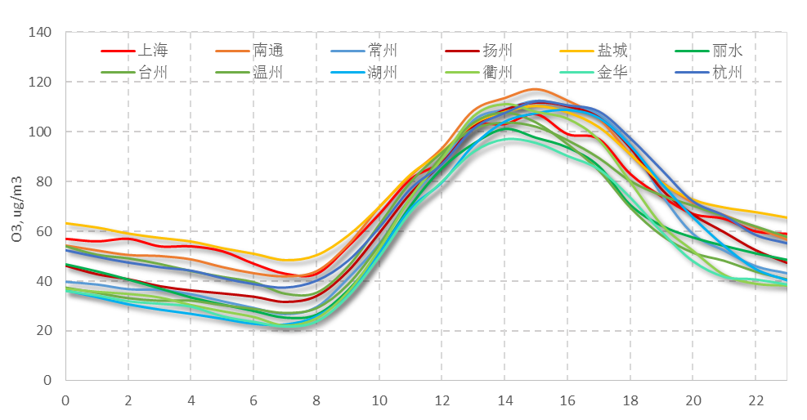
Ground ozone in YRD
Diurnal O₃ mixing ratio of 12 major cities in YRD region (2014)

Slide 9
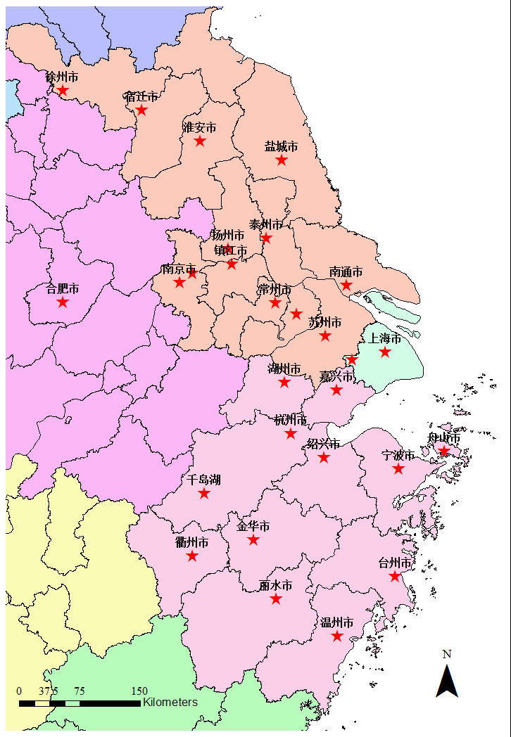
Ground ozone in YRD
Peak value time:15:00
Peak value time:16:00
Peak value time:13:00-14:00

Slide 10
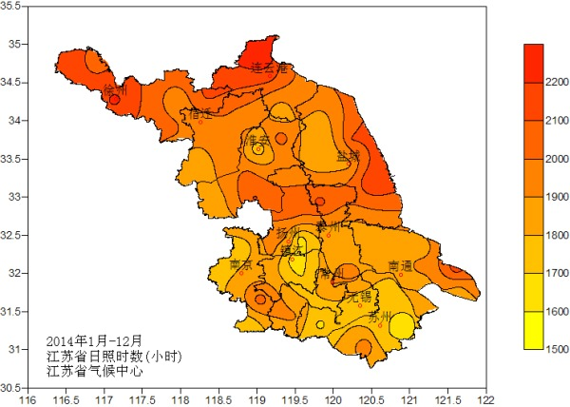
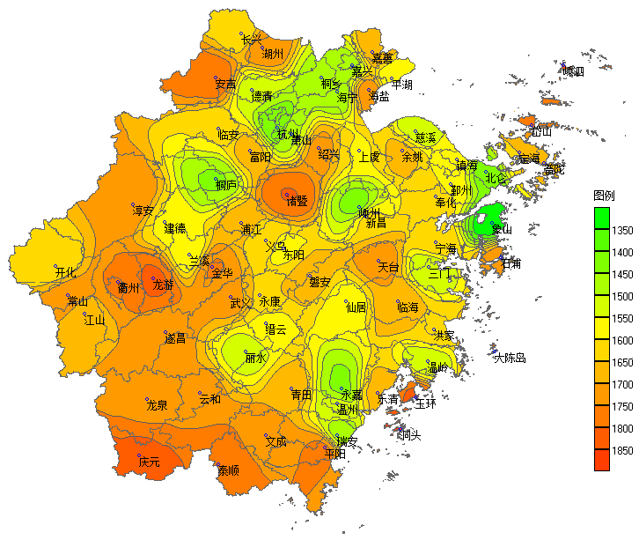
Annual daylight-hour average special distribution
in YRD region
Northern Part
(Jiangsu Province)
Southern Part
(Zhejiang Province)
Data from Jiangsu Climate Center & Zhejiang Climate Center、Shanghai EMC;

Slide 11
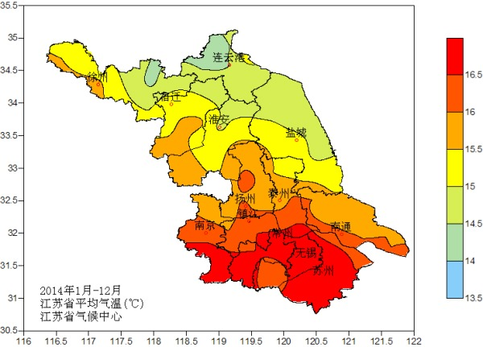
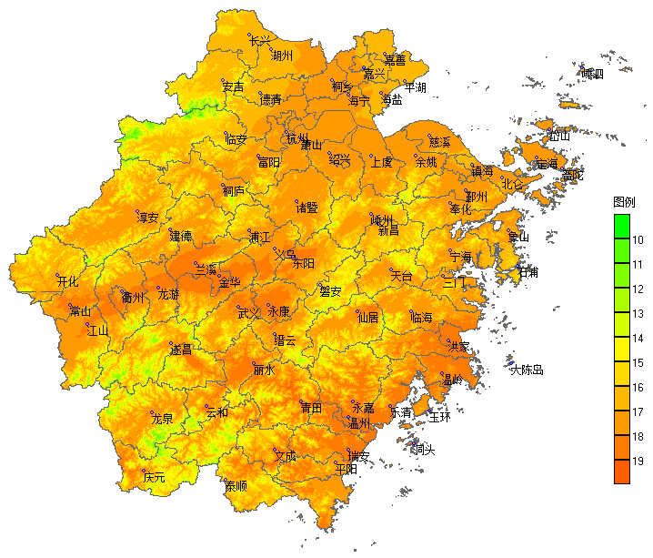
Annual temperature average special distribution
in YRD region
Northern Part
(Jiangsu Province)
Southern Part
(Zhejiang Province)
Data from Jiangsu Climate Center & Zhejiang Climate Center、Shanghai EMC;
Notes:
江苏总体北低南高的气温梯度较为分明；
浙江山区较多，气温梯度不分明，城市区域及浙北温度较高；
长三角区域为温度较高的区域；

Slide 12
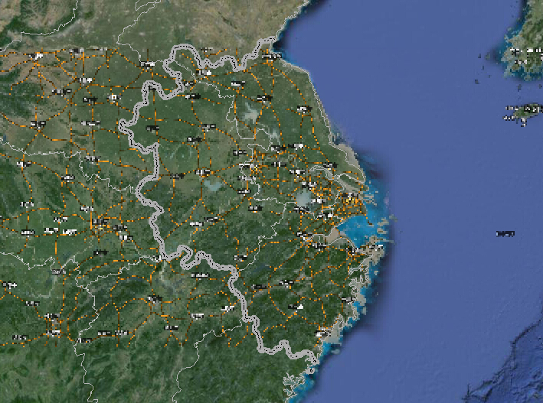
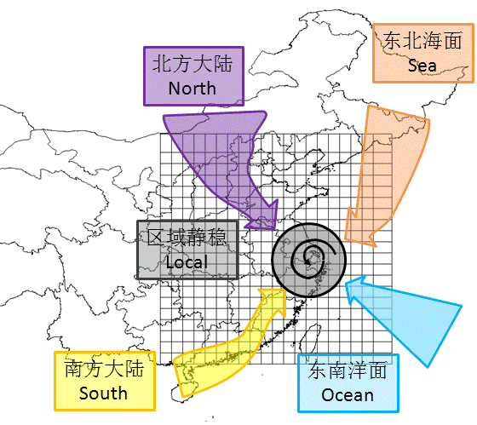
Major Contributtion:
Northern(land), North-East(Sea), South-East(Sea), South(land), Local stable condition
Local meteological stable condition is critical to AQ in Core Area
Base on data analysis of 2006-2014 by Shang还 EMC

Slide 13
Measured VOCs
Alkane Alkene Aromatics Acetylene OVOC Haloalkane
Notes:
VOCs的混合比在空间分布上存在差异；AVOCs在城市地区的混合比大于边界点和区域背景点；
O-VOC的混合比为边界点和区域背景点大于城市地区；
上海、常州VOCs体积分数大于大丰、泗洪和临安；而OVOC的混合比则大丰、泗洪和临安大于上海、常州；x-VOCs的混合比各点差异不大；

Slide 14
OFP Calculated VOCs
Alkane Alkene Aromatics Acetylene OVOC Haloalkane

Slide 15
Consumed VOCs
Alkane Alkene Aromatics Acetylene OVOC Haloalkane
Notes:
VOCs光化学消耗的排序：上海、常州 > 临安 > 泗洪 > 大丰，说明VOCs活性组分光化学消耗较多的在城市地区；臭氧生成潜势较大的是烯烃类物质，SOA生成潜势较大的是芳香烃类物质.

Slide 16
CONTENTS
YRD Region Background
Ozone Pollution Status in YRD
Ozone in megacity of YRD
Summary

Slide 17
Annual trend of O₃ in Shanghai
Slightly Increase
on urbansite
Ozone Diurnal Cycle
In shanghia

Slide 18
O₃/NOx/VOCs Trend in Shanghai

Slide 19
Annual trend of O₃ in Shanghai
Land-Sea Breeze effect cause the high ozone in late afternoon.

Slide 20
O₃ & VOCs in Shanghai

Slide 21
O₃ & VOCs in Shanghai

Slide 22
O₃ & VOCs in Shanghai
Ozone Formation Potential
calculation
VOC Reactivity Distribution

Slide 23
O₃ Source in Shanghai
Vehicle
Petrol Ind.
Oil
Solvent

Slide 24
Summary
O₃ become the air quality problem in YRD;
Anthropological VOCs is the main source of O₃ in cities;
More than 60% VOCs are consumed in O₃ formation process.

Slide 25
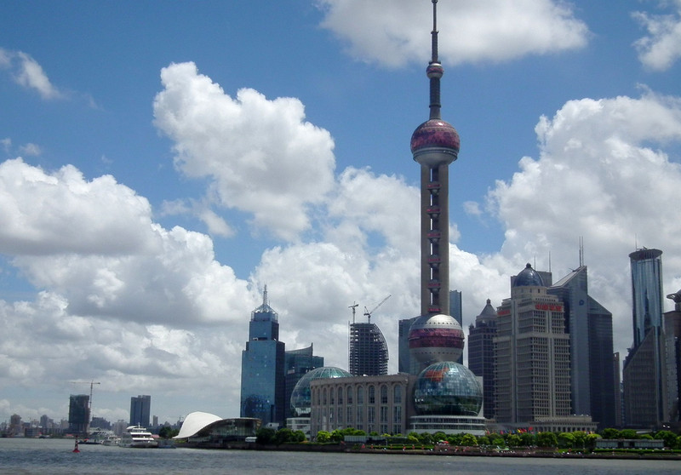
Thank you!

