Slide 1


Long-term measurements of surface ozone at remote and rural sites in China
TOAR Workshop 1.03, January 25-27, 2016
Xiaobin Xu¹, Weili Lin^{1,2}
¹ Chinese Academy of Meteorological Sciences
Key Laboratory for Atmospheric Chemistry, CMA
² Meteorological Observation Center, CMA

Slide 2
Outline
Brief introduction
Results from a baseline station
Results from three background stations
Summary

Slide 3
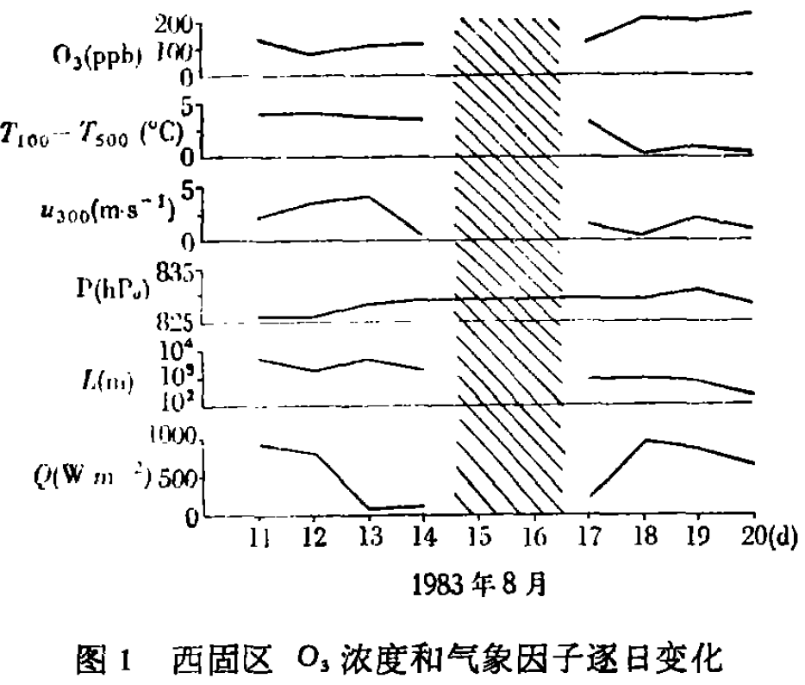
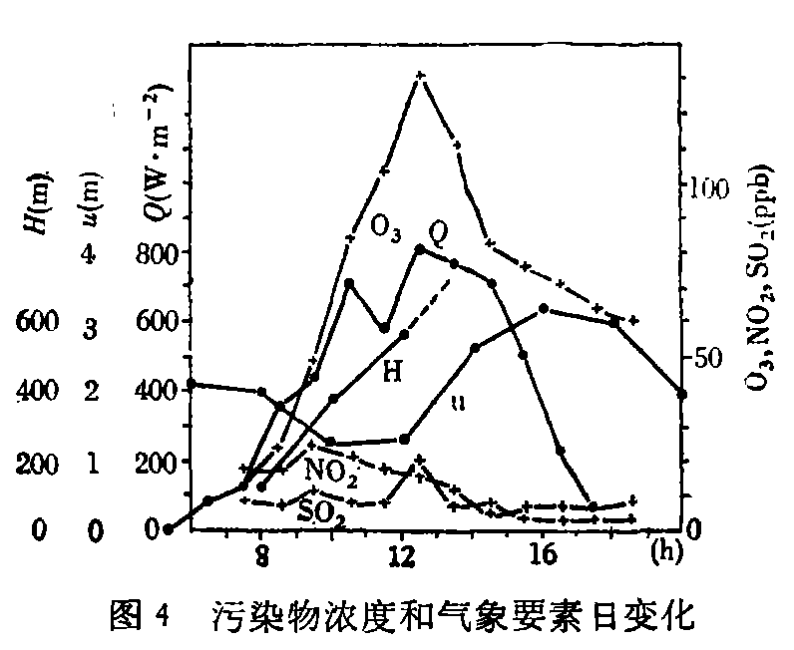
Photochemical pollution first found in Lanzhou during the later 1970s
Causes: emissions from oil refining factory and power plant
Ozone problem in Lanzhou
32 observation days during 1981-1983: 17 days with O₃>100ppb，10 days with O₃>200ppb;
Chen et al. (1986)

Slide 4
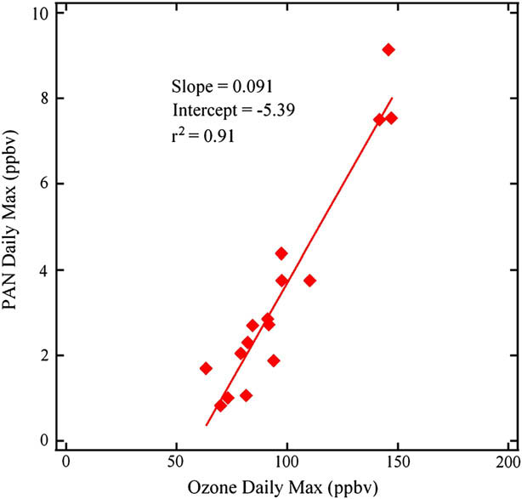
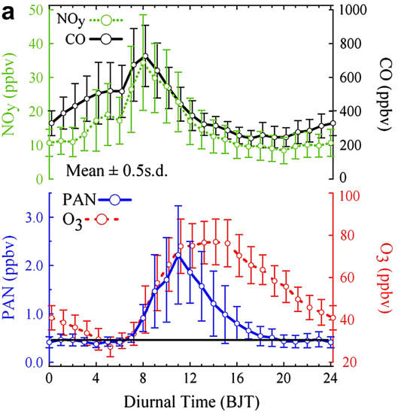
More recent observations in Lanzhou: reduced O₃ levels, but still some high O₃ values
Summer of 2006
J.M. Zhang, T. Wang*, A.J. Ding，et al. (2009)

Slide 5
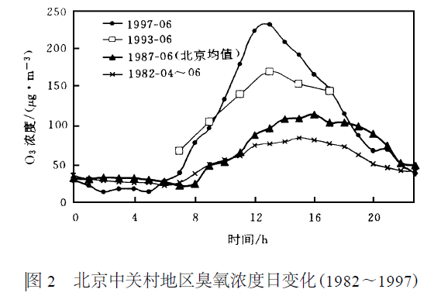
Higher O₃ levels were also observed in Beijing
A clear increase trend in daily maximum
Ma & Zhang（2000）

Slide 6
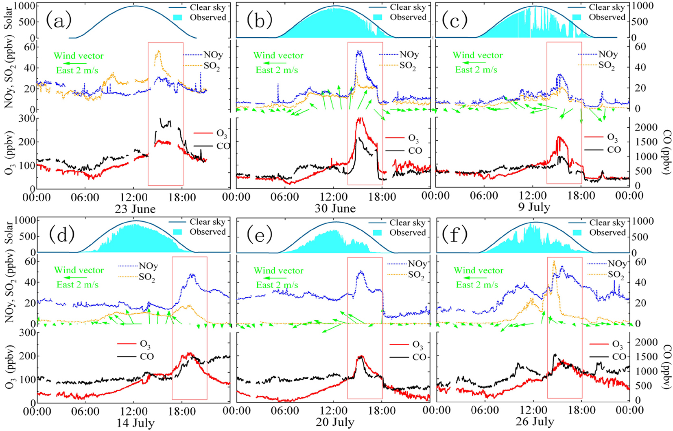
Some very high O₃ levels found in downwind of Beijing
July 2005
maximum 286 ppb ！
Wang et al. (2006)

Slide 7
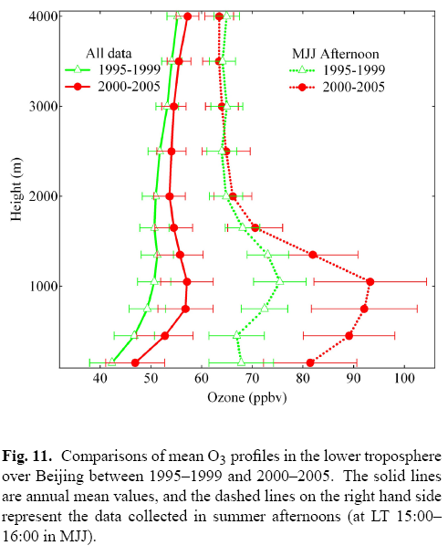
MOZAIC data indicated rapid increase of O₃ in PBL
PBL entire year：1 ppb/yr
PBL summer：3 ppb/yr
Ding et al. (2008)

Slide 8
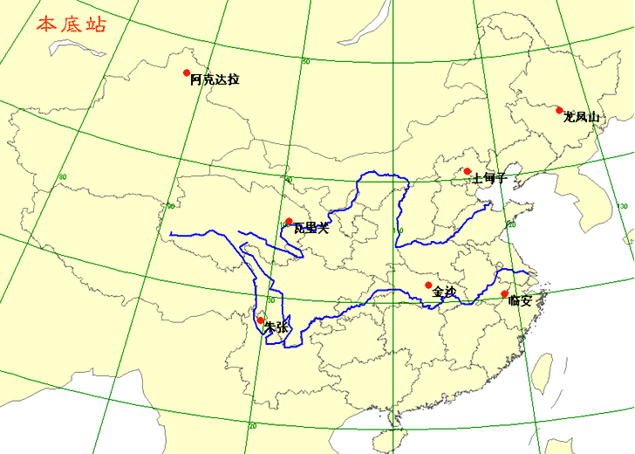
Operational observations surface O₃ at CMA’s GAW sites
WLG：1994-
SDZ：2004-
LA：2005-
LFS：2005-
XGLL：2007-
AKDL：2009-
47.10°N, 87.93°E , 562m a.s.l
Akedala
44.73 °N, 127.60 °E, 310 m a.s.l）
Longfengshan
40.39°N, 117.07°E, 293.9 m a.s.l.
Shangdianzi
36.3°N, 100.9°E , 3810m a.s.l
Mt. Waliguan
30.3 °N， 119.73 °E， 138 m a.s.l
Jinsha
Linan
28.006°N,99.684°E，3582m asl
Xianggelila
29.63 °N，114.20 °E, 750 m a.s.l
In operation
In construction

Slide 9
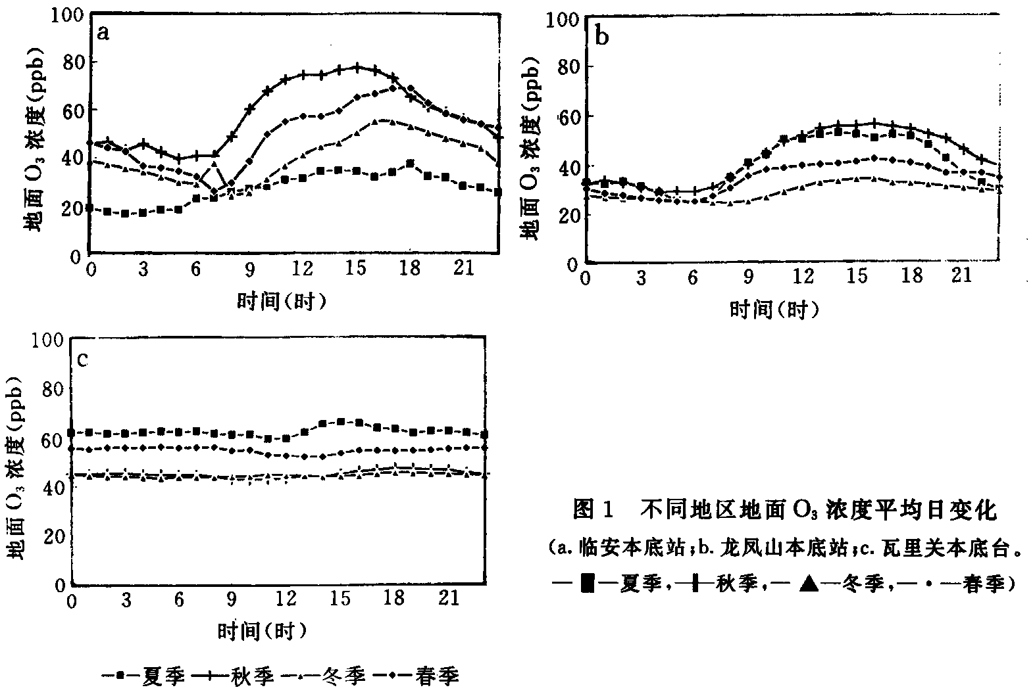
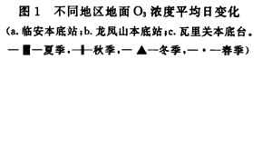
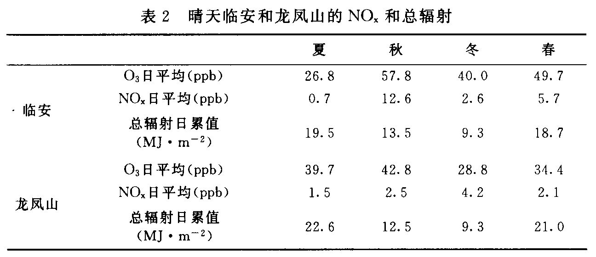
Previous one year measurements
LA
LFS
August 1994-July 1995
Higher background in western China
slightly polluted in eastern China
WLG
Ding et al（2001）

Slide 10
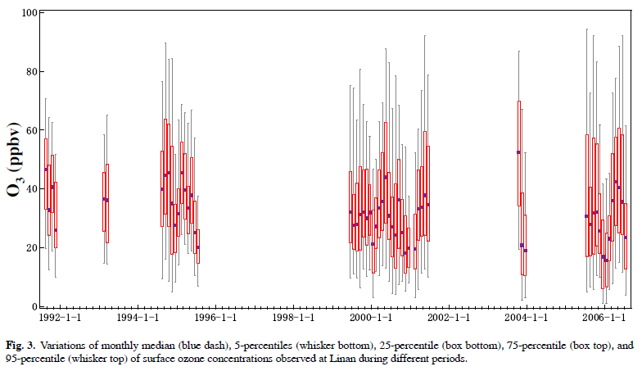
More previous measurements from Linan,
PEM-West A/B, China Map, etc.
Xu et al. (2008)

Slide 11
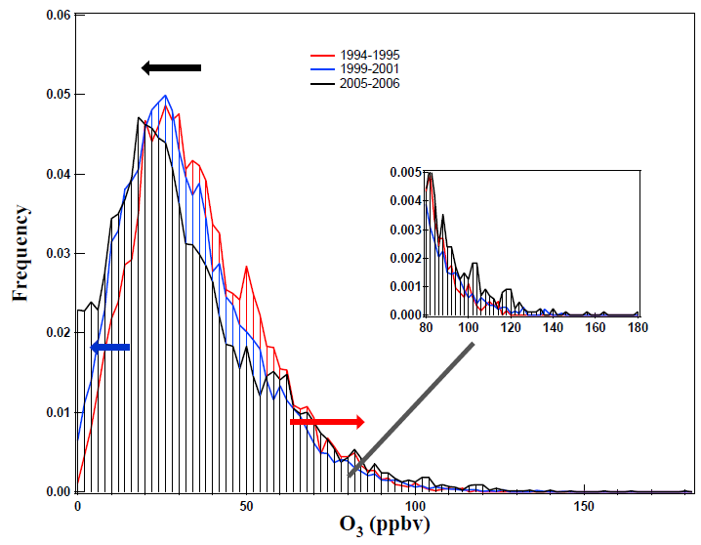
Conclusion based on earlier O₃ data from LA：
O₃ variability was enhanced, probably caused by increase of the NO_{x} level
Xu et al. (2008)

Slide 12
Major results from the operational long-term measurements of surface O₃ at WLG, SDZ, LA, and LFS

Slide 13
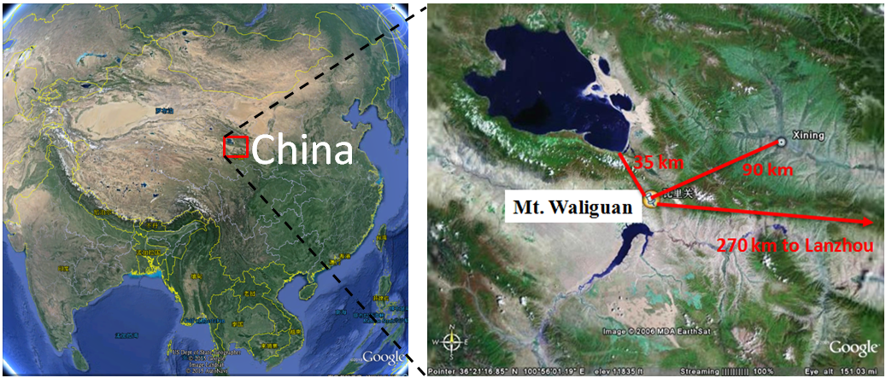
Mt. Waliguan (WLG)
WMO/GAW global baseline station
Very few population (about 6 persons km⁻²)
Nearly no industry within 30 km

Slide 14
Hourly O₃ data from WLG
The longest surface O₃ time series in mainland China

Slide 15
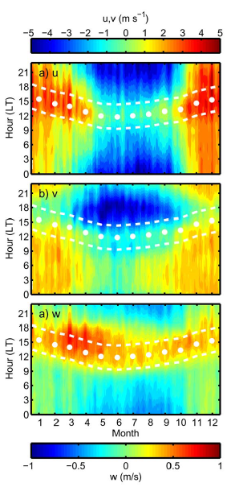
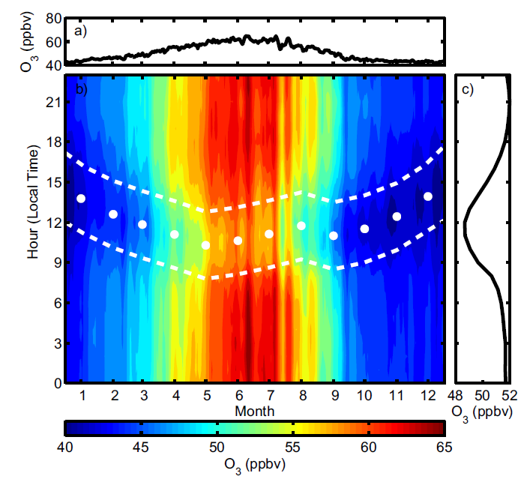
Average seasonal and diurnal variations
Mountain-valley breeze effect:
Daytime minimum (more from PBL)
Nighttime maximum (more from the free troposphere)
Seasonal change of the timing of daily minimum
Xu et al. (ACPD, 2015)

Slide 16
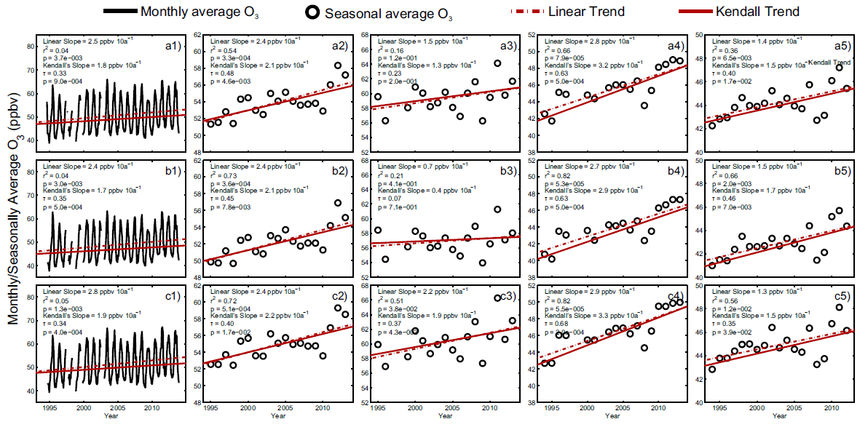
Linear and Mann-Kendall trends
Both methods give similar trends
All
Day
Night
All months
MAM
JJA
SON
DJF

Slide 17
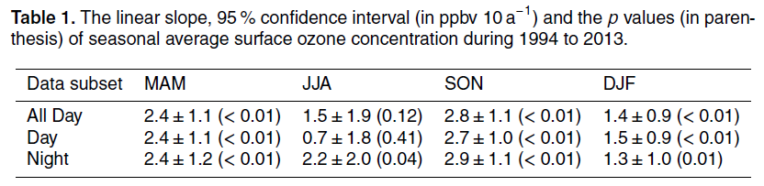
Increase trends in all seasons
Largest and significant increase in fall (2.8 ppb/10yr)
Smallest increase in winter (1.4 ppb/10yr)
Trends in summer much less significant
Pollution from east of WLG seems not to be the main cause

Slide 18
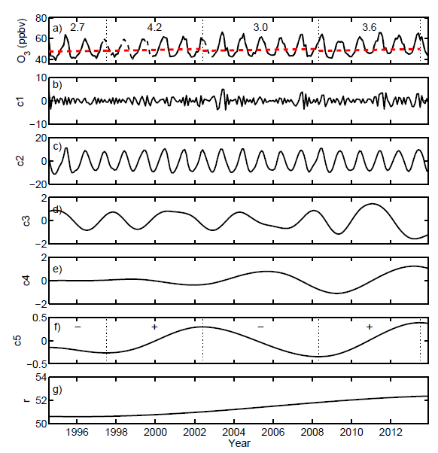
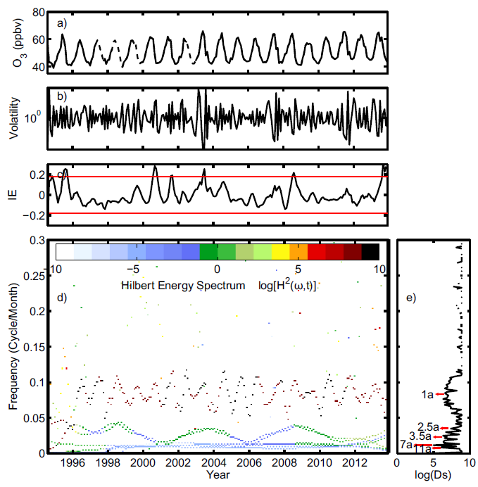
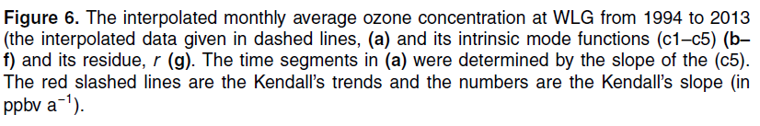

Hilbert–Huang spectral analysis
Some low frequency oscillations contributed significantly to the trends of O₃ at WLG.
Changes of transport patterns, QBO, ENSO, STE, solar activity, etc.

Slide 19
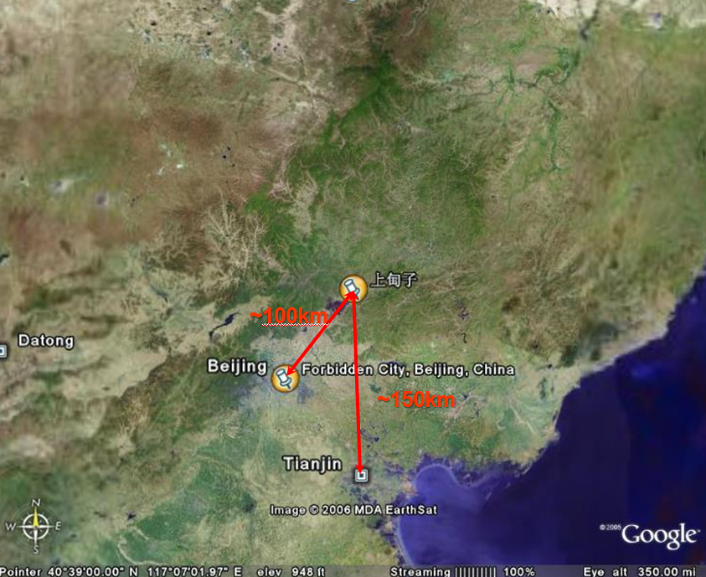
Shangdianzi (SDZ)
WMO/GAW regional background station

Slide 20
Long-term O₃ data from SDZ

Slide 21
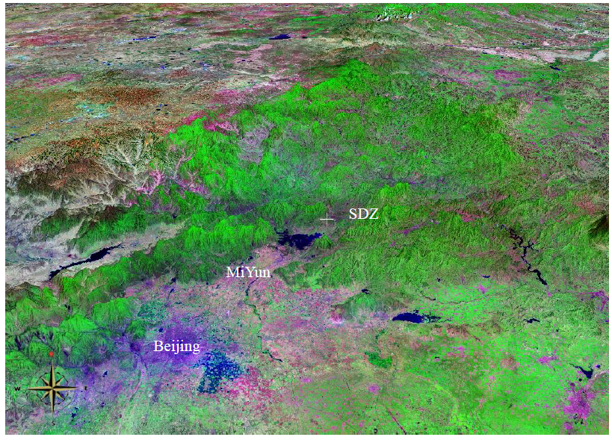
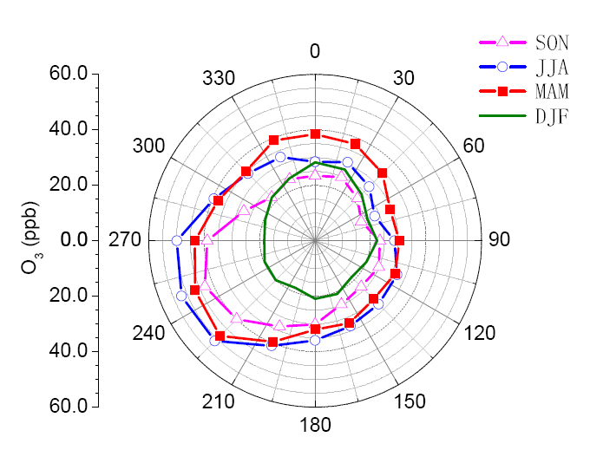
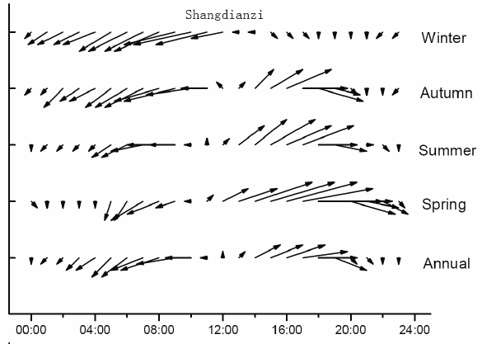
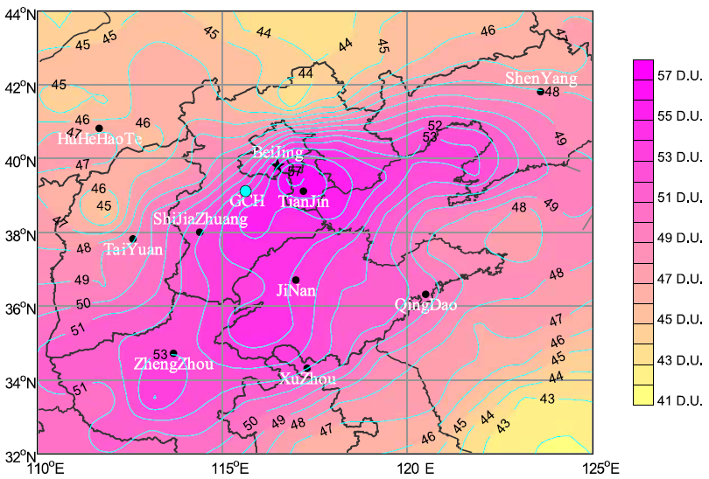
Significant contribution of pollutant transport from the North China Plain
SDZ
North China Plain
SDZ
Lin et al. (2008；2009)

Slide 22
Long-term trends
Daily mean
Slightly increasing
significant α=0.01
Yearly mean

Slide 23
Yearly O₃ metrics for TOAR
The three methods for getting 4th highest 8-h average give the same results.

Slide 24
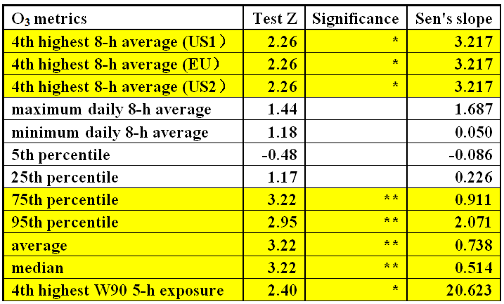
Yearly Mann-Kendall trends of O₃ metrics

Slide 25
Change of proportion of O₃ concentration in each bin
Sen’s slope

Slide 26
AOT40, 3-month
Increase trends of AOT40 in spring, summer and fall

Slide 27
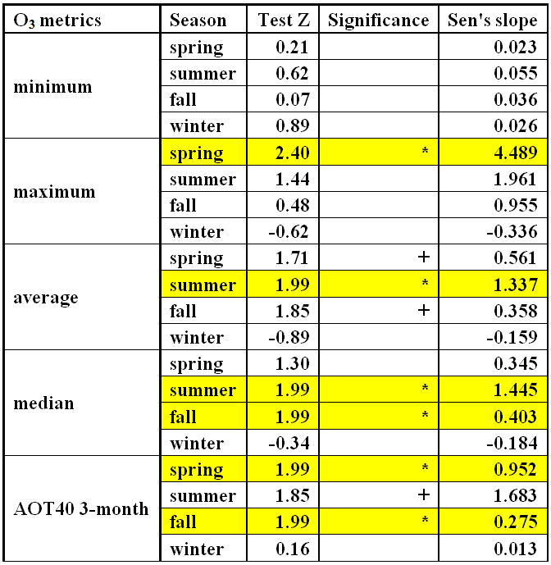
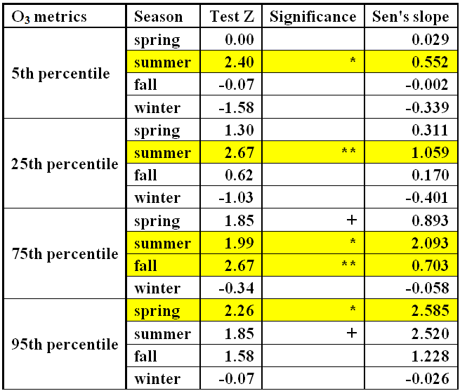
Seasonal Mann-Kendall trends of O₃ metrics

Slide 28
O₃ exceedance
GB 3095-2012
Grade I: ~75 ppb
Grade II: ~93 ppb
~10%

Slide 29
No significant trend in the ground-level NOx concentration

Slide 30
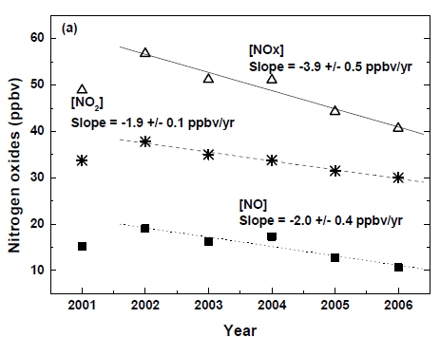
Trend of surface NO_{x} in urban area of Beijing
Trend of tropospheric NO₂ over Beijing
Tang et al. (2009)
Zhang et al. (2007)

Slide 31
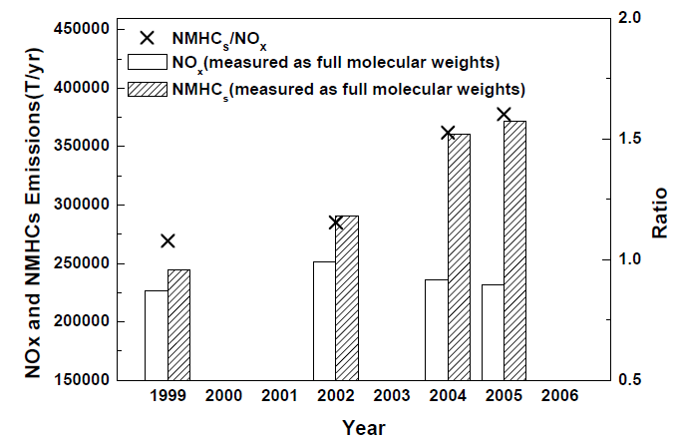
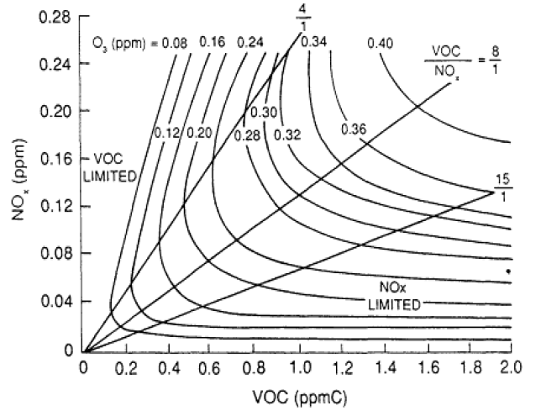
Why increase of O₃ with decreasing NO_{x}？
Caused by increase of VOCs？
？
Tang et al. (2009)

Slide 32
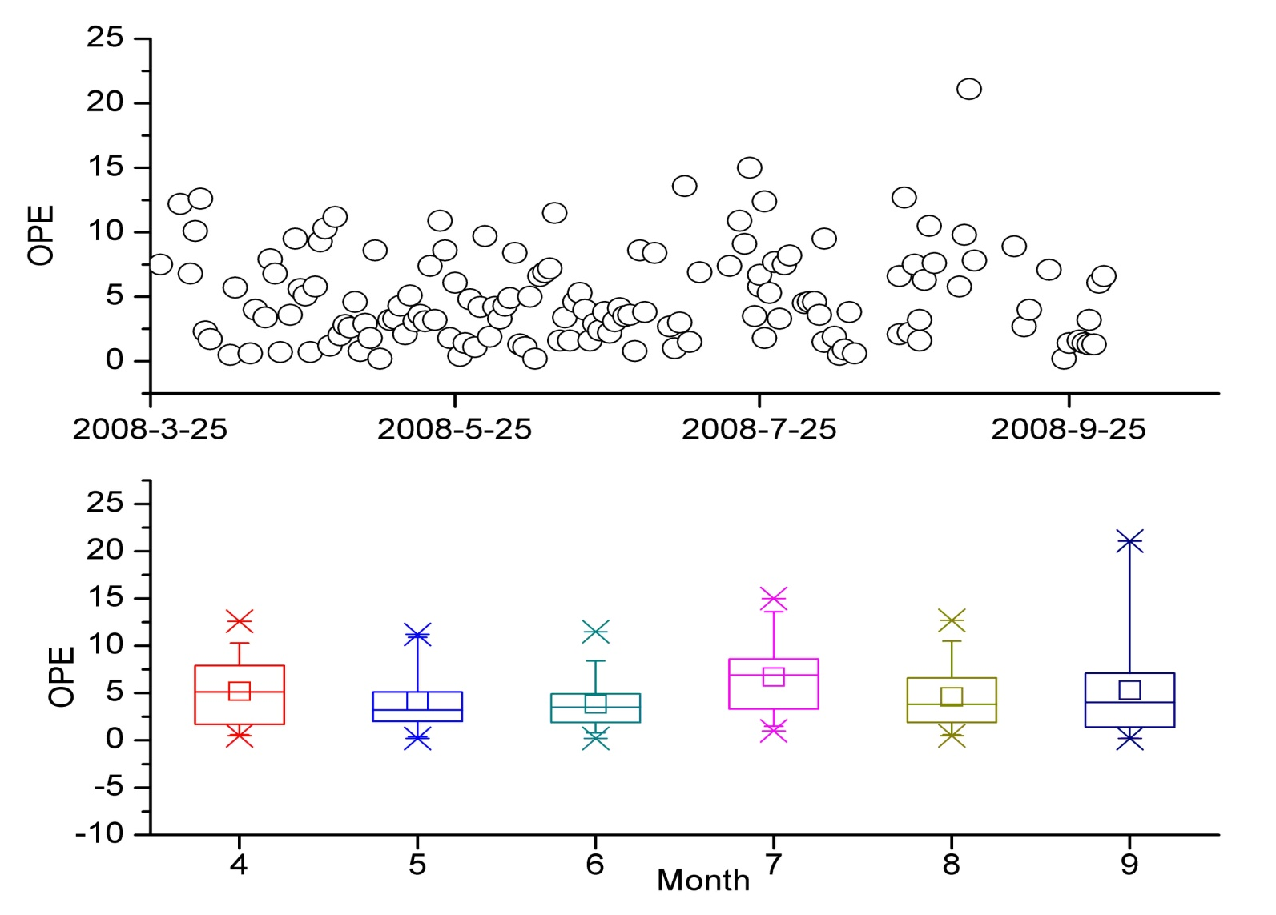
Ozone production efficiency (OPE) at SDZ
Range： 0.2~21.1; average：4.9±3.6
Sensitive to VOCs and NOx, but mainly to VOCs
The NOx level is too high in North China, O₃ is more sensitive to VOCs even at the background site.
Ge et al.（2010）

Slide 33
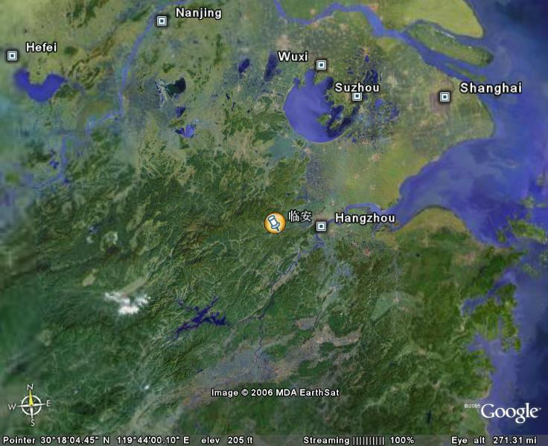
Linan (LA)
WMO/GAW regional background station
210 km
Linan
50 km
located in the Yangtze Delta region,
densely populated and industrialized

Slide 34
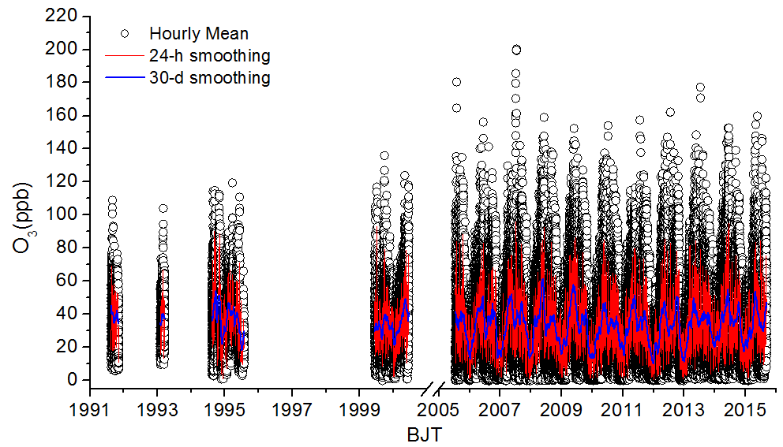
O₃ data from LA

Slide 35
O₃ data analyzed in this work
Strongly impacted by East Asia Monsoon

Slide 36
Long-term trends
Slightly decreasing
Not significant

Slide 37
No clear trend in high level O₃ metrics

Slide 38
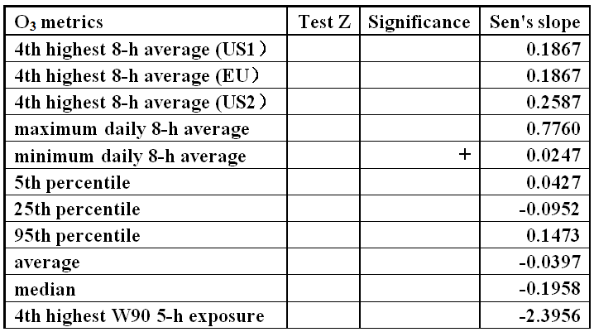
Yearly Mann-Kendall trends of O₃ metrics
Caution: only 9 years of data (2006-2014) used

Slide 39
Change of proportion of O₃ concentration in each bin between 2006 and 2014
Slope from Linear regression
None of these trends is statistically significant

Slide 40
AOT40, 3-month moving
Spring and summer AOT40 values are not low, but there is no significant trend

Slide 41
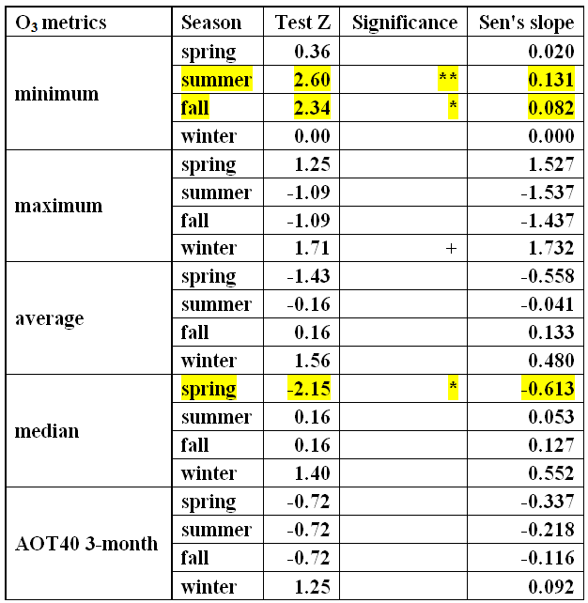
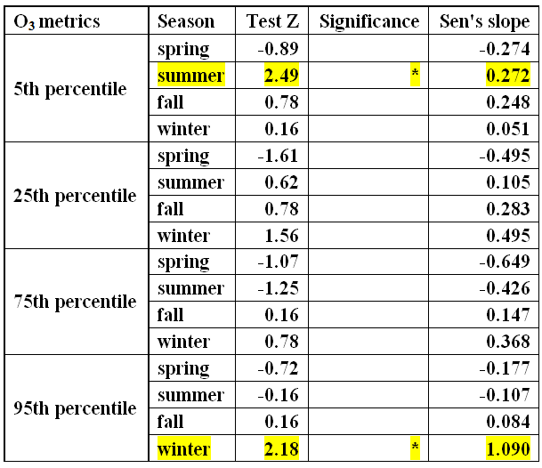
Seasonal Mann-Kendall trends of O₃ metrics
Minimum values are too close to the LOD

Slide 42
O₃ exceedance

Slide 43
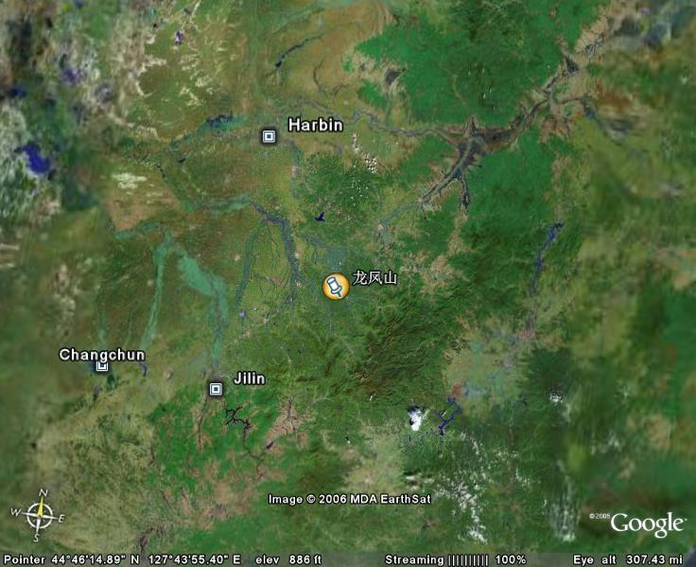
Longfengshan (LFS)
WMO/GAW regional background station
~140 km
Longfengshan
~200 km
~130 km
located in Northeast China, far away from major cities, but significantly impacted by agricultural activities (rice)

Slide 44
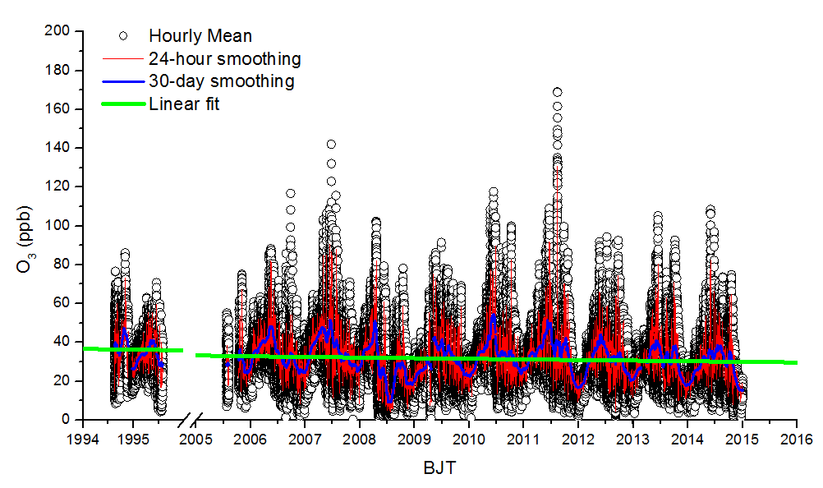
O₃ data from LFS

Slide 45
Long-term trends
Decrease trend
Lower significance

Slide 46
O₃ metrics

Slide 47
Change of proportion of O₃ concentration in each bin between 2006 and 2014
Slope from linear regression
R²=0.42
R²=0.43

Slide 48
O₃ exceedance

Slide 49
Average diurnal O₃ profiles from three regional background stations
LFS
LA
SDZ
Highest O₃ level
Strongest photochemistry

Slide 50
Tropospheric NO₂ over east Asia
Peters et al.(2005)

Slide 51
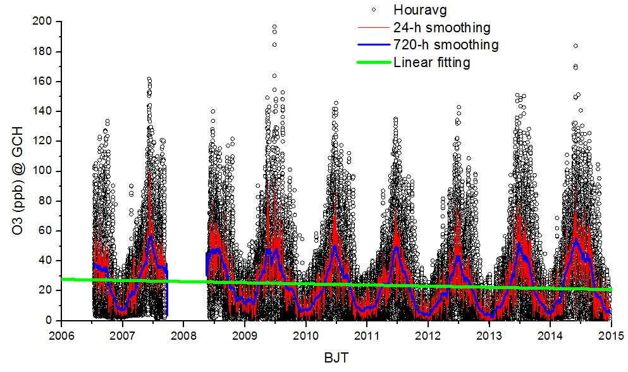
Gucheng: a rural site, 100 km southwest of Beijing
Need to be analyzed

Slide 52
Summary
Baseline O₃ in western China has been slightly increasing mainly due to dynamic processes.
Regional background O₃ in North China has been rapidly increasing (0.73 ppb/yr). Many O₃ metrics show significant trends.
Regional background O₃ in the Yangtze River Delta and Northeast China shows insignificant decreasing trends.

Slide 53
Thank you!
Acknowledgement
We thank all operators of the GAW stations for their routine work.
The work is supported by Natural Science Foundation of China (41330422) and Environmental Research in the Public Interest (201509002).

