Slide 1
Chapter 3
Global Ozone Metrics for Climate Change, Human Health, and Crop/Ecosystem Research
Summary of Our Meeting
January 27, 2016
Allen S. Lefohn, Lead Author
A.S.L. & Associates, Helena, Montana, USA

Slide 2
Current Authors
Allen S. Lefohn, Christopher S. Malley, Gina Mills, Luther Smith, Milan Hazucha, Vaishali Naik, Martin G. Schultz, Heather Simon, Benjamin Wells, Elena Paoletti, Alessandra De Marco, Xu Xiaobin, Howard Neufeld, Robert Musselman, David Tarasick, David Parrish, Michael Brauer, Mhairi Coyle, Zhaozhong Feng, Tang Haoye, Kazuhiko Kobayashi, …..
Chapter 3 now has grown from 28 to 32 participants in last few days.

Slide 3
Discussion Items
We recognize that the chapter is long but we also understand that much of the material in it is important and must be streamlined so that the chapter serves to provide a platform of knowledge that allows authors of the other chapters to refer to so that they can perform their trends and present-day distributions analyses without having to take up valuable space to develop background materials;
We believe that the information in Chapter 3 has covered most of the areas that may be needed for other chapters to draw upon;
However, we believe that we must now turn toward producing tables and figures that summarize the metrics, what they are used for, and identify perhaps which countries are currently using specific metrics as indicators for human health and vegetation goals and standards;
An important consideration is what to do with short-term data sets. The statistics section can address possible statistical methods and exposure metrics that will be most sensitive to change (at both the high end and the low end of the distribution);
What is the question we wish to ask concerning the use of short-term data series? For example, if emissions are reduced, can we see changes in the more sensitive metrics?; and
Statistics section will add additional material on contrasting the nonparametric and parametric approaches.

Slide 4
Discussion Items (Continued)
Based on discussions with Chapter 4 and 5 authors, we believe for TOAR that we need to clarify the time period for long-term trends. For example, do we identify a fixed period (e.g., 1990-2013) or do we include all data available for each site (specifying a minimum number of years) and compare the patterns? At the Madrid workshop, we discussed using all the data when the trends are summarized in the database output. However, for the individual chapters, it should be decided on whether all data are going to be used or whether a fixed time period will be identified.

Slide 5
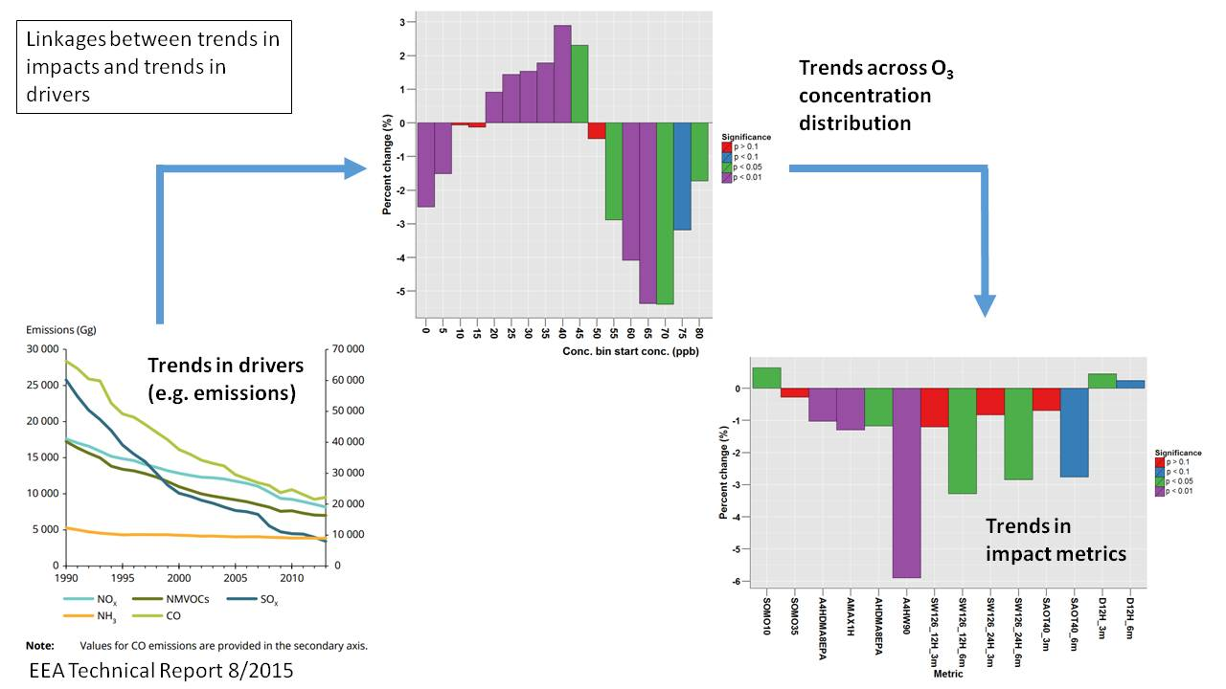
Changing Concentration Distributions Over Time Affect Metrics Differently (1989-2013)
Glazebury, UK

Slide 6
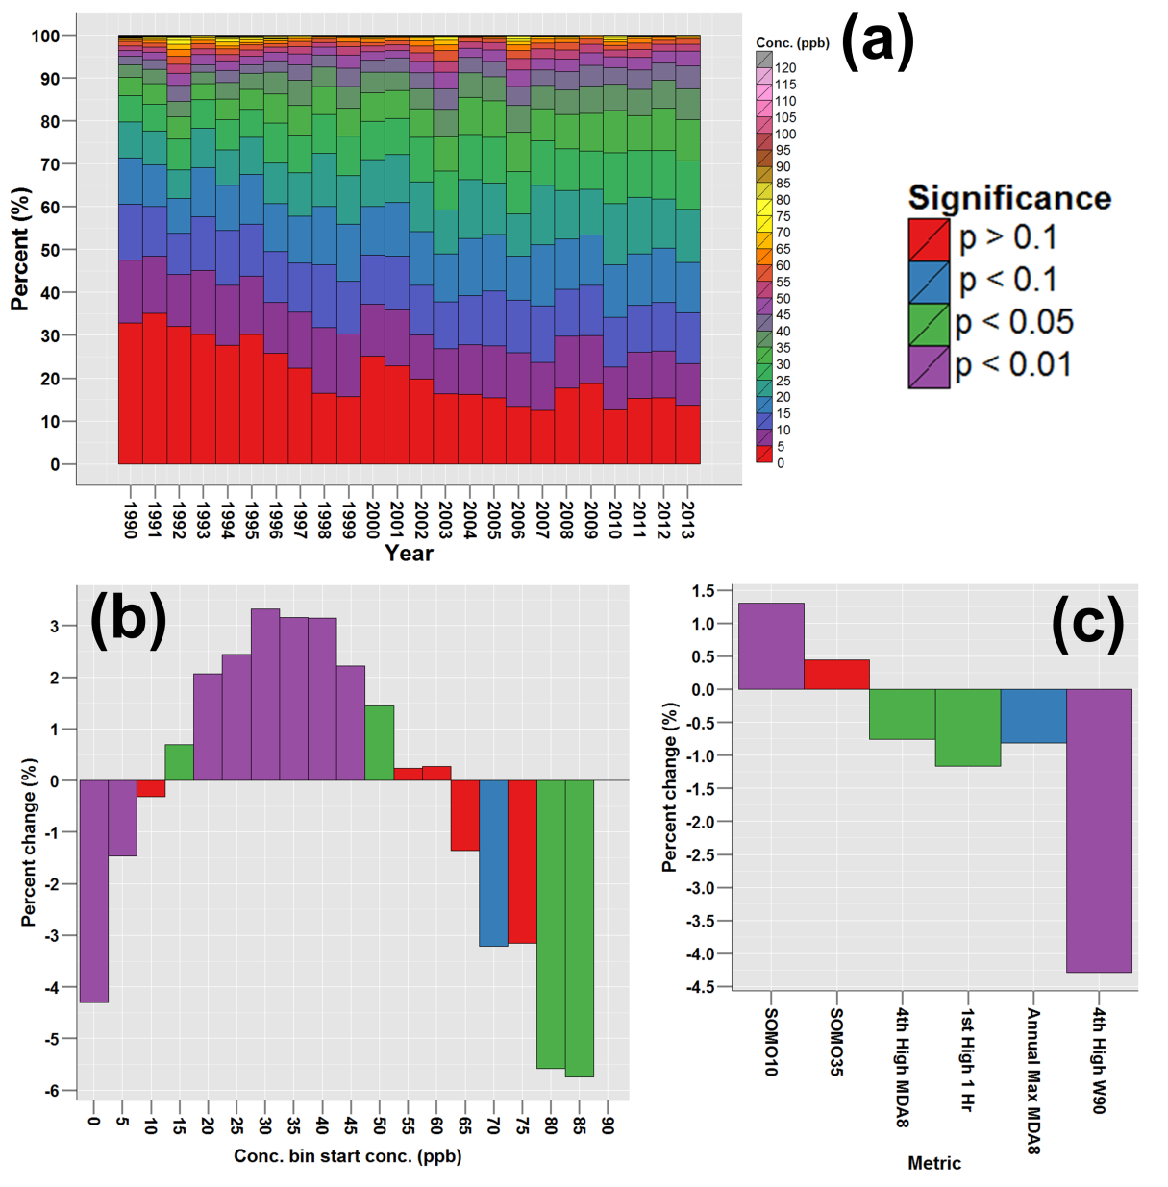
Summary of changes in O₃ concentration distribution and human health O₃ metrics at an urban site in Berlin, Germany (EU AirBase ID: DEBE034): a) Proportion of hourly O₃ concentrations in 5 ppb O₃ concentration bins for each year, b) Theil-Sen percent trend in proportion of O₃ concentrations in each bin between 1990 and 2013 (significance determined by the Mann-Kendall test), and c) Theil-Sen percent trend in 6 human health O₃ metrics between 1990 and 2013.

Slide 7
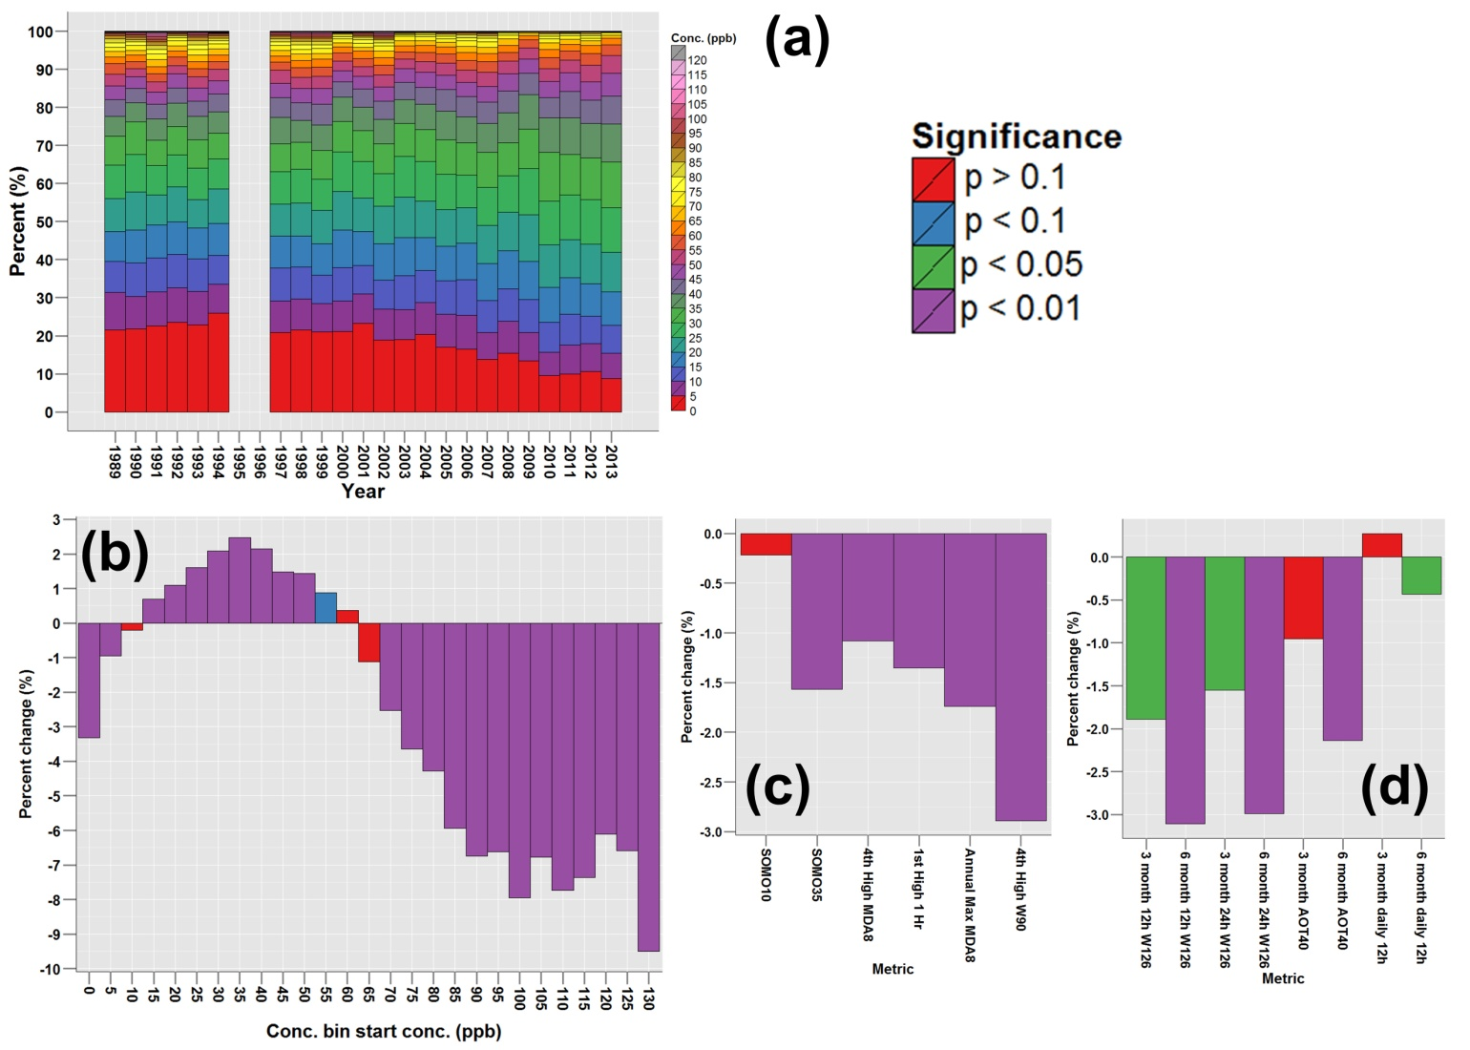
Summary of changes in O₃ concentration distribution and vegetation metrics at a rural site at Beltsville, Maryland (EPA AQS ID: 240339991-1): a) Proportion of hourly O₃ concentrations in 5 ppb O₃ concentration bins for each year, b) Theil-Sen percent trend in proportion of O₃ concentrations in each bin between 1990 and 2013 (significance determined by the Mann-Kendall test), c) Theil-Sen percent trend in 6 human health O₃ metrics between 1990 and 2013, and d) Theil-Sen percent trend in 8 vegetation O₃ metrics between 1990 and 2013.

Slide 8
Important Questions Addressed by TOAR Presented in Chapter 3
Which regions of the world have the greatest exposure to ozone pollution relevant to human health and vegetation (i.e., crops and ecosystems)?
What conclusions can be derived regarding the interactions between climate change and temporally related tropospheric ozone concentrations?
What changes in ozone concentrations are occurring in regions where strong emissions controls are implemented?
What changes in ozone concentrations are occurring in regions with increasing emissions of ozone precursors?
Adopted from Overview of TOAR (http://www.igacproject.org/TOAR).

