Slide 1

Chapter 4: Present day ozone distribution and trends relevant to human Health
Zoe Fleming U. Leicester, Ruth Doherty U. Edinburgh UK
Cooper, O. R., Xu, X., Moolla, R., Simpson, D., von Schneidemesser, E., Schultz, M., Malley, C.
Feng, Z., Pinto, J., Shallcross , D., Lefer, B., Solberg, S., Jaffe, D., Hamad, S. Colette, A.

Slide 2
Chapter Structure
Introduction
  Acute exposure and Air quality standards
  Plethora of metrics- differ by timescale and world region
Station data selection and classification
  Networks utilised for health metric calculations and time periods
  Optimal station classification for health purposes- i.e. accounting for population
  Regional aggregation
Health metrics for present-day ozone
  Which one/ones/few…?
Present-day ozone and metrics relevant for human health
  Present-day distribution and disparities in distributions
  Population –weighting
Ozone trends and metrics relevant for human health
  Time –series and trend methodology
  Encompassing trends for different metrics/distributions/percentiles
  Mapping Regional ozone trends
Discussion

Slide 3
Chapter Structure
Introduction
Station data selection and classification
Health metrics for present-day ozone
Present-day ozone and metrics relevant for human health
Ozone trends and metrics relevant for human health
Discussion

Slide 4
Station classification for health
  Urban + rural standard classification, suburban and baseline
  In addition proxies:
    Urban (high NO_{x} emissions/NO₂ column)
    Urban (zero ozone at night in winter if available)
    Urban (population density)
    Urban (night time lights)
    Urban (land cover)

Slide 5
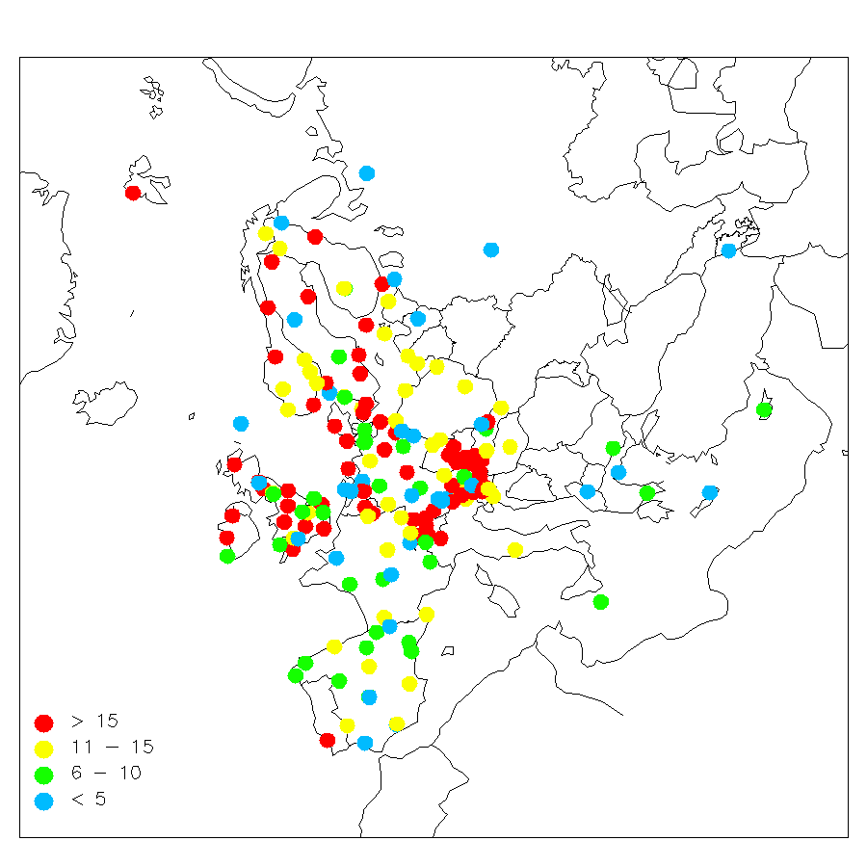
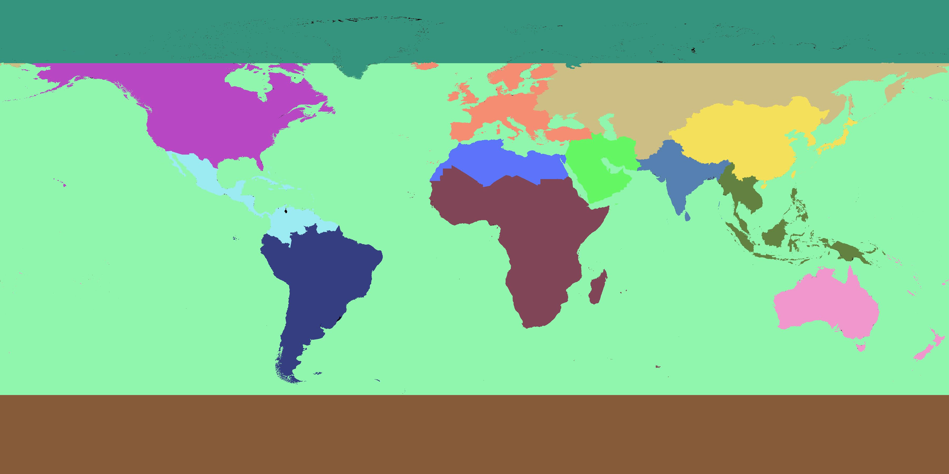
Regions/Regional aggregation
  Which regions? - common decision for TOAR chapters
  Regional aggregation for present-day ozone and for trends
    Averaging, kriging …. How complex?
TF-HTAP source regions
European EMEP ozone monitoring sites, the number of years of data during 1990–2009 (courtesy S. Solberg)

Slide 6
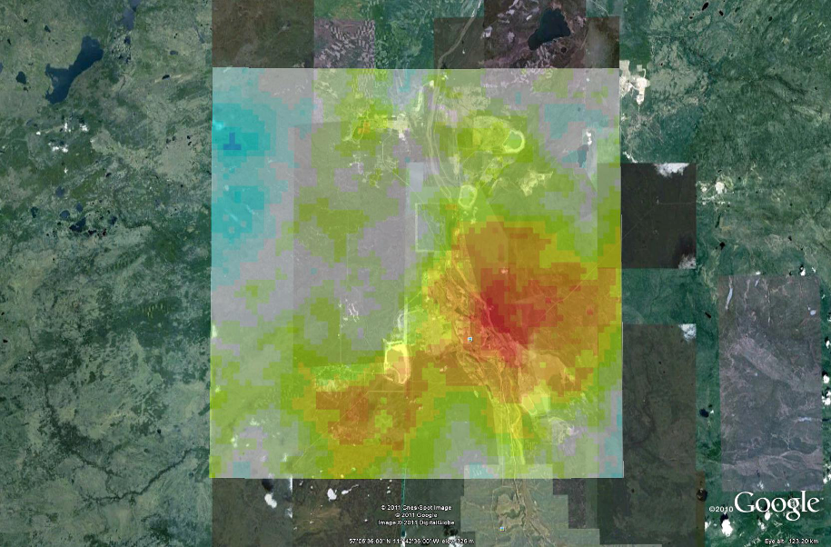
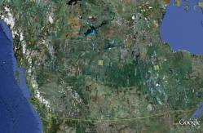
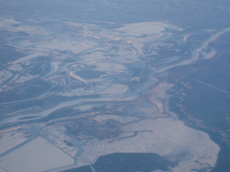
Mildred Lake (Oil Sands), 2005-2010, SO₂ emissions: ~120 kT

Slide 7
Which metrics? Still under debate
Wide range including:
4th highest 8 hour average for each year (USA)
Ditto daytime average
Maximum daily 8 hour
Maximum daily 1 hour
SUMO35, SUM010
W90
Percentiles annual and seasonal
Number of exceedances above an absolute threshold (8 and 1 hr)
Running mean 3 month average

Slide 8
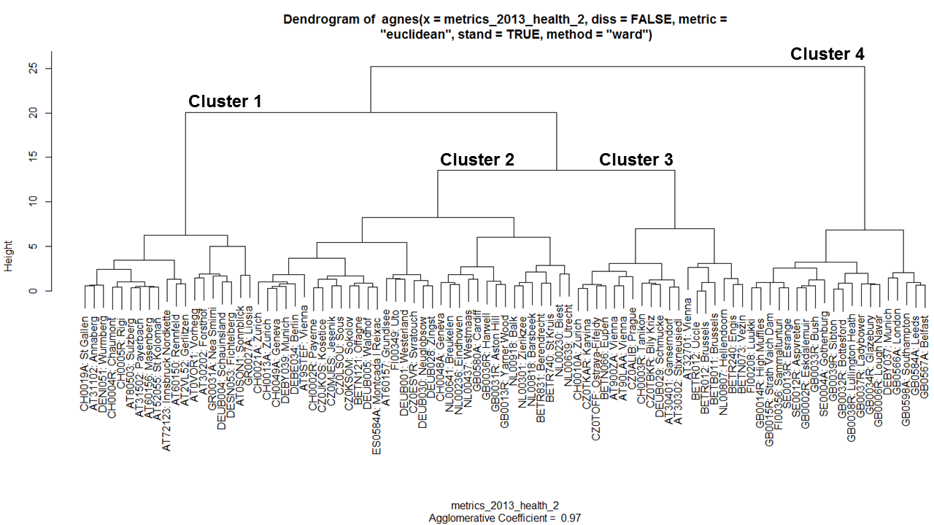
Cluster analysis: site similarity across metrics

Slide 9
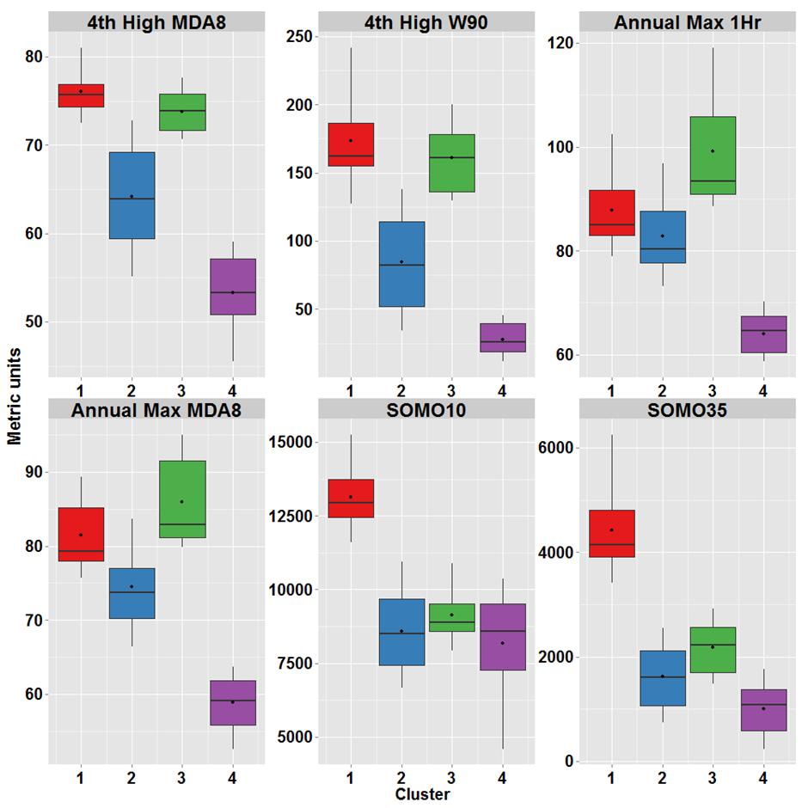
Cluster analysis: site similarity across metrics

Slide 10
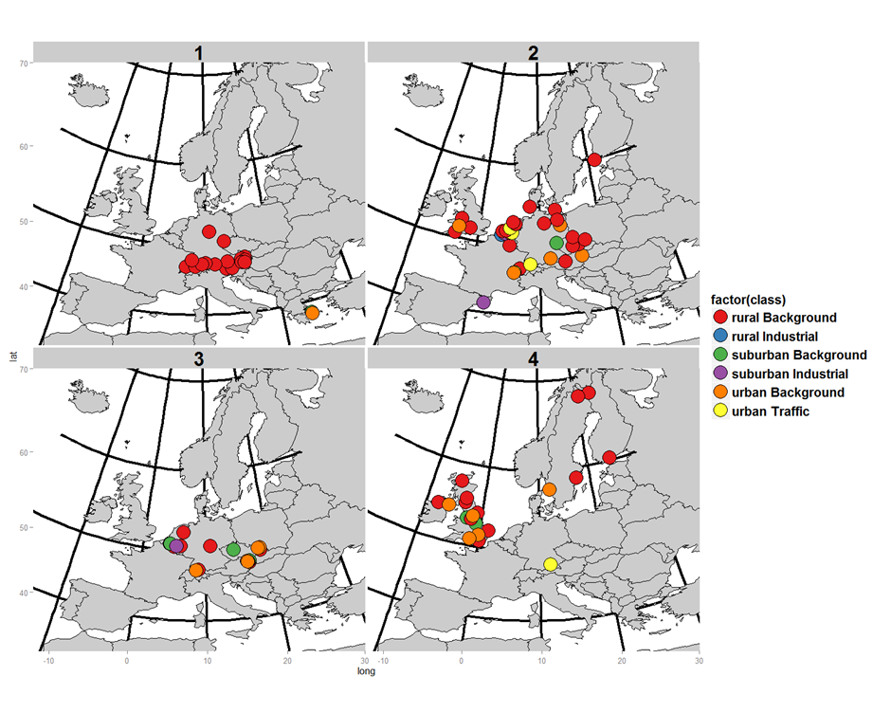
Cluster analysis: site similarity across metrics- to relate to chosen metrics

Slide 11
Population – weighting
= 0₃ x pop density

Slide 12
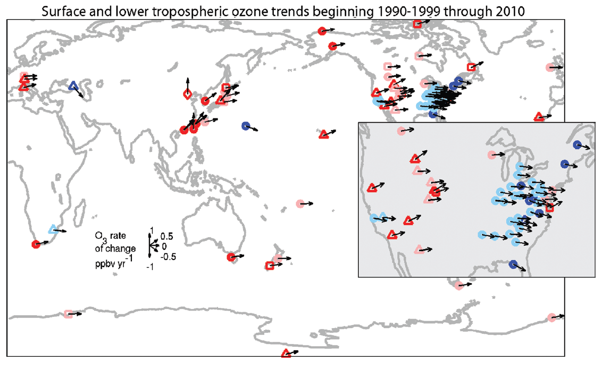
Displaying regional? trends globally
Cooper et al. 2015

Slide 13
Urban data and overlap
Enough urban data
Chapter 3 to advise on trend periods
Chapter 5 synergies
Other chapters?
Chapter 8 to bring together chapters 4 and 5- common conclusions?
Cooper et al. 2015

