Slide 1
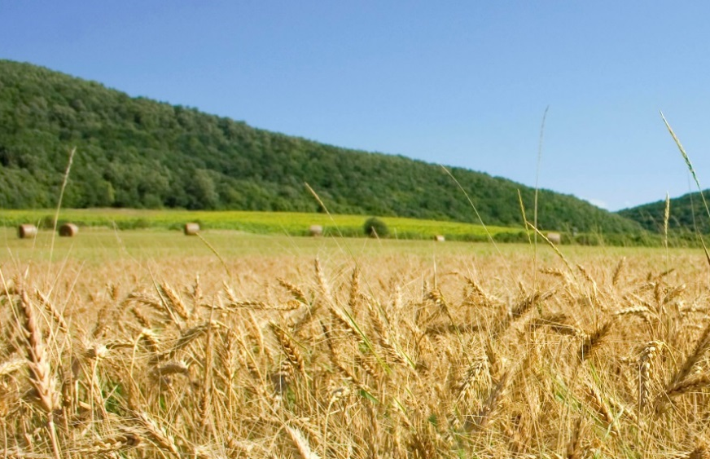
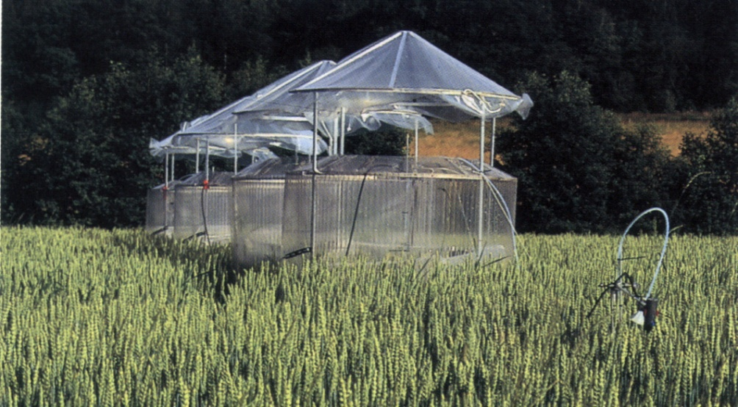


TOAR Chapter 5: Present day tropospheric ozone distribution and trends relevant to vegetation
Gina Mills¹, Zhaozhong Feng²
Owen Cooper, Giacomo Gerosa, Allen Lefohn, Howie Neufeld, Elena Paoletti, Håkan Pleijel, Pallavi Saxena, Martin Schultz, David Simpson, Baerbel Sinha, Vinayak Sinha, Sverre Solberg, Xiaobin Xu
¹ Centre for Ecology and Hydrology, UK
² Chinese Academy of Sciences, Beijing
Notes:
Zhaozhong – please could you add your Institute’s logo?

Slide 2
Outline of this chapter
Introduction
Methodology for vegetation metrics
choice of vegetation metrics
Site selection
Data selection and calculation of metric values
Analysis, including trends analysis
Results
Present day ozone (M12, AOT40, W126,
PODy)
Trends in vegetation metrics (global long-term, regional short-term, trends in seasonal variation and relevance to plant growth cycels.
Discussion

Slide 3
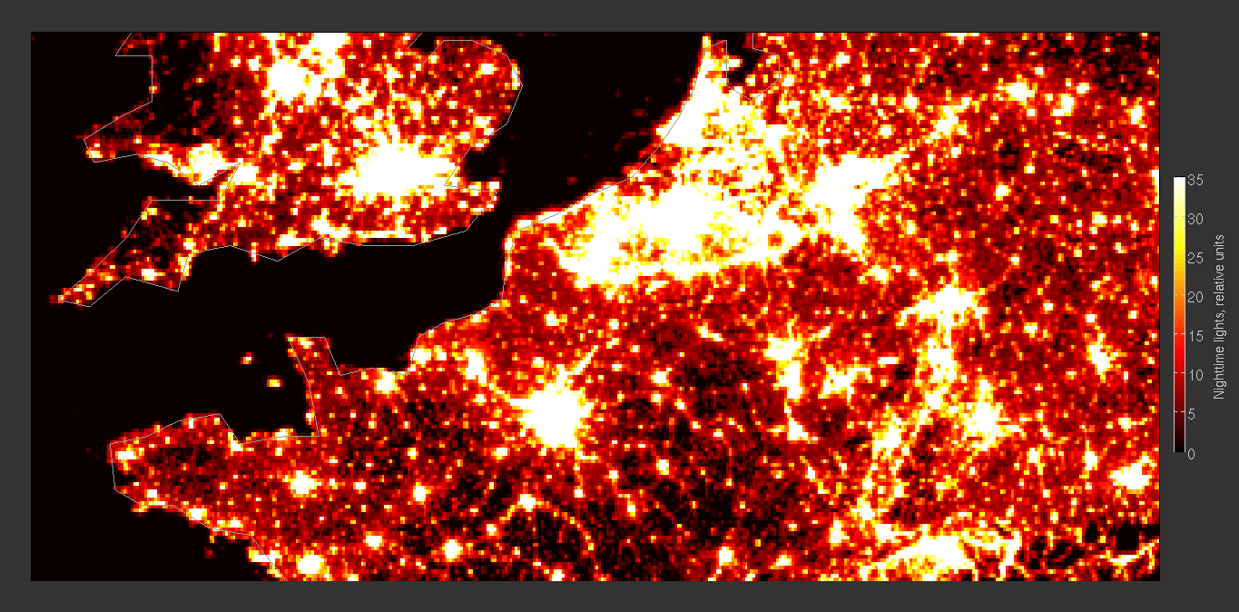
(1) Defining rural areas
We will use the growing areas for wheat, rice to define rural areas.
Night-time brightness index information can be put in Supporting information
Questions: determine growing area as greater or less 500 tons/ha per year?
Night-time brightness index being considered but rules needed e.g. the Netherlands shows as very bright, therefore urban but has extensive agricultural areas

Slide 4
(2) Representative species – landcover data
Deciduous trees: Landcover data source to be decided, suggestions include:
  Phytoclimatic/bioclimatic regions
  Alex Gunthers' Megan model for BVOC emissions
  GLC data-sets (GLC2000 is used in EMEP): www.glcn.org
  Crowther et al. Nature, 2015 Mapping tree density at a global scale
  Discussion: Alex Gunthers' Megan model for BVOC emissions will be used
  Question: There might be overlapped in some growing areas of wheat, rice and deciduous trees if land cover is from different data sources

Slide 5
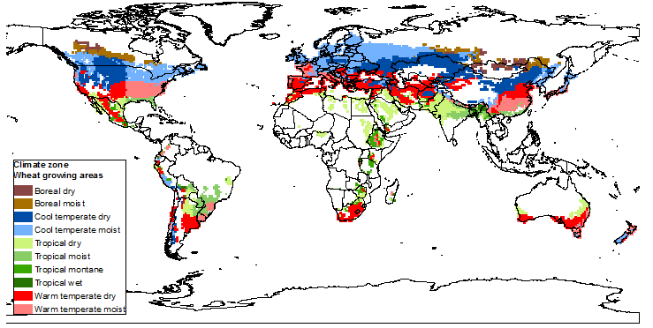
(3) Timing of window for metric
3 month windows for crops
6 and 12 month windows for crops and trees
Discussion: this part is acceptable and reasonable

Slide 6
(4) Data availability
We will work with agreed TOAR process for dealing with gaps in data
Such gaps are especially important for cumulative indices like AOT40 and W126
Example rural site at Arconate near Milan, Italy
Weeks 6-8 have missing data out of the 13 week period
Metric | Complete data | 2 weeks missing | % change
AOT40 | 19.3 ppm h | 17.6 ppm h | 8.7% decrease
W126 | 28.4 ppm h | 26.2 ppm h | 7.8 % decrease
M12 | 56.1 ppb | 57.9 ppb | 3.2% increase
Discussion: For AOT40 and W126, when data capture across time period is below 100% (but above 75%), metric will be scaled to 100% to account for the missing data.

Slide 7
(5) Measurement height
For vegetation, this is an important consideration.
The ozone concentration decreases with height and will need modifying for vegetation height, standardised as 20m for trees and 1m for crops.
LRTAP Convention methods exist, including a tabulated gradient and use of neutral stability profiles
Discussion: we use the TOAR database directly.
For some sites, we will compare how much difference between TOAR database and adjusted dataset (-3 ppb or 5ppb)
Data from Jürgen Bender, Germany

Slide 8
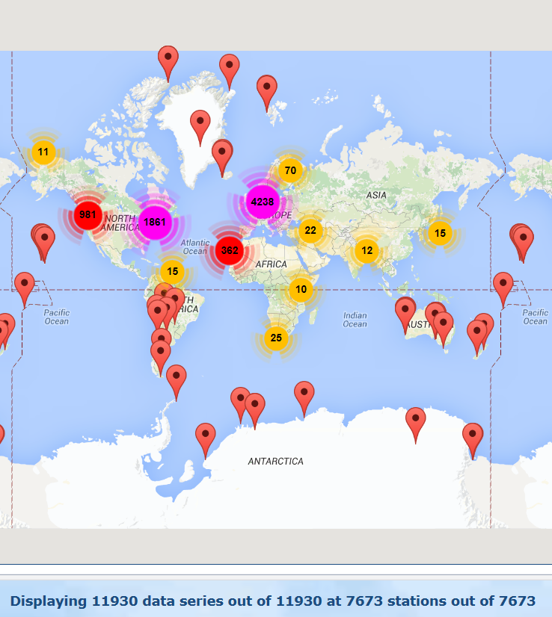
(6) Consideration of disproportionate representation of data
Need to also decide on which sites to select for each region for trends analysis
This will be decided during the database workshop at the last week of April
TOAR datasers

Slide 9
Figures to be made for chapter
Global distribution in wheat, rice and tree growing areas
We will show 2 figures. One is used for wheat and rice, the other is for tree growing areas.

Slide 10
Figures to be made for chapter
Present day ozone
Averaged metric (M12) in wheat, rice and tree growing areas
Accumulated indices (AOT40, W126) in wheat, rice and tree growing areas
Flux-based indices (PODy):
Include map with bar charts showing values at specific locations. Offers of sites wishing to contribute so far are fairly limited and are primarily from Europe.
We will show 9 figures or 10 figures.

Slide 11
Figures to be made for chapter
Trends in vegetation metrics (M12, AOT40, W126)
(1) Global long-term trends (>20 years)
Show vector plots for metrics on a global scale
(2) Regional short-term trends (~10 years)
Show vector plots for metrics on a regional scale
Notes:
Lomg –term trend, >15 years,
Shorte0tem, regional assessment, decrease the emissions of O3 precurs.

Slide 12
Figures to be made for chapter
Trends in vegetation metrics
(2) Trends in seasonal variation and relevance to plant growth cycles
E.g. show that spring peak is now earlier in Europe and USA and discuss implications
Might show monthly value in SI, but discuss in the text.
Discuss need for all year round metrics in some biogeographic zones, and include these for tropical/sub-tropical regions?
Only limit to tropical/sub-tropical regions

