Slide 1


Breakout session – Chapter 6
Present day ozone distribution and trends relevant to climate change
A. Gaudel, O. R. Cooper, G. Ancellet, J. Cuesta, G. Dufour, F. Ebojie, G. Huang, S. S. Kulawik, B. Latter, T. Leblanc, J. Liu, X. Liu, J. Neu, H. Petetin, I. Petropavlovskikh, H. Tanimoto, D. Tarasick, V. Thouret, C. Wespes, H. Worden, C. Vigouroux, J. Ziemke
TOAR Workshop 1.03, Beijing, January 25th 2016

Slide 2
Chapter 6: Present day ozone distribution and trends relevant to climate change
Section 1 – Introduction
  1.1 Present day distribution and trends of ozone metrics relevant to climate
  1.2 Description of the relevant metrics
Section 2 – Description of data sets
  2.1 Satellite
  2.2 FTIR and Umkehr
  2.3 IAGOS, Ozonesondes, TOST, lidar
  2.4 Regionally representative surface sites
Section 3 – Present day distribution of ozone
  3.1 Surface sites
  3.2 Free tropospheric mixing ratios
  3.3 Tropospheric columns
Section 4 – Trends
  4.1 Surface sites
  4.2 Free tropospheric mixing ratios
  4.3 Tropospheric columns
Section 5 – Discussions and Conclusions

Slide 3
Points that have been discussed
Climate change / rural surface sites: change the title of the chapter
Tropopause height definition for TOC: WMO definition, PV
Consistency or non consistency between data sets especially satellites
Various time-periods of time series
Summary figures

Slide 4
Points that have been discussed
Climate change / rural surface sites: change the title of the chapter
Present day distribution and trends of tropospheric ozone relevant to climate and global model evaluation

Slide 5
Points that have been discussed
Climate change / rural surface sites: change the title of the chapter
Present day distribution and trends of tropospheric ozone relevant to climate and global model evaluation
Rural/remote sites
To add Cape Point and Cape Grim, others?
Criteria: NOx emission, night time lights, population density
Give the spatial representativeness: needed for modelers (Table)
Metrics: Monthly mean, 5th and 95th percentiles
Rural/remote sites at surface separated from Mountain sites

Slide 6
Points that have been discussed
Climate change / rural surface sites: change the title of the chapter
Tropopause height definition for TOC: WMO definition, PV

Slide 7
Points that have been discussed
Climate change / rural surface sites: change the title of the chapter
Tropopause height definition for TOC: WMO definition, PV
Consistency or non consistency between data sets especially satellites

Slide 8
Points that have been discussed
Climate change / rural surface sites: change the title of the chapter
Tropopause height definition for TOC: WMO definition, PV
Consistency or non consistency between data sets especially satellites
  Make sure it is not instrument artefact

Slide 9
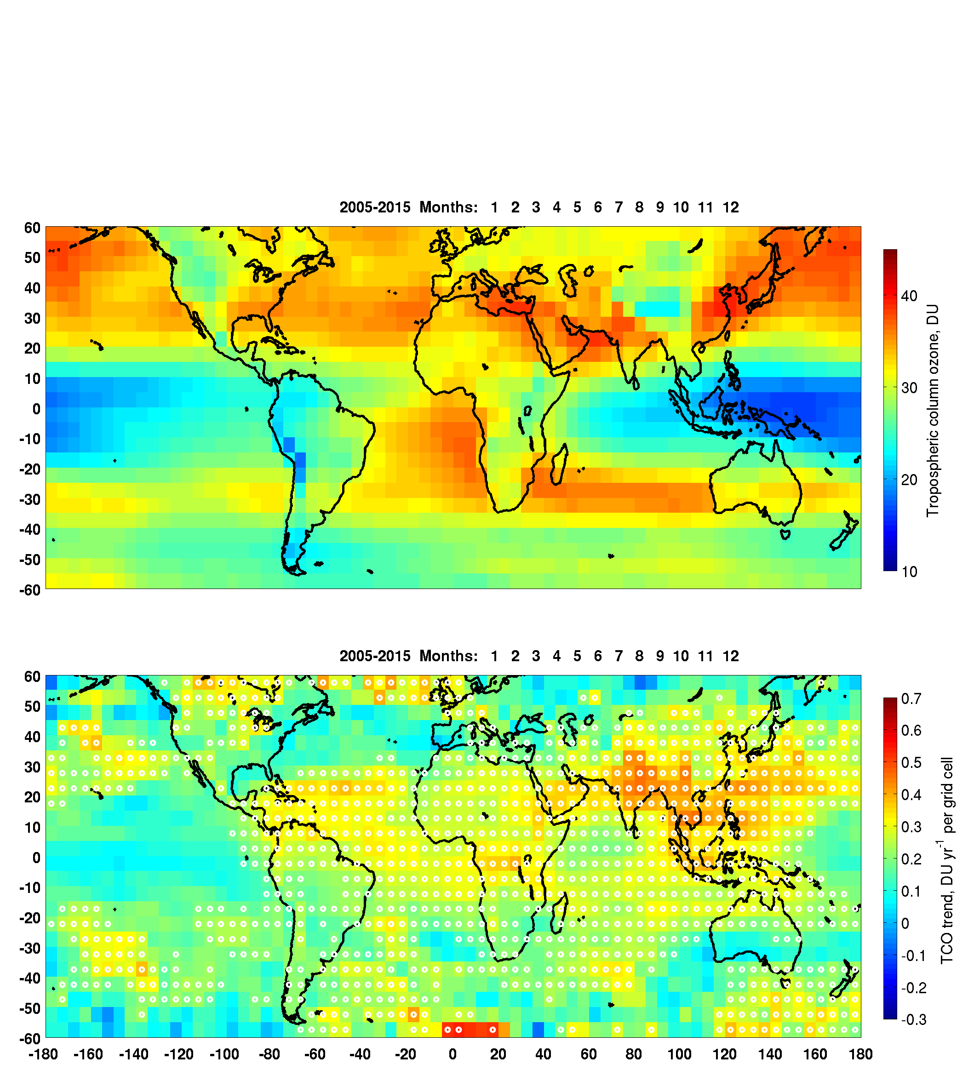
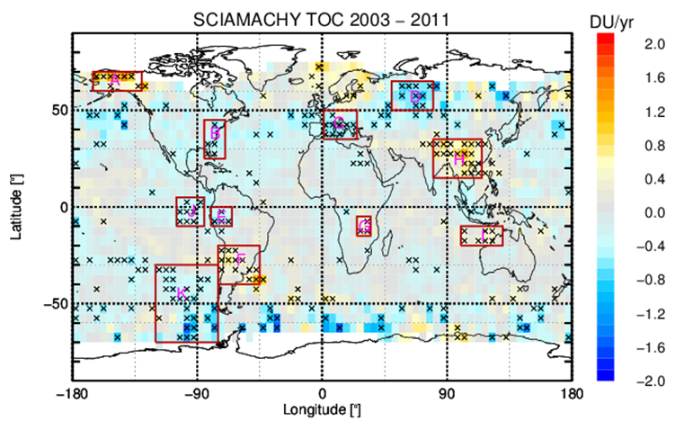
OMI/MLS

Slide 10
Points that have been discussed
Climate change / rural surface sites: change the title of the chapter
Tropopause height definition for TOC: WMO definition, PV
Consistency or non consistency between data sets especially satellites
Various time-periods of time series
  Table
  Common time-period
  > 20yrs: trends
  10yrs: changes

Slide 11
Points that have been discussed
Climate change / rural surface sites: change the title of the chapter
Tropopause height definition for TOC: WMO definition, PV
Consistency or non consistency between data sets especially satellites
Various time-periods of time series
Summary figures

Slide 12
Points that have been discussed
Climate change / rural surface sites: change the title of the chapter
Tropopause height definition for TOC: WMO definition, PV
Consistency or non consistency between data sets especially satellites
Various time-periods of time series
Summary figures
  Description of data sets
  Trends

Slide 13
Vertical
Averaging
Color to indicate
#samples/month?
tropopause
sondes
Aura/OMI-MLS
(gridded product)
10
IAGOS
ENVISAT/SCIAMACHY
(gridded product)
Altitude (km)
MetOP-A/IASI
MetOP-B/IASI
FTIR
Aura/TES
IASI/GOME
1
2000 2005 2010 2015
Year
Notes:
Vertical range and time availability of tropospheric ozone data products

Slide 14
Trends

Slide 15
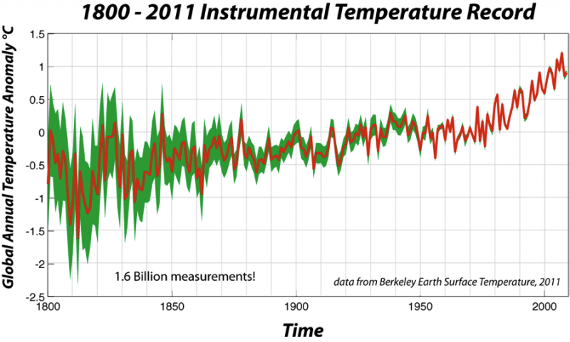
Trends

