Slide 1
Tropospheric ozone in global models
TOAR Chapter 7
P. J. Young, V. Naik, J. Brandt, R. Doherty, A. M. Fiore, A Gaudel, C. Geels, M. I. Hegglin, L. Hu, U. Im, R. Kumar, M. Lin, A. Luhar, L. Murray, J. Neu, D. D. Parrish, D. Plummer, H. E. Rieder, J. Rodriguez, J. L. Schnell, M. Schultz, S. Tilmes, O. Wild, M. Woodhouse, G. Zeng, L. Zhang, J. Ziemke
TOAR Beijing Workshop, Jan 2016

Slide 2
Chapter structure
Introduction
History and description of global models and assessments
Methods of evaluating model performance
Present day ozone distribution (climatology)
Extreme ozone pollution episodes
Sub-decadal scale ozone variability
Long term ozone changes
Drivers of model biases
Summary and conclusions

Slide 3
Chapter structure leads
Naik and Young
Introduction
History and description of global models and assessments
Methods of evaluating model performance
Present day ozone distribution (climatology)
Extreme ozone pollution episodes
Sub-decadal scale ozone variability
Long term ozone changes
Drivers of model biases
Summary and conclusions
Young
Young (with others)
Naik
Fiore, Schnell and Reider
Neu and Lin
Parrish
Wild?? Young and Naik
Naik and Young

Slide 4
New figures
Surf O3: ACCMIP bias plus correlation (currently Sofen data)
Free trop: Frankfurt vertical distribution
Free trop/col: IAV plot (maybe)
Additional comparison: ongoing discussion with chapter 6

Slide 5
Discussion
General points around representativeness/suitability of comparisons
General tightening required
Drastic shortening of section 4
Refocusing of sections 6 and 7
Thinking about where STE fits (“events” vs variability)

Slide 6
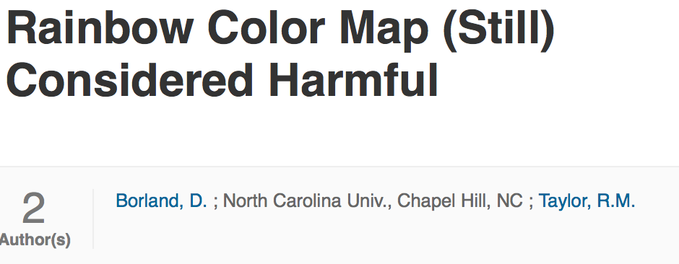
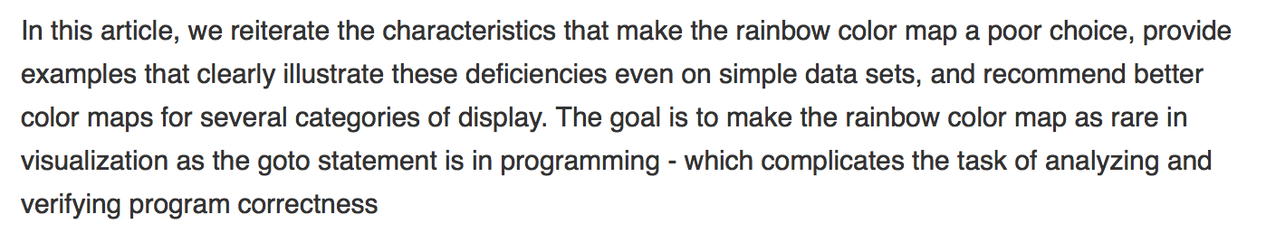

#endtheRainbow
See also

