Slide 1
Evaluating Emissions Using Satellite Observations
Gregory Frost*, Si-Wan Kim*, Stuart McKeen*, Eirh Yu Hsie*, Claire Granier*†, & Michael Trainer
Chemical Sciences Division, NOAA Earth System Research Laboratory, Boulder, Colorado, USA
*also at Cooperative Institute for Research in Environmental Sciences, University of Colorado, Boulder, CO
†also at Université Pierre et Marie Curie and LATMOS-CNRS, Paris, France
Andreas Heckel, Andreas Hilboll, Andreas Richter, & John Burrows
Institute of Environmental Physics & Institute of Remote Sensing, University of Bremen, Germany
James Gleason
NASA Goddard Space Flight Center, Greenbelt, Maryland, USA
OUTLINE
Many research groups have done emissions evaluation and estimations using satellites
Global, regional, and individual sources
Fossil fuel combustion, biogenic emissions, fires, soils and agriculture, …
NO_{x}, SO₂, HCHO, (CHO)₂, CO, CH₄, CO₂,…
Our approach: Top-down assessment of sector-wide NO_{x} emissions using atmospheric NO₂ columns retrieved from satellites and calculated by a regional chemical-transport model
2 examples applying this approach:
NO_{x} emission controls at Eastern US power plants (S.-W. Kim et al., GRL., 2006)
NO_{x} emissions from Western US power plants & urban areas (S.-W. Kim et al., JGR, 2009)
Coordinated US Initiative on Emissions Research
First Workshop, 4 December 2009, NOAA DSRC, Boulder, CO

Slide 2
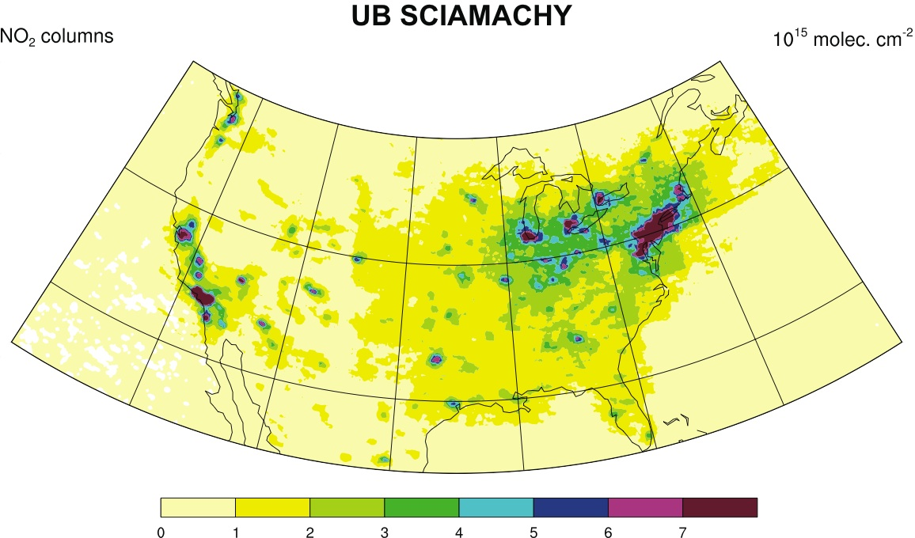
Top-Down Emissions Assessment by Satellites
NO_{x} emissions ∝ NO₂ columns (summer day ⇒ short NO_{x} lifetime)
Satellite-observations of NO₂ columns in combination with chemical-transport models
Understand and improve NO_{x} emissions (Martin et al., 2003; Beirle et al., 2003; Richter et al., 2005; van der A, 2006; Kim et al., 2006 & 2009; … )
Uncertainties in satellite retrieval and modeling (Boersma et al., 2004; Kim et al. 2009)
US power plant measure their NO_{x} emissions in-stack (CEMS)
More accurate modeled NO₂ columns
Evaluate & calibrate satellite NO₂ columns over power plants with regional model
Satellite-retrieved NO₂ columns used to evaluate inventories for other NO_{x} sources

Slide 3
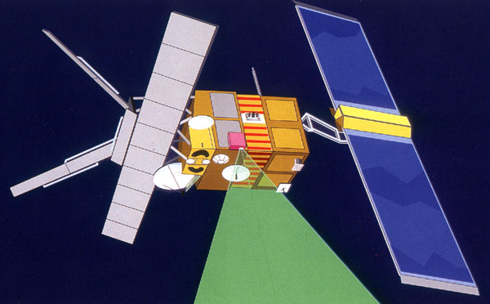
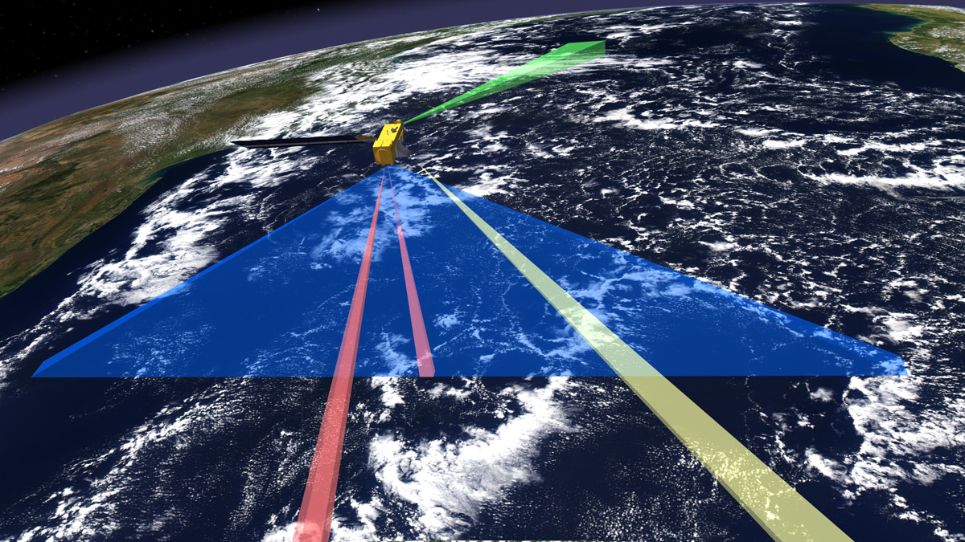
Satellite NO₂ Column Retrievals
Satellite Instrument | Period | Overpass time | Global coverage | Pixel size
GOME (ERS-2) | 1995/4-2003/6 | 10:30 LT | 3 days | 340 x 40 km²
SCIAMACHY (ENVISAT) | 2002/3-present | 10:00 LT | 6 days | 60 x 30 km²
OMI (AURA) | 2004/7-present | 13:30 LT | 1 day | 27 x 13 km² (nominal)
GOME-2 (METOP) | 2007/3-present | 09:30 LT | 1.5 days | 80 x 40 km²
NO₂ Column Retrieval Process
Spectral fittings to get NO₂ slant column (S)
Subtraction of stratospheric NO₂ column
Calculation and application of air mass factor (AMF) to get NO₂ vertical column (V) ➔ V = S / AMF
AMF calculation:
A priori NO₂ profile: chemical-transport models
A priori aerosol profile
Aerosol optical depth
Terrain height
Surface albedo
Temperature & Pressure
Radiative transfer equation: LOWTRAN, etc

Slide 4
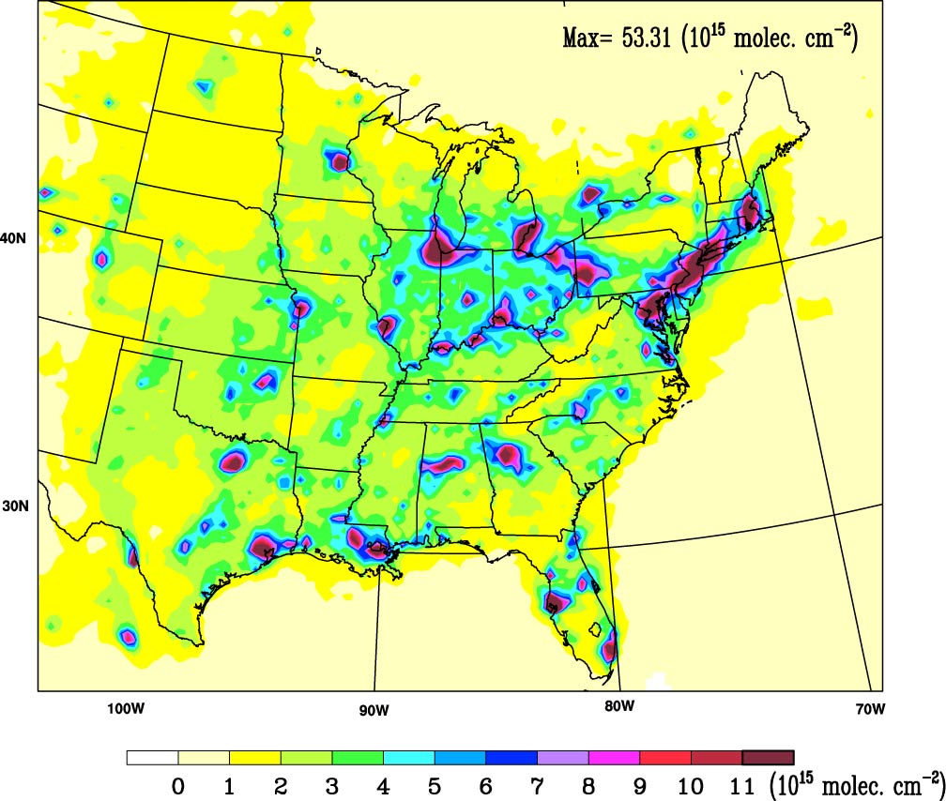
WRF-Chem Modeling of NO₂ Vertical Columns
Weather Research and Forecasting - Chemistry model
www.wrf-model.org/WG11
Simulates atmospheric chemistry online within WRF meteorological model
Can choose between various modules for gas and aerosol chemistry, planetary boundary layer dynamics, aerosol and cloud microphysics, radiation, and convection
Setup for these case studies
Eastern US
Summer 2004 simulation period
27 x 27 km² horizontal resolution
Western US
Summer 2005 simulation period
15 x 15 km² horizontal resolution
Emissions
EPA NEI1999 and NEI2005
CEMS power plant emissions
NOAA ESRL High Performance Computing System
WRF-Chem Summer 2004 Average NO₂ Vertical Columns

Slide 5
NO_{x} Controls at Eastern US Power Plants
Effects of NO_{x} controls on large point sources in the Eastern US beginning in the late 1990s
National and regional pollution control programs
Focus on coal-burning power plants
Improved burner technology, post-burner scrubbers
Continuous Emission Monitoring Systems (CEMS)
Stack measurements of hourly NO_{x}, SO₂, and CO₂ emissions made by utility companies
Data for 966 facilities in 1999 and 1427 facilities in 2004
CEMS data show:
Substantial NO_{x} emission reductions since late 1990’s
Amount of electric power generated has increased
∆(US) = -36%
∆(Ohio River) = -45%
EPA Clean Air Markets Division Emissions Query Wizard
http://camddataandmaps.epa.gov/gdm/index.cfm?fuseaction=emissions.wizard

Slide 6
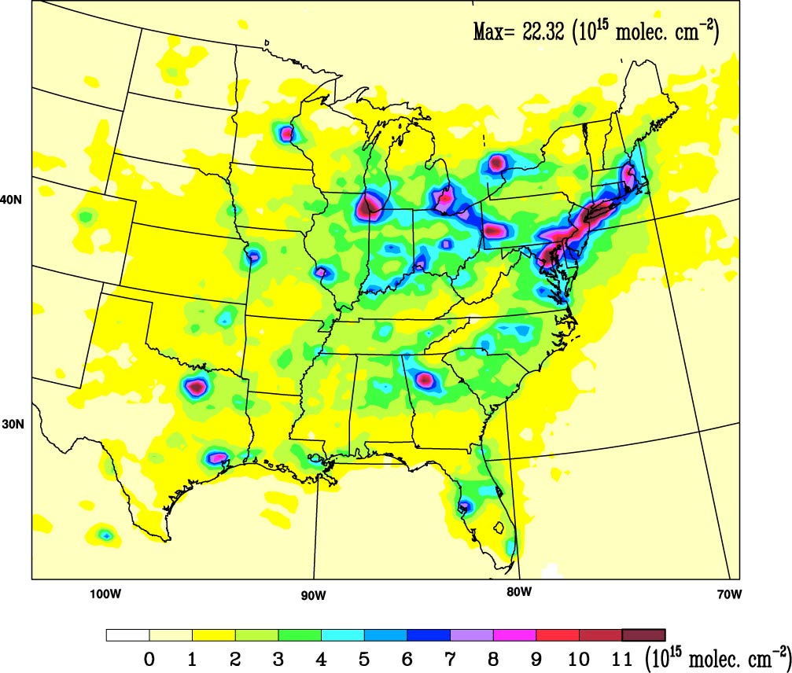
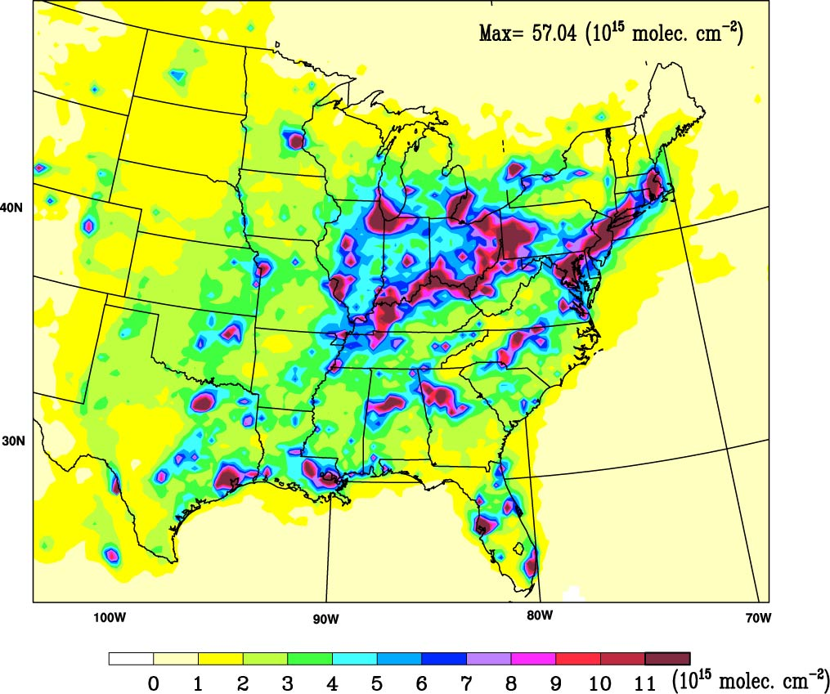
Eastern US Power Plant NO_{x} Controls Detected by Satellite
Summer 2004 Average NO₂ Vertical Columns
SCIAMACHY
WRF-Chem, Reference Emissions (NEI 99)
Northeast Urban Corridor
Ohio River Valley
Model reproduces satellite NO₂ vertical columns over urban areas
Model NO₂ columns too large over power plants using 1999 emissions
S.-W. Kim et al., Geophys. Res. Lett., 2006

Slide 7
Eastern US Power Plant NO_{x} Controls Detected by Satellite
Summer 2004 Average NO₂ Vertical Columns
SCIAMACHY
WRF-Chem, Updated Power Plant Emissions
Power plants = CEMS 2004 monthly averages
All other sources = NEI 1999
Model with summer 2004 power plant emissions agrees much better with satellite NO₂ columns over power plants
Satellite detects changes in Ohio River Valley from recent power plant NO_{x} emission controls
S.-W. Kim et al., Geophys. Res. Lett., 2006

Slide 8
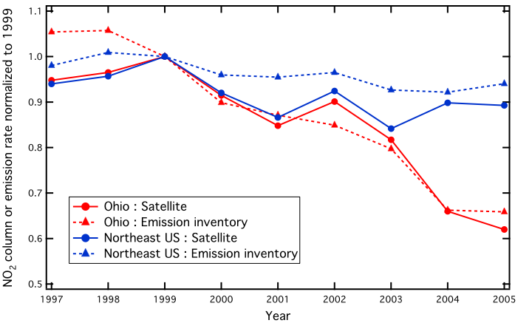
Trends in Eastern US Satellite NO₂ and NO_{x} Emissions
Northeast Urban Corridor
1997 - 2005
E(NO_{x}) < 20% power plant
Ohio River Valley 1997
E(NO_{x}) ~ 50% power plant
Ohio River Valley 2005
E(NO_{x}) ~ 20% power plant
Similar trends in satellite NO₂ columns and NO_{x} emissions
Power plant NO_{x} controls have decreased NO₂ columns
Mobile NO_{x} emission changes smaller than those from power plants
S.-W. Kim et al., Geophys. Res. Lett., 2006

Slide 9
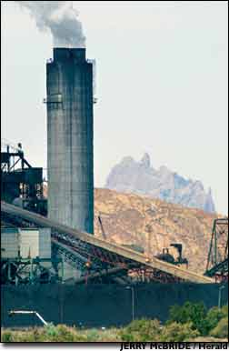
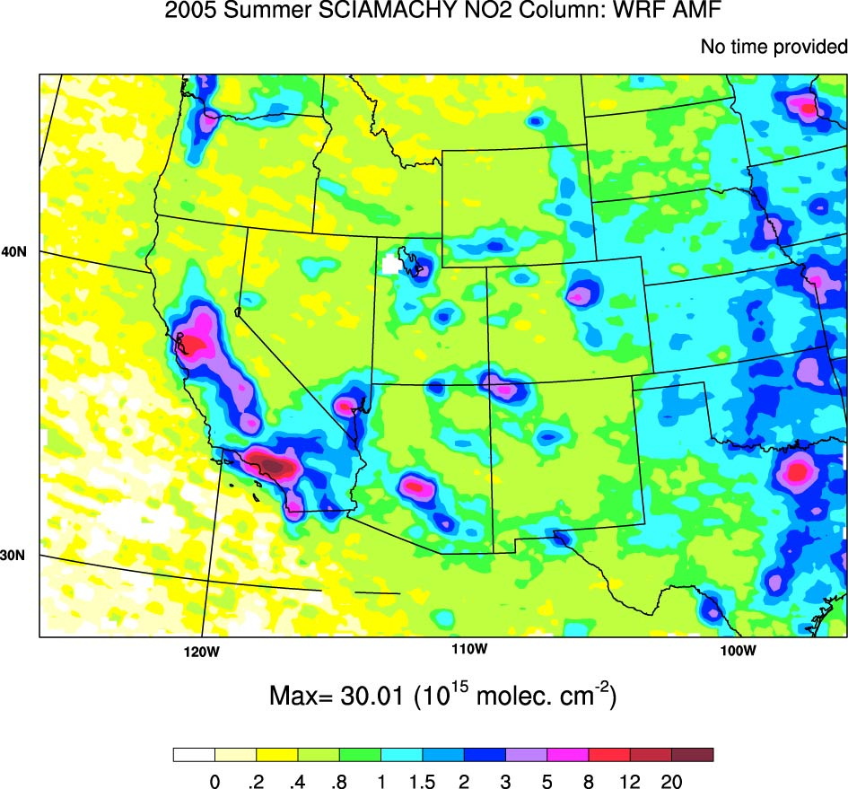
NO_{x} Emissions from Western US Power Plants
Isolated plants have discrete signatures in satellite retrievals
Power plant emissions are measured continuously at each stack
Currently no NO_{x} pollution controls on large coal-burning plants in the West
“Calibration” for satellite-model comparison
North Valmy
Colstrip
Dave Johnston/
Laramie River
Intermountain
Hunter /
Huntington
Jim Bridger/
Naughton
Reid Gardener
Craig/Hayden
Bonanza
Mohave
Navajo
Four Corners/
San Juan
Cholla/Coronado/ Springerville
SCIAMACHY, Summer 2005
S.-W. Kim et al., J. Geophys. Res., 2009

Slide 10
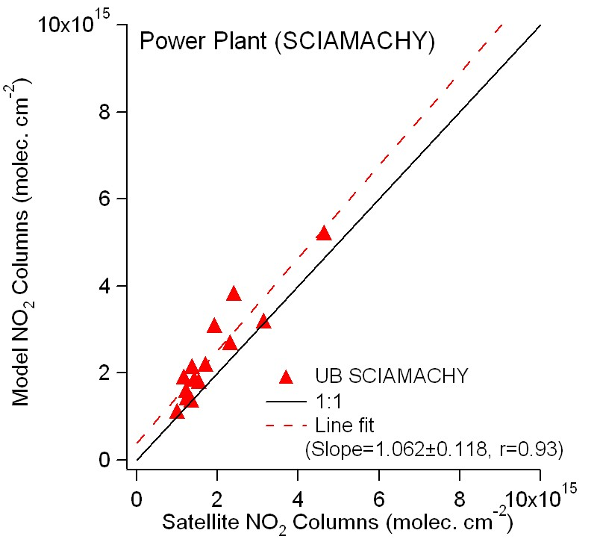
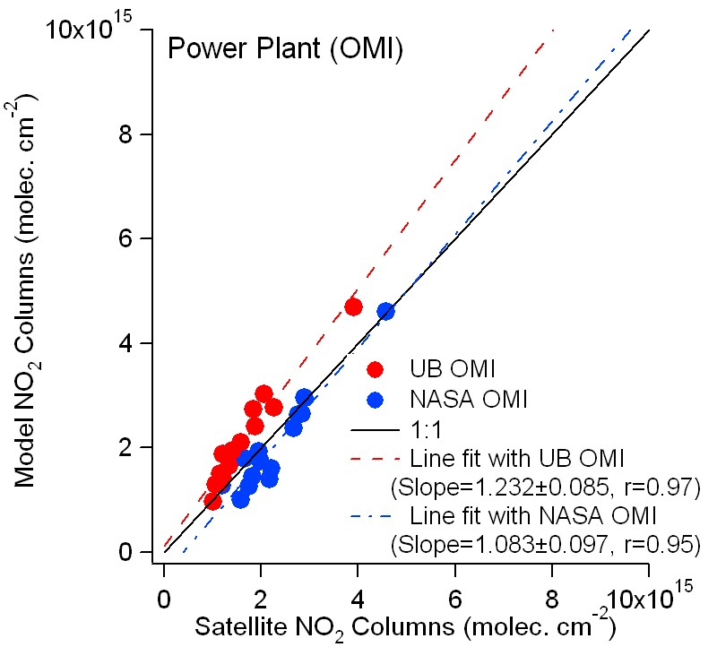
Satellite - Model NO₂ Column Comparison: Power Plants
Model uses observed emissions (CEMS) for power plants
Satellite and model NO₂ columns nearly equal over Western US power plants
Optimize satellite column retrievals and model parameterizations
Model enables comparison of different satellite retrieval approaches
Consistency for different retrievals: confidence in conclusions about emissions
S.-W. Kim et al., J. Geophys. Res., 2009

Slide 11
NO_{x} Emissions from Western US Urban Areas
Build on satellite-model comparisons for power plants
Evaluate urban area emission inventories and monitor changes
Denver
Boise
Salt Lake City
Reno
Sacramento
San Francisco
Albuquerque / Santa Fe
Fresno
Bakersfield
Los Angeles
Las Vegas
Phoenix
El Paso
Tucson
SCIAMACHY, Summer 2005
S.-W. Kim et al., J. Geophys. Res., 2009

Slide 12
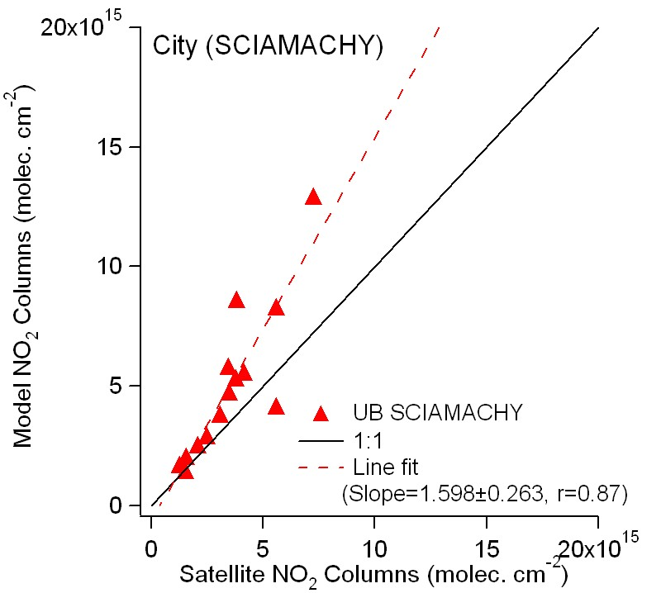
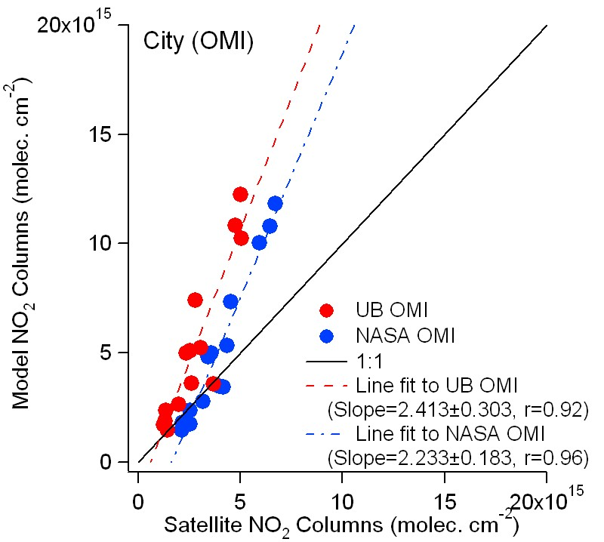
Satellite - Model NO₂ Column Comparison: Urban Areas
Note: weekend days are omitted in this analysis
Large satellite - model NO₂ column differences over many Western US cities
Urban emissions not well represented by 1999 inventory
Urban model NO₂ columns higher than satellite retrievals
Trends in NO_{x} emissions since 1999?
S.-W. Kim et al., J. Geophys. Res., 2009

Slide 13
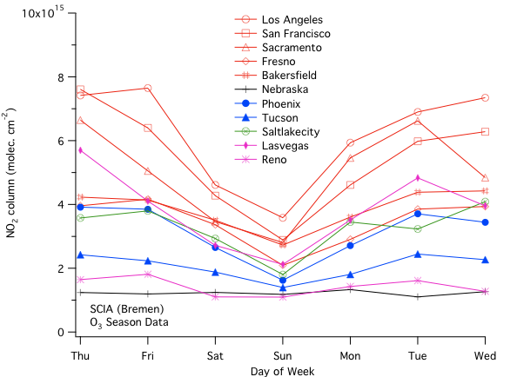
Day-of-Week Trends in Urban Satellite NO₂ Columns
Satellites show weekend decline in urban NO₂ columns
Reduced traffic, particularly heavy-duty diesel vehicles
Lower mobile source NO_{x} emissions on weekends
Consistent with roadside monitoring
Model did not include day-of-week variations in NO_{x} emissions
Day of week changes in satellite NO₂ columns first reported by:
S. Beirle et al. (2003), Weekly cycle of NO₂ by GOME measurements: a signature of anthropogenic sources, Atmos. Chem. Phys., 3, 2225-2232
S.-W. Kim et al., J. Geophys. Res., 2009

Slide 14
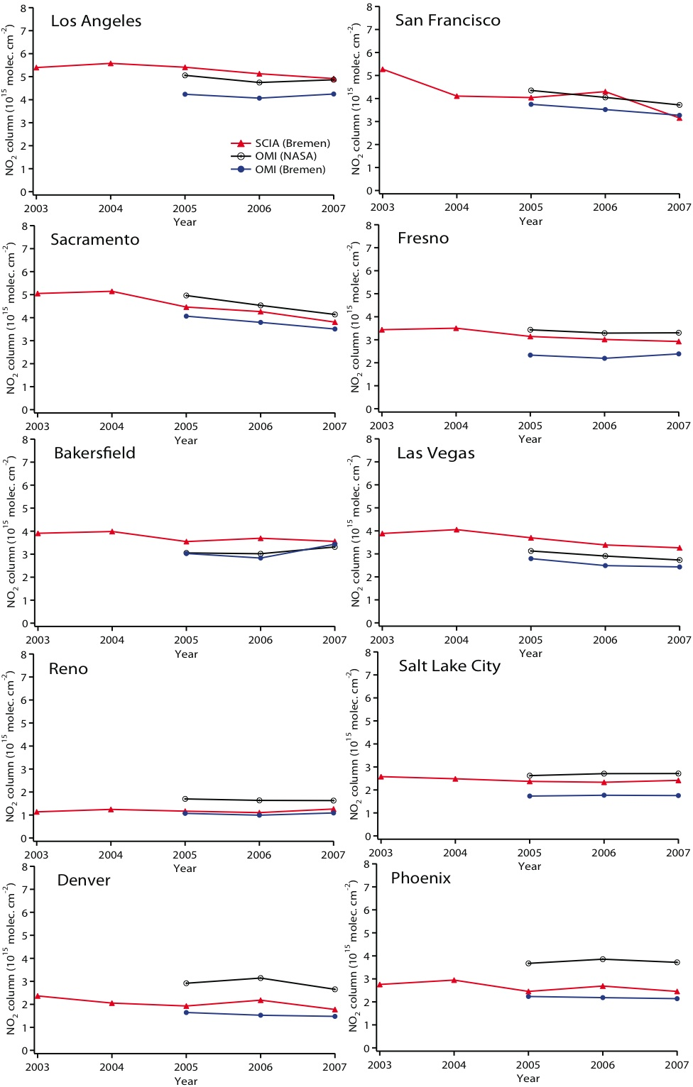
Year-to-Year Trends in Urban Satellite NO₂ Columns
Left axis: NO₂ columns averaged over box
Year-to-year declines in satellite NO₂ columns in many Western US cities
Coincide with NO_{x} declines seen by roadside monitoring (Ban-Weiss et al., 2008; Bishop and Stedman, 2008).
Effect of cleaner engines, especially light-duty gasoline vehicles
Declining trends in aerosols are not included in retrievals
Declines in satellite NO₂ column might be underestimated
-8.13%/yr (SCIA)
-6.38%/yr (UB OMI)
-7.23%/yr (NASA OMI)
-2.53%/yr
(SCIA)
-6.46%/yr (SCIA)
-6.86%/yr (UB OMI)
-8.31%/yr (NASA OMI)
-4.32%/yr (SCIA)
-4.73%/yr (SCIA)
-6.57%/yr (UB OMI)
-6.35%/yr (NASA OMI)
-2.54%/yr (SCIA)
S.-W. Kim et al., J. Geophys. Res., 2009

Slide 15
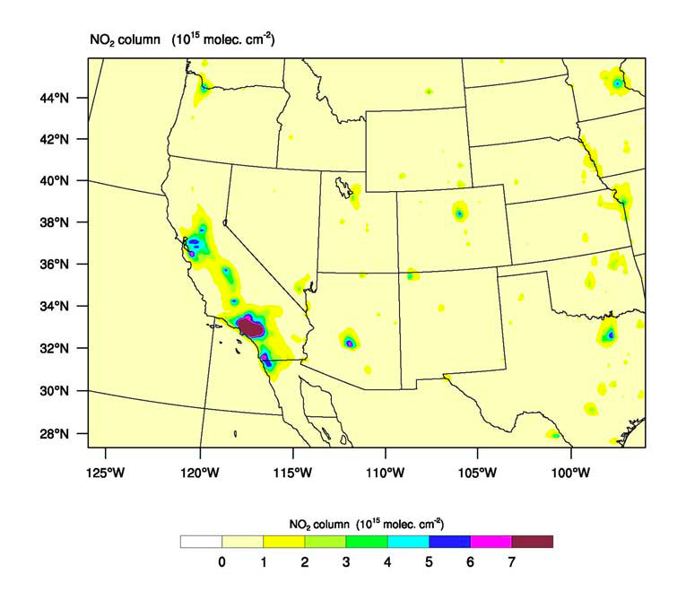
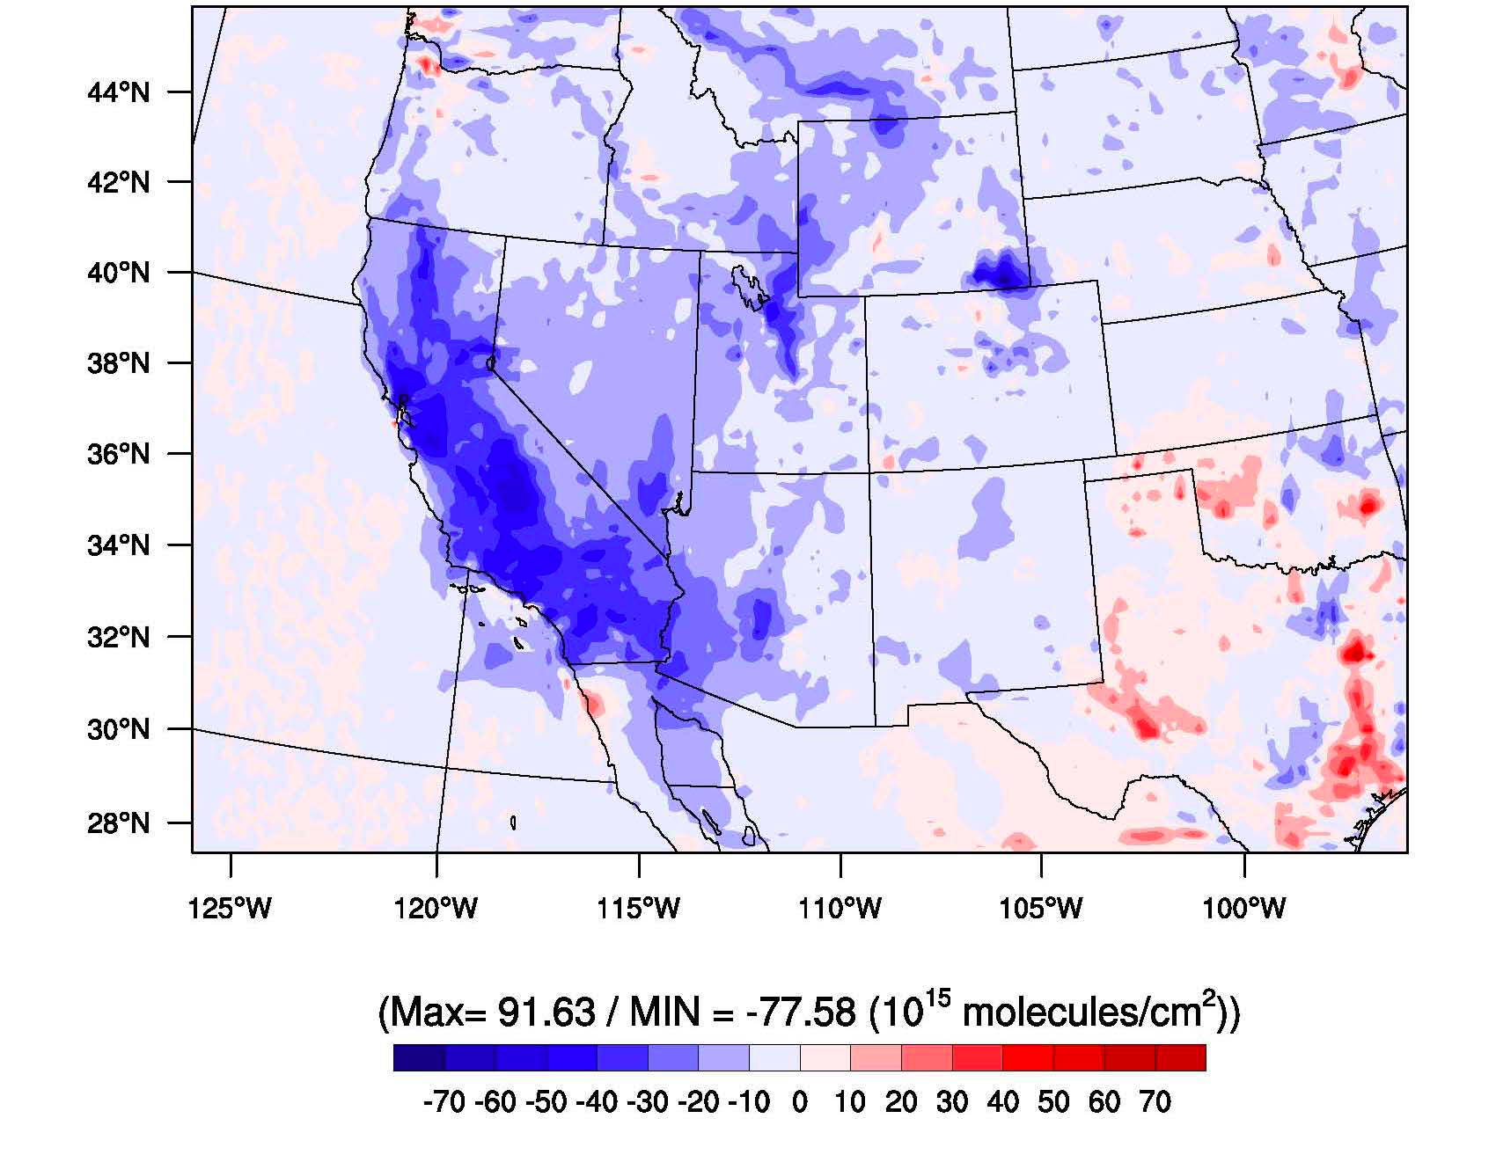
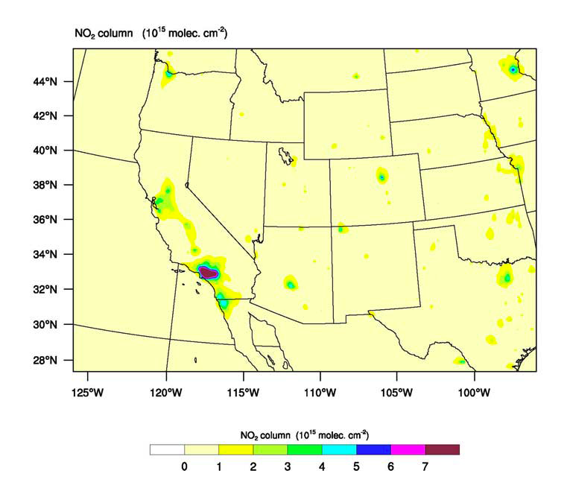
Improved Modeled NO₂ Columns with Updated Emissions
WRF-Chem:NEI99
Modeled NO2 Column Difference (%) = (NEI05 - NEI99) / NEI99
Max = 92 (%) / Min = -78(%)
WRF-Chem:NEI05

Slide 16
Conclusions
Combination of satellite instruments and regional model provides useful evaluation of NO_{x} emission inventories and trends
Satellites detect impact of NO_{x} pollution controls at Eastern US power plants
Large Western US power plant NO_{x} emissions help calibrate NO₂ columns
Satellites detect impact of changes in Western US urban NO_{x} emissions that are likely due to motor vehicles
Research Needs
Satellite retrievals
Impact of aerosols, temperature, land-use
Can satellites detect other types of NO_{x} sources?
NO₂ and aerosol vertical profiles/columns from surface and aircraft instruments
Modeling + other observations
Impact of NO_{x} changes on O₃ and PM
Interactions with inventory developers
Understand differences in top-down and bottom-up approaches
Understand differences between state and national inventories
Notes:
2010: Two more years of satellite data to evaluate trends in emissions
CalNex 2010: investigate possible reasons for discrepancies between model and satellite NO₂ columns over California urban areas
mobile and surface-based NO₂ observations could validate both model and satellite NO₂ columns (e.g. Stutz et al., Volkamer et al.)
tests of satellite retrievals over complex terrain: accurate NO₂ profiles, aerosol optical depth, and better characterization of ground albedo (e.g. Pilewski et al.)
closer look at day-of-week variations for several California cities with satellite and in-situ data (e.g. Harley et al.)
Agricultural NO_{x} emissions could be estimated from satellite data along with other measurement platforms (e.g. SJV ground site)
Use model to investigate impacts of NO_{x} emission changes on ozone
Satellite HCHO and CHOCHO retrievals: assess VOC emissions and constrain sources of SOA

