Slide 1
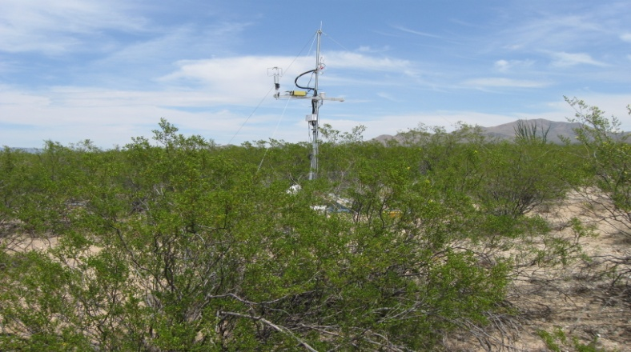
Biogenic VOC Emissions
Alex Guenther
NCAR, Boulder, CO
Chris Geron
USEPA, RTP, NC

Slide 2
What models/approaches are available?
MAG: MAGBEIS
LPJ: DGVM-Isoprene
NOAA: WRF-CHEM BVOC default
LADCO/ALPINE: BIOME3
TNRCC/ENVIRON/NCAR: GloBEIS
IFU: Europe BVOC
JRC: Europe BVOC IDL MEGAN
Harvard: GEOS-CHEM/MEGAN
LSCE: BVOCEM
CARB: BEIGIS
U. Helsinki: MALTE/MEGAN
EPA: BEIS, BEIS2, BEIS3, BEIS 3.14
NCAR: GEIA, MEGAN, MEGAN2.04, MEGAN2.1
The other models are either based on BEIS/MEGAN and/or are not suitable for regional modeling in the U.S.

Slide 3
BEIS and MEGAN are being developed and evaluated through an interagency agreement between USEPA and NSF/NCAR
Two decades: 1991 – 2010
~ $?M EPA internal funding
~ $4M NCAR/NSF internal funding
~ $2.5M IAG from EPA to NCAR
NCAR past focus:
Basic research to understand the processes controlling emissions
Evaluate estimates on canopy to regional scales
Development of model for research applications (GEIA, GloBEIS, MEGAN)
EPA past focus:
-Development of regional model for regulatory air quality modeling (BEIS)
-Development of landcover database
In the future we plan to have to have more integrated efforts (e.g. working together on model and landcover database development.

Slide 4
BEIS 3.14 and MEGAN 2.1 are based on similar observaions
So why do their emission estimates differ by a factor of 2?
BEIS 30% underestimate: BEIS 3.14 uses a light response curve that does not represent a canopy average response.
BEIS 25% underestimate: BEIS 3.14 does not account for the influence of the weather of the past several days. This would increase emissions by about 25% (in the southeastern U.S. in July)
BEIS 12% underestimate: BEIS 3.14 does not account for higher leaf mass in sun leaves
Together, these three changes result in BEIS estimates that agree with MEGAN 2.1 to within ~15%

Slide 5
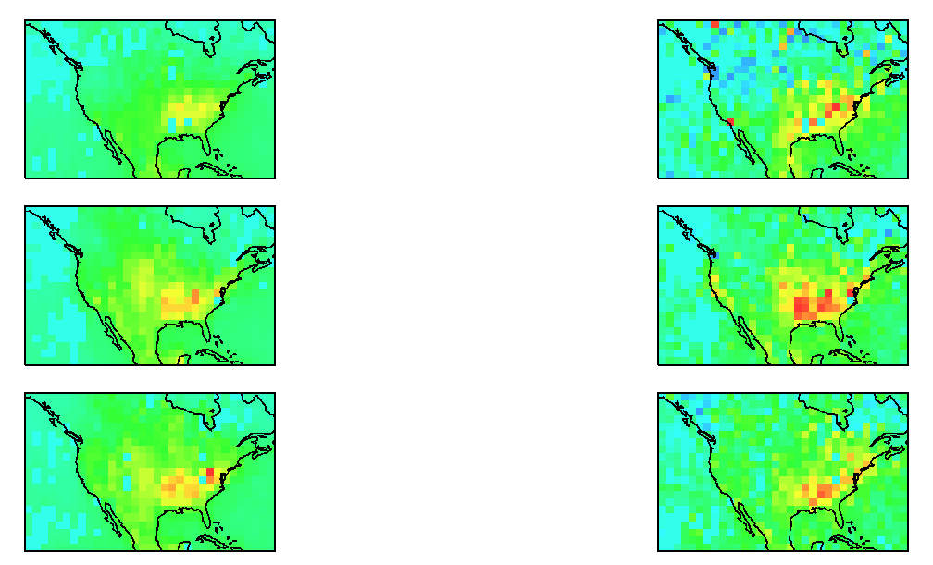
Bottom-up, Top-down and Direct approaches for characterizing biogenic VOC emissions
Direct measurements are needed to evaluate these model estimates
Bottom-up: Use enclosure measurements to provide emission factors/algorithms for forward model
Top-down approach: Start with ambient concentrations and use inverse model to account for chemistry and transport
Landcover mapping from space
BVOC Emission Estimates
HCHO mapping from space

Slide 6
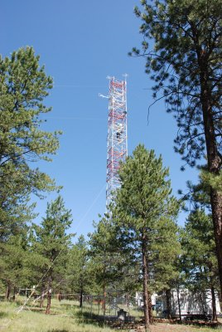
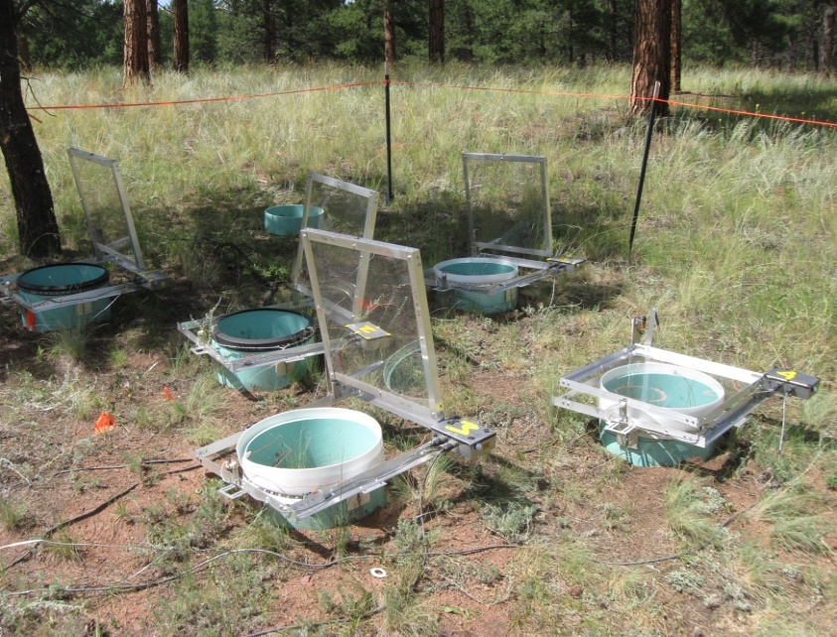
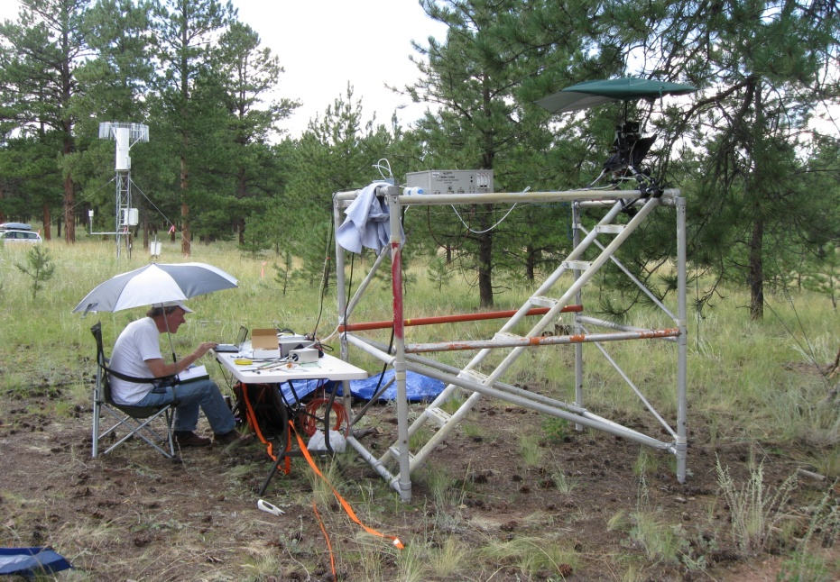
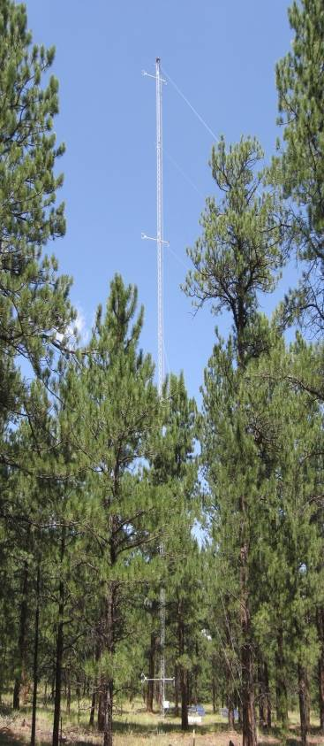
We need a few sites with comprehensive long-term measurements
Manitou Forest Observatory: Ponderosa pine woodland in the Colorado Rockies
Chemistry
28-m walk-up tower
Fluxes: VOC, NO/NOy, ozone, particles
Conc.: sulfuric acid, OH, OH reactivity, particle formation/ growth, CCN, aerosol composition, SO2, CO
enclosure CO2, H2O, VOC, NO flux
soil moisture and characteristics
Soil
branch/leaf enclosure CO2, H2O, VOC flux
sap flow, 3D canopy description
45-m walk-up tower with 5 flux levels with CO2, H2O, temperature, turbulence (8 more towers are proposed)
k-band radar
Micrometeorology
Vegetation
Notes:
6

Slide 7
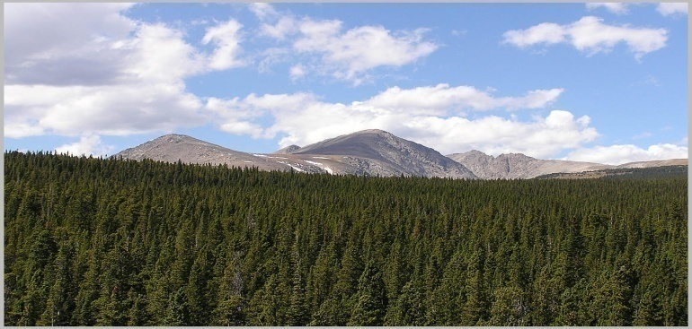
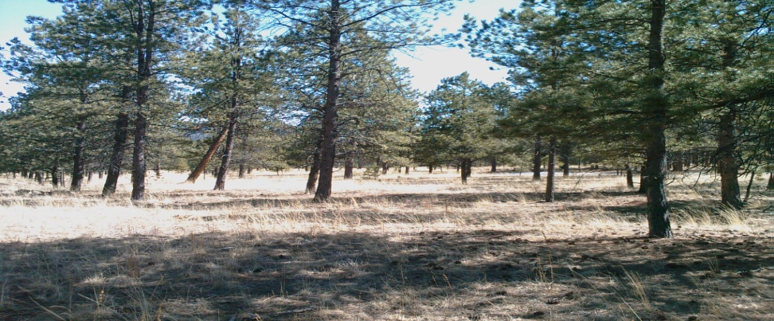
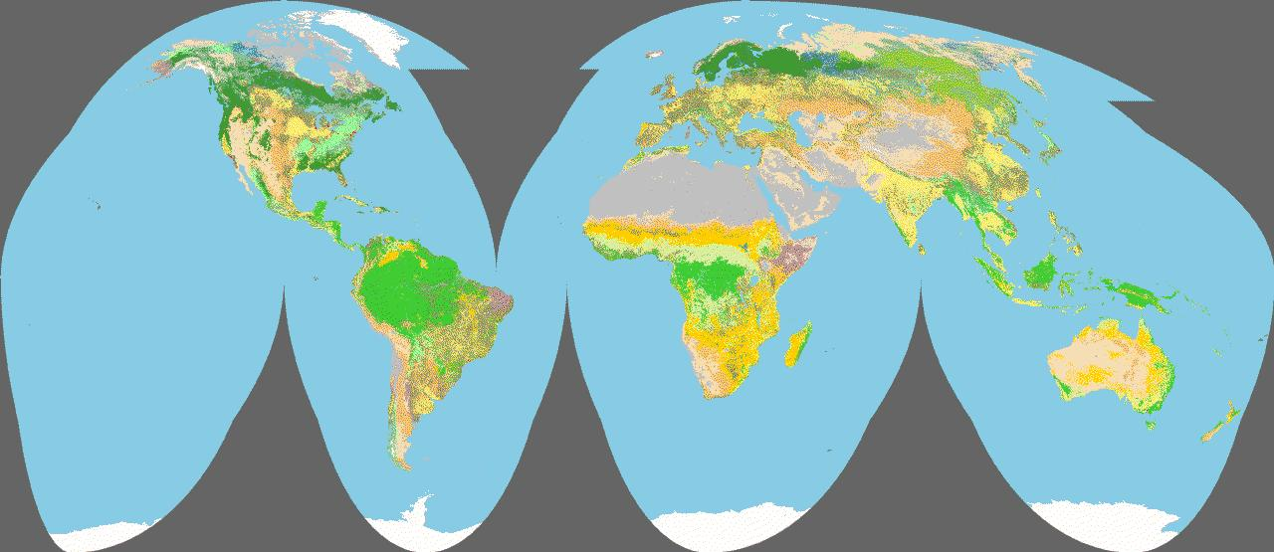
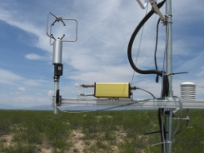
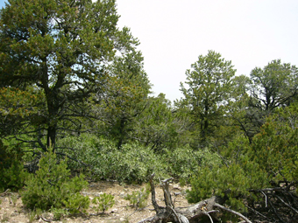
We need a larger number of sites with long-term BVOC fluxes
GLObal Biogenic Organic Emissions NETwork (GLOBOENET)
Manitou Forest Observatory, CO: MBO, pinenes
Niwot Ridge Colorado: MBO
Building on:
-existing flux tower networks
-development of reliable and inexpensive, low power Relaxed Eddy Accumulators
# of REA Sites
2007 (1) 2009 (5)
2010 (12)
2011??
New Mexico: α-pinene
French Guiana: isoprene
Arizona: aromatics, organic acids, alkanes

Slide 8

How many sites do we need?
Source Density: amount of vegetation foliage and other sources
Emission Factor: ability to emit- controlled by genetics
Emission Activity: deviations controlled by environment and phenology
This may be fairly consistent- at least within the major biomes. An REA network of ~20 sites may be sufficient
There is more variability here- with large differences among and within ecoregions. A complementary strategy is needed for this: airborne flux measurements

Slide 9
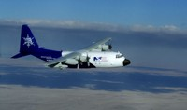
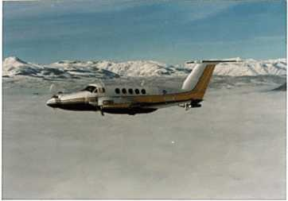
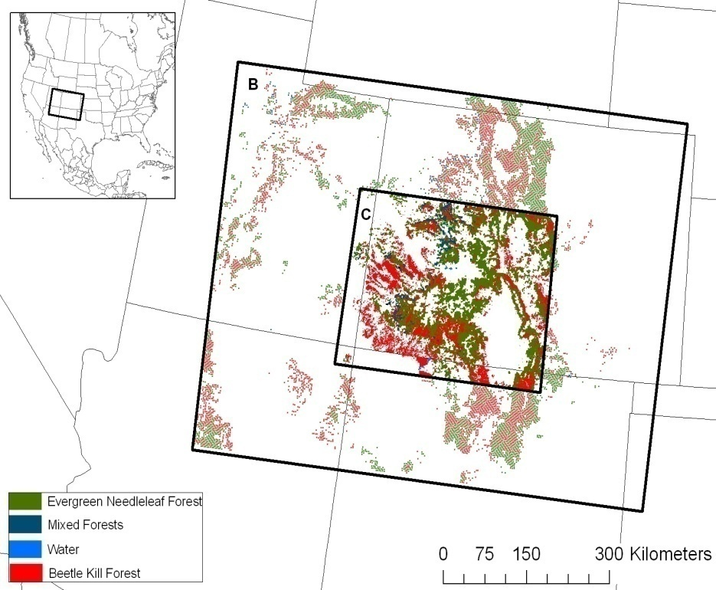

Regional airborne VOC emission measurements
using PTRMS eddy covariance
NCAR C130:
Completed technique Development
U. Wyoming King Air:
Colorado Pine Beetle outbreaks (campaign planned for 2011)
Demonstrated airborne organic flux capability (PTR/EC Karl et al. 2009)
CIRPAS Twin Otter:
California BVOC emissions inventory evaluation (campaign planned for 2011 )
PTRMS EC

Slide 10
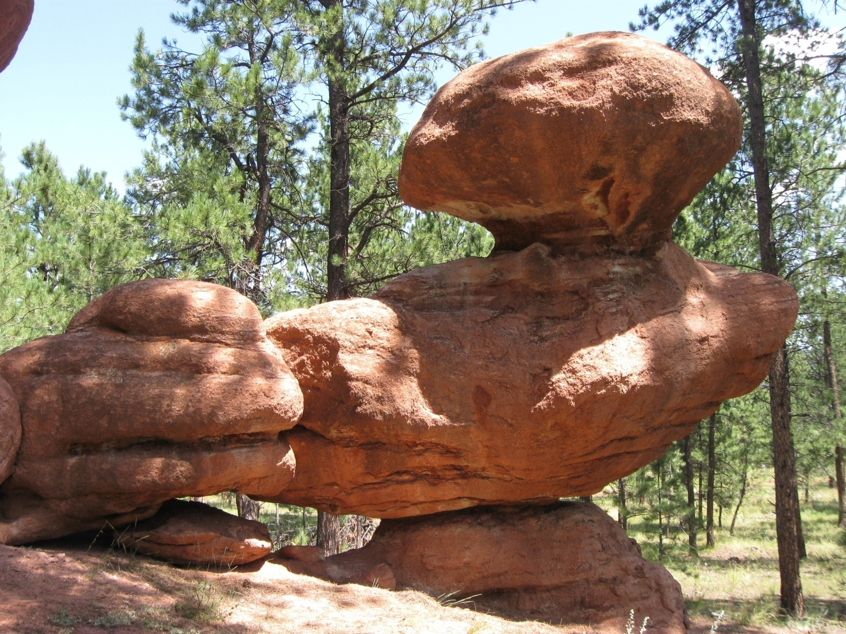
Summary
- EPA/NCAR collaboration produced widely used BVOC emission models
Closer integration of EPA/NCAR future efforts
Continuing process studies, emission factor, landcover database development
- Comprehensive observatories, flux tower REA network, and airborne flux campaigns will be used to evaluate and improve BVOC emission estimates.

