Slide 1
Coordinated US initiative on Emissions Research
A. R. Ravishankara, ESRL/CSD, NOAA
Welcome!
Thank you all for taking time to start this dialogue

Slide 2
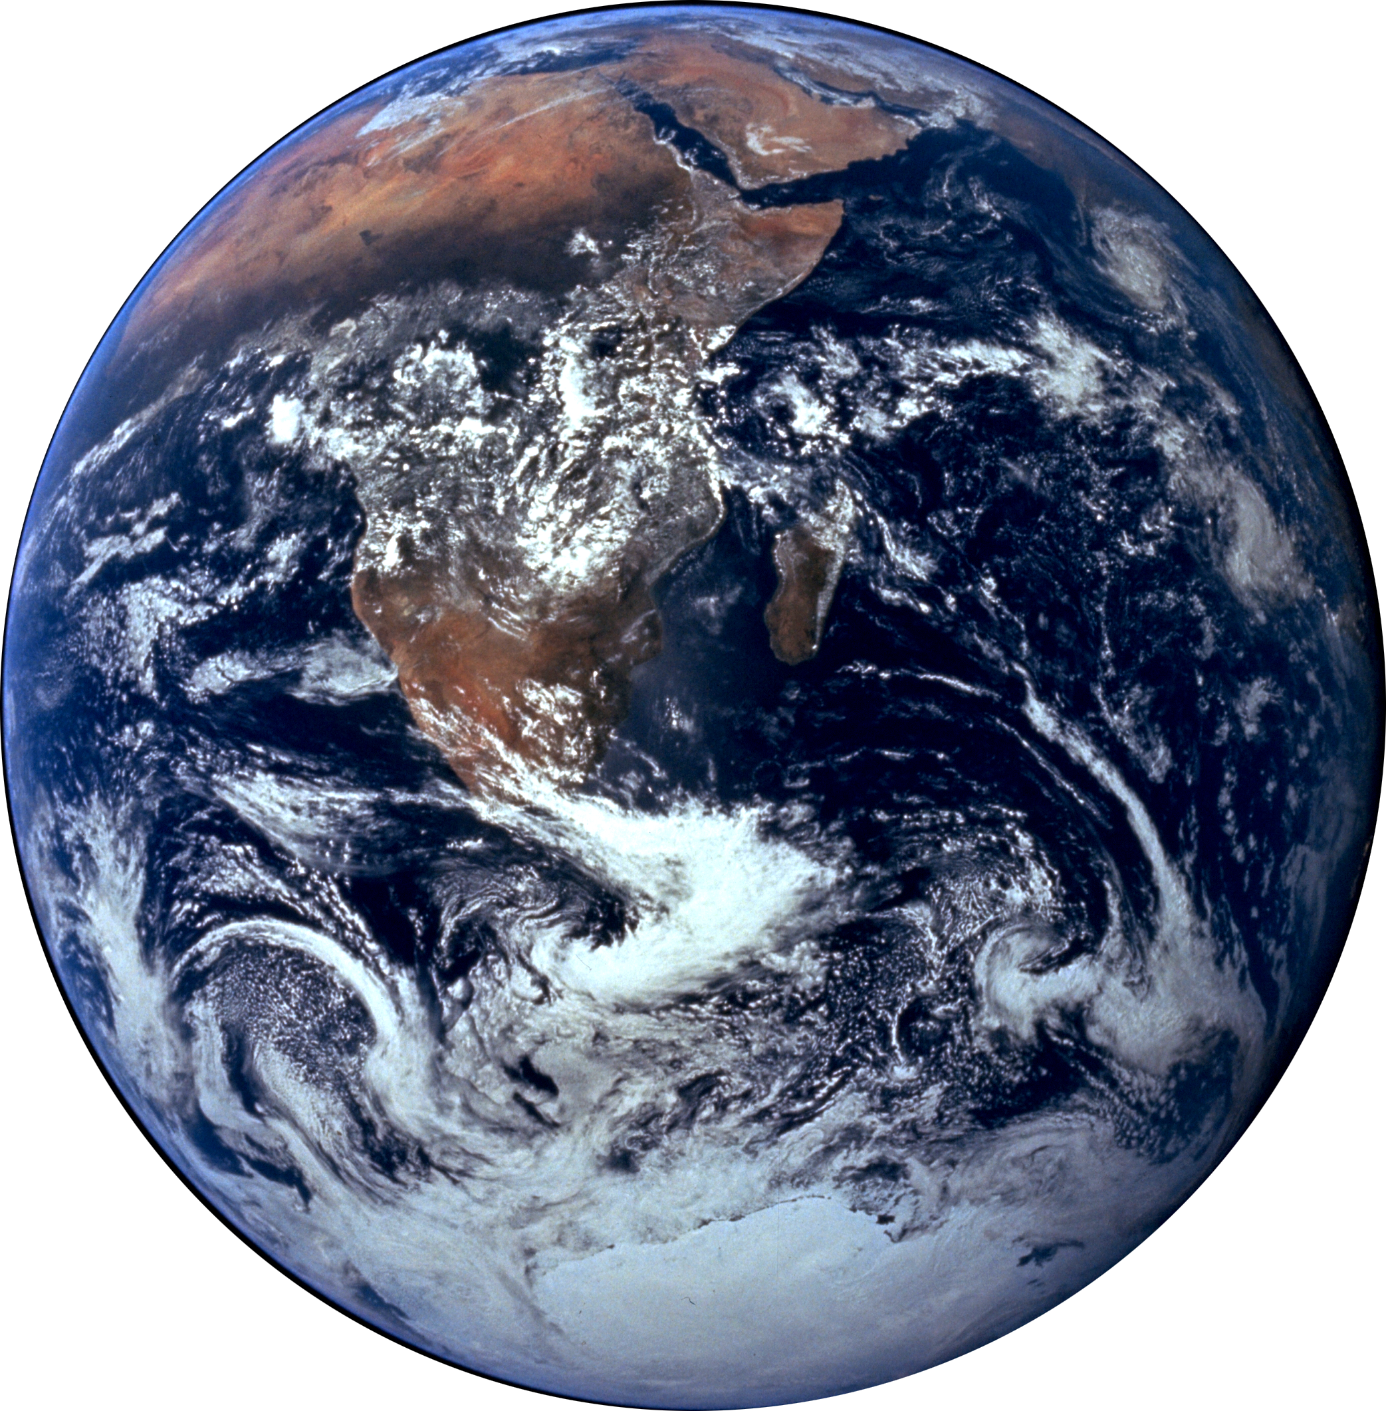
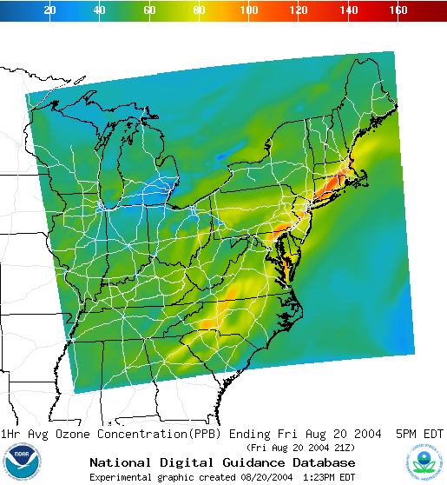
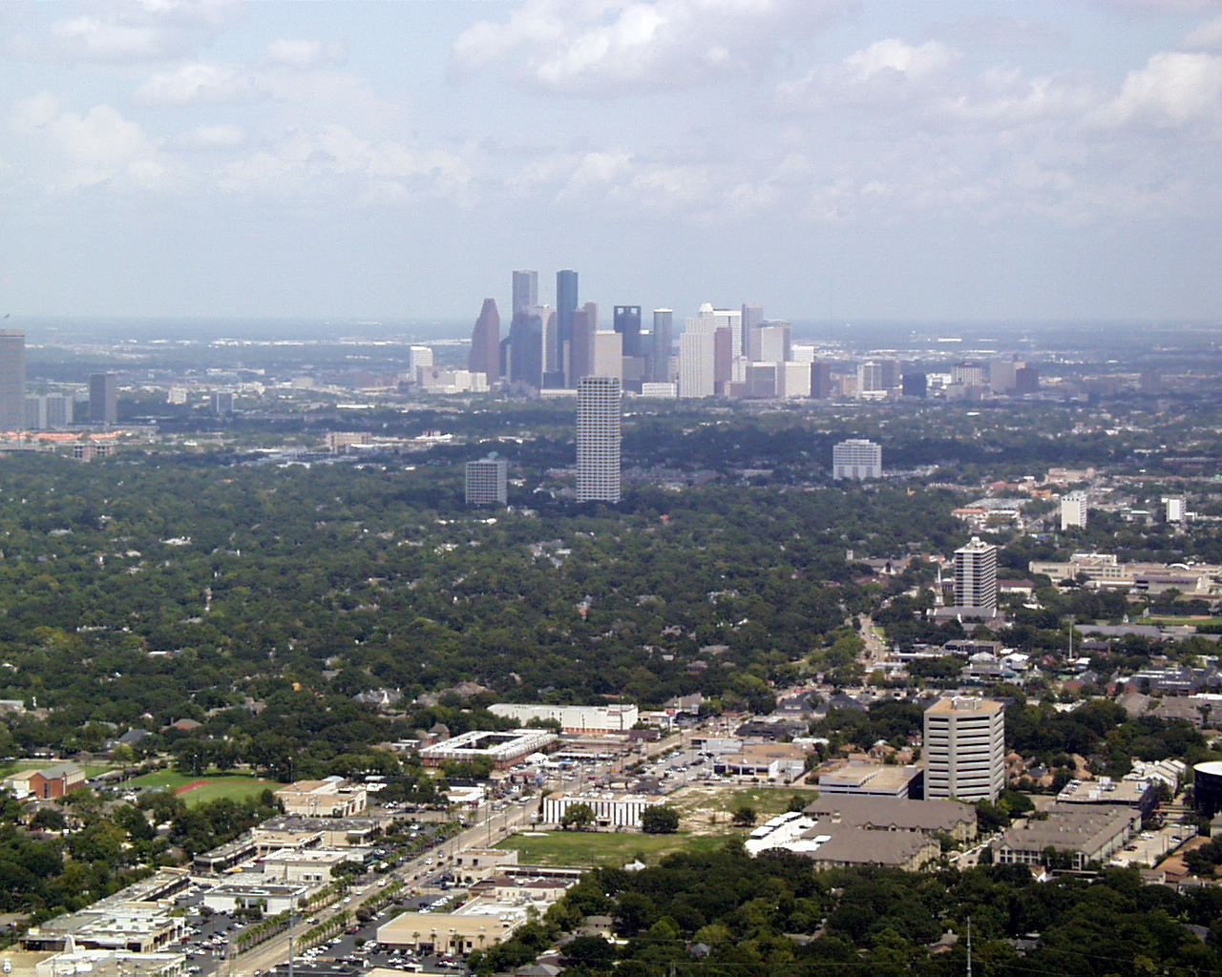
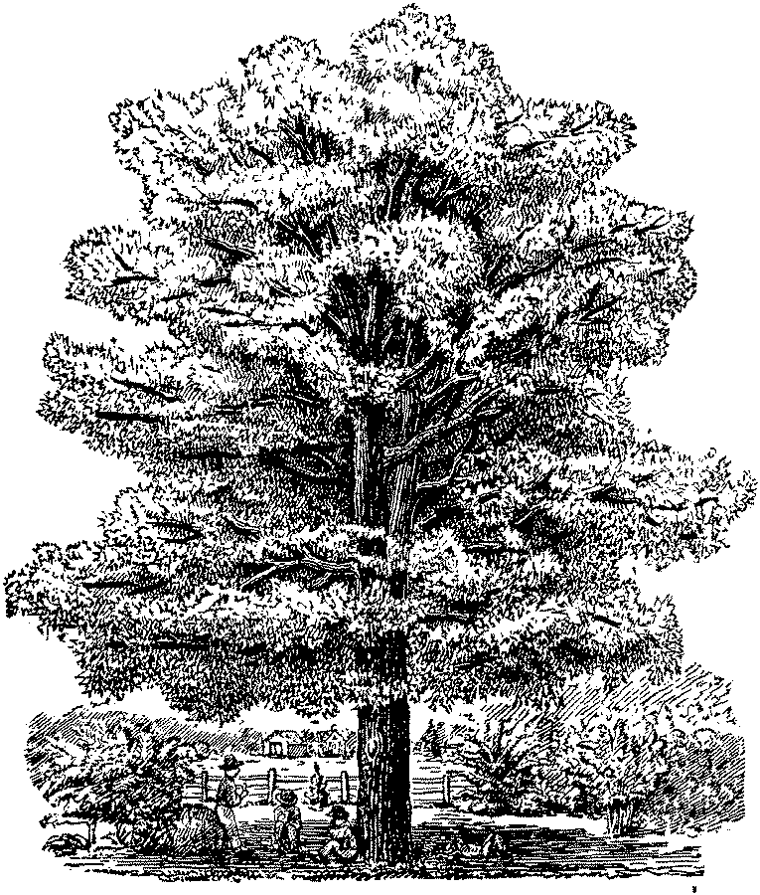
Actions and decisions are about emissions
Emissions
Impacts
Atmospheric
Composition
Global
Global
Regional
Local
Knobs:
Quantitative emission information is needed for:
Accounting for the past
Observing and calculating the present
Predicting and projecting the future
Taking action for mitigation, adaptation, etc.
Making choices: Which “knob” to turn? One better than the other?

Slide 3
Process understanding and emission quantification are inseparable
Abundance
composition
Radiative
Forcing/ΔO₃/
Health effects
Sources
Precursors
Processes
Properties/
Processes
Climate/
ΔO₃/
Air Quality
Transformation and transport
Chemistry, other factors (including policy)
To define current and predict future concentrations of species
Radiative
Forcing/
Health Effects
Emissions
ESSENTIAL
for policy
Actions taken by people.
Changes occurring due to other changes (e.g., climate, land use change, forestation, etc.)
Influence of external factors
Follows from process understanding
Notes:
SO, THE INFORMATION ABOUT CHEMISTRY HAS TO BE
REPRESENTED IN MODELS…
WHAT MODELS ARE USED FOR?
ACCOUNT FOR THE PAST AND PRESENT
PREDICT THE FUTURE.
AND ANSWER WHAT-IF-THEN QUESTIONS

Slide 4
Emissions are key for atmospheric chemistry
Chemical
Transformations
Meteorology and dynamics
Emissions
Deposition
Separation essential - almost different disciplines!

Slide 5
Emission Quantification
Needed for decision support information
Rapid changes in technology and fuel usage in the near future (urgency and opportunity)
Needed for multiple issues and compatibility for multiple uses- climate, air quality, …
Direct usable information product- in addition to other uses

Slide 6
Multiple needs, approaches, and results
Multiple needs:
Regulatory needs
Economic issues (e.g., cap and trade)
Science needs
Detailed Chemistry
Initialization for predictions
Baselines for projections
…..
Other needs
Needs of different communities have to be, and are, different!
Approaches used should fit the needs- differences exist and will exist
The results of of the differing needs and approaches will be different
How best can we come together to optimize the system for the US and the world?
Understand needs and requirements of all
Understand what is already being done

Slide 7
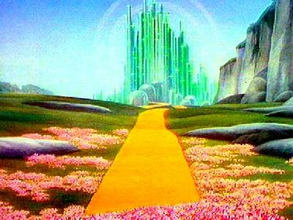
Start of a journey
Quantified emissions inventory will take heart, brain, and ways to find ourselves!
Start small ….
Produce some thing tangible….
Build on what others have, and are already, doing

