Slide 1


AJAX Flights in Support of CABOTS
April 19, 2017
Laura Iraci, Josette Marrero, Ju-Mee Ryoo, Emma Yates, Mimi McNamara, Warren Gore
Follow us in NASA's Airborne Science "Mission Tools Suite": http://airbornescience.nasa.gov /tracker/
Twitter: @NASAAJAX Instagram: nasa_ajax
POC: Laura Iraci, NASA Ames Research Center, 650-604-0129 Laura.Iraci@NASA.gov

Slide 2
Flight # | Date | Profile Locations | Species Measured | Notes
185 | April 19, 2016 | Madera, Chews Ridge, RAINS | O3, CH4, CO2, H2O, HCHO
186 | April 26, 2016 | Visalia, Panoche, Bodega Bay | O3, CH4, CO2, H2O, HCHO
187 | May 4, 2016 | Bodega Bay, Santa Rosa, SHOEY | O3, CH4, CO2, H2O, HCHO
188 | May 12, 2016 | Farallones, CORSE, SHOEY | O3, CH4, CO2, H2O, HCHO | Sondes began May 16
189 | May 19, 2016 | Trinidad Head | O3, CH4, CO2, H2O
190 | June 3, 2016 | Point Sur, Chews, Panoche, Visalia | O3, CH4, CO2, H2O | TOPAZ shows midday wind shift; sonde; Mooney morning
191 | June 15, 2016 Late afternoon: 4-6pm PDT | Bodega Bay and Visalia | O3, CH4, CO2, H2O, HCHO | TOPAZ - compare to 6/13 too??; sonde Strong horizontal gradient in O3 in SJV at 5 km
192 | June 23, 2016 | Point Sur, Chews, Panoche, Visalia | O3, CH4, CO2, H2O, HCHO | Sonde; Noticeable horizontal gradient in O3

Slide 3
Flight # | Date | Profile Locations | Species Measured | Notes
193 | July 1, 2016 | Railroad Valley, NV
194 | July 6, 2016 | Point Sur, Chews, Panoche, Visalia | O3, CH4, CO2, H2O | Sonde, TOPAZ
195 | July 21, 2016 | Bodega Bay, Point Sur, Chews Ridge, Visalia | O3, CH4, CO2, H2O, HCHO | Sonde, TOPAZ
196 | July 28, 2016 | Pt. Sur, BLANC | O3, CH4, CO2, H2O, HCHO | Soberanes Fire, flew through Visalia (TOPAZ), instrument failure
197 | Aug 9, 2106 |  |  | Soberanes Fire
198 | Aug 12, 2016 |  |  | Soberanes and Mineral Fires

Slide 4
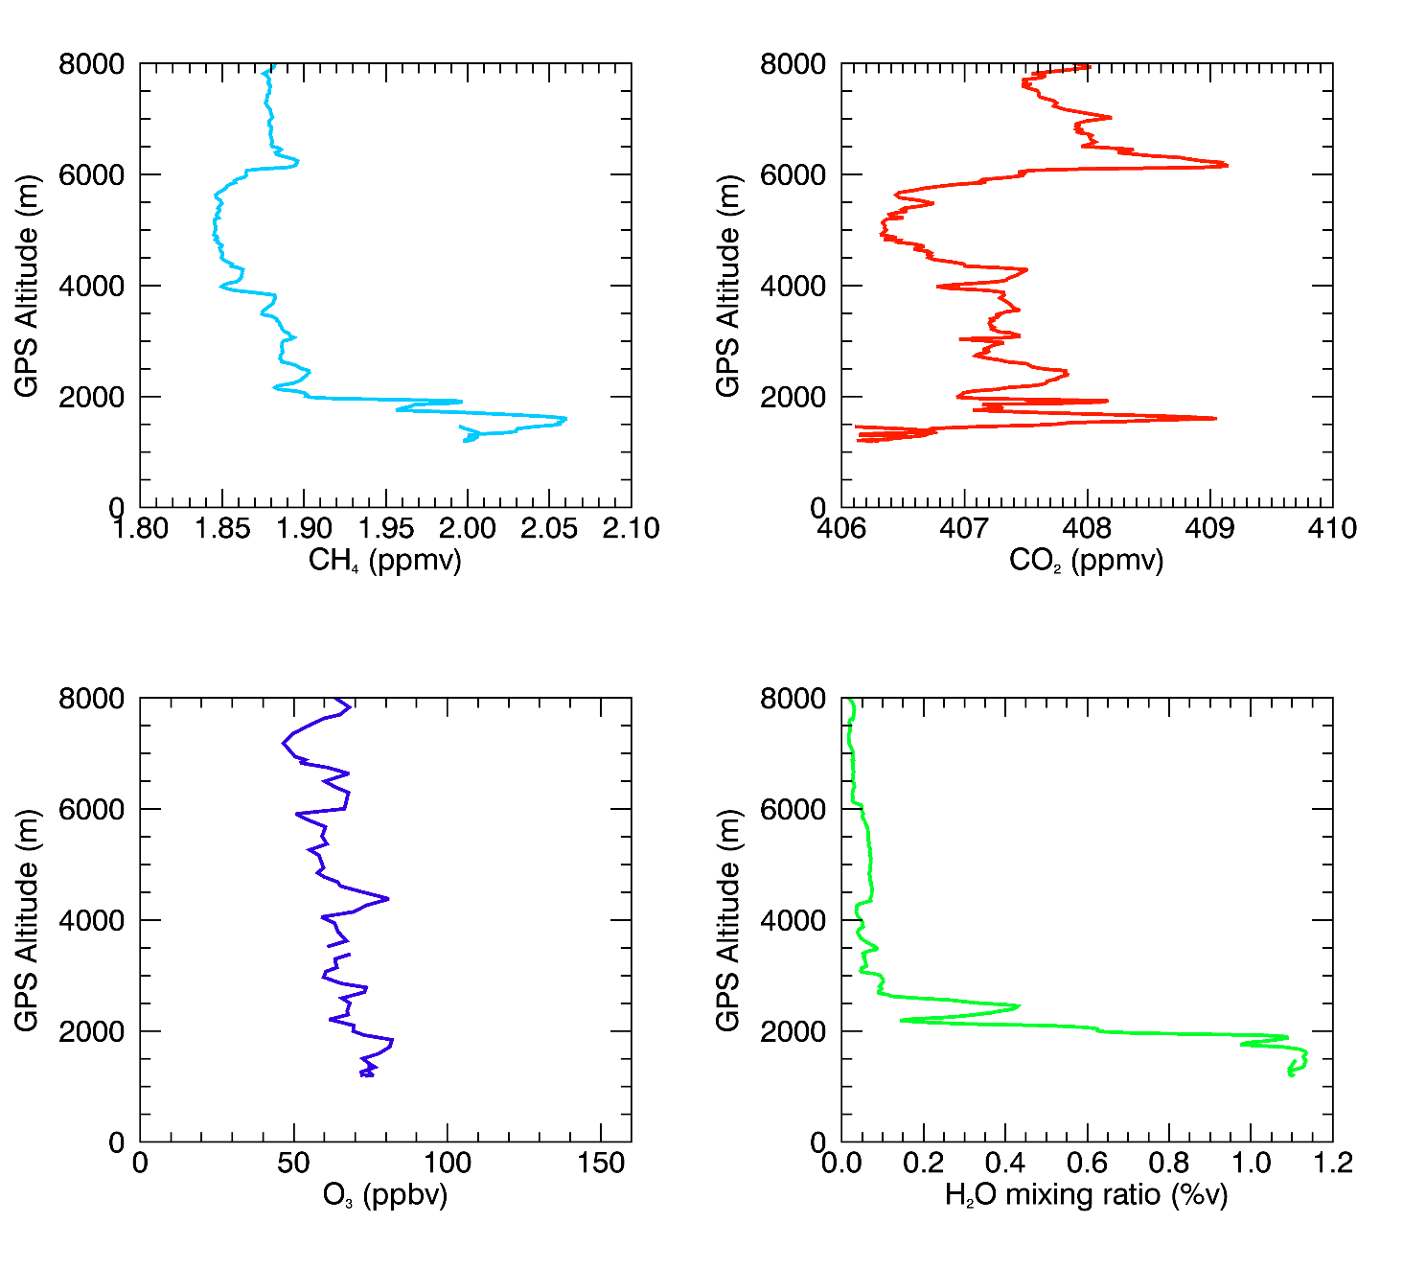
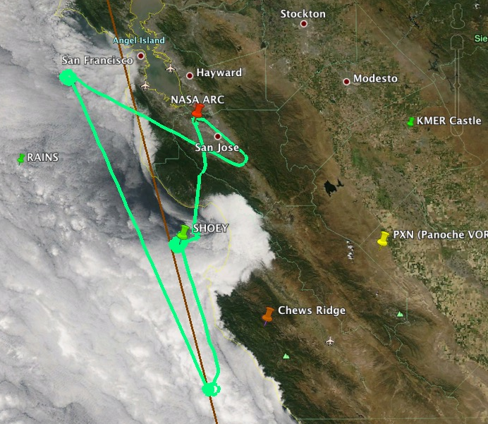
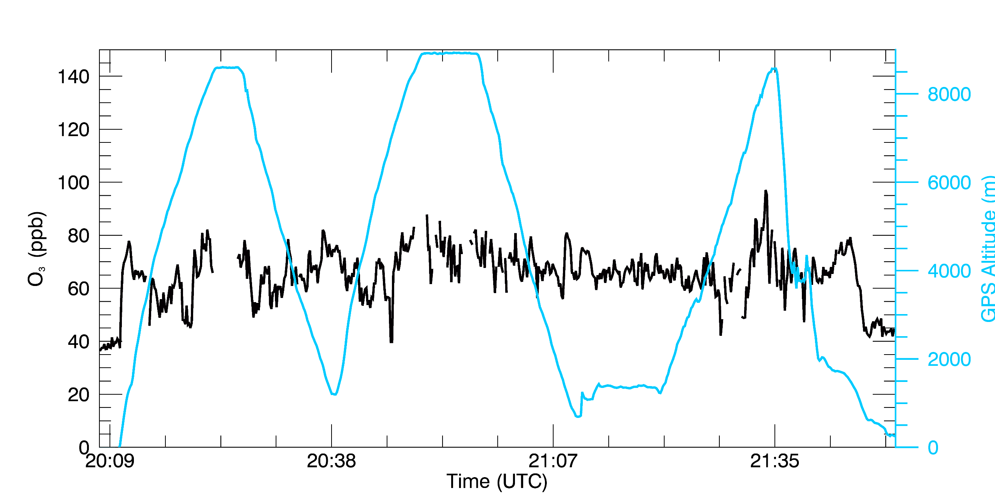
Flight 188: May 12, 2016
~8 km, elevated O3 (decrease CH4)
Marine BL
Profiles at the Farallon Islands

Slide 5
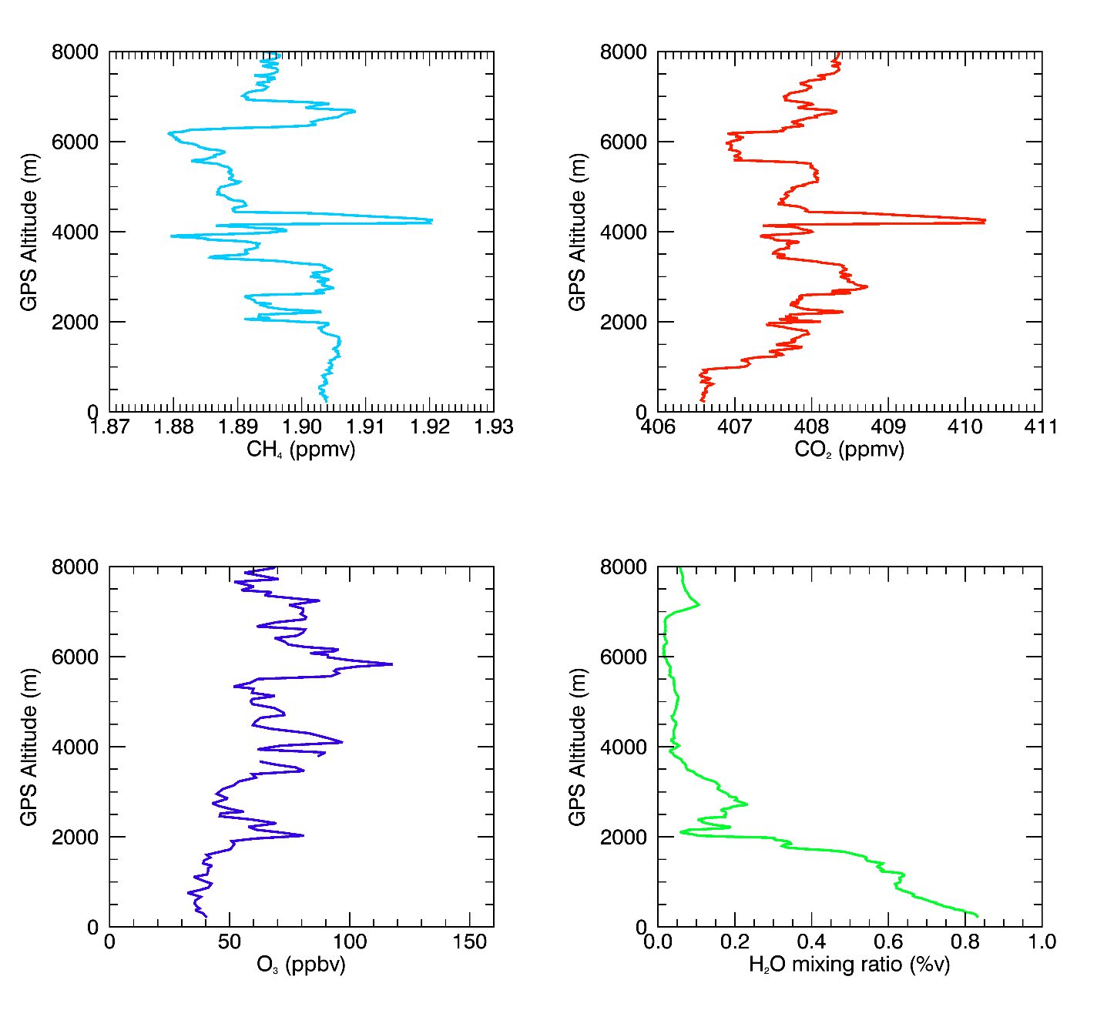
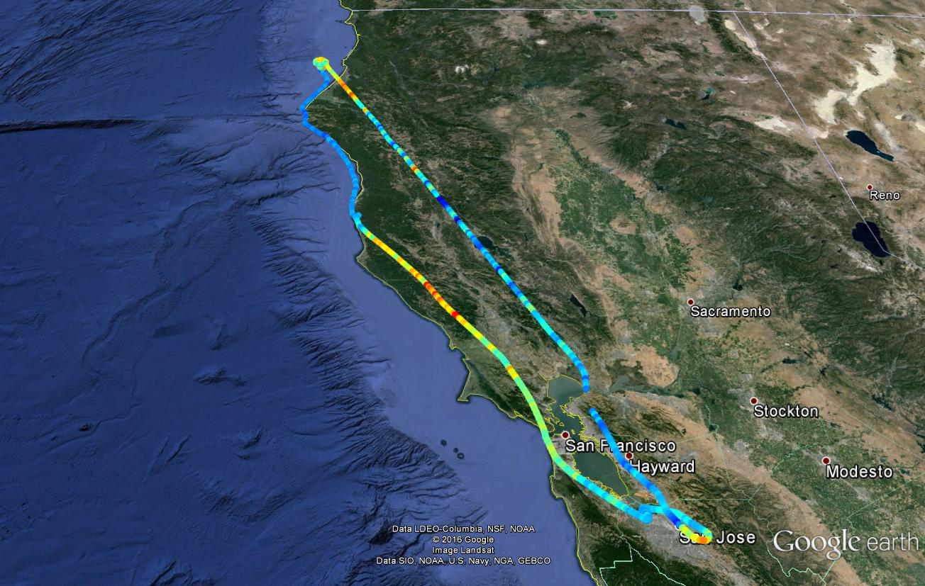

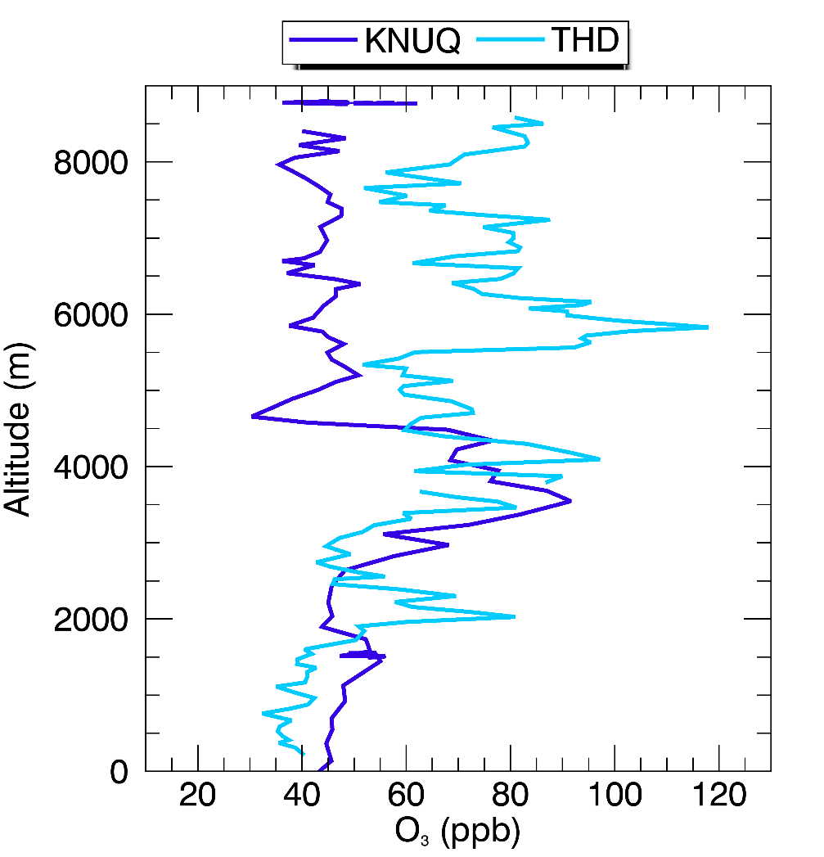
Flight 189: May 19, 2016
Within SELVY profile, 3 high O3 laminae ~ 6, 4 & 2 km, with elevated CH4, low H2O and decreased CO2
~4 km
~8 km, elevated O3 (decrease CH4)
Marine BL
SELVY profile (~20 km SW of THD): 3 high ozone laminae ~ 6, 4 & 2 km
KNUQ (Moffett Field): lamina at ~ 4 km only

Slide 6
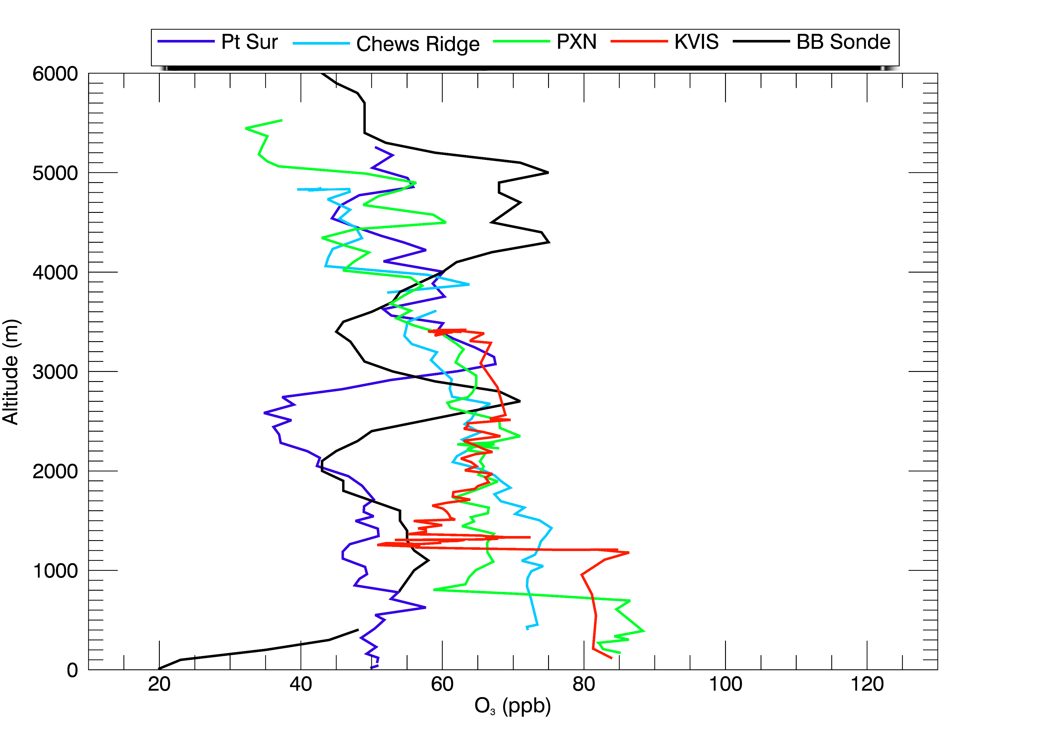
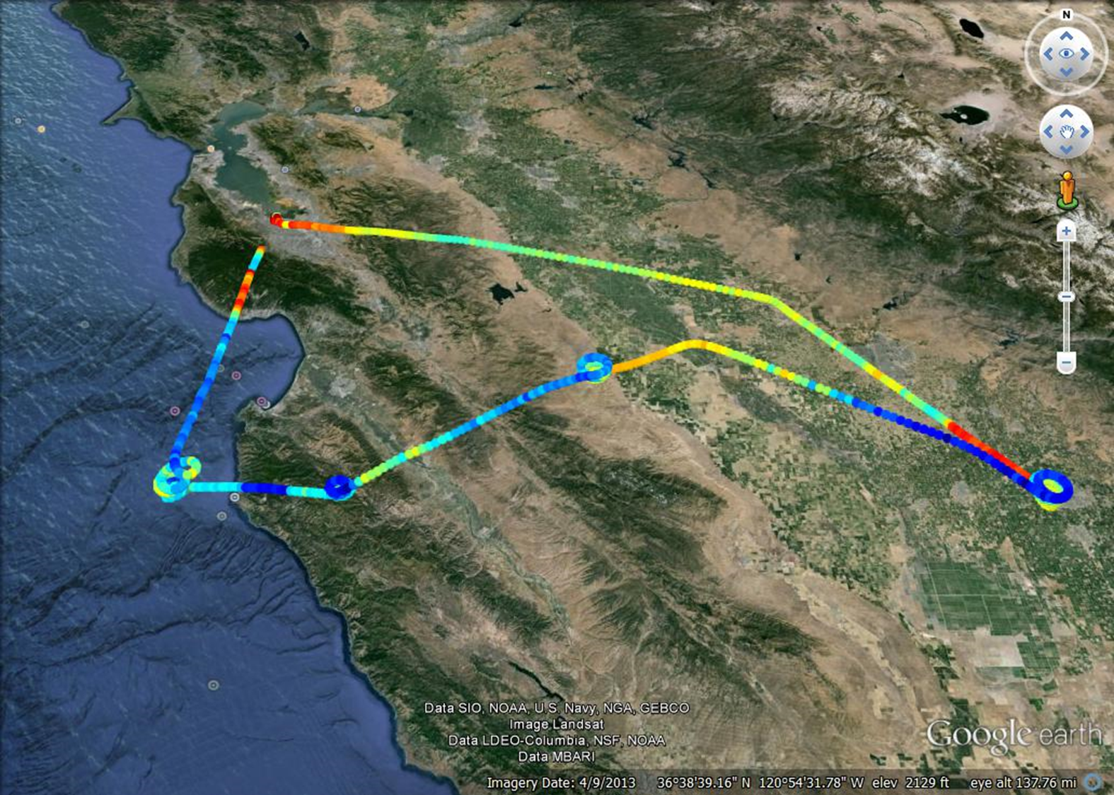

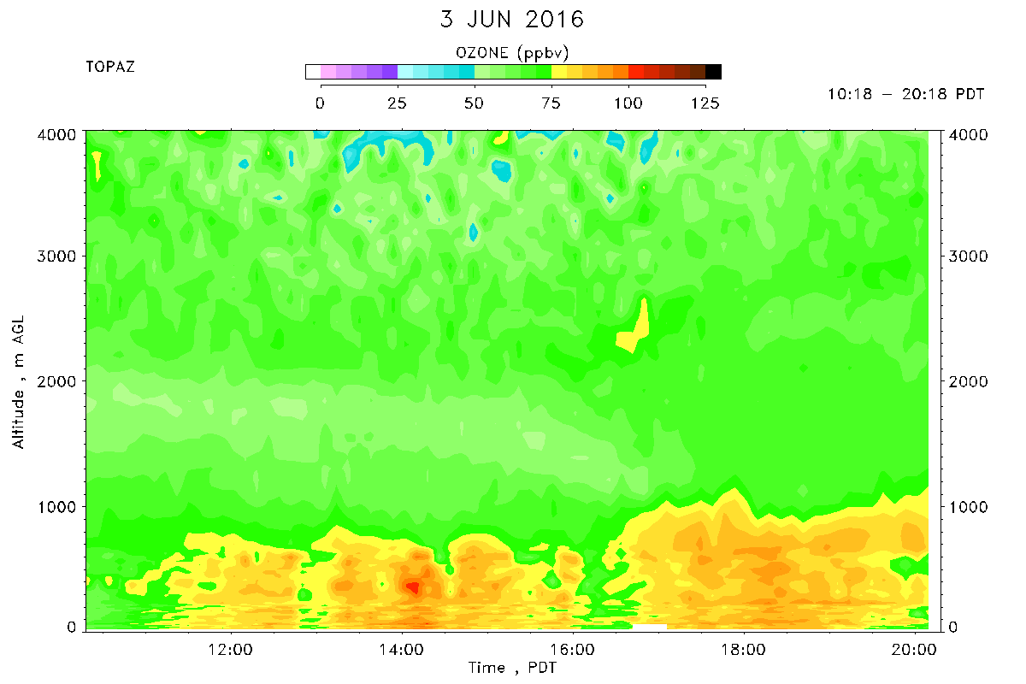
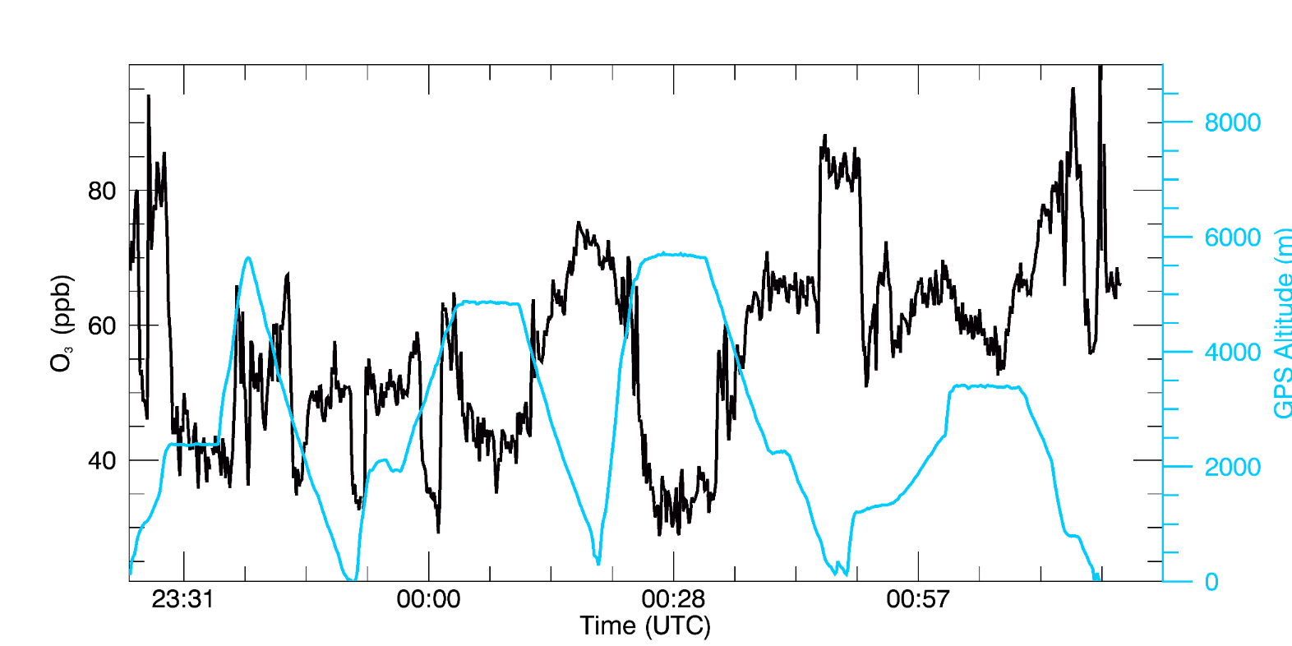
Flight 190: June 3, 2016
Panoche
Chews Ridge
Pt. Sur
Visalia
Pt. Sur
AJAX Flight compared to TOPAZ Data
Panoche
Chews Ridge
Visalia
Notes:
Elevated O3 at the transit to Pt. Sur, at the Visalia spiral, and the descent from Madera
High CO2 on descent from Madera (~410-412 ppmv)
Visalia profile has highest O3 concentrations (~85 ppb)
At boundary layer, KVIS O3 is the highest (~90 ppb)

Slide 7
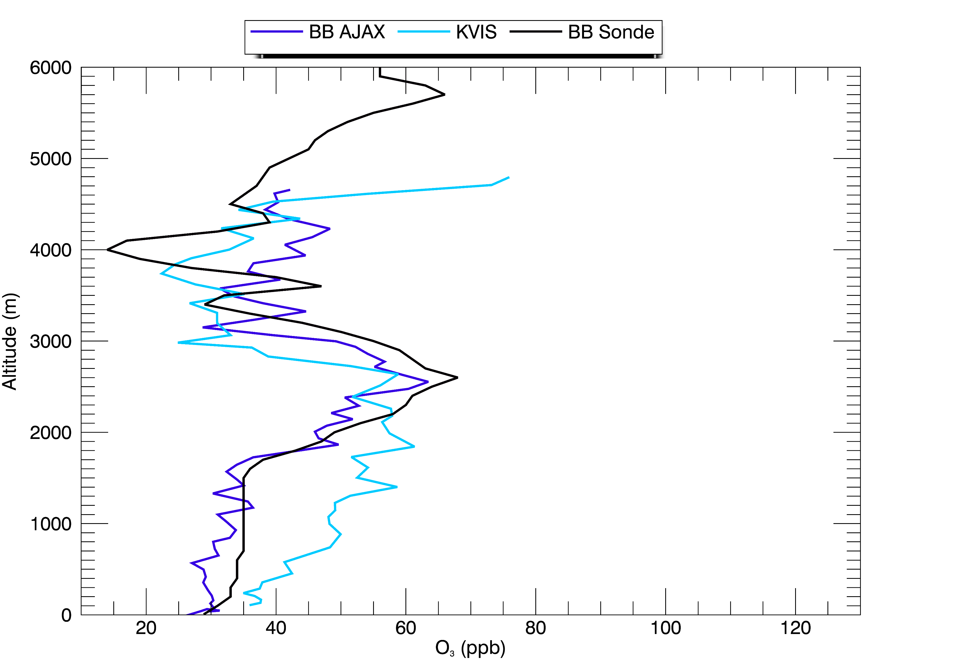
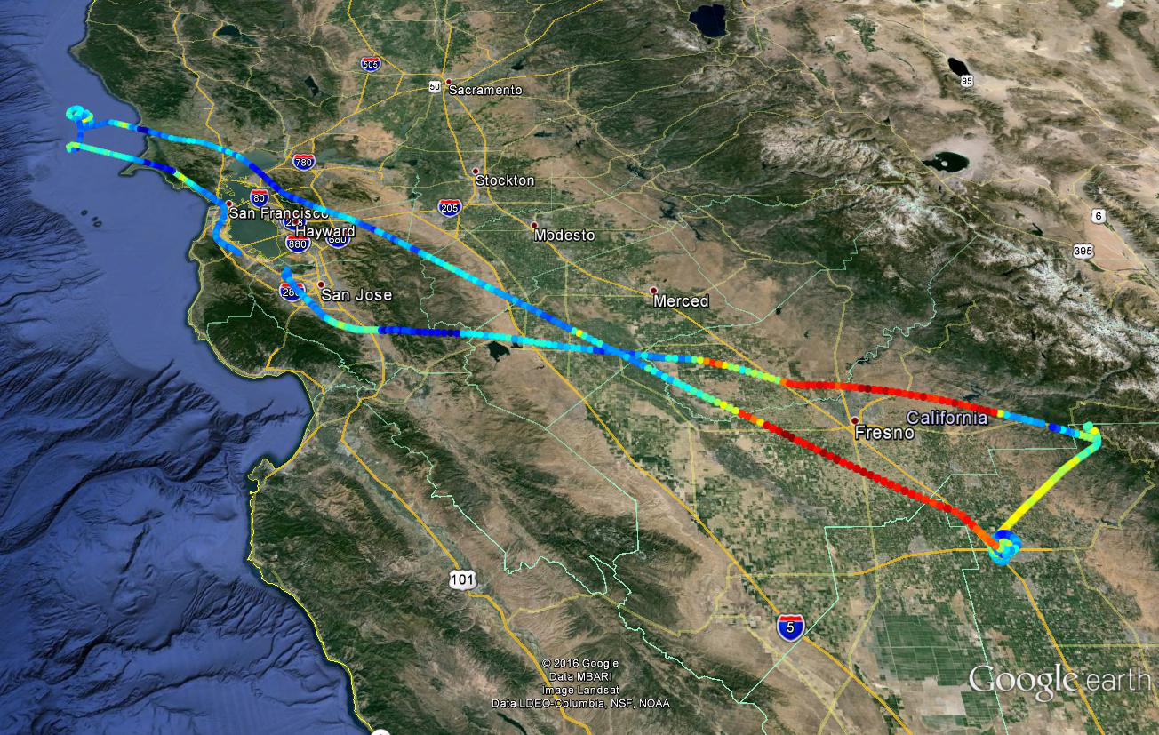

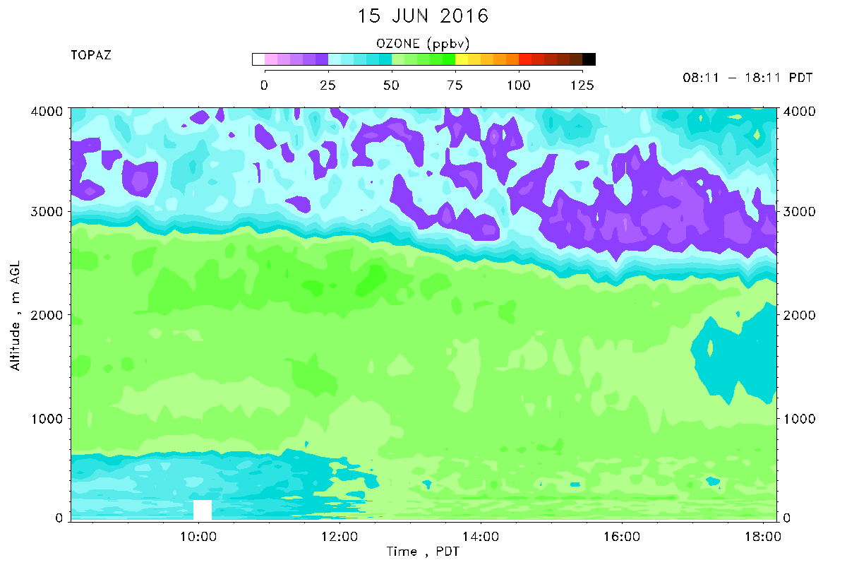
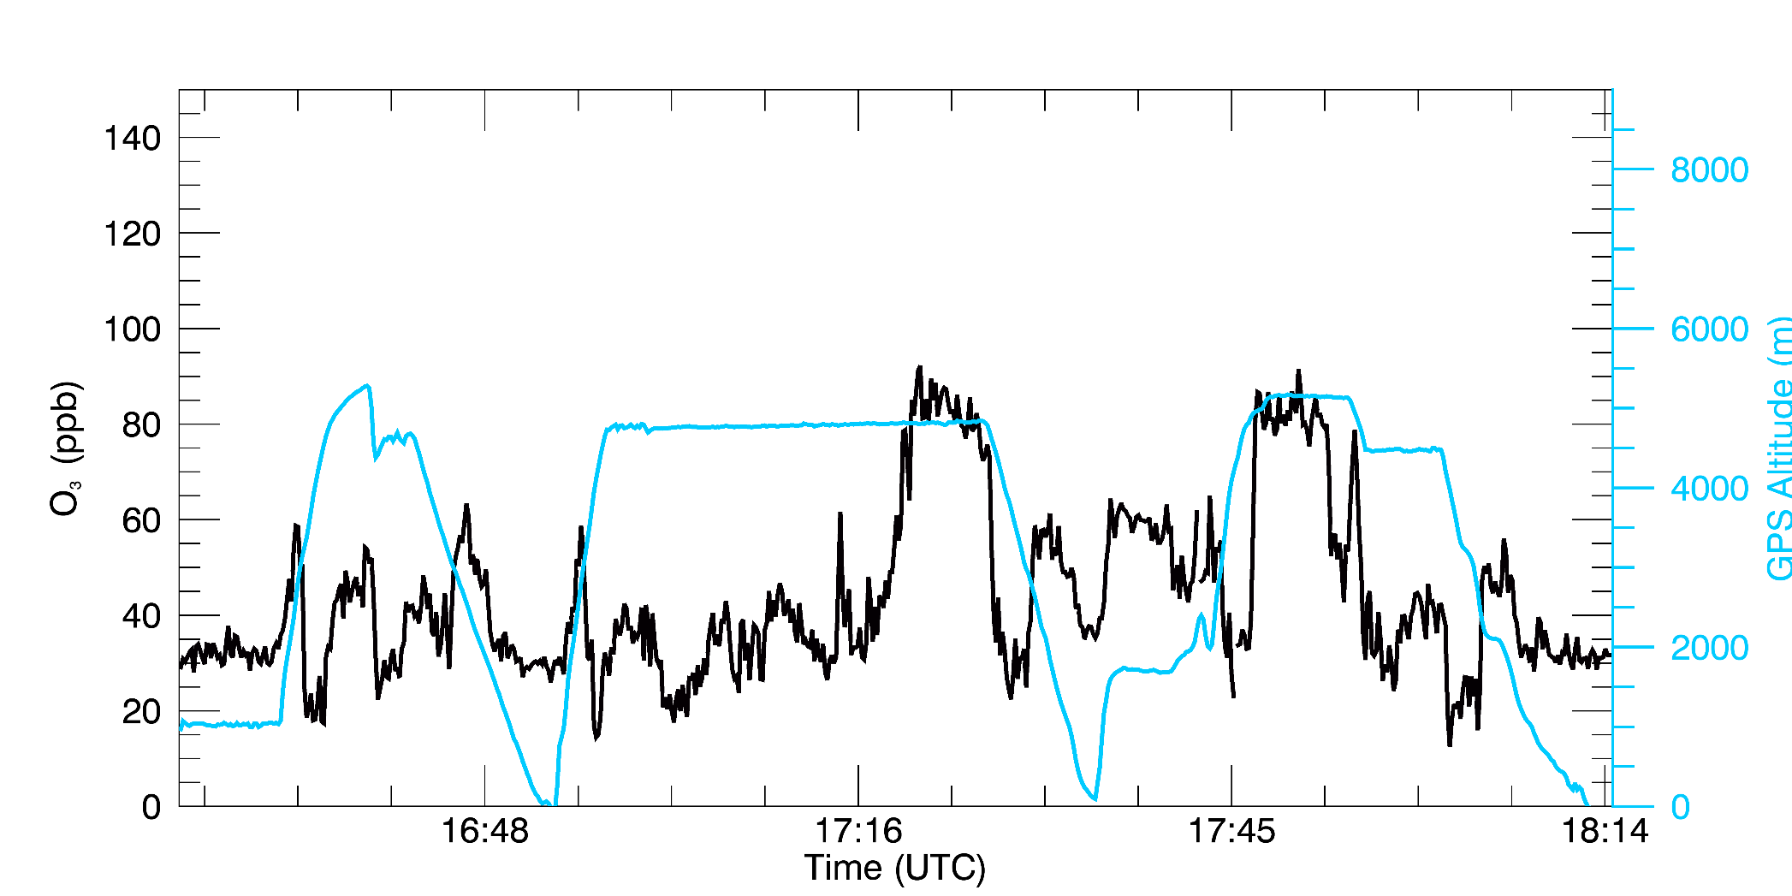

Flight 191: June 15, 2016
Bodega Bay
Visalia
AJAX Flight compared to TOPAZ Data
Bodega Bay
Visalia
Notes:
Captured prescribed fire
High ozone on transit to Visalia and on transit back to Moffett Field
Low levels of CO2, CH4, and H2O
Fire Sample: High levels of CH4 and CO2 but decreased O3
High O3 (> 90 ppbv) at ~ 5 km
Stratospheric Intrusion in the mid-toposphere
Notice sudden increase in O3 in central valley

Slide 8
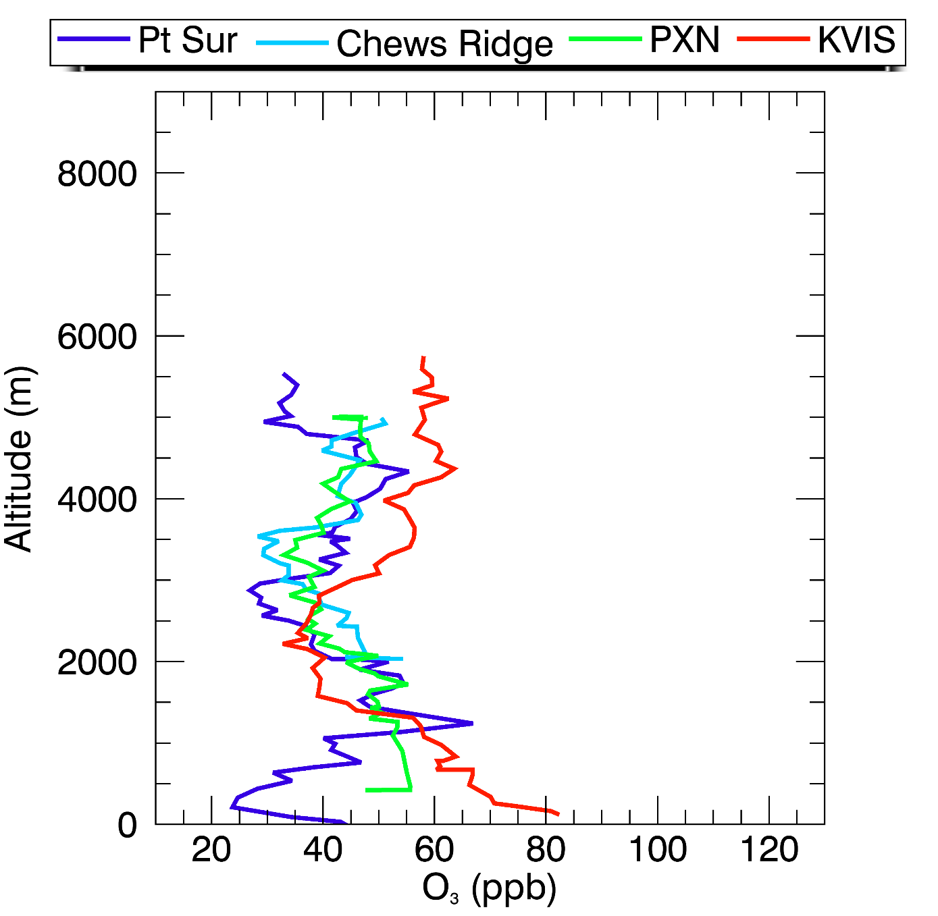

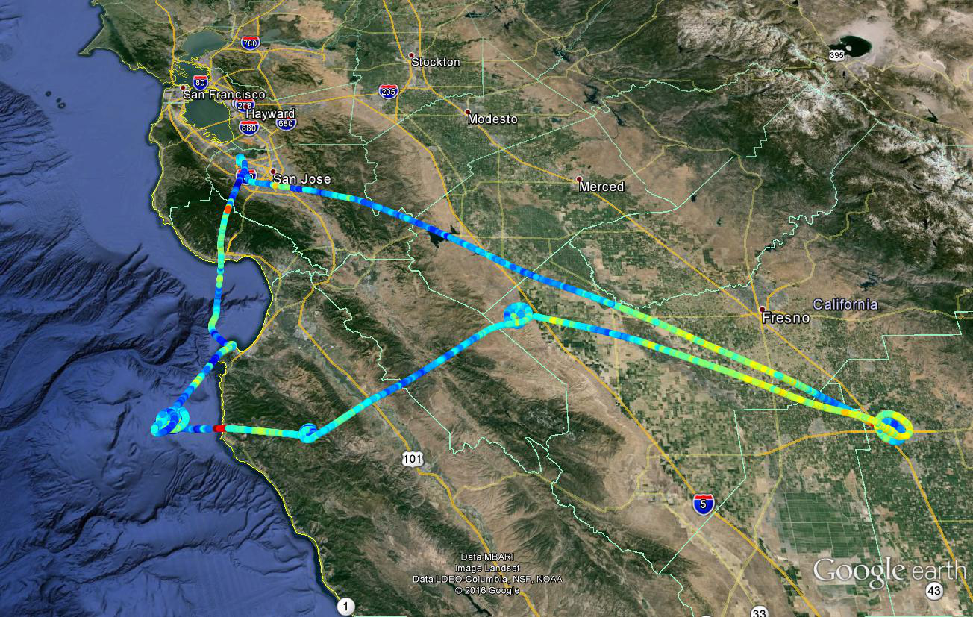
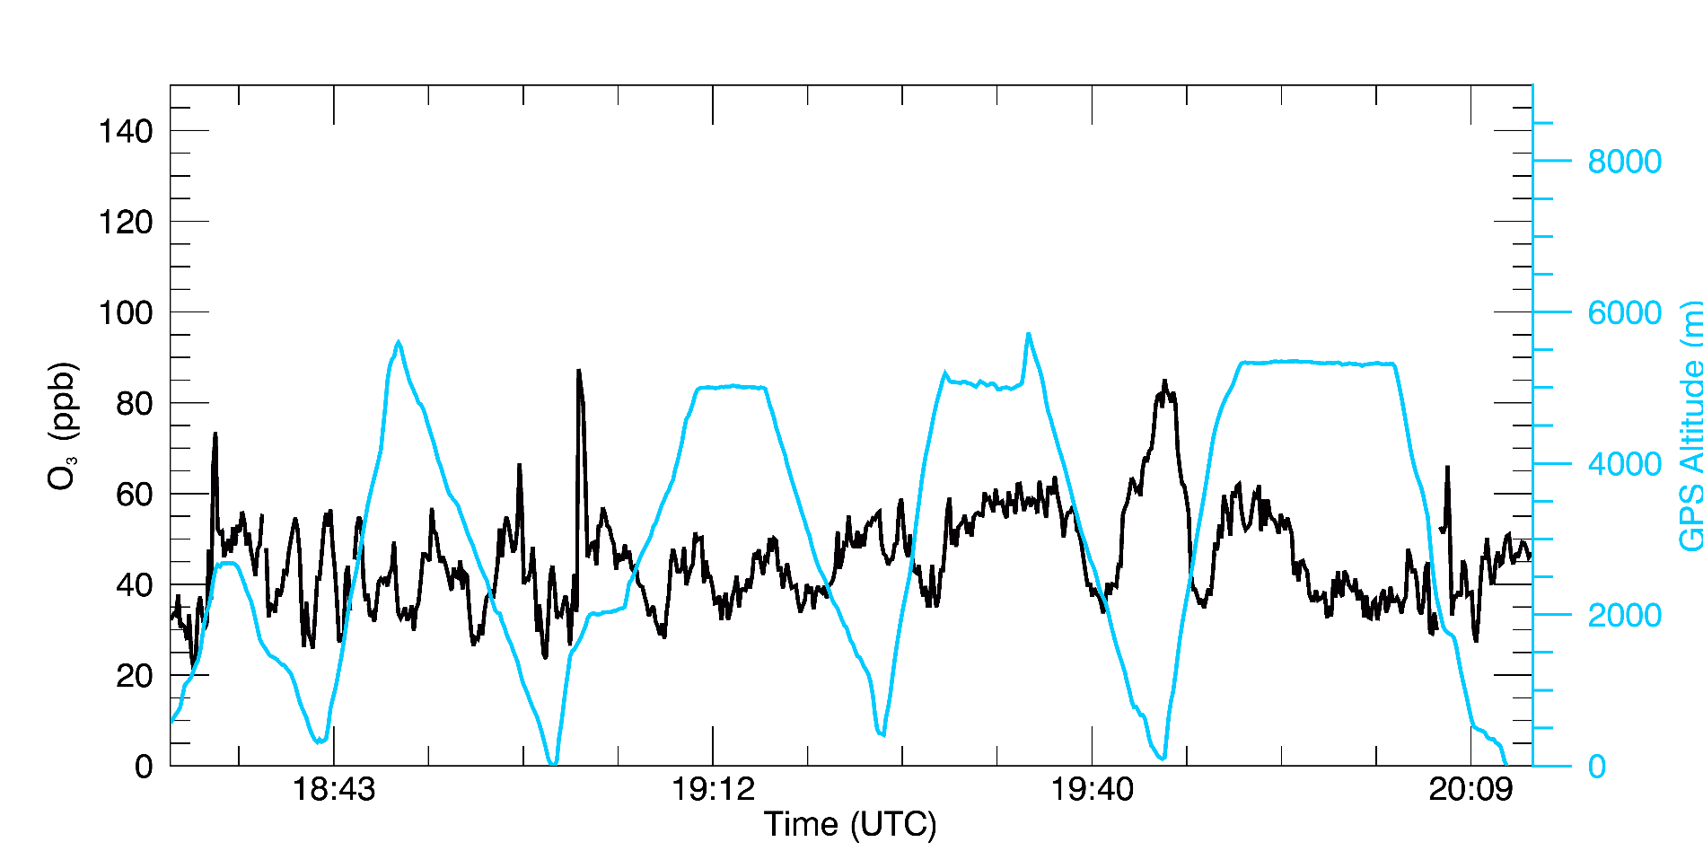
Flight 192: June 23, 2016
Panoche
Pt. Sur
Visalia
Chew’s Ridge
Pt. Sur
Chews Ridge
Panoche
Visalia
Notes:
Increased O3 (80 ppb) climbing towards Chews Ridge
Increased O3 at Visalia with increased in CH4, H2O and CO2 at ~7 km
Same sudden increase in O3 in Central Valley
Similar to Flight 191

Slide 9
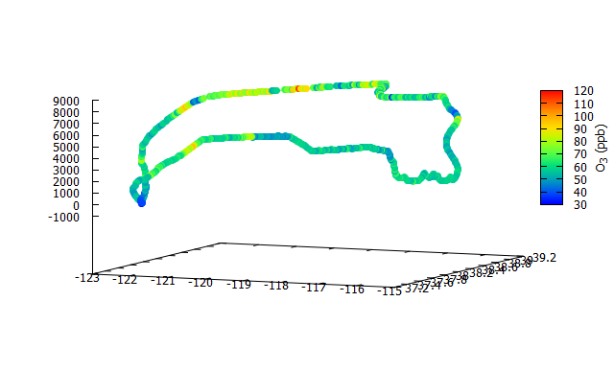
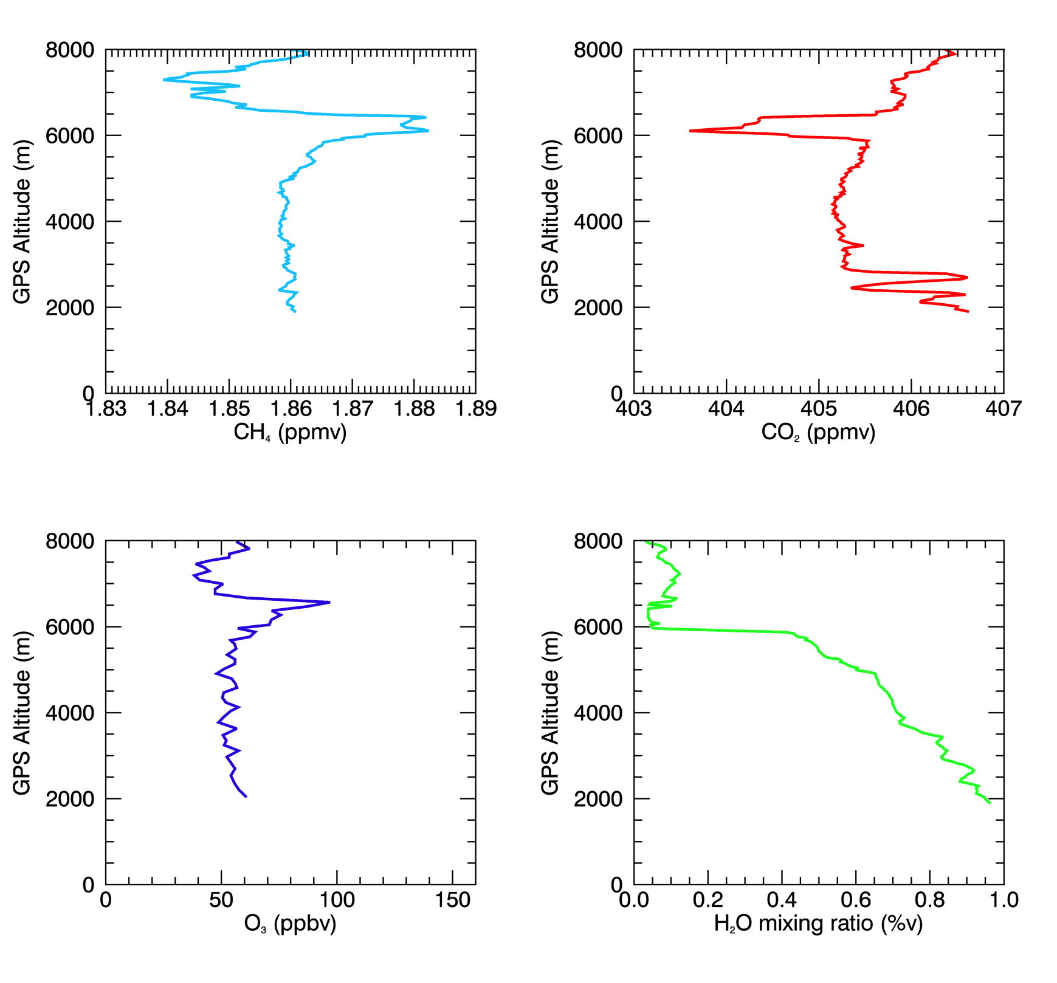
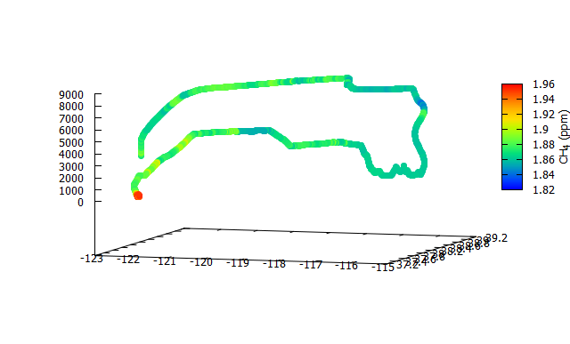
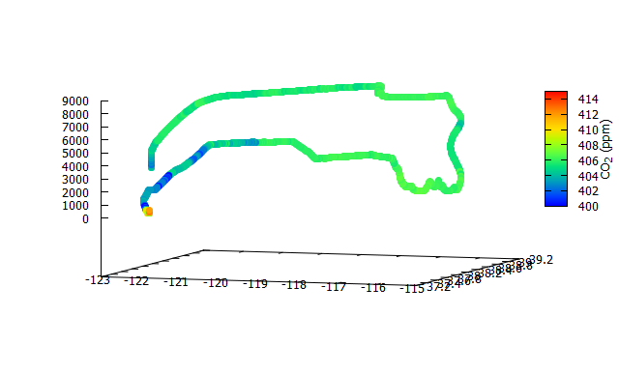
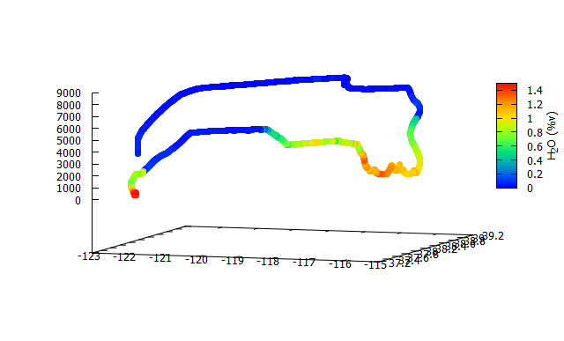
Flight 193: July 1, 2016
O₃
Transits from CA across NV at 27 kft and 12.5 kft
Pilots reported their trickiest conditions yet on trying to reach the playa. Had to divert around a lot of thunderstorms over NV.
Looks like a very high boundary layer up to 6 km with an interesting lamina capping it!
CH₄
CO₂
H₂O
9

Slide 10
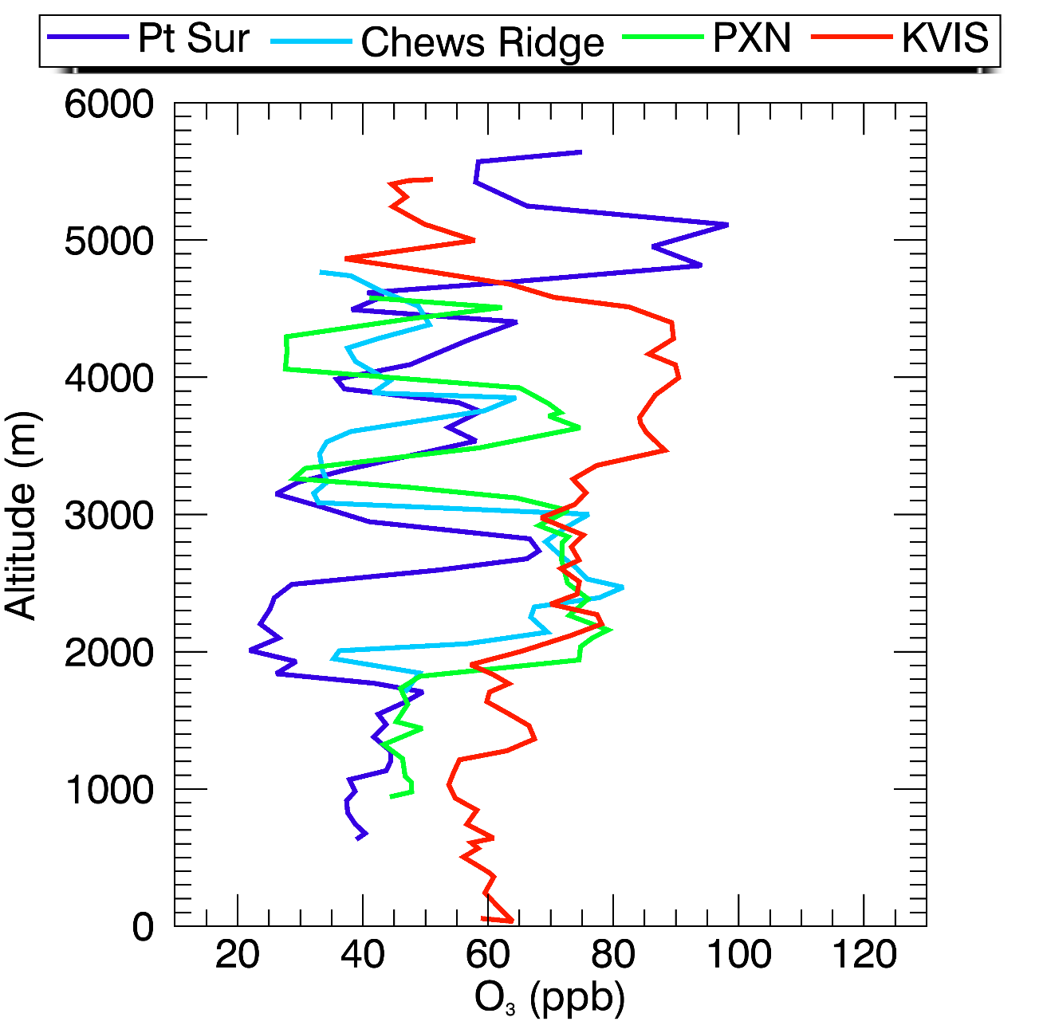
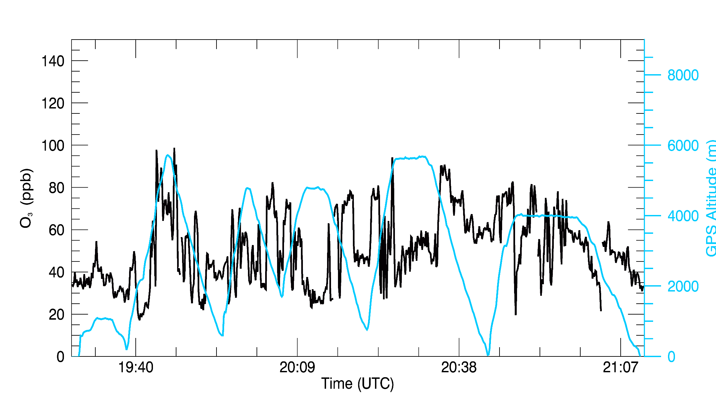
Flight 194: July 6, 2016
Panoche
Chew’s Ridge
Visalia
Pt. Sur
Pt. Sur
Chews Ridge
Panoche
Visalia
Notes:
Ozone KVIS boundary layer is ~60 ppb
Pt Sur: ~40 ppb
Chews Ridge and PXN: ~46 ppb
High concentration of ~99 ppb at 5100m at Pt Sur

Slide 11
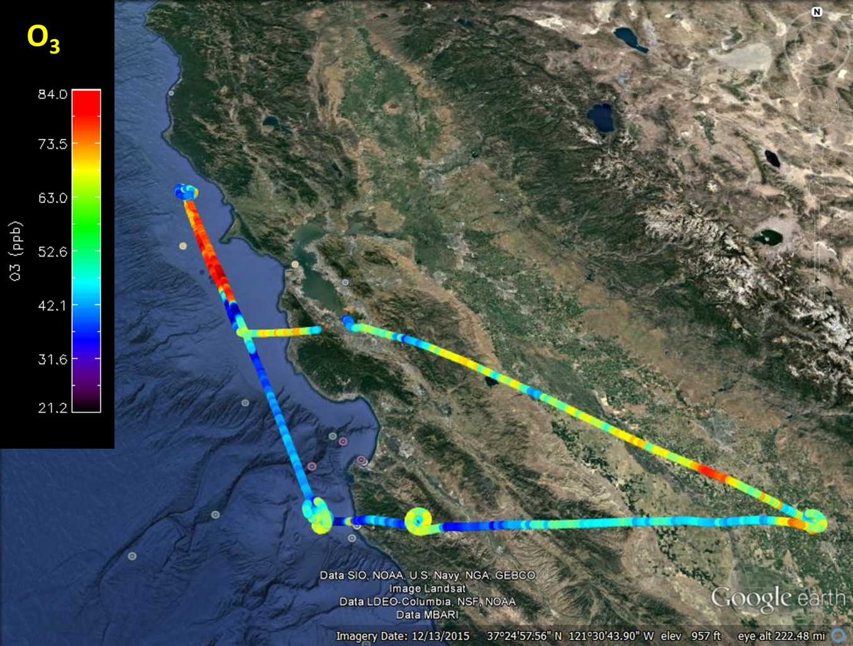
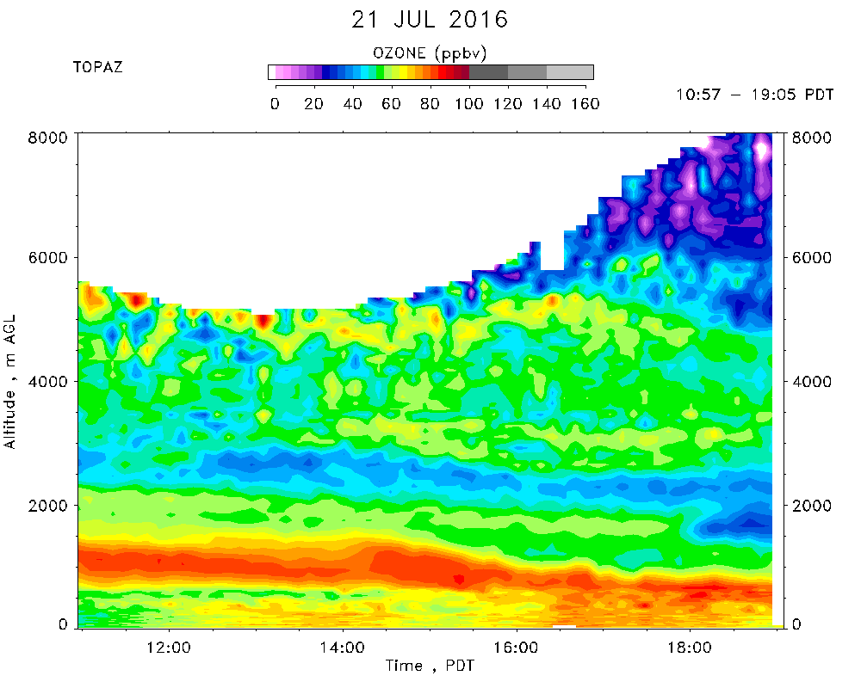
Flight 195: July 21, 2016
Bodega Bay
Chew’s Ridge
Visalia
Pt. Sur
AJAX Flight
19:11 – 21:28 UTC
Need Vertical Profile: BBY and AJAX from Emma

Slide 12
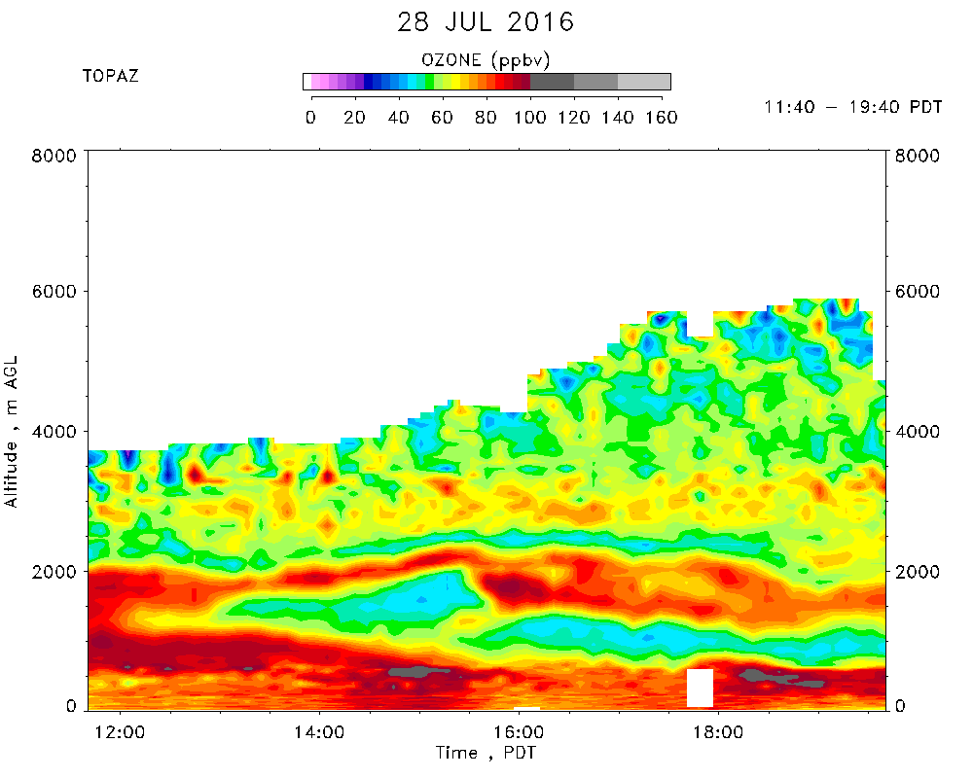
Flight 196: July 28, 2016
O3
Soberanes
Instrument over-heated
Pt. Sur
Soberanes
Instrument over-heated
Pt. Sur
BLANC
Visalia
(400-45 m)
BLANC
Need Vertical Profile: BBY and AJAX from Emma
Time of AJAX flt missed approach
~400-45 m

Slide 13
Flight 197: August 9, 2016
High O3 in fresh plume, close to source
Further downwind = reduced O3 enhancement

Slide 14

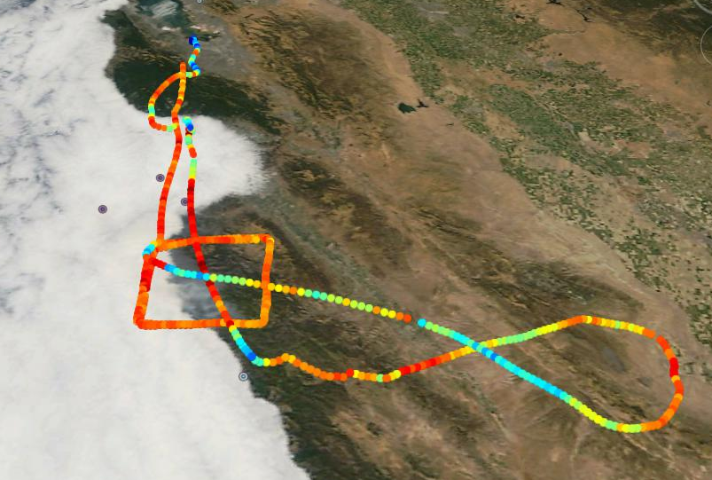
Flight 198: August 12, 2016
O₃
Chews Ridge
CO2 , CH4 , O3 , H2O
O3 concentration increase in the downwind side.

Slide 15
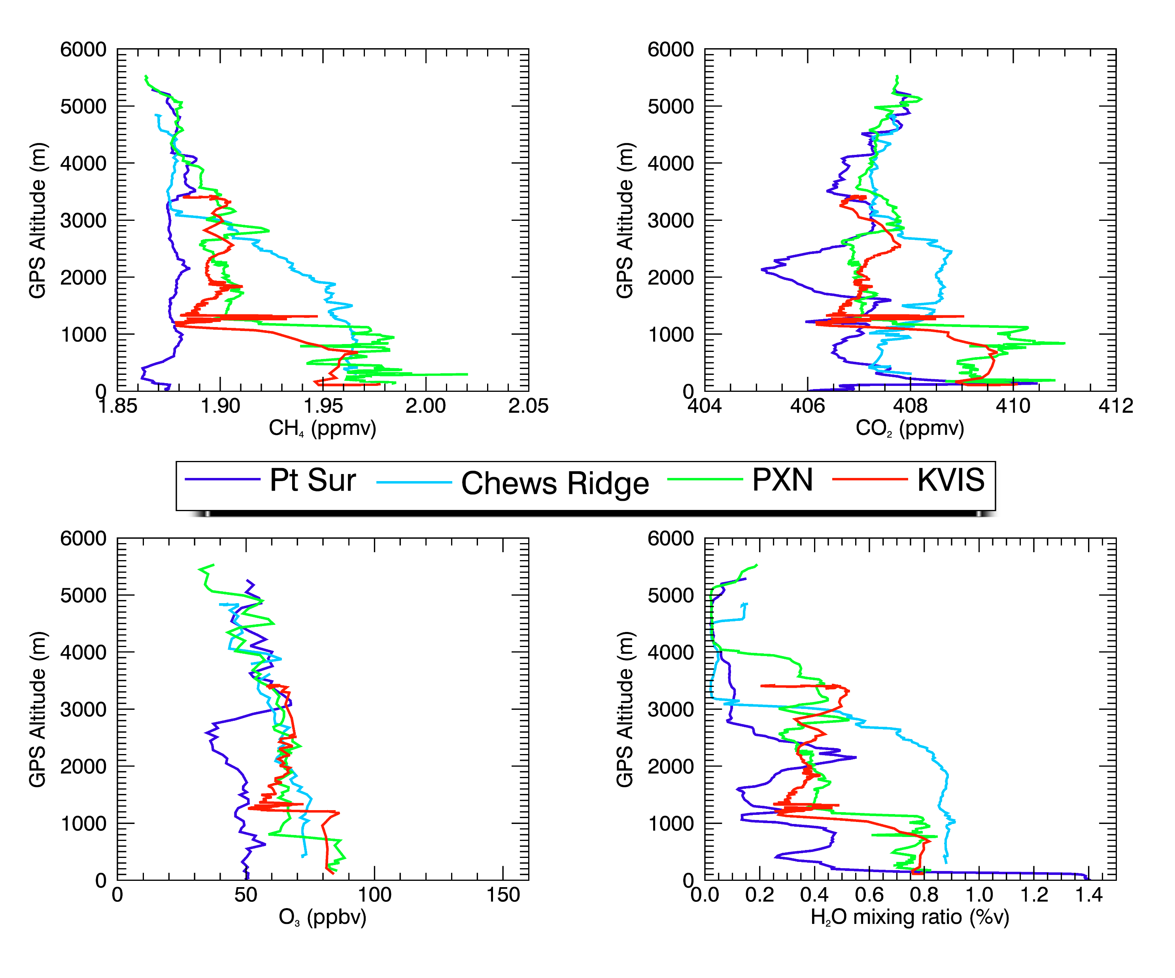
Supplementary Data: Flight 190 O3 & GHG Comparison

Slide 16
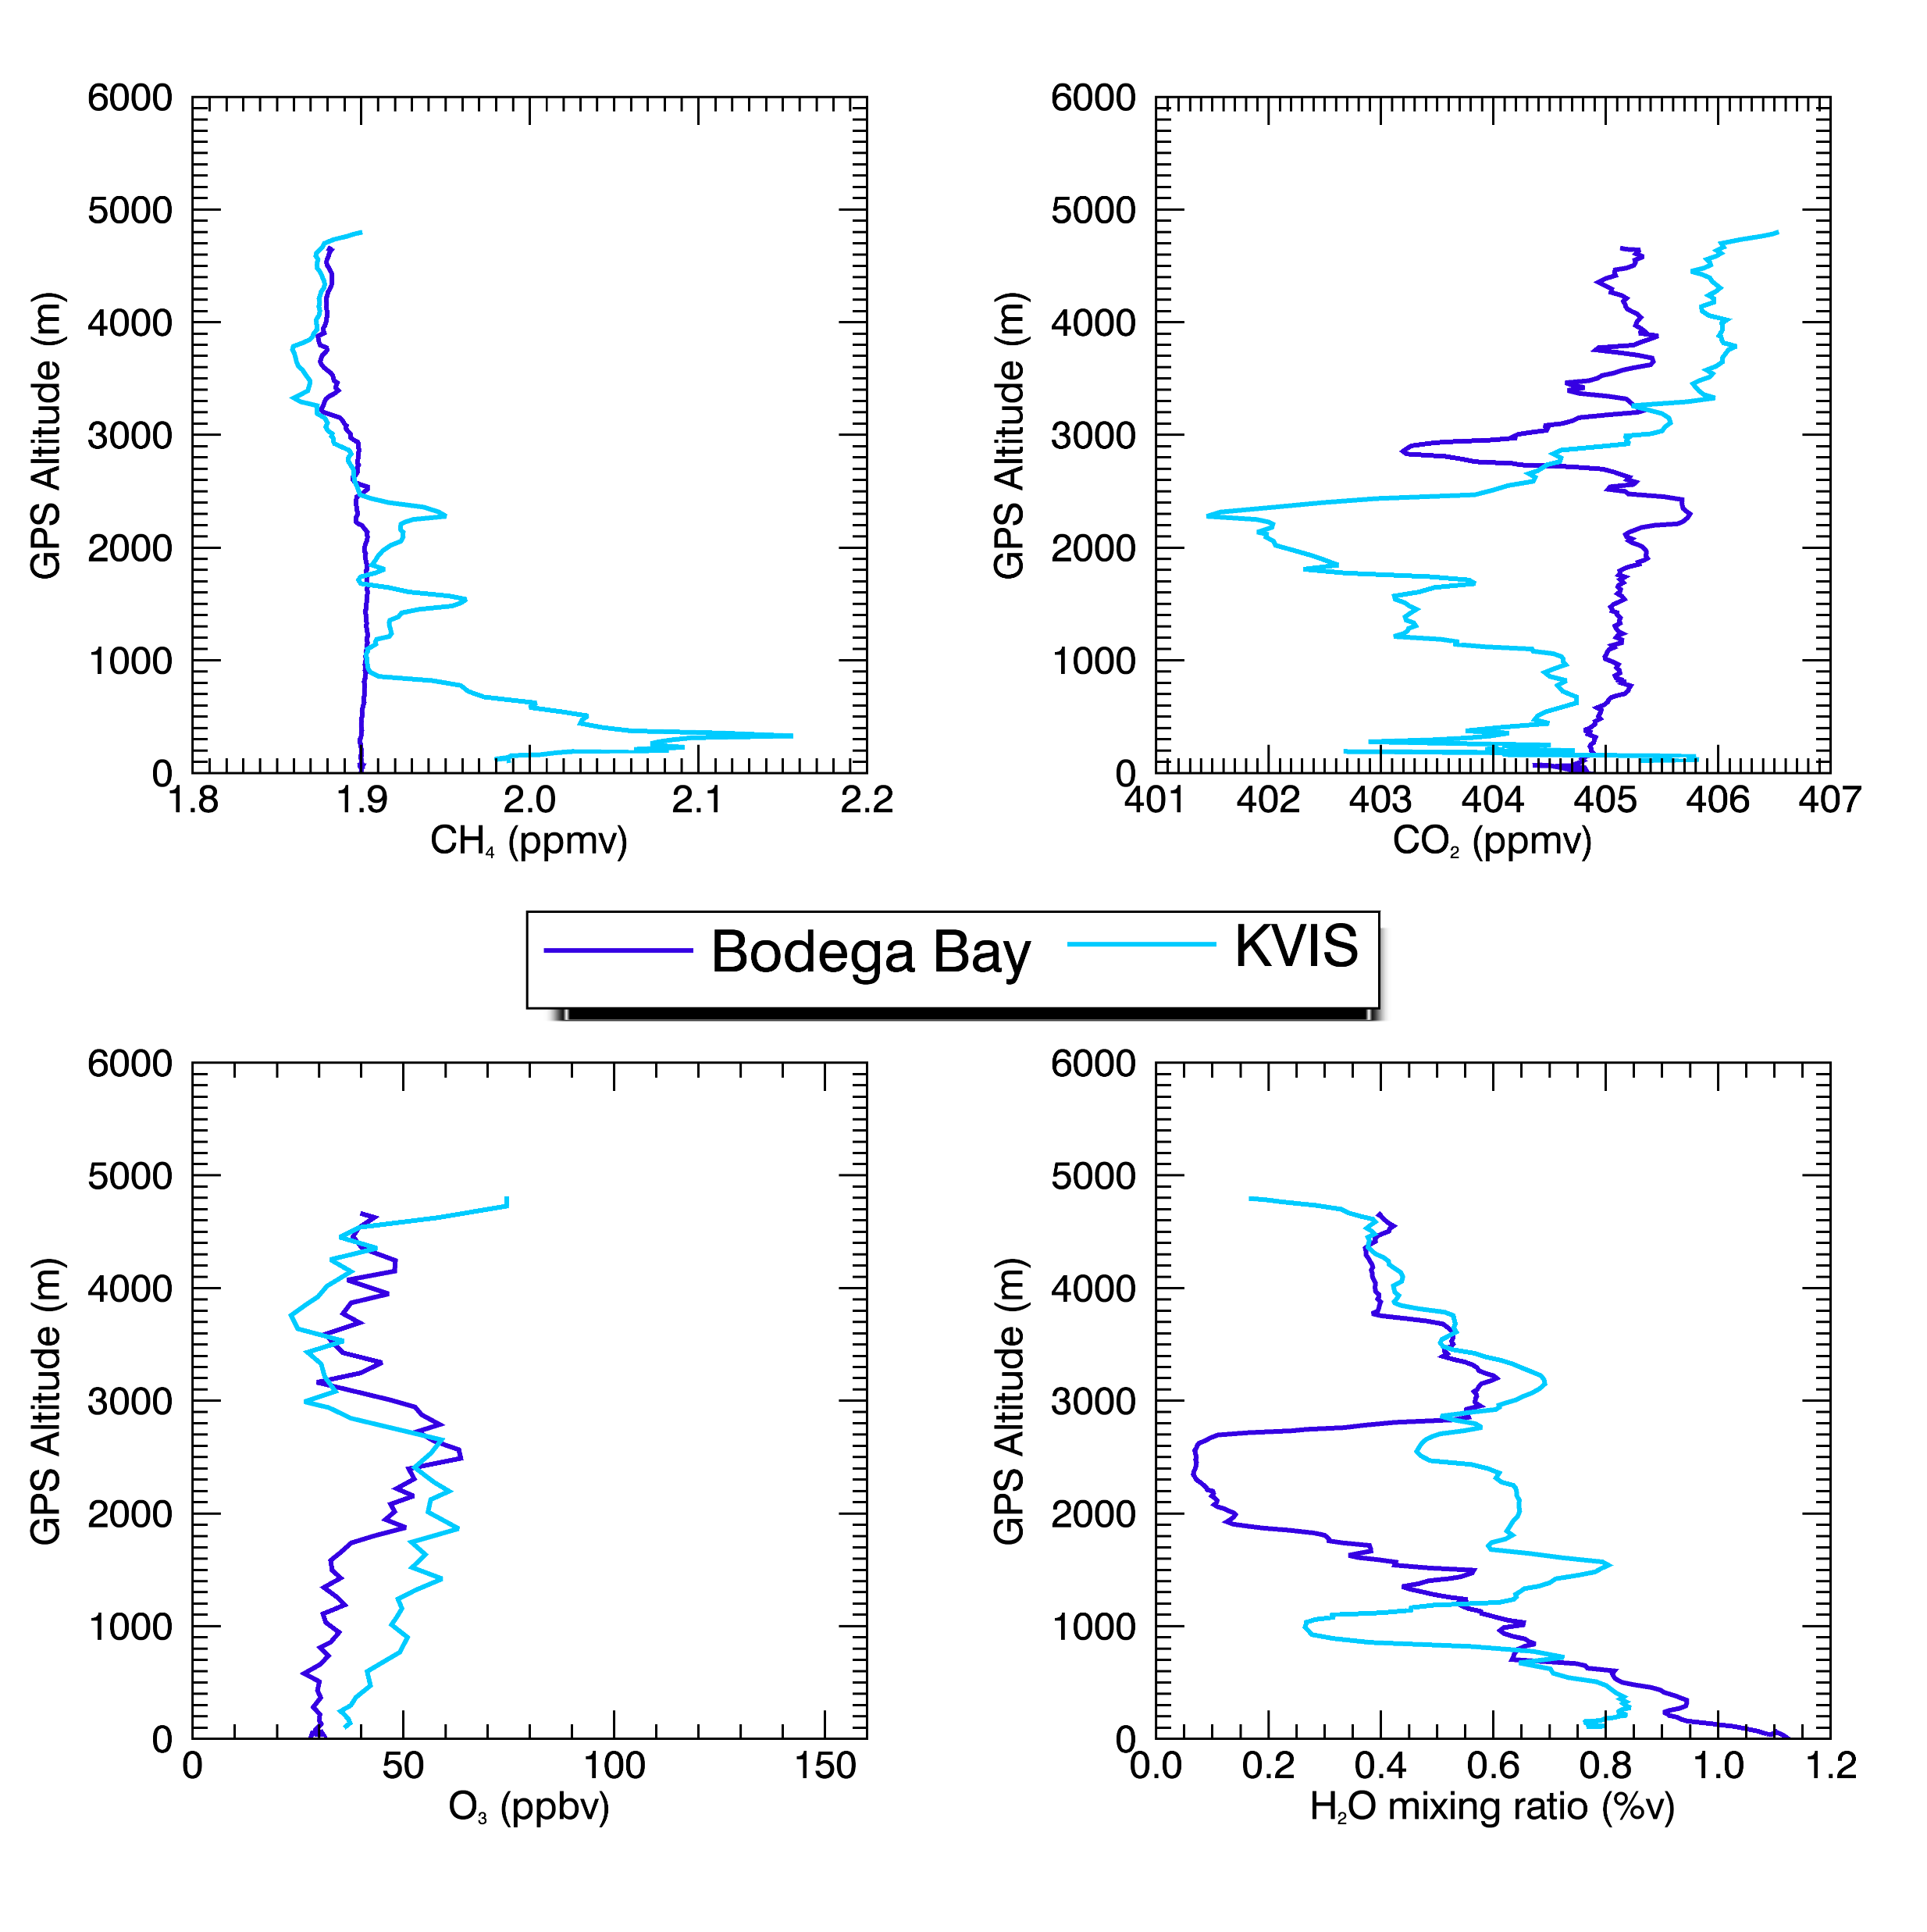
Supplementary Data: Flight 191 O3 & GHG Comparison

Slide 17
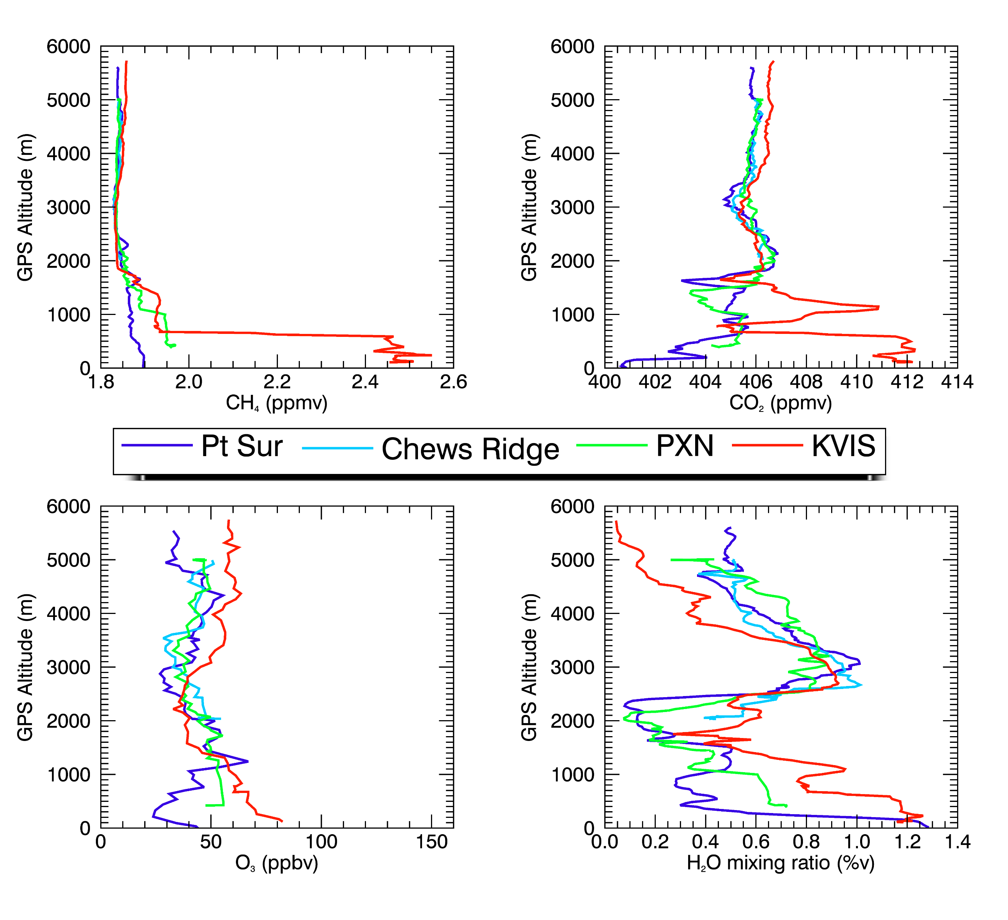
Supplementary Data: Flight 192 O3 & GHG Comparison

Slide 18
Supplementary Data: Flight 194 O3 Profile & GHG Comparison

Slide 19
Supplementary Data: Flight 195 O3 Profile and GHG Comparison

