Slide 1
-Earth System Research Laboratory-
-Chemical Sciences Division-
-Tropospheric Chemistry Program-
-Zachary Decker-
Notes:
Introduce the group: Something like…We are an analytical and physical chemistry group that investigates trace gases in the troposphere with field measurements, box modeling, and laboratory experiments. We design and build instruments that are field capable to measure several trace gases in the troposphere and then deploy them via aircraft, ships, mobile laboratories, towers, or stationary sites.

Slide 2
Presented by Zachary Decker
Tropospheric Chemistry at NOAA
3rd year PhD student
CU Boulder

Slide 3
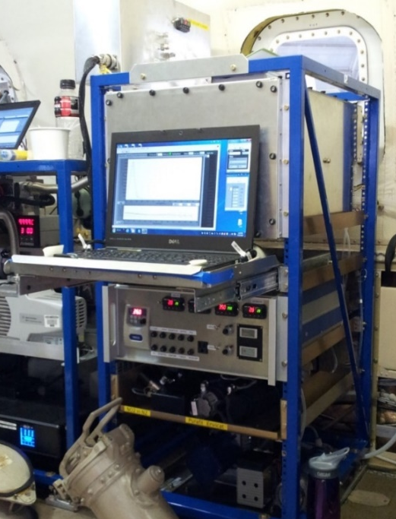
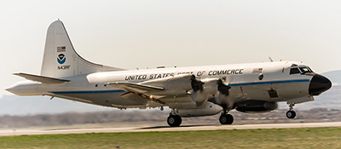
Our focus
is to improve understanding of atmospheric processes that underlie regional and continental air quality and to understand the influence that these processes have on climate, regionally and globally.
Our goal
is to enhance our ability to predict and monitor future changes, leading to improved scientific information in support of decision making.
How do we do it?
We measure atmospheric trace gases and regulated pollutants. We record atmospheric fingerprints.
+
Aircraft (NOAA WP-3D)
State-of-the-art instruments
Photo by A. Moravek
Notes:
Our focus is to improve understanding of atmospheric processes that underline air quality and the influence that these processes have on climate
Furthermore, our goal is to enhance our ability to predict future changes leading to improved scientific information in support of decision making.

Slide 4
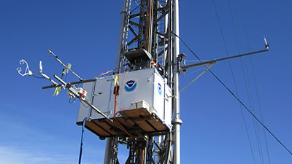
Our focus
Is to improve understanding of atmospheric processes that underline regional and continental air quality and to understand he influence that these processes have on climate, regionally and globally.
Our goal
Is to enhance our ability to predict and monitor future changes, leading to improved scientific information in support of decision making.
How do we do it?
We measure atmospheric trace gasses and regulated pollutants. We record atmospheric fingerprints.
+
Ground Based (Boulder Atmospheric Observatory)
State-of-the-art instruments
Photo by A. Moravek
Notes:
Our focus is to improve understanding of atmospheric processes that underline air quality and the influence that these processes have on climate
Furthermore, our goal is to enhance our ability to predict future changes leading to improved scientific information in support of decision making.

Slide 5
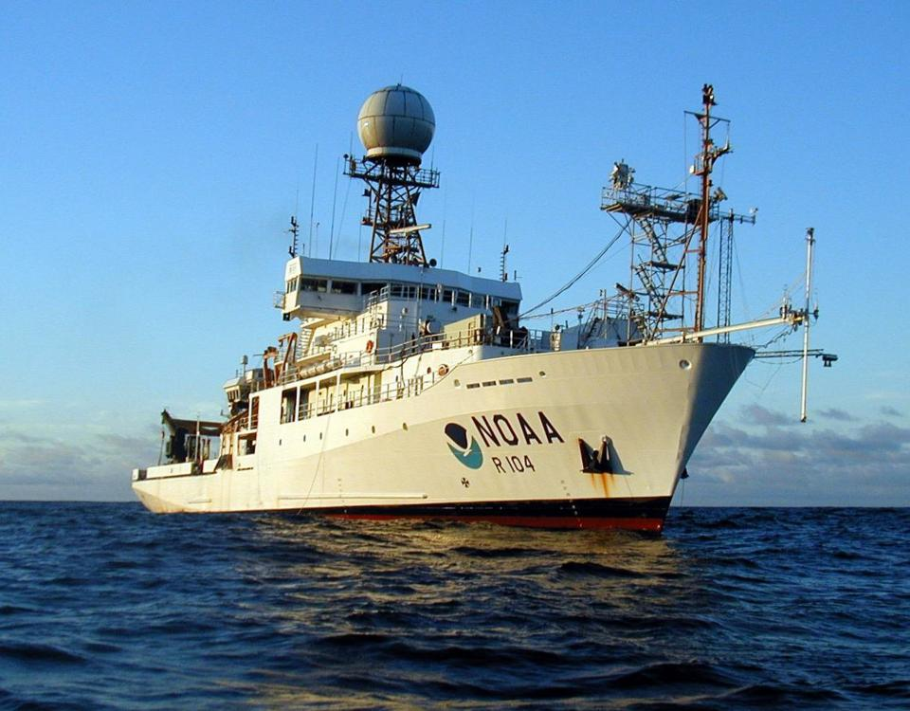
Our focus
Is to improve understanding of atmospheric processes that underline regional and continental air quality and to understand he influence that these processes have on climate, regionally and globally.
Our goal
Is to enhance our ability to predict and monitor future changes, leading to improved scientific information in support of decision making.
How do we do it?
We measure atmospheric trace gasses and regulated pollutants. We record atmospheric fingerprints.
+
State-of-the-art instruments
Ships (NOAA R/V Ronald H. Brown)
Photo by A. Moravek
Notes:
Our focus is to improve understanding of atmospheric processes that underline air quality and the influence that these processes have on climate
Furthermore, our goal is to enhance our ability to predict future changes leading to improved scientific information in support of decision making.

Slide 6
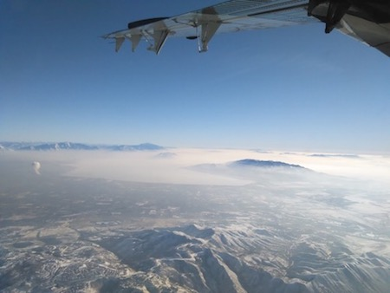
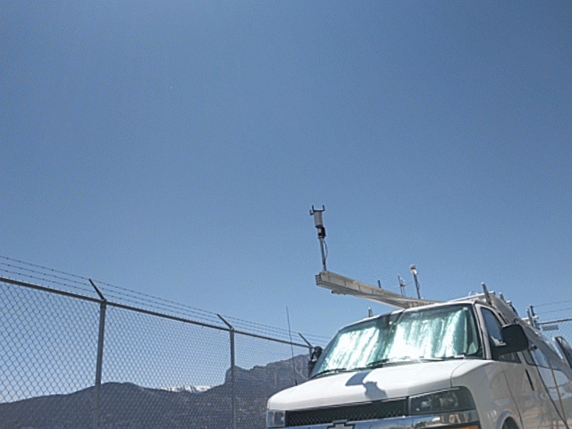
Tropospheric Chemistry Program Field Campaigns
WINTER 2015
Winter Investigation of Transport Emissions and Reactivity
UWFPS 2017
Utah Winter Fine Particulate Study
Goal: Determine factors governing high particulate matter pollution in Northern Utah during winter.
Goal: To understand the source, fate and impact of air pollutants in winter.
Results:
New information on emissions, fundamental chemical processes, pollutant transport and lifetime to inform predictive models.
Results:
Provided time critical information to key stakeholders to improve pollution control strategies.
FAST-LVOS 2017
Fires-Asian and Stratospheric Transport Las Vegas Ozone Study
Notes:
WINTER: To gain a fundamental understanding of the fate and impact of pollution. We gained insights into the gas and particle phase processes affecting nitrogen oxides. As well as wintertime SOA production.
UWFPS: Our goal was to determine the factors governing high PM pollution in a Northern Utah winter.
FAST-LVOS: Where our goal was to understand the factors contributing to high Las Vegas Ozone.

Slide 7
Our team measures trace gases and aerosol
We measure pollutants relevant to daytime and nighttime atmospheric chemistry
My research focuses on the nighttime processes that impact air quality.
We Measure
NO
NO₂
NO₃
N₂O₅
NO_{y}
Glyoxal
HONO
O₃
Aerosol Optical
Properties
Different Chemistry Happens Here
Chemistry Happens Here
Trop.
Gases
Detector
Laser
Notes:
Our measurements are made using an absorption spectroscopy technique called cavity ringdown spectroscopy. We pull in tropospheric gases into our instrument where we shine laser light as a specific wavelength through this gas sample. The light is specifically absorbed by the molecules we want to measure. Based on how much light is lost we can determine the amount of pollutant inside the instrument.

Slide 8
Up Next Is The FIREX-AQ (Summer 2019) Campaign
Fire Influence on Regional to Global Environments and Air Quality
An interagency partnership engaging collaborations across the United States

Slide 9
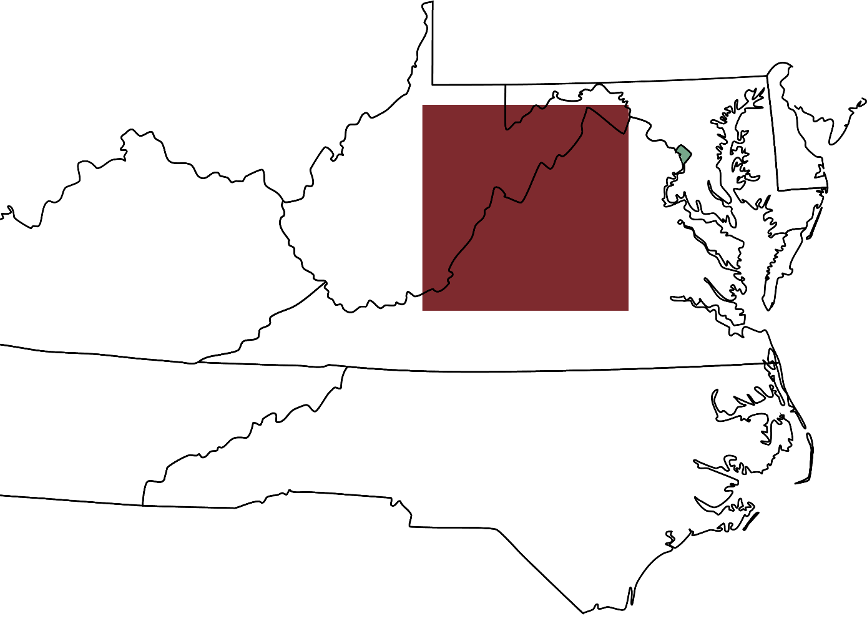
Washington D.C.
Last year 16.4 million acres burned in the U.S.¹
That’s the area of this red square.
WV
KY
VA
That doesn’t include agricultural burning.
TN
NC
(1) National Interagency Fire Center

Slide 10
Important emissions from wildfires
Particulate Matter
Nitrogen Oxides
NO + NO₂
Biomass Burning Volatile Organic Compounds (BBVOCs)
These emissions will react with common oxidants
O₃, OH, NO₃
NO₃ + BBVOCs is an Open Science Question

Slide 11
NO₃ + BBVOCs is an Open Science Question
Are these reactions a significant source of particulate matter?
How do these reactions affect next day ozone?
We are now working to answer these questions.

Slide 12
Wildfires
Agricultural Burning
Notes:
My most recent research modeled these nighttime plumes. It suggests that a wildfire smoke plume undergoes chemistry dominated by ozone and NO3 oxidation. An agricultural burn smoke plume undergoes chemistry dominated by NO3, with important contributions from ozone.

Slide 13
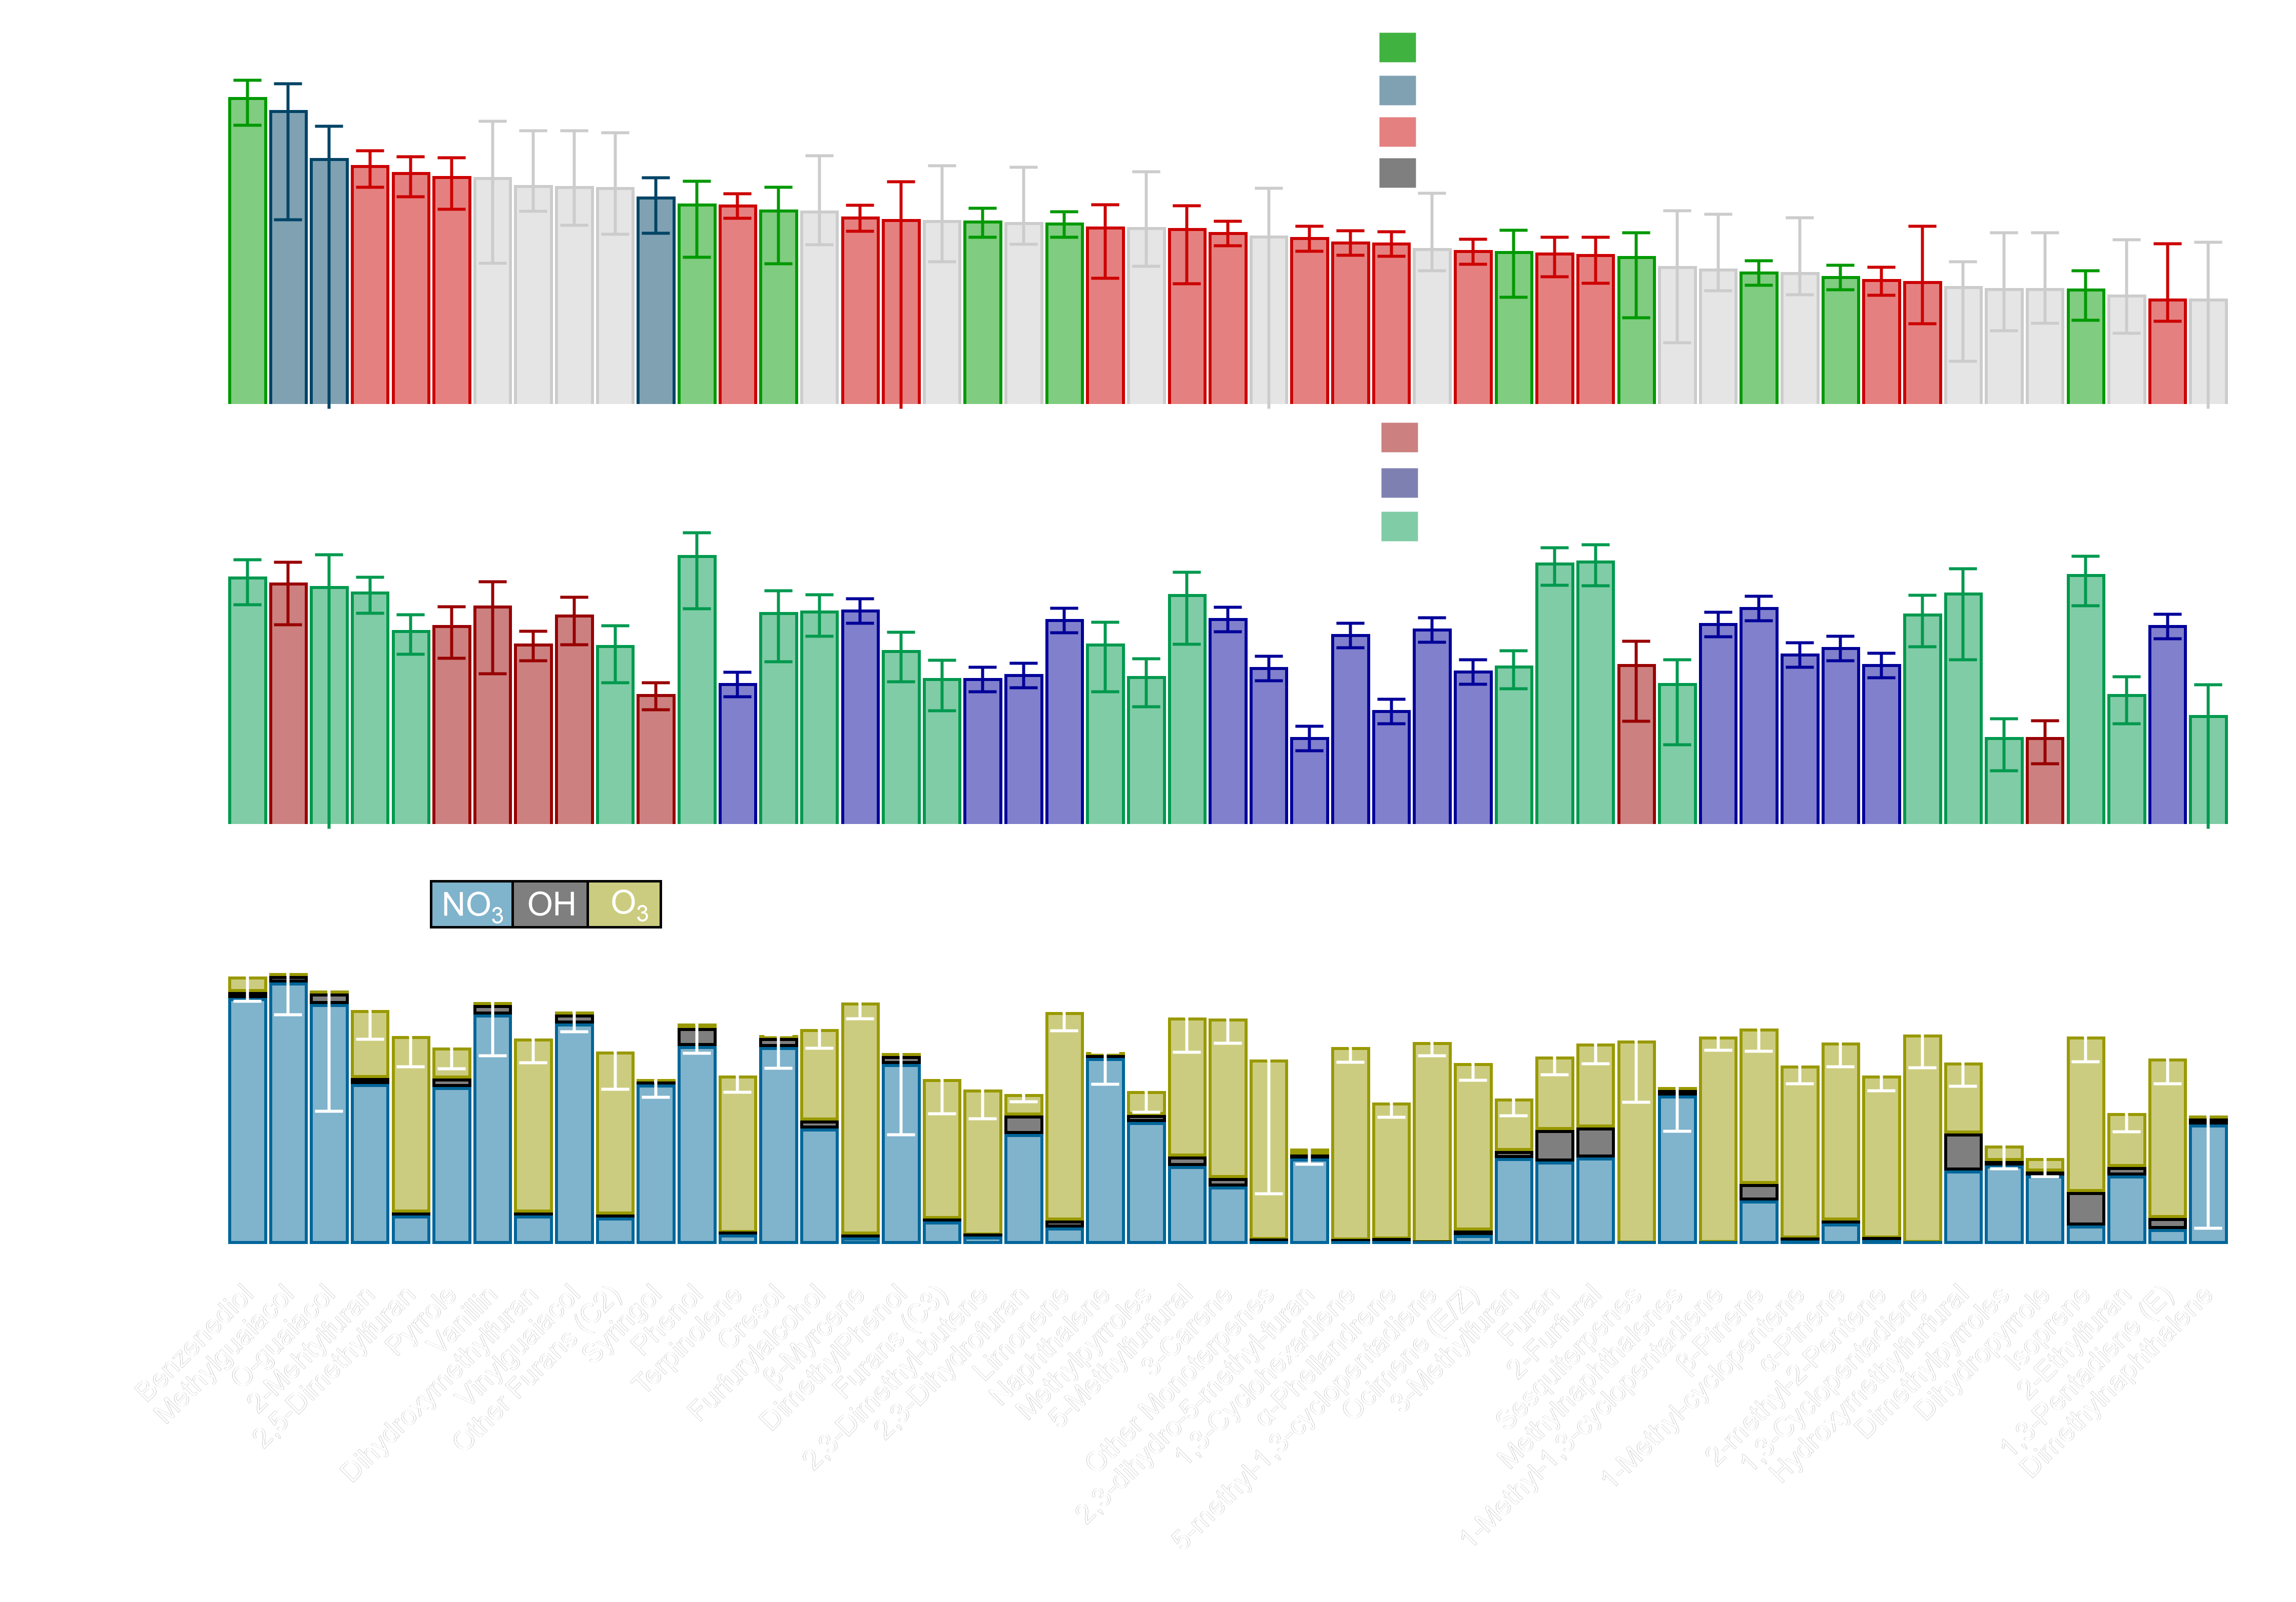
Terpene emissions are greater
Oxidation by O₃ is more important
O₃ uncertainties are larger
Detailed results at my poster
Nighttime Aircraft Intercepts of Biomass Burning Plumes: Observations and Box Model Analysis
Thursday, 13 December 2018; 13:40 - 18:00
Abstract ID: A43M-3287
OH
O₃
NO₃
Max NO₃
Max O₃
Ponderosa Pine

Slide 14
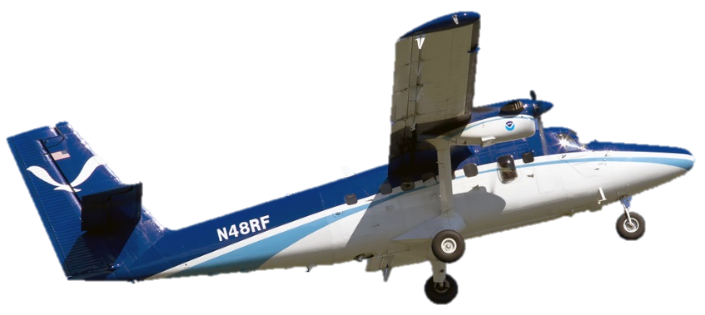
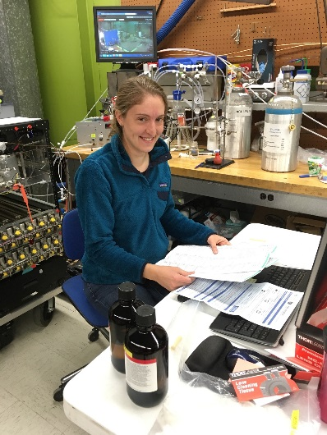
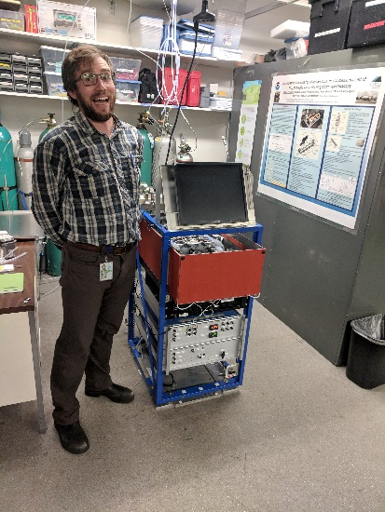
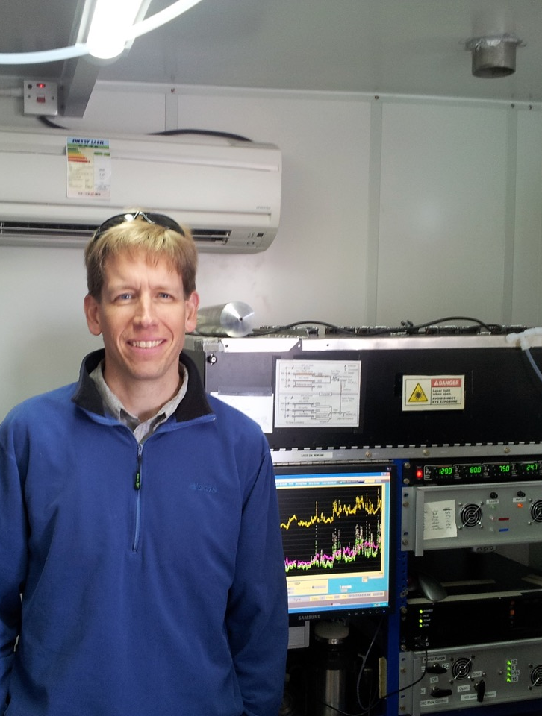
NOAA Twin Otter Aircraft
Rebecca
Washenfelder
Carrie
Womack
Mike
Robinson
Steve
Brown
We will fly at night on a NOAA Twin Otter Aircraft

