Slide 1
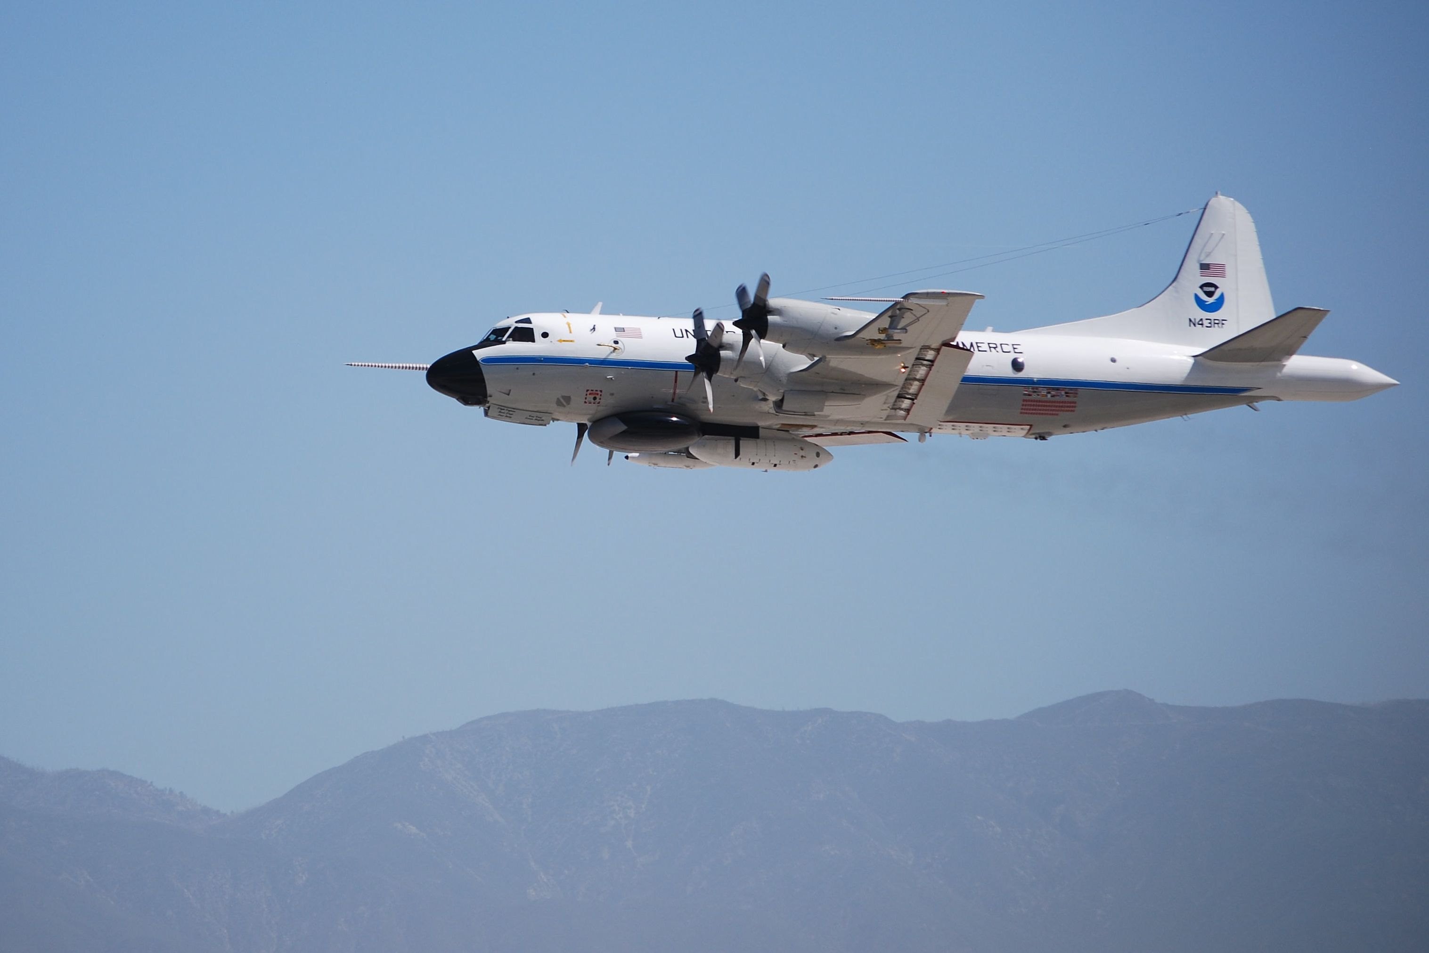
Airborne Measurements of Ammonia and Implications for Ammonium Nitrate Formation in the Central Valley and the South Coast Air Basin of California
P-3 NH₃ Observations
SoCAB NH₃ : Cars and Cows
Central Valley Dairy NH₃ Flux
NH₄NO₃ in Central Valley -
  NH₃ or HNO₃?
J.B. Nowak^{1,2}, J.A. Neuman^{1,2}, R. Bahreini^{1,2}, A. M. Middlebrook², C.A. Brock², G. J. Frost^{1,2}, J.S. Holloway^{1,2}, S.A. McKeen^{1,2}, J. Peischl^{1,2}, I.B. Pollack^{1,2}, J.M. Roberts², T.B. Ryerson², M. Trainer², and D.D. Parrish^{1,2}
¹CIRES, University of Colorado, Boulder, CO
²NOAA-ESRL, Chemical Sciences Division, Boulder, CO
http://www.esrl.noaa.gov/csd/calnex/
Notes:
Focusing on sources in this talk

Slide 2
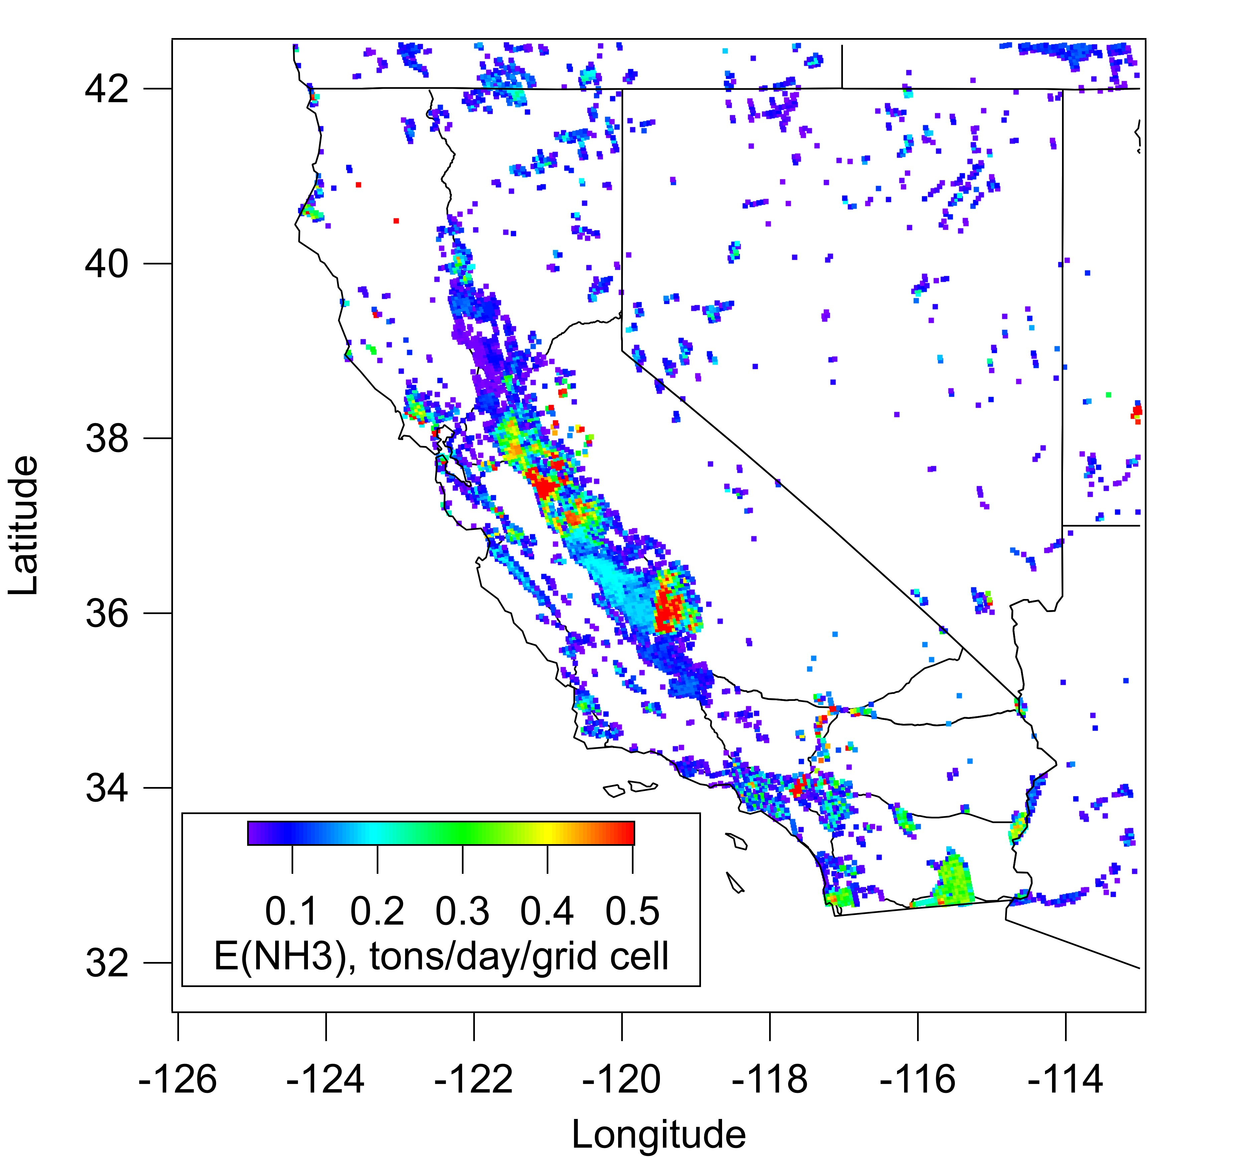
California NH₃ Area Emissions
EPA NEI 1999v3
(Frost et al., JGR 2006)
All area sources
Point sources excluded
4 km resolution
Grid emissions < 0.05 tons/day not shown
Central Valley
  Agriculture
SoCAB
  Agriculture
  Cars

Slide 3
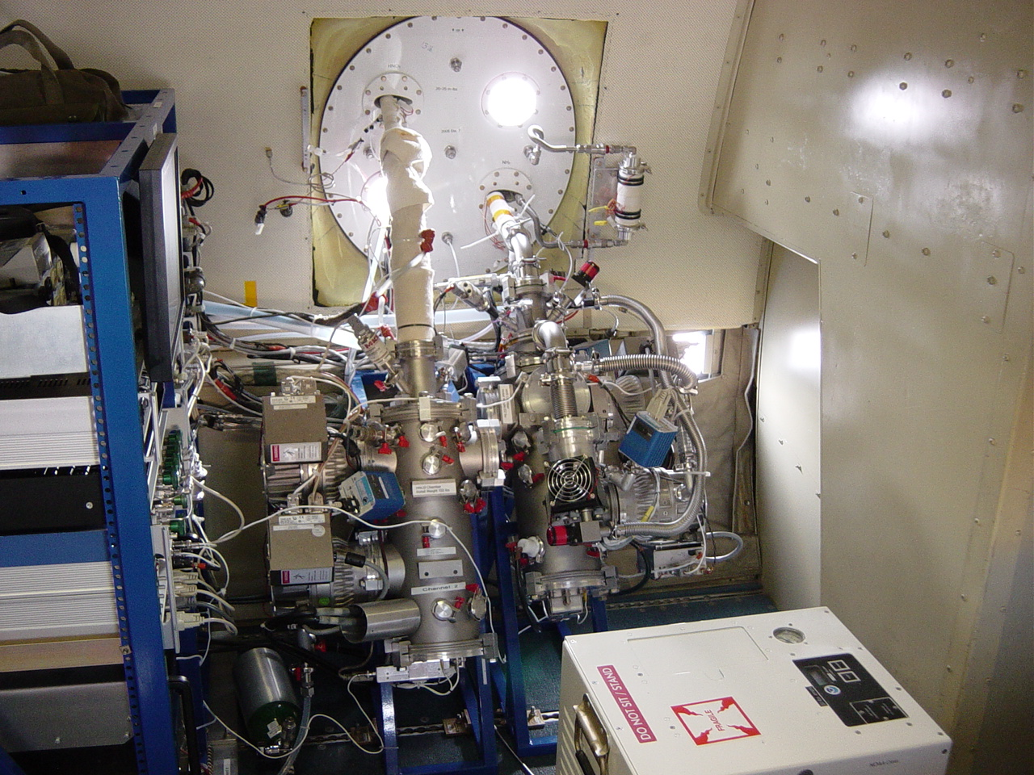
P-3 NH₃ CIMS Instrument
Chemical Ionization Mass Spectrometry (CIMS) uses ion-molecule reactions to selectively react gas-phase species of interest to an easily detectable product ion. (Nowak et al., JGR, 2007, 2010)
(C₃H₆O)₂H⁺ + NH₃ → (C₃H₆O)₂H⁺•NH₃
Sensitivity ~ 1± 0.5 Hz/pptv (for 1 MHz reagent ion)
Background ~ 0.2 to 1 ppbv (varied flight-to-flight)
Time Response ~ 1 s
Uncertainty ~ ± (30% + (0.100 to 0.200) ppbv)

Slide 4
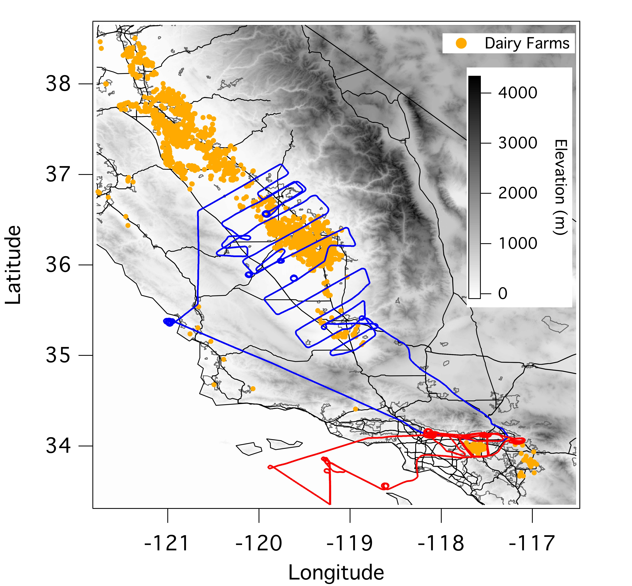
P-3 NH₃ Sampling Strategy
Dairy locations from Salas et al., PIER Report, 2008
Flight tracks
  May 7 – SJV
  May 14 – LA
6 flights in the Central Valley
7 flights through the SoCAB
Notes:
Salas,␣William,␣Li,␣Changsheng,␣Mitloehner,␣Frank,␣and␣John␣Pisano.␣2008.␣Developing␣and␣ Applying␣Process␣Based␣Models␣for␣Estimating␣Greenhouse␣Gas␣and␣Air␣Emission␣From␣California␣ Dairies.␣California␣Energy␣Commission,␣PIER␣Energy␣Related␣Environmental␣Research.␣CEC␣ 500␣2008␣093␣
PIER – Public Interest Energy Research

Slide 5
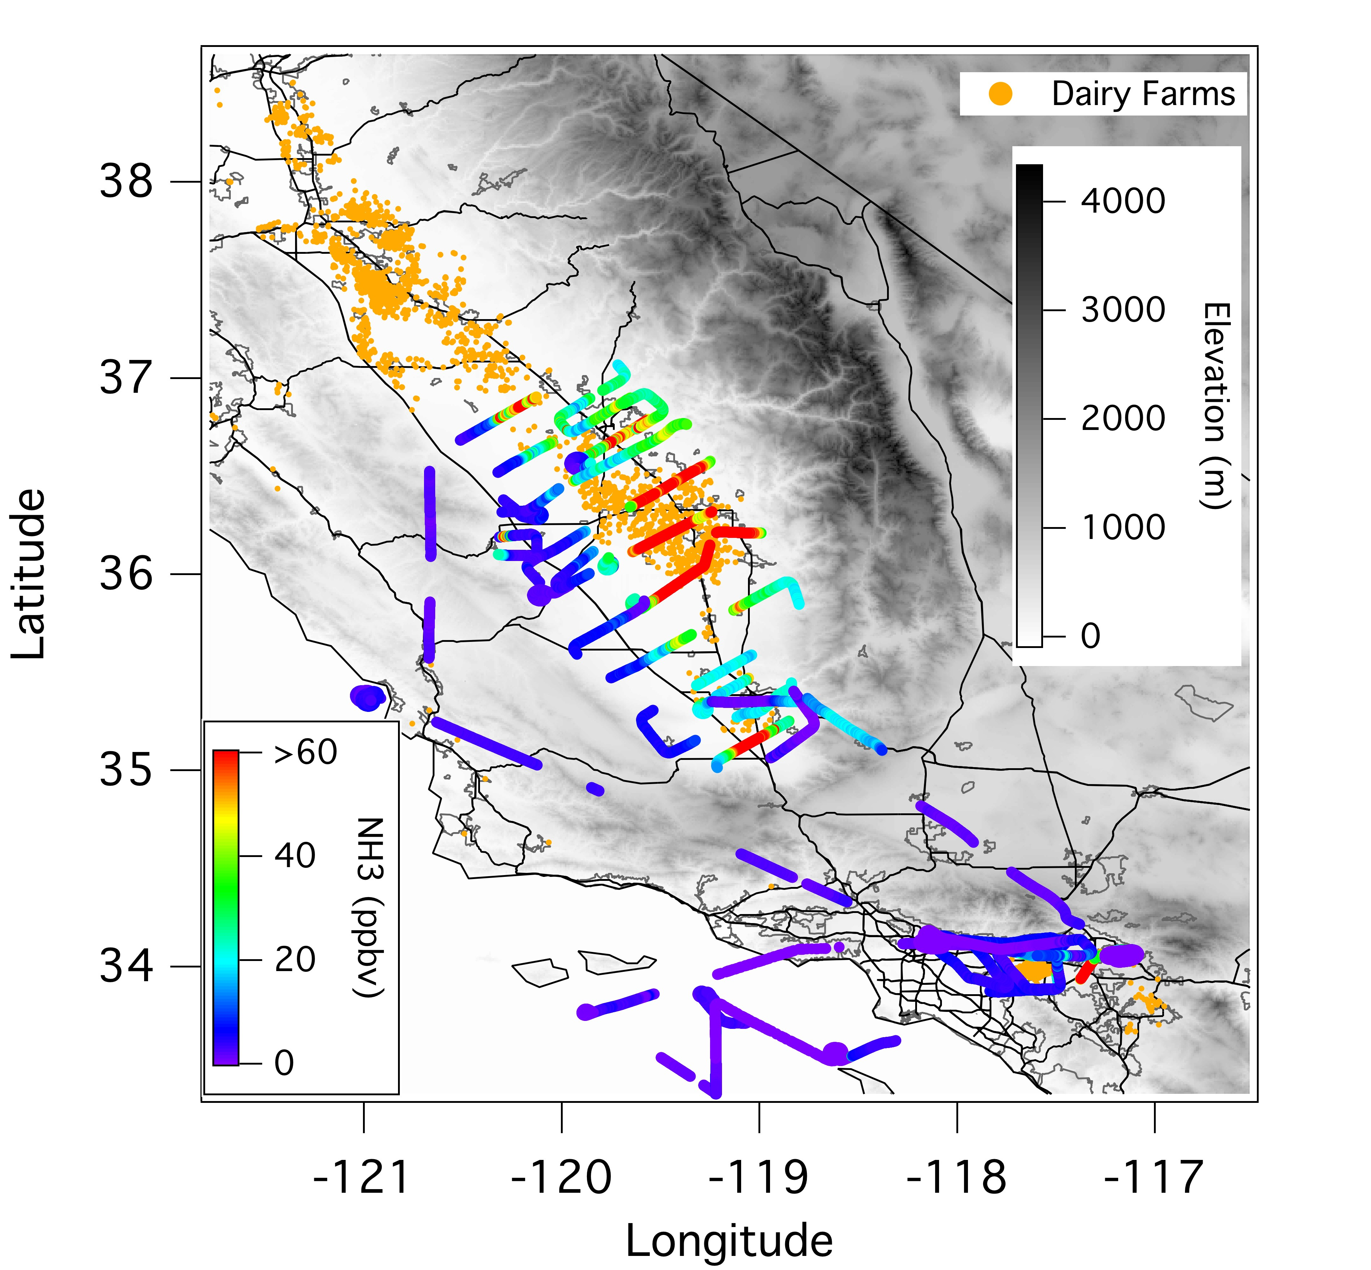
High NH₃ Mixing Ratios
Peak Mixing Ratios
May 7 - 963 ppbv
May 14 - 140 ppbv
Notes:
Hot Spots also seen from Satellites, IASI NH3 Nature Geoscience 2009.

Slide 6
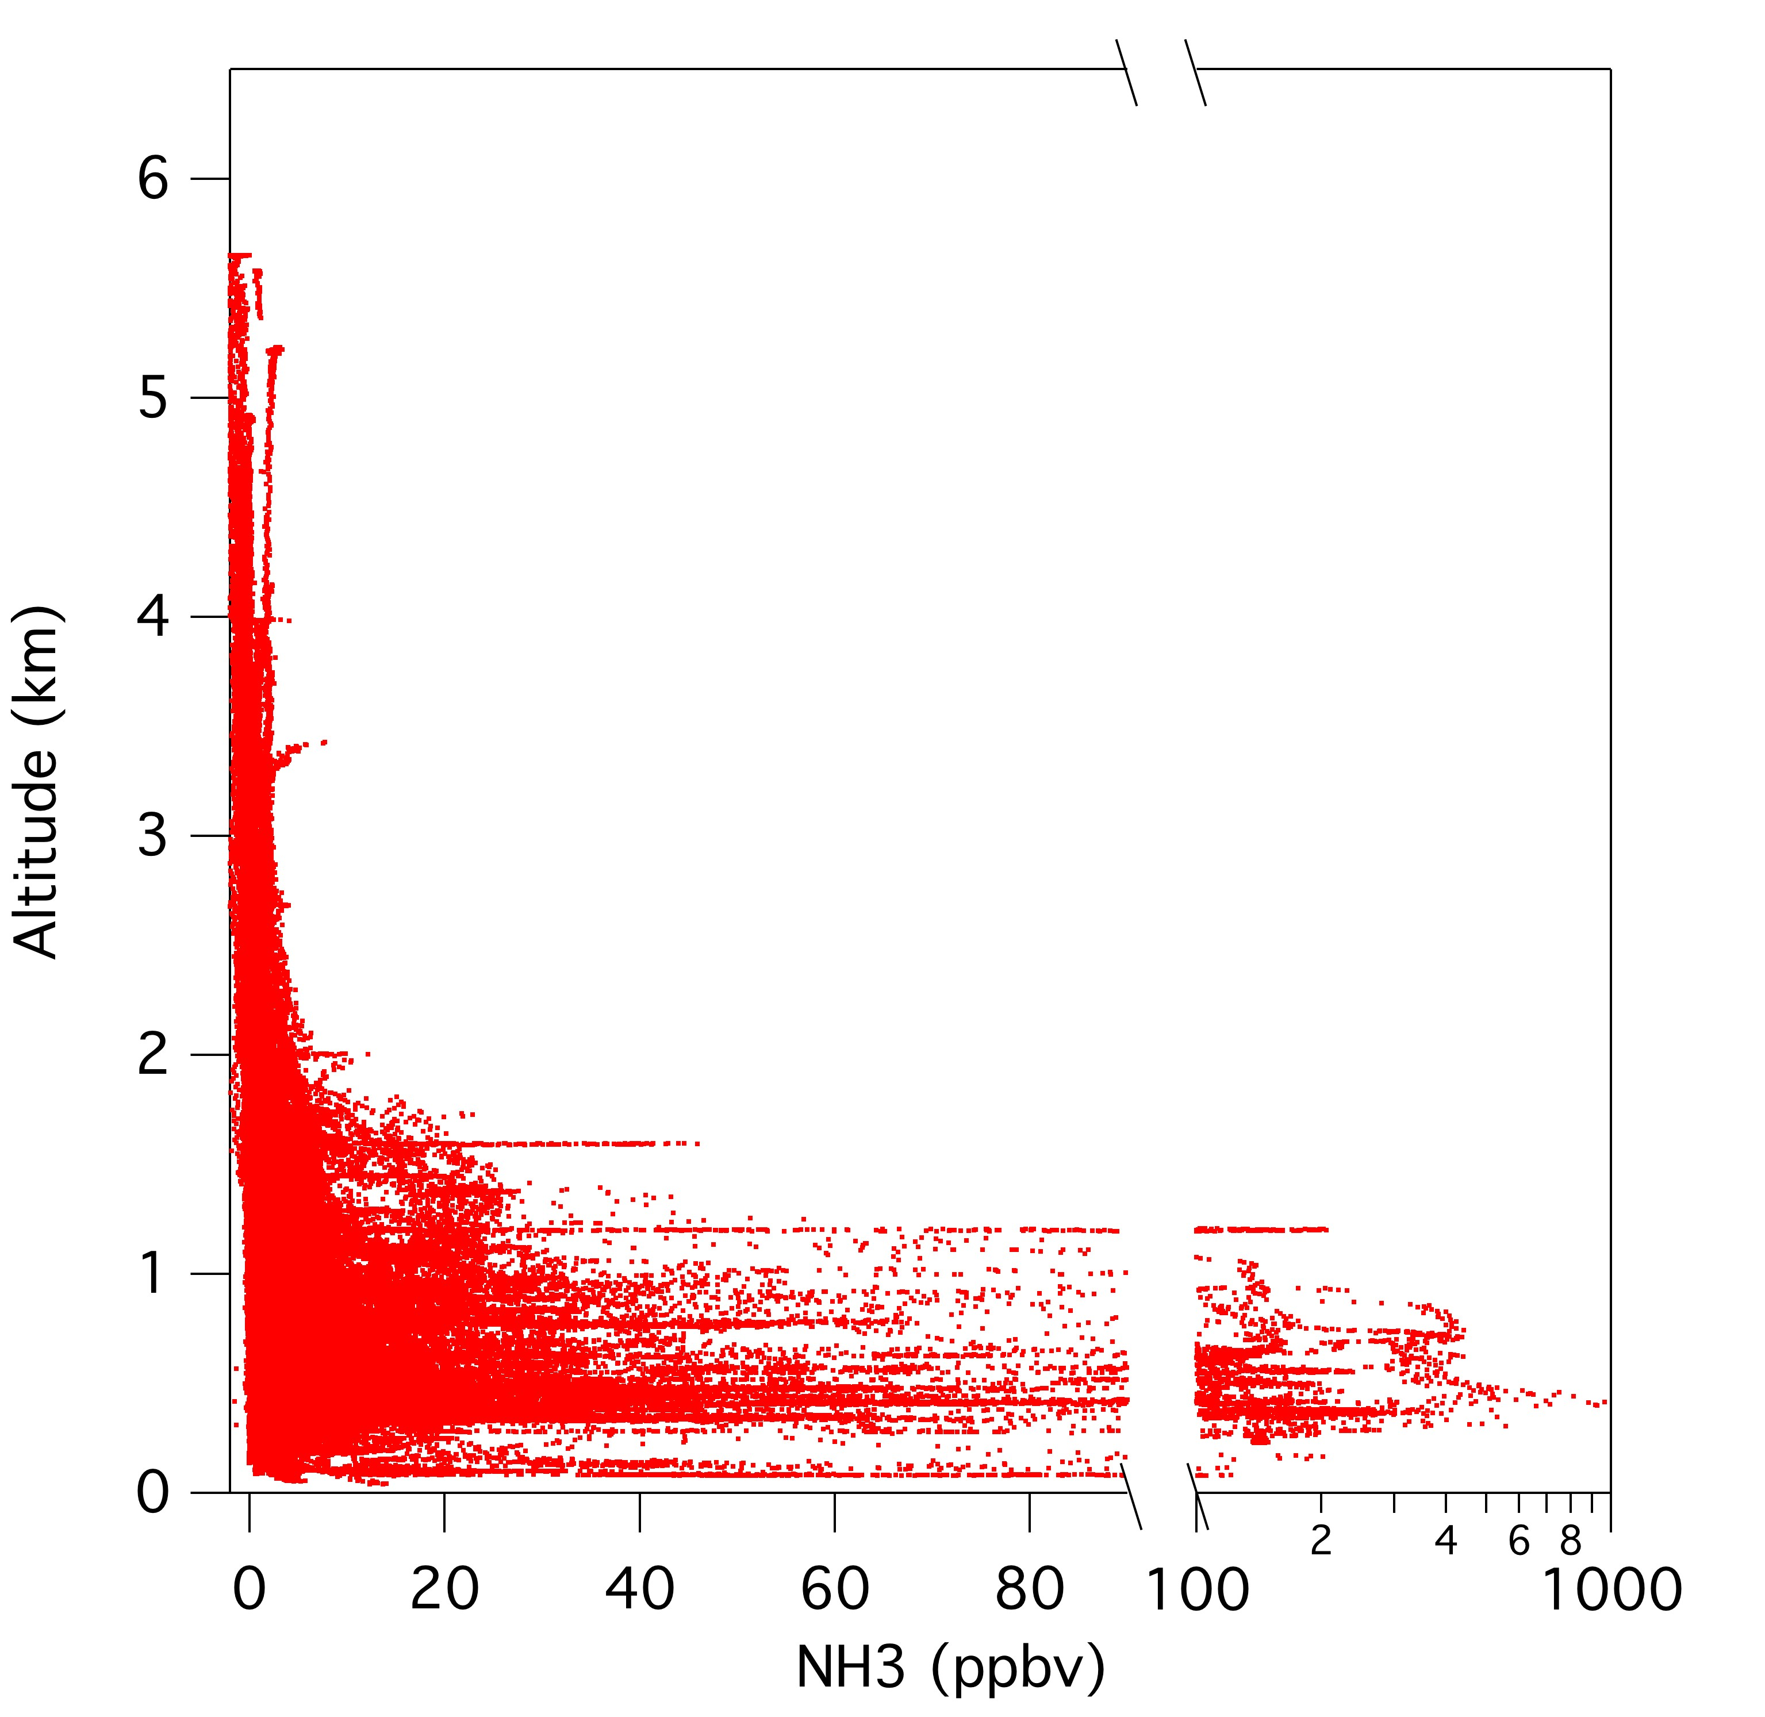
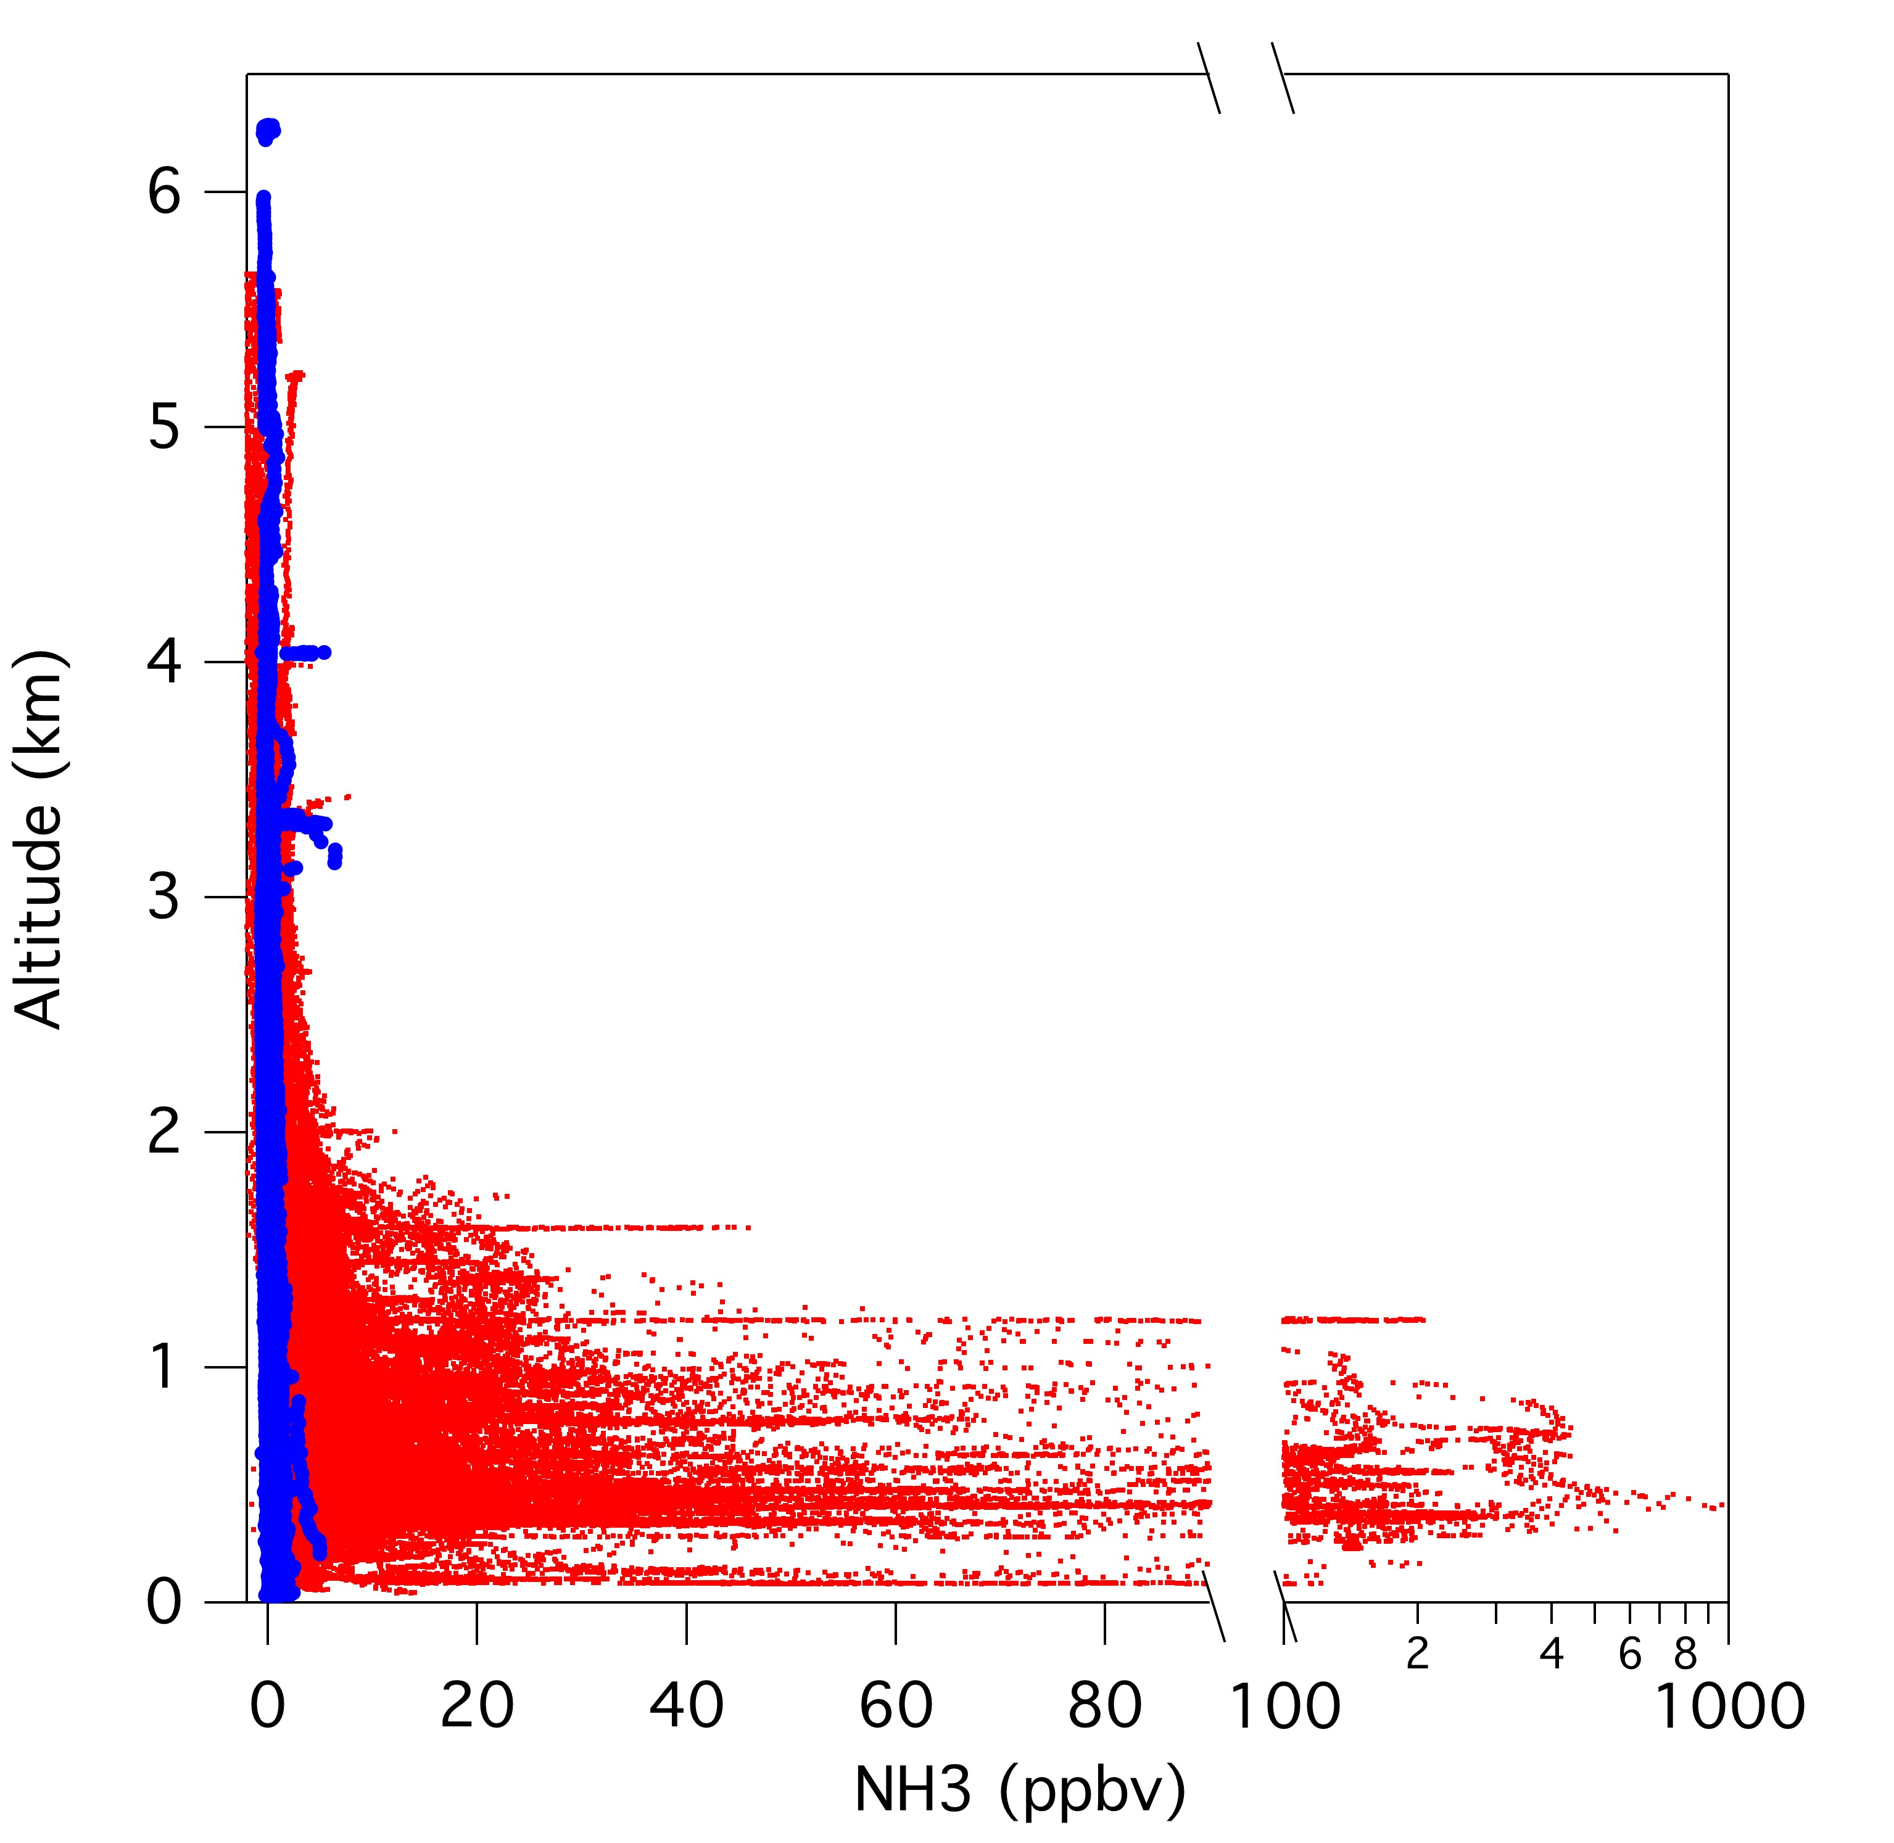
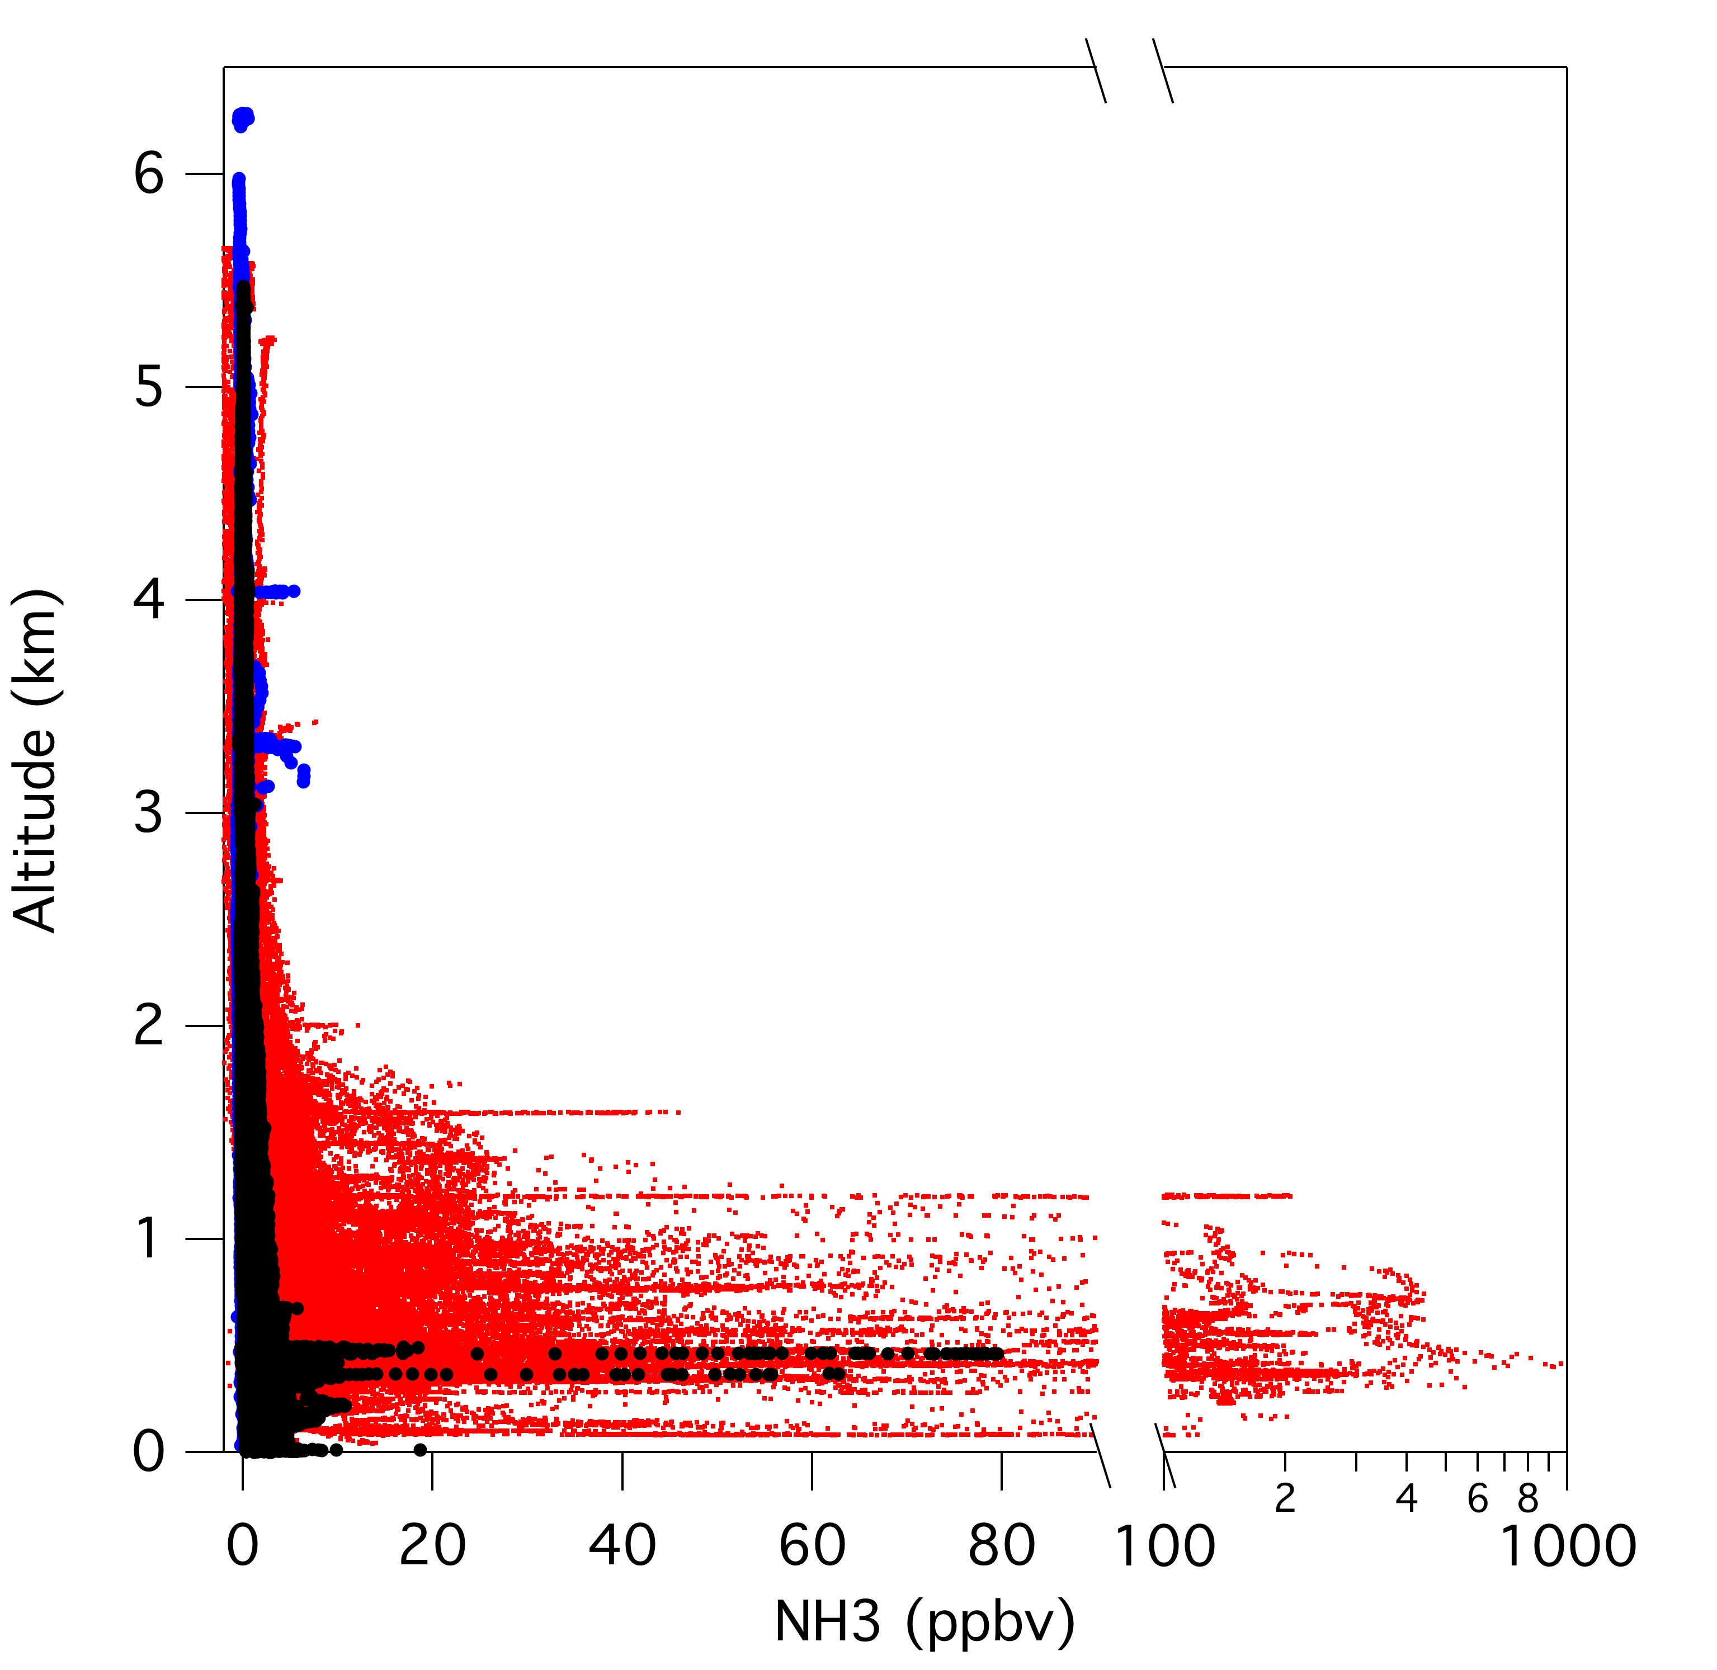
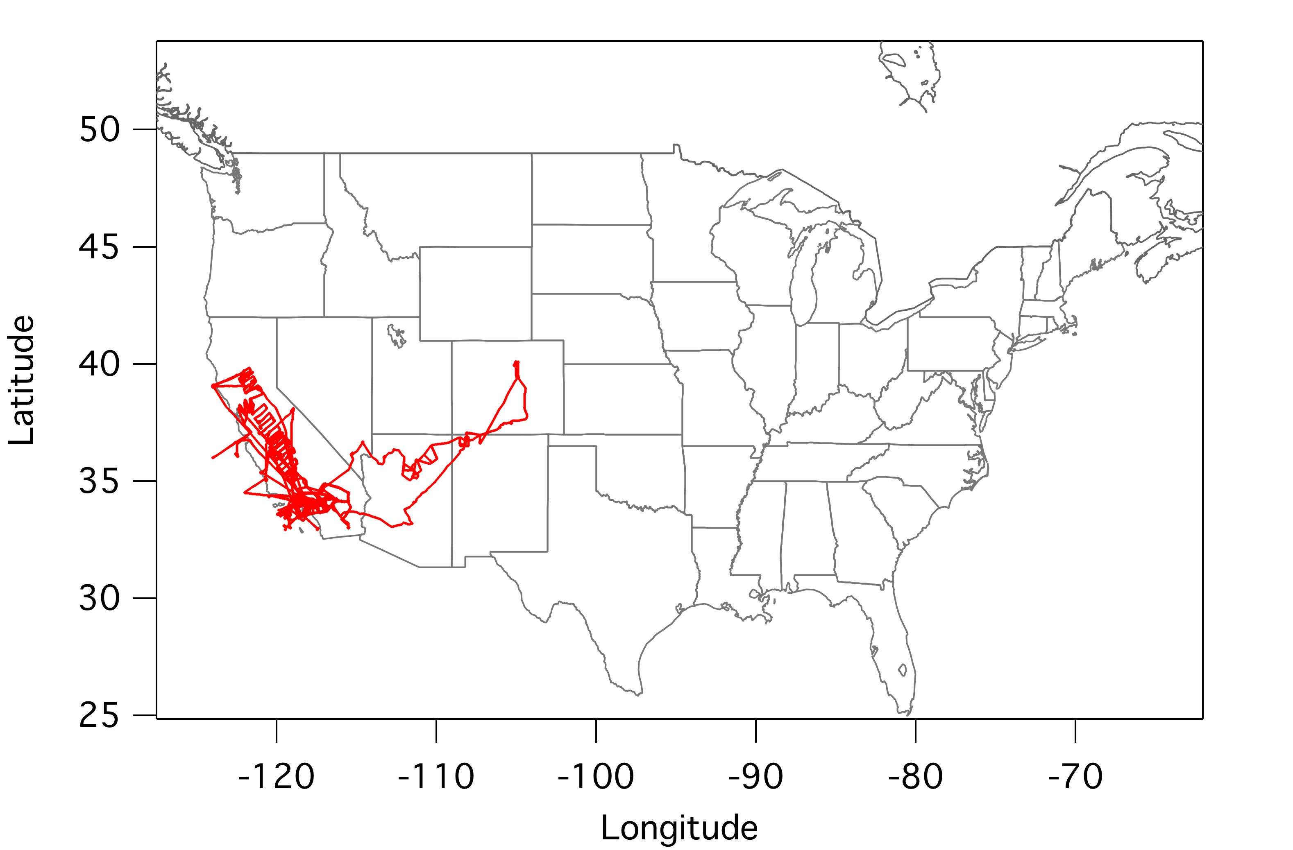
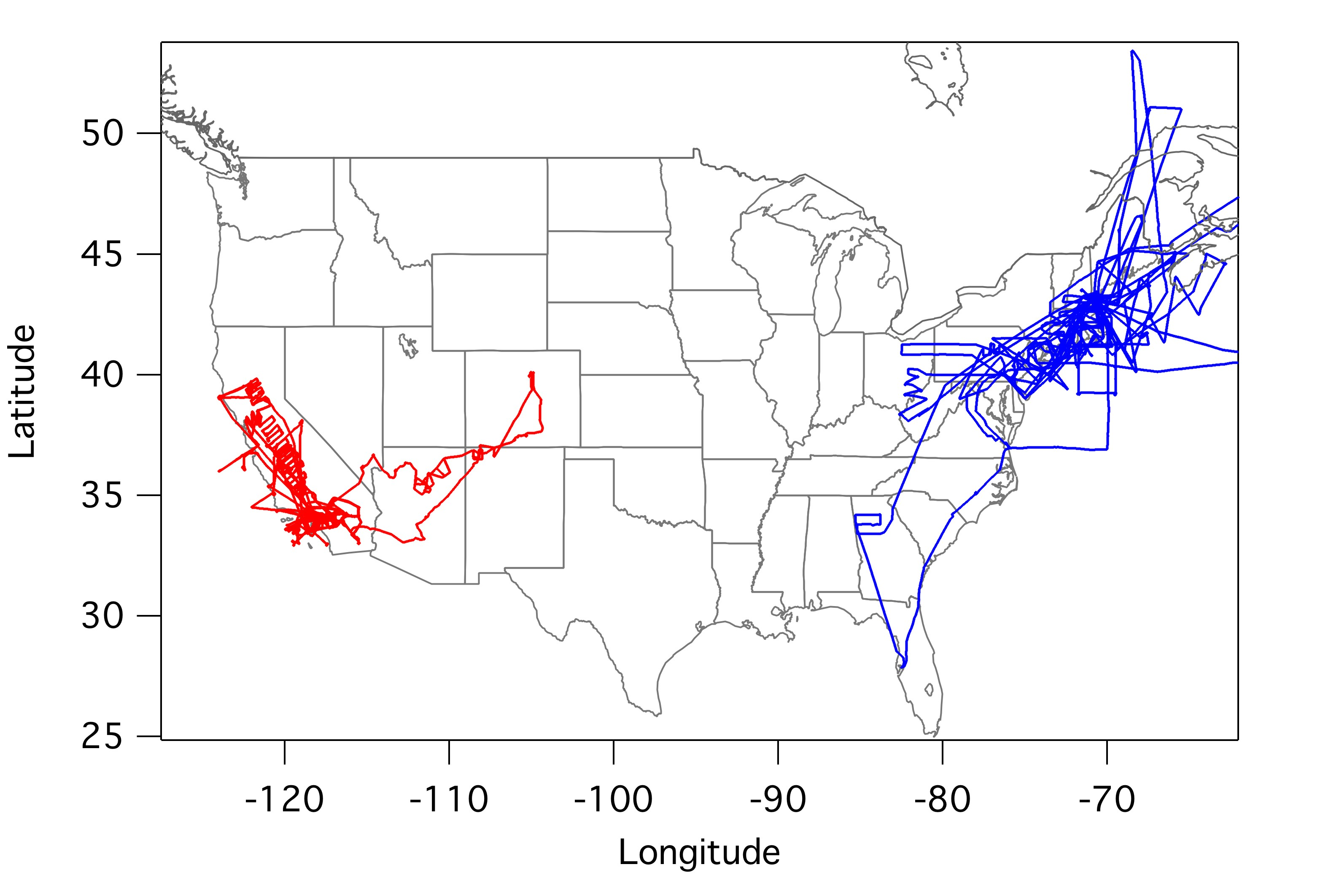
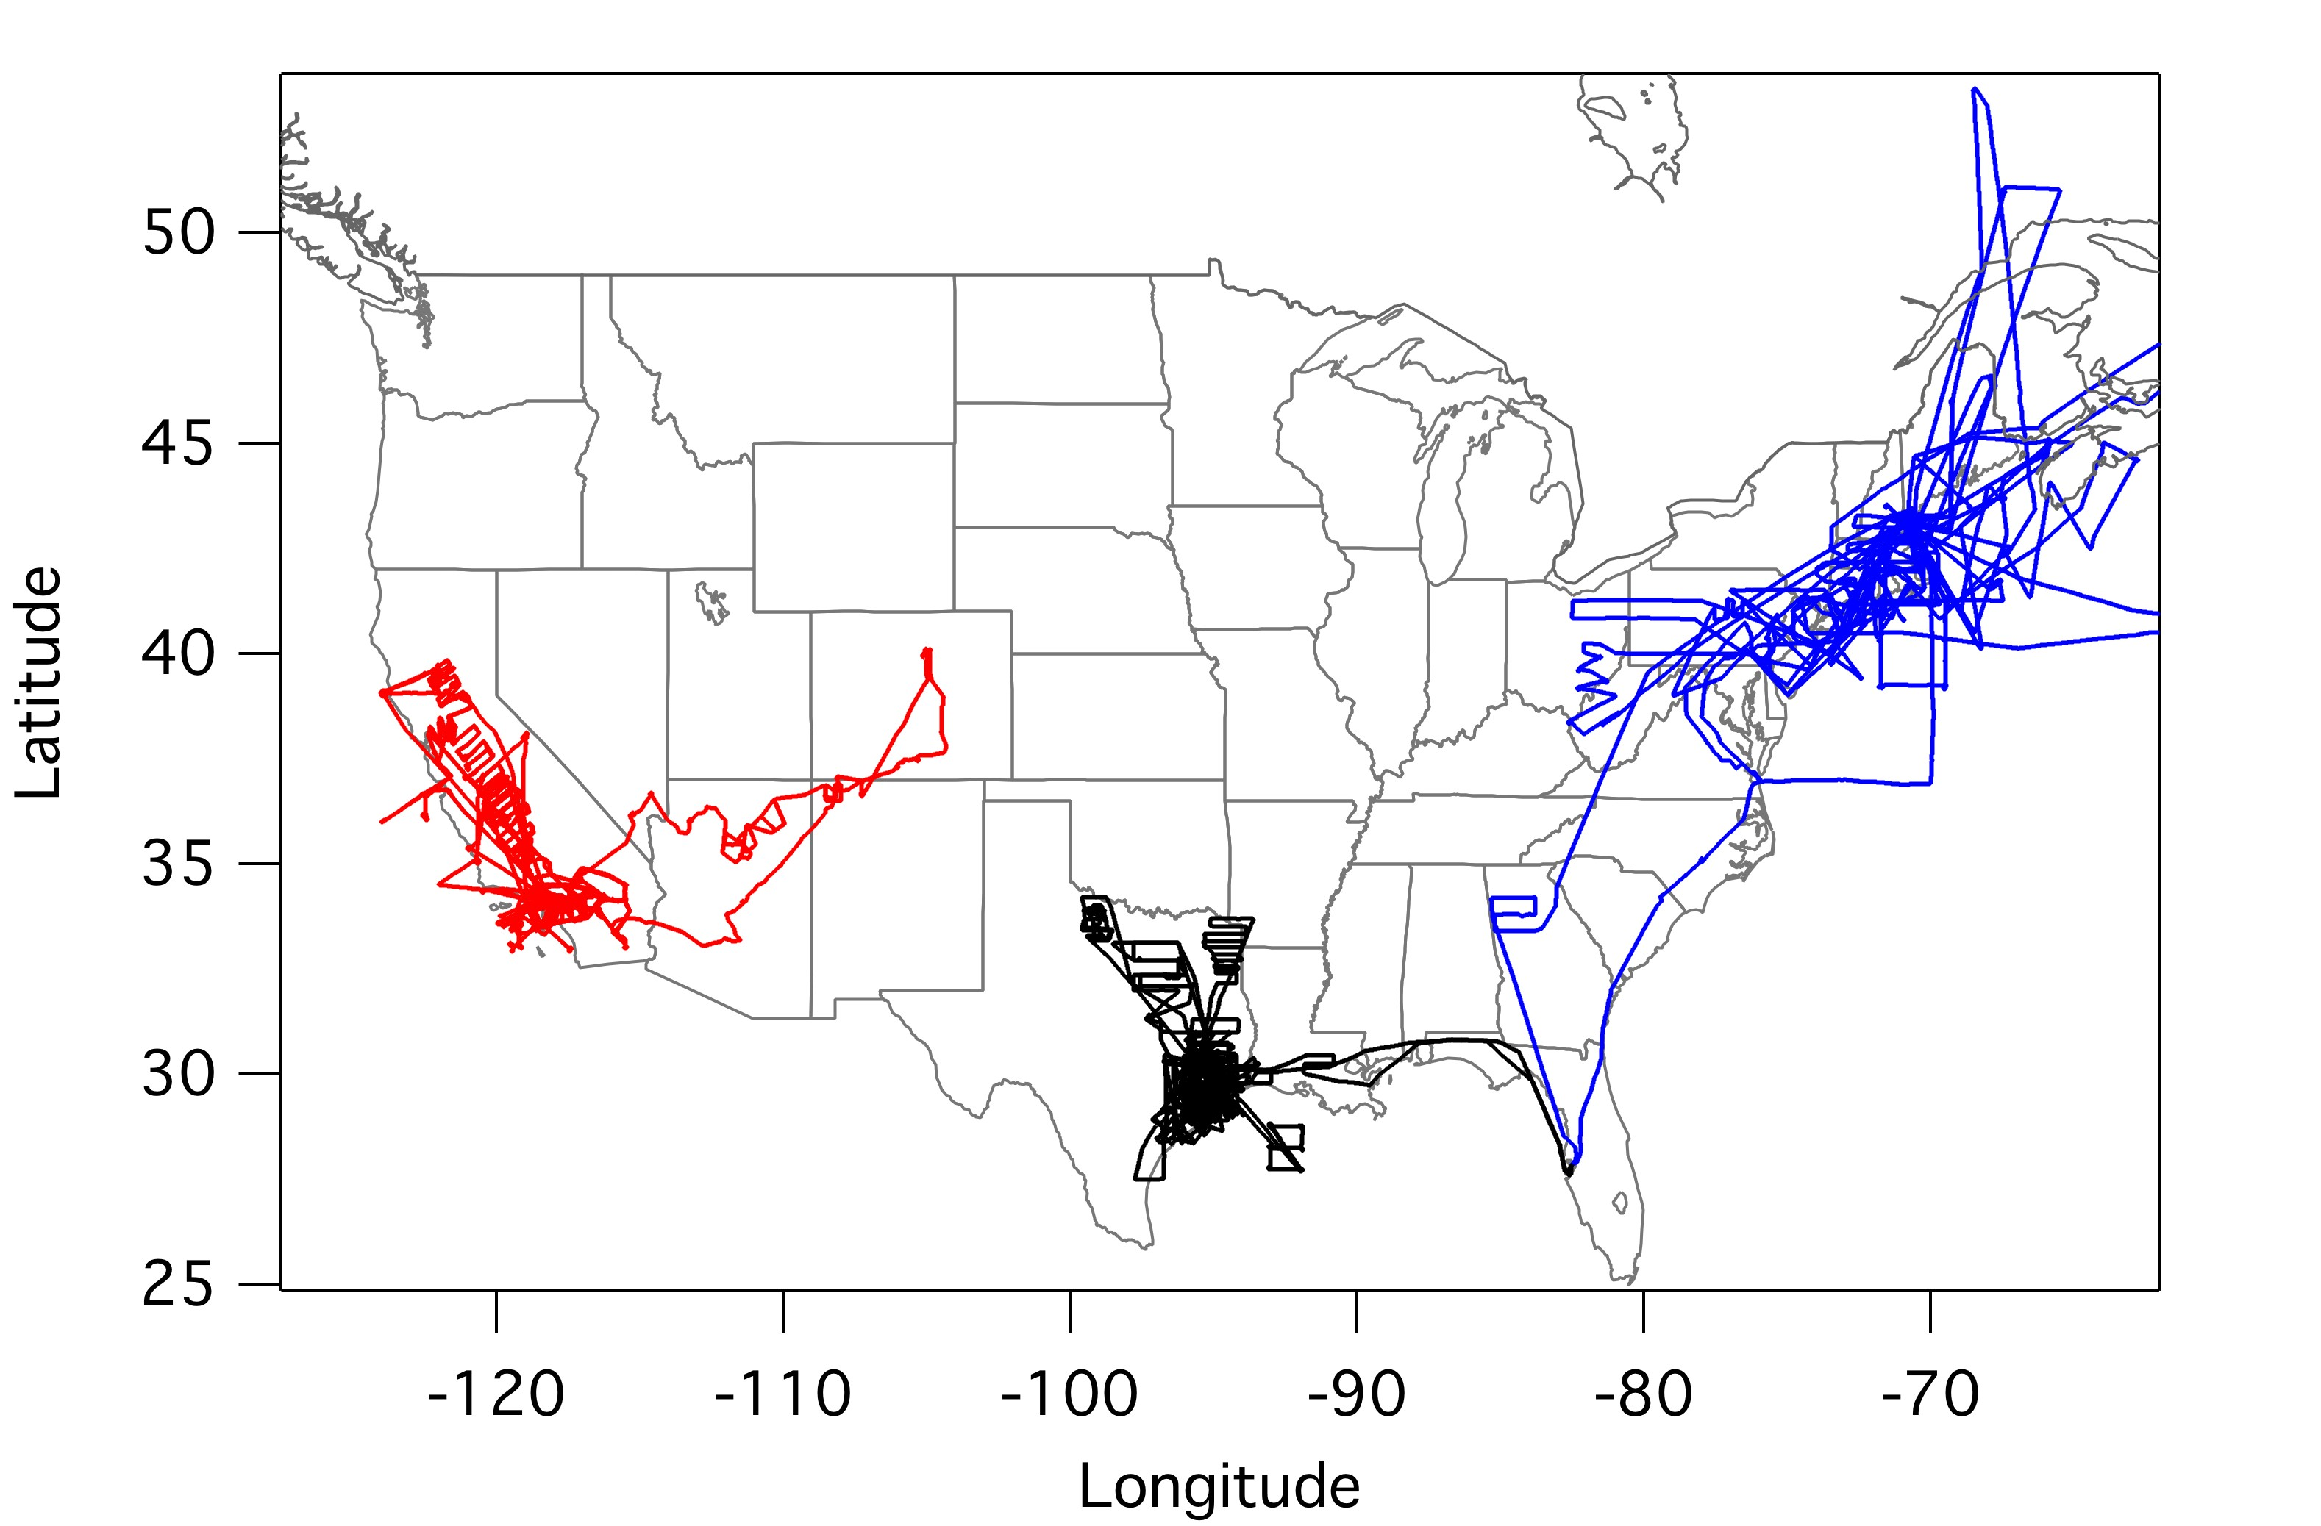
CalNex NH₃ Altitude Profile
100 pptv – ~ 1 ppmv
Highest near surface
First in-situ profiles concurrent with satellite observations
  NEAQS 2004
BL mixing ratios up to 3 ppbv
Biomass burning layers at altitude
(Nowak et al., JGR 2007)
  TexAQS 2006
BL mixing ratios up to 8 ppbv
BL plumes from industrial accident
(Nowak et al., JGR 2010)
Notes:
X axis, linear 0-90, logarithmic 100 -1000, begun collaborations with TES and IASI measurement teams

Slide 7
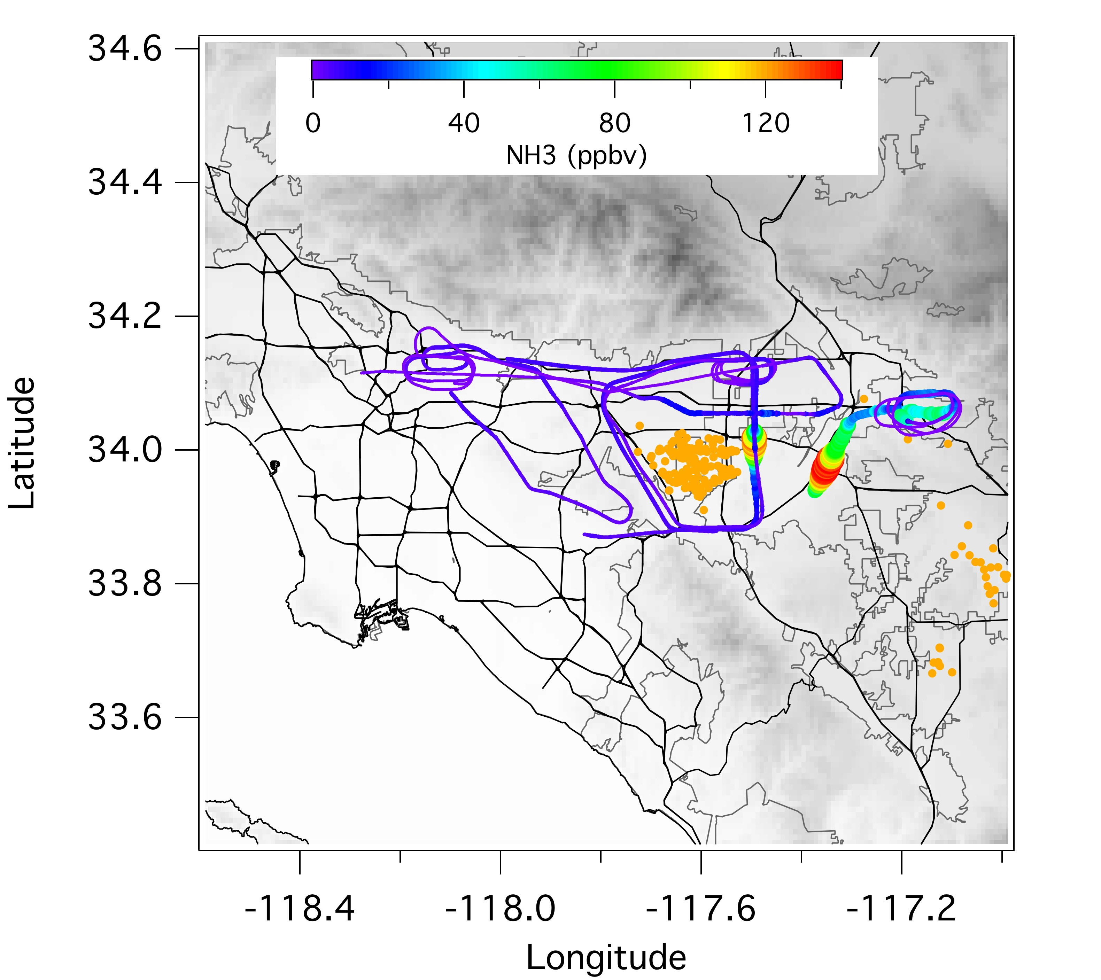
South Coast Air Basin NH₃ Sources
May 14 flight track colored and sized by NH₃ mixing ratio
Automobiles
Dairy farms
Notes:
Note color scale values and wind

Slide 8

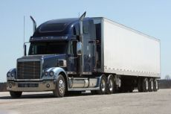
Why do automobiles emit NH₃?
Unregulated byproduct of three-way catalytic converters
  Resulting from over-reduction of NO on the catalyst surface
  Emissions mode dependent (i.e., acceleration events)
Emissions dominated by ‘middle-aged’ vehicles
  Older vehicles - no converter or deactivated catalyst
  Newer vehicles - better process control technology
Now
Future/Now
Mainly light-duty vehicles
SCRs using urea
in heavy-duty vehicles ?
Notes:
The production of NH3 emissions is contingent upon the vehicle’s ability to produce NO in the presence of a catalytic convertor that has enough stored hydrogen to reduce the NO to NH3. Dynamometer studies have shown that these conditions are met during acceleration events, particularly when the catalyst surface is slightly fuel rich from a recent deceleration

Slide 9
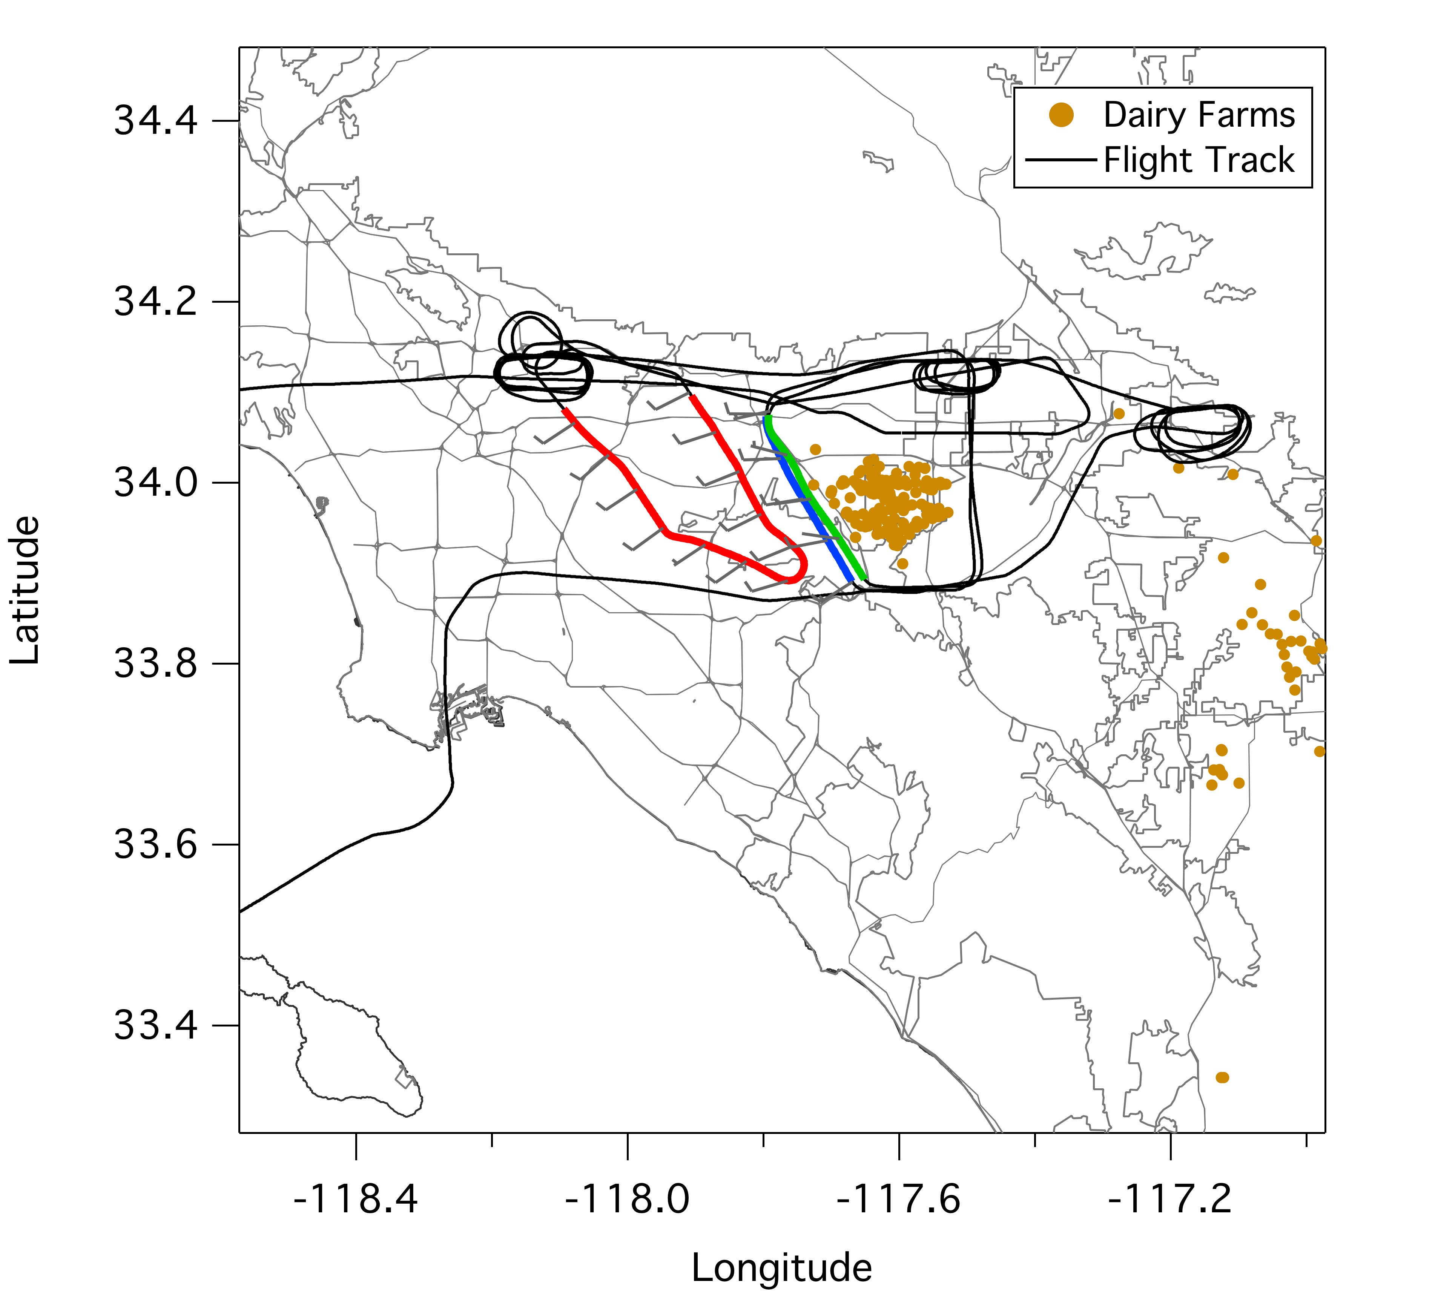
NH₃ Automobile Source – Data Selection
May 14
NH₃:CO
NH_{x} (NH₃ + NH₄⁺):CO
May 8, 14, 16, 19, and June 20
2008
Fuel-based NH₃:CO
  West LA ~ 0.060
  Fresno ~ 0.040
  San Jose ~ 0.048
Bishop et al., ES&T 2010
Notes:
Point out location of Bishop west LA Sampling Location, mol/mol

Slide 10
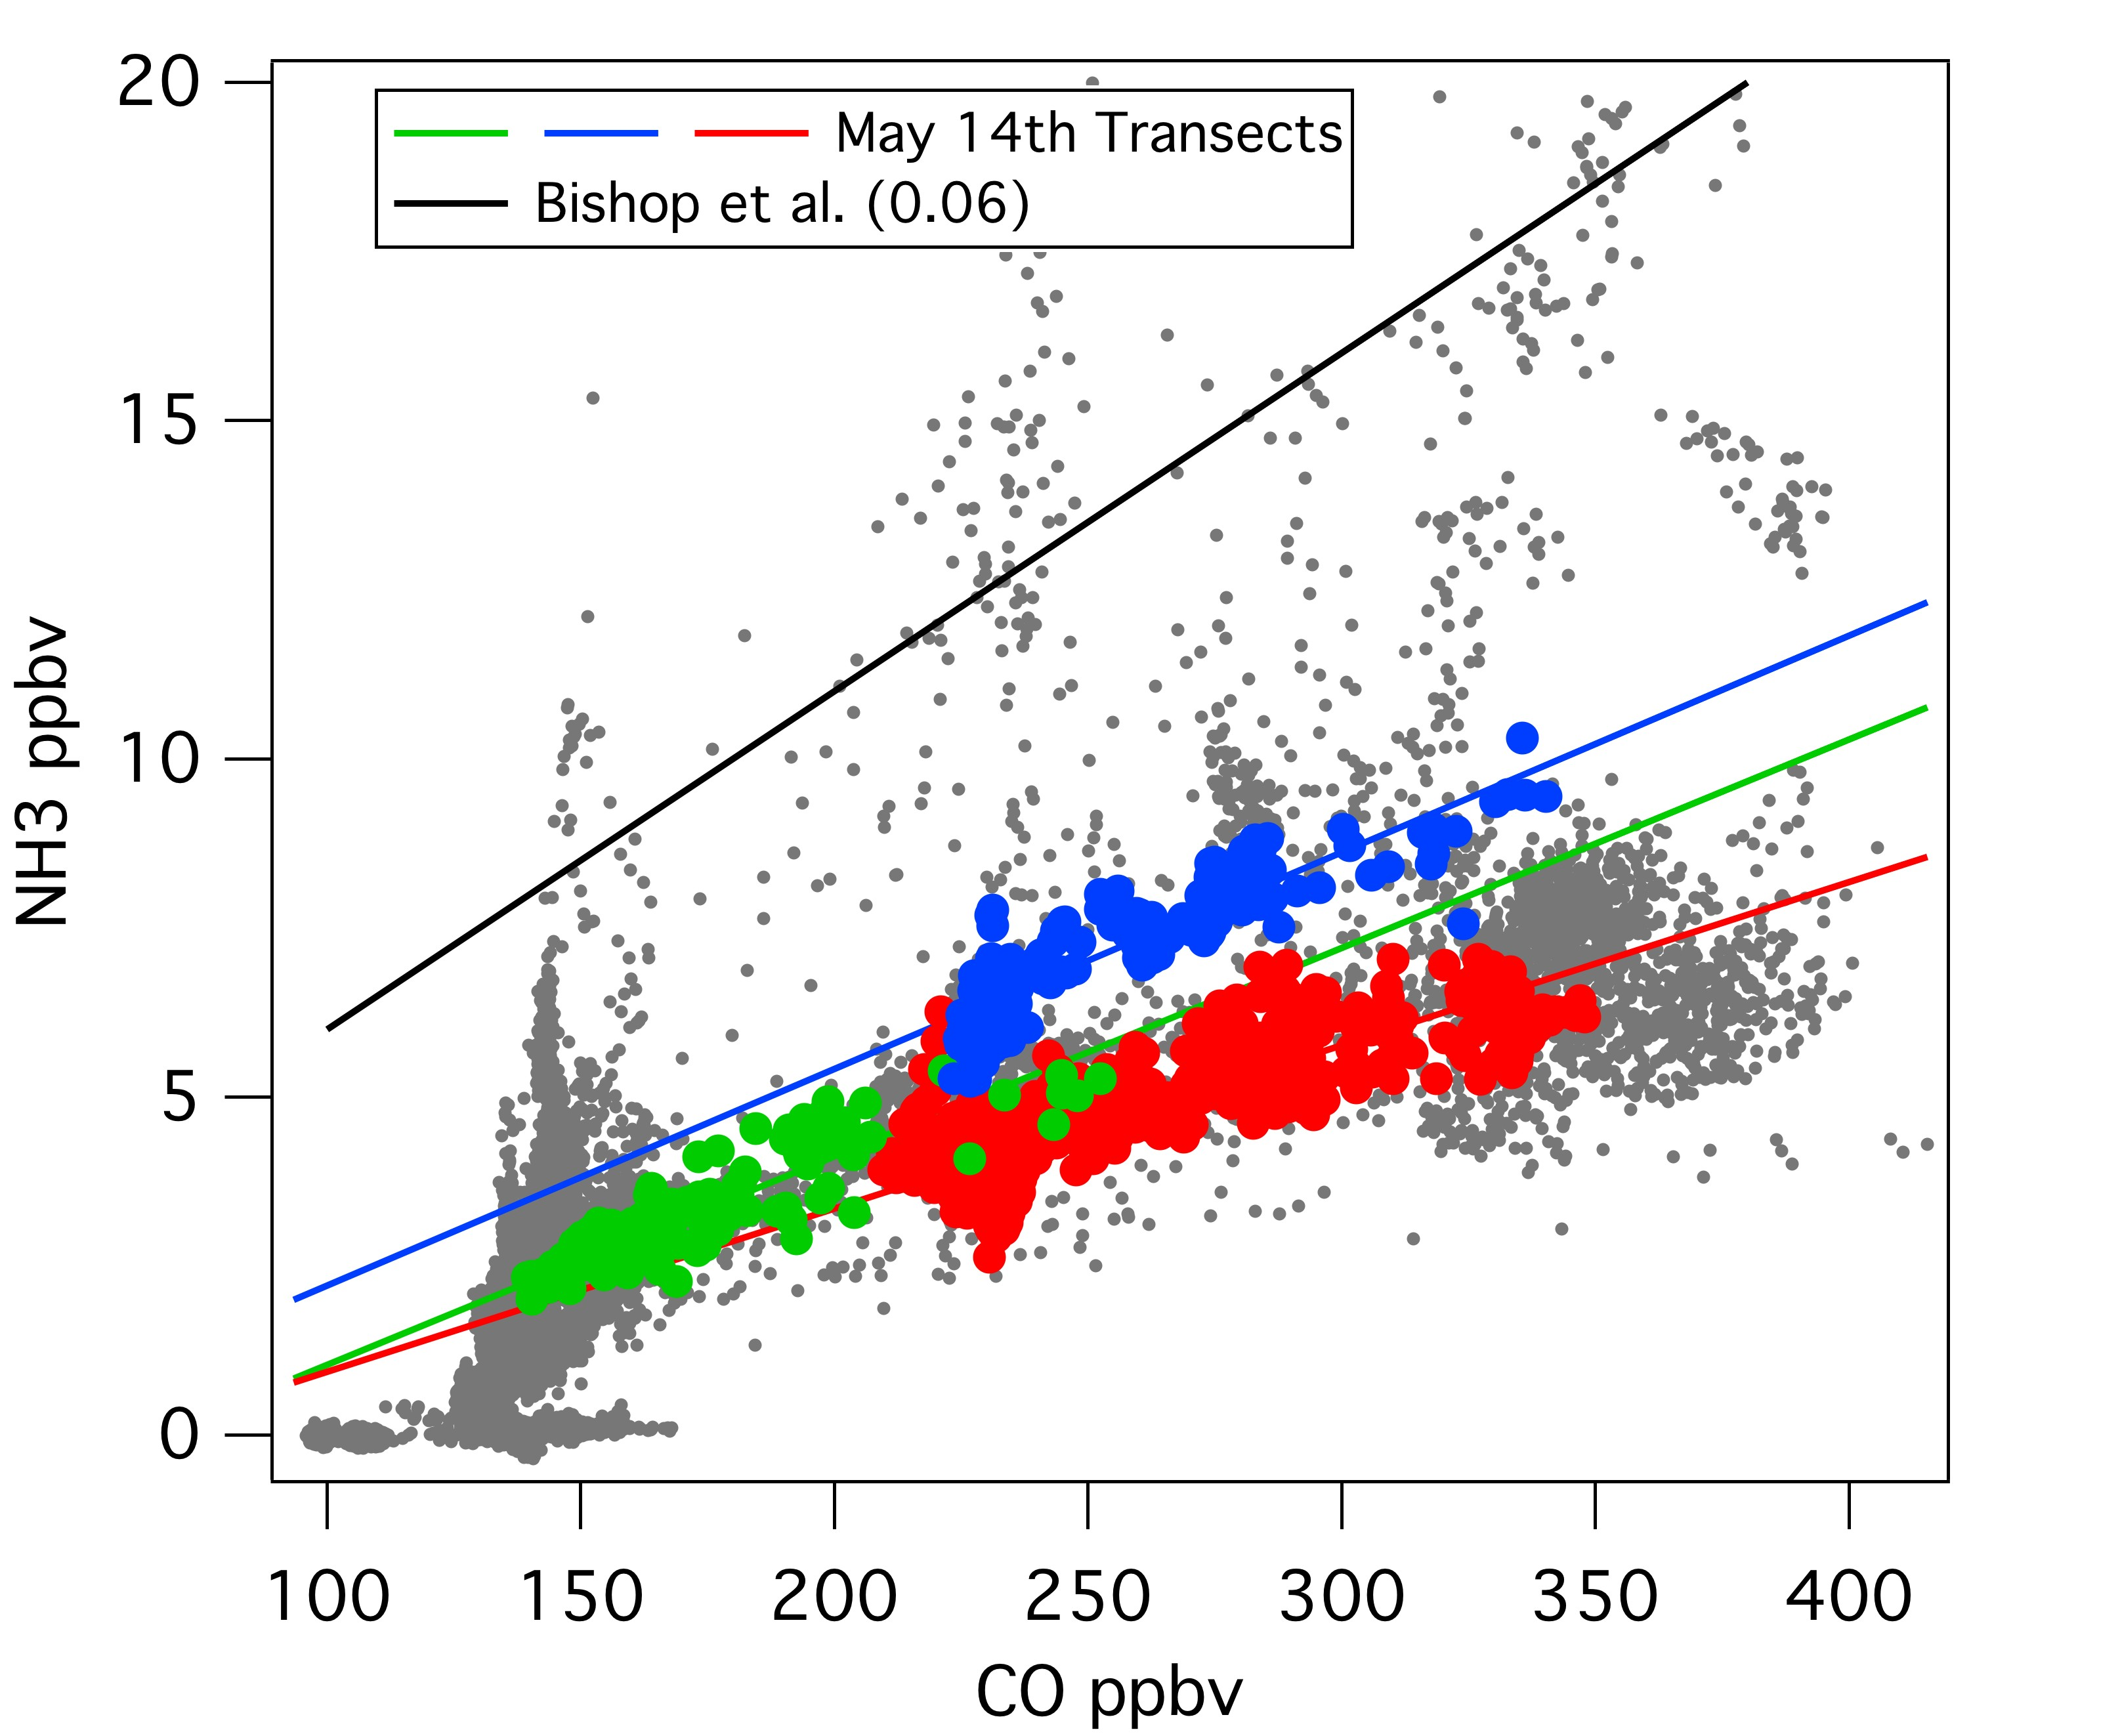
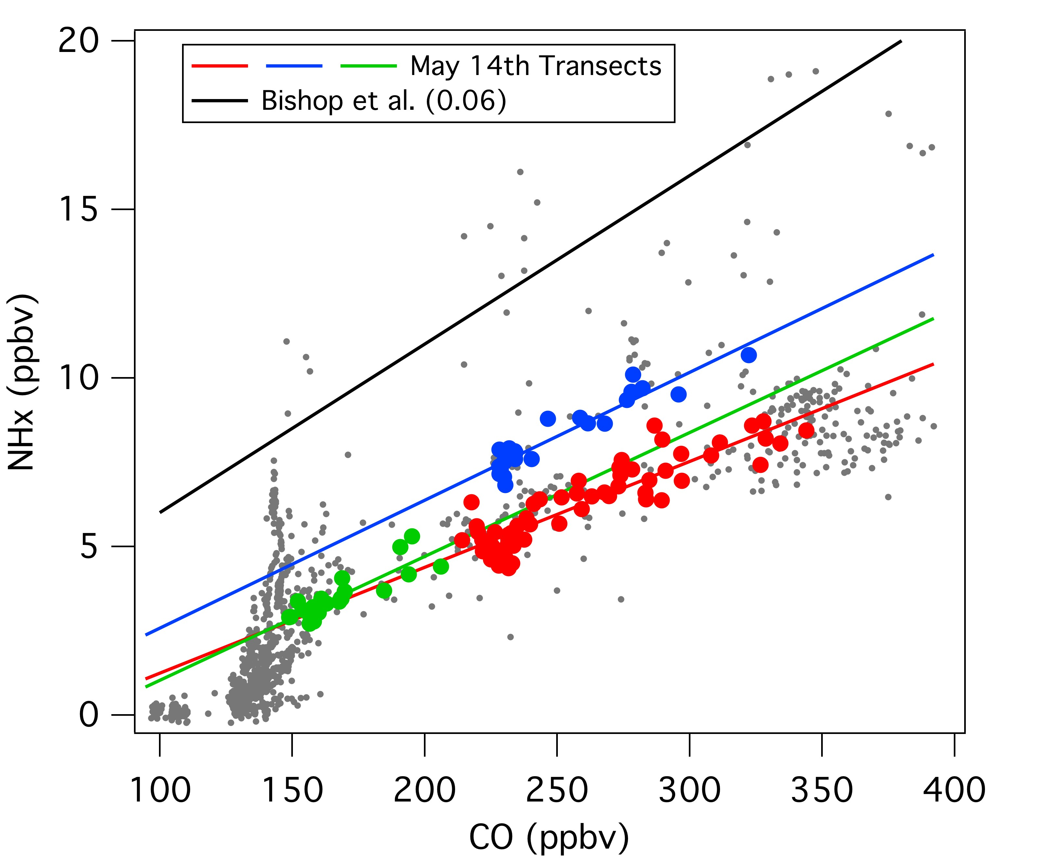
NH₃ Automobile Source
Summary of May 14 NH₃:CO and NH_{x}:CO Ratios
Transect | NH₃:CO | NH_{x}:CO
Red | s = 0.024, r² = 0.72 | s = 0.031, r² = 0.81
Blue | s = 0.032, r² = 0.82 | s = 0.038, r² = 0.89
Green | s = 0.031, r² = 0.80 | s = 0.037, r² = 0.75
Notes:
Point out NH3 from dairy, no CO correlations,

Slide 11
NH₃ Automobile Source
NH_{x}:CO within factor of two of Bishop, 2010
2010 estimated SoCAB CO emissions ~ 2.68 x 10⁹ g/day
(www.arb.ca.gov/app/emsinv/emssumcat.php)
For May 14, 83 – 101 metric tons/day
All CalNex, 67 – 101 metric tons/day
Compare to NH₃ flux from SoCAB dairy farms
Notes:
Calculate with Bishop and 2008 Carb data ~ 115 metric tonnes/day
Estimated 2010 CO emissions published in 2009, average for CalNex 78 metric tonnes/day

Slide 12
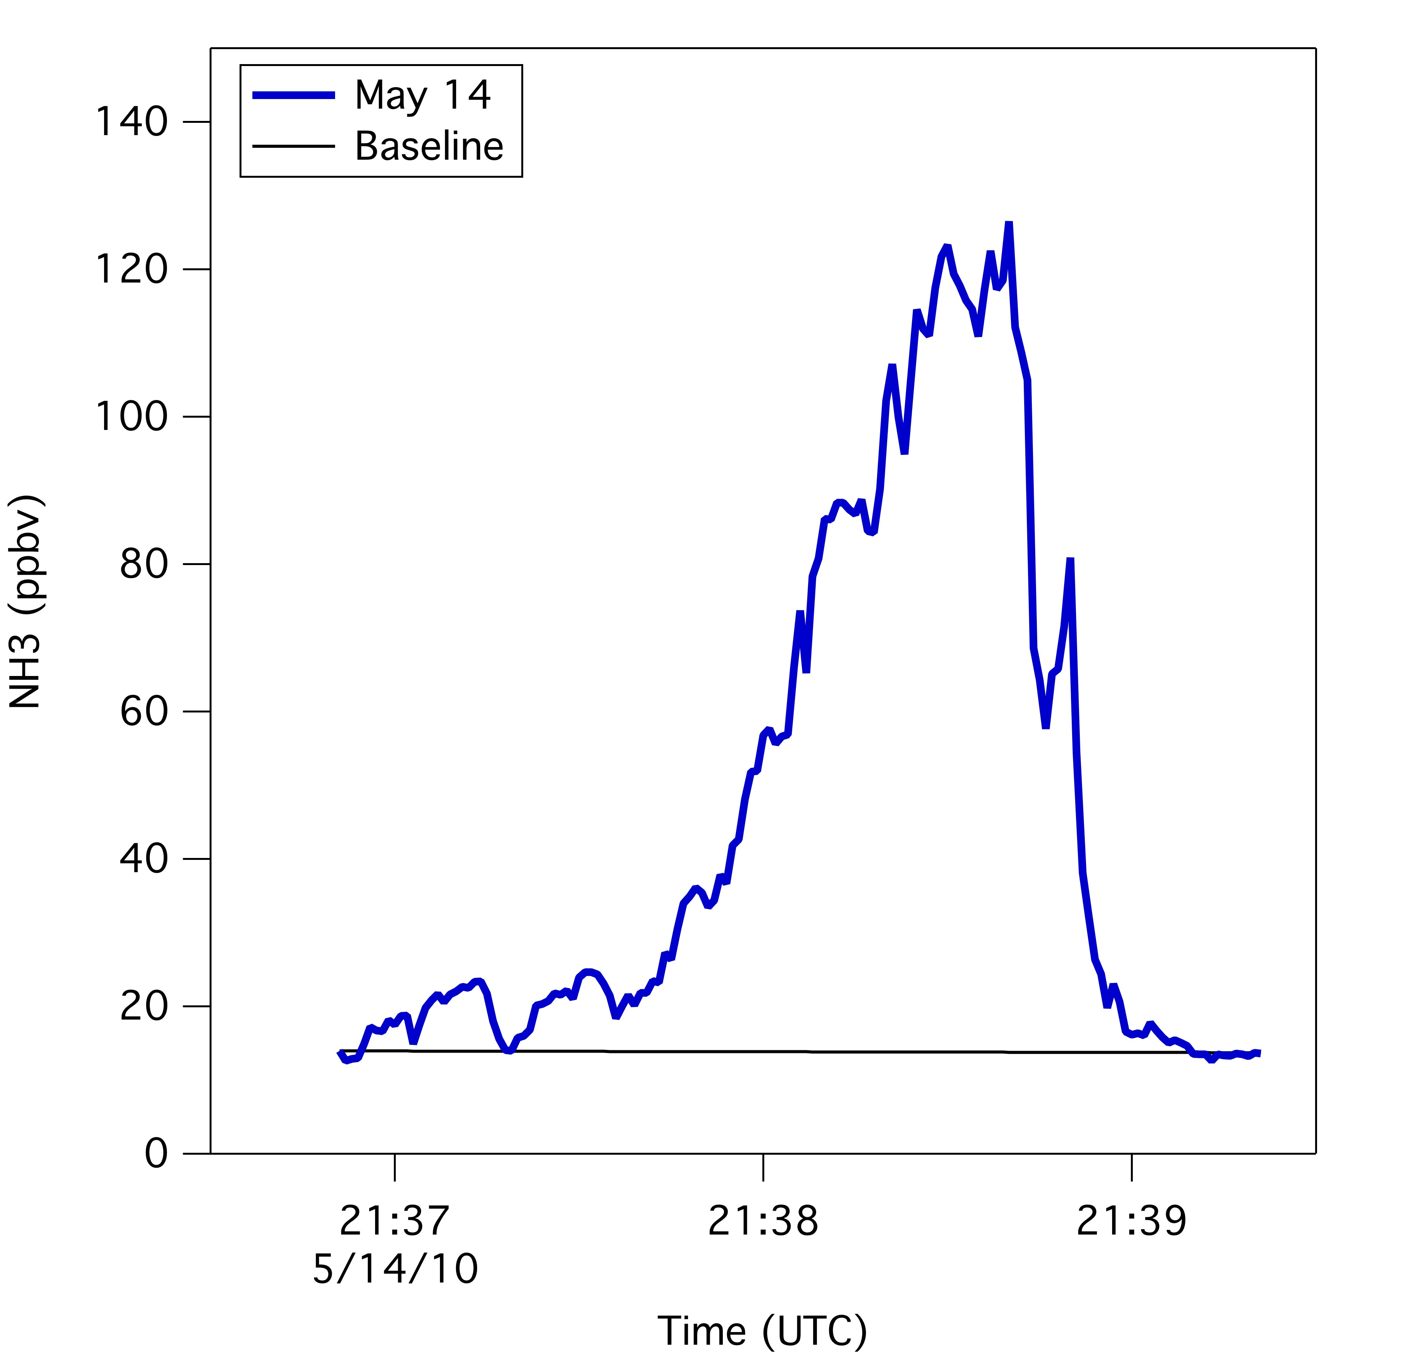
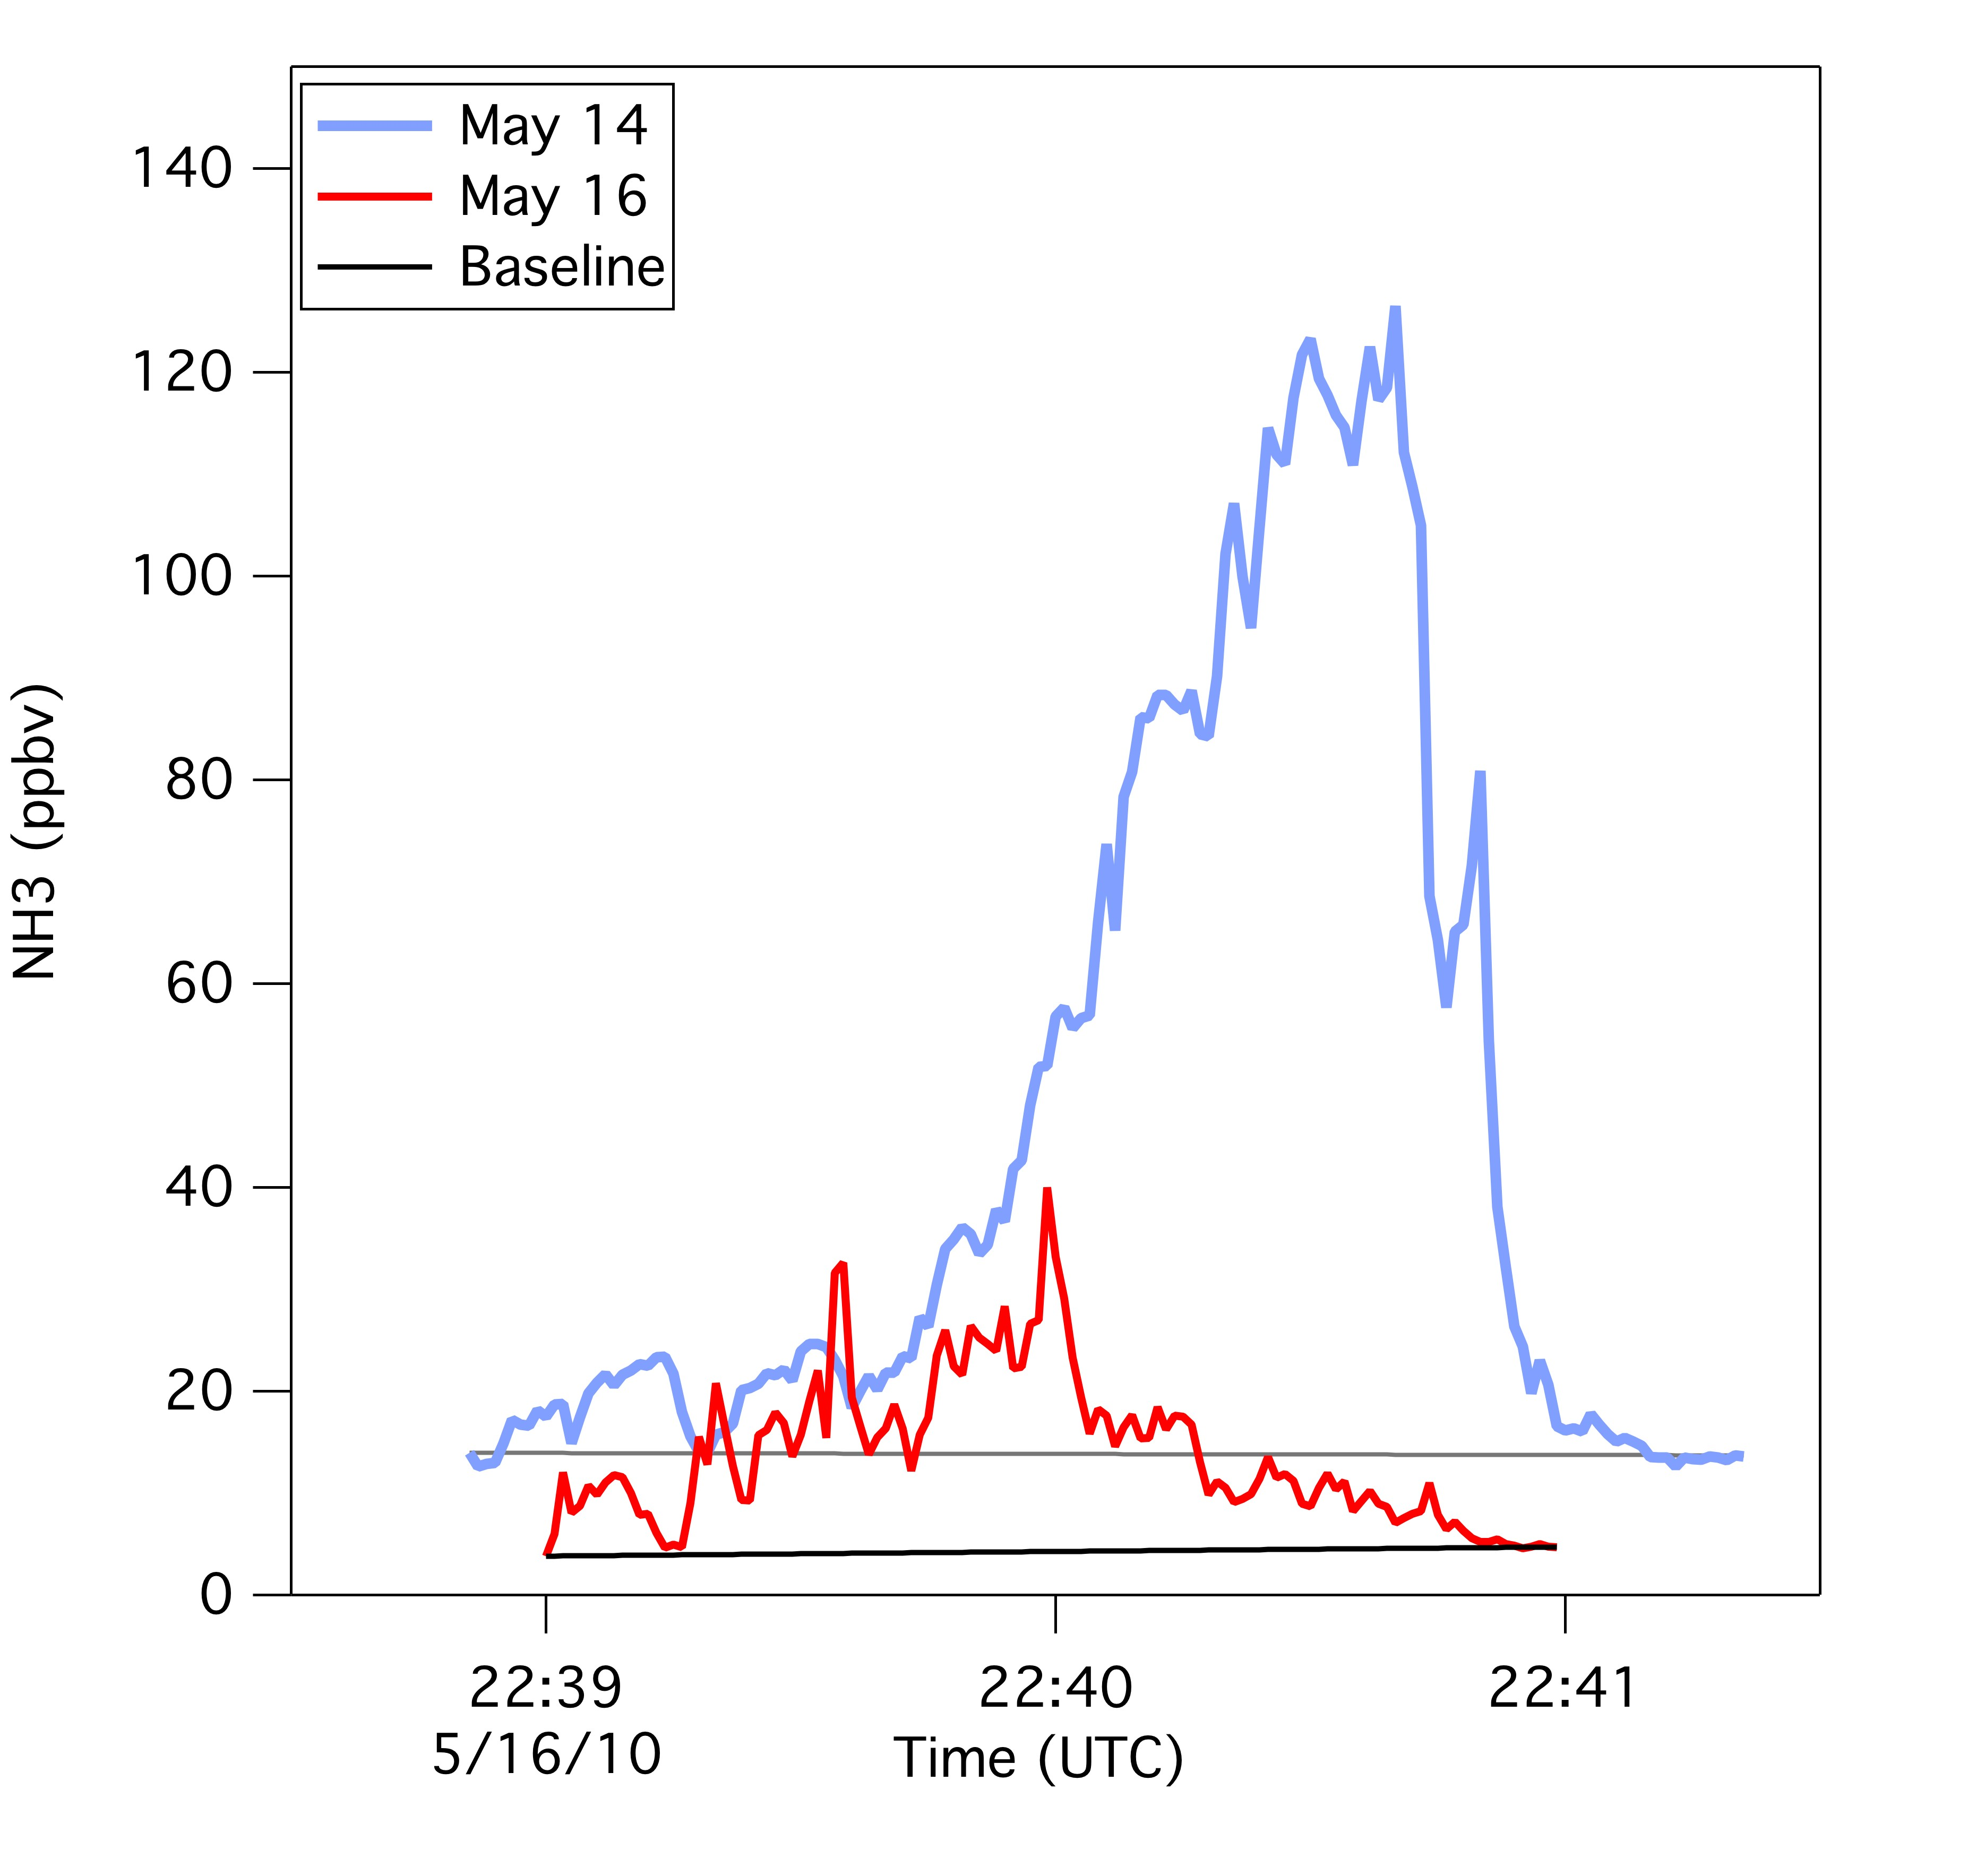
Dairy Farm NH₃ Mass Flux Calculation
flux_{m} =v•cos(α)• ∫n(z)dz• ∫ X_{m}(y)dy
Standard method, White et al., Science, 1976
Wind speed
Aircraft track correction
Atmospheric number density over the boundary layer height
Integral of the observed plume
Factor of 2 uncertainty
Two crosswind transects
May 16
  Dairy farm flux ~ 33 metric tons/day (± 50%)
May 14
  Dairy farm flux ~ 115 metric tons/day (± 50%)

Slide 13
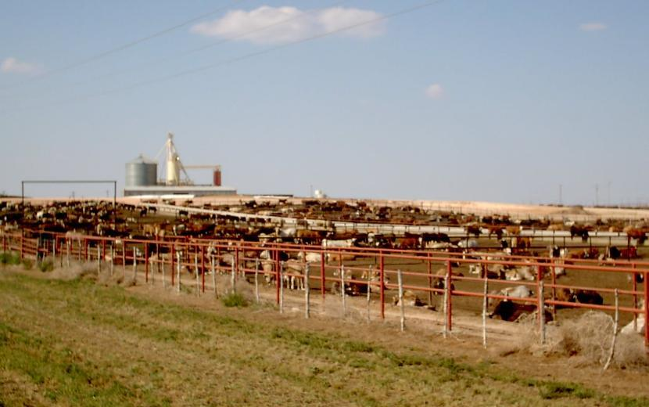
SoCAB NH₃ Sources
May 14 ~ 83 – 101 (metric tons/day) ~ 115 (metric tons/day)
May 16 ~ 61 – 65 (metric tons/day) ~ 33 (metric tons/day)
Cars ≅ Cows
(within factor 2)
Cows geographically concentrated higher mixing ratios

Slide 14
Consequence of NH₃ emissions - NH₄NO₃
NH₄NO₃ Formation

Slide 15
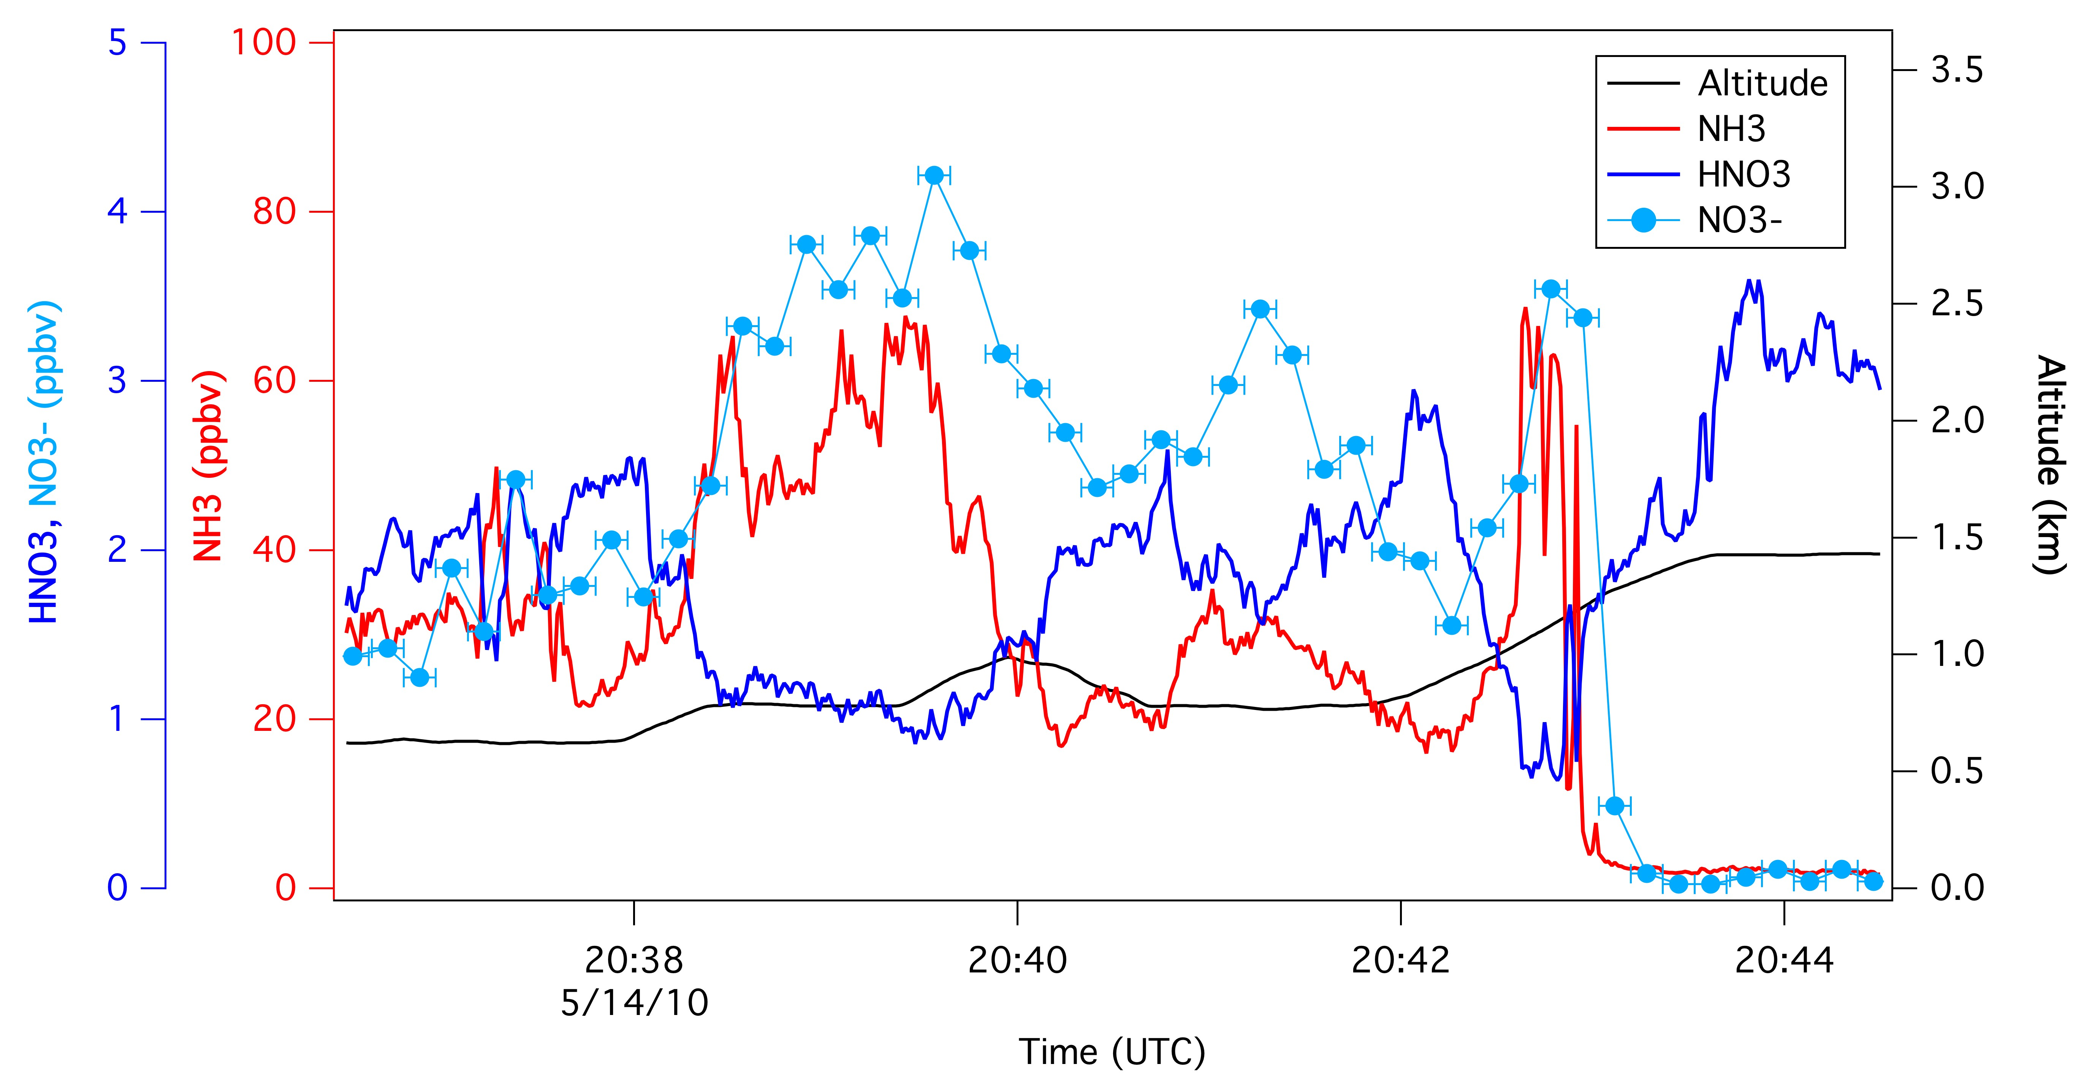
Consequence of NH₃ emissions - NH₄NO₃
NH₃ and HNO₃ anti-correlated
NO₃⁻ increased indicating NH₄NO₃ formed
~10x more NO₃⁻ than in car transects
Notes:
NO3 peak ~11 ug m-3
Temp 19 to 16 C, RH 50 to 20%

Slide 16
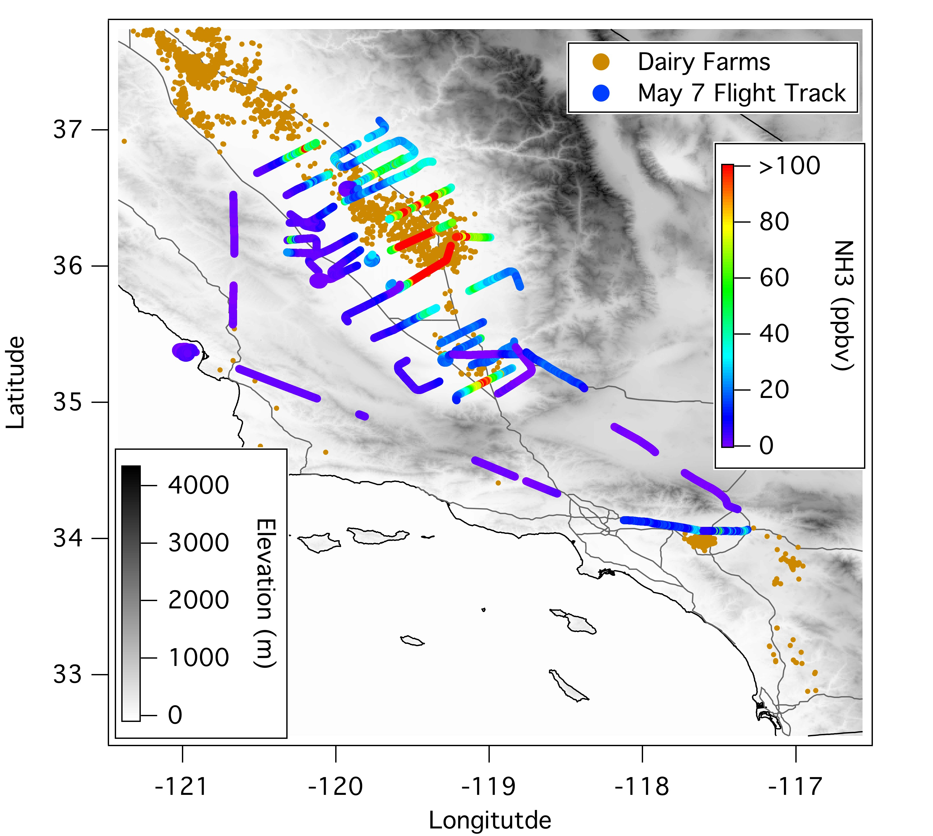
Central Valley NH₃ Dairy Farm Flux
Estimate flux from dairy farms
Notes:
7th – Southern SJV
11th – Sacramento, Rice
12th – Northern SJV

Slide 17
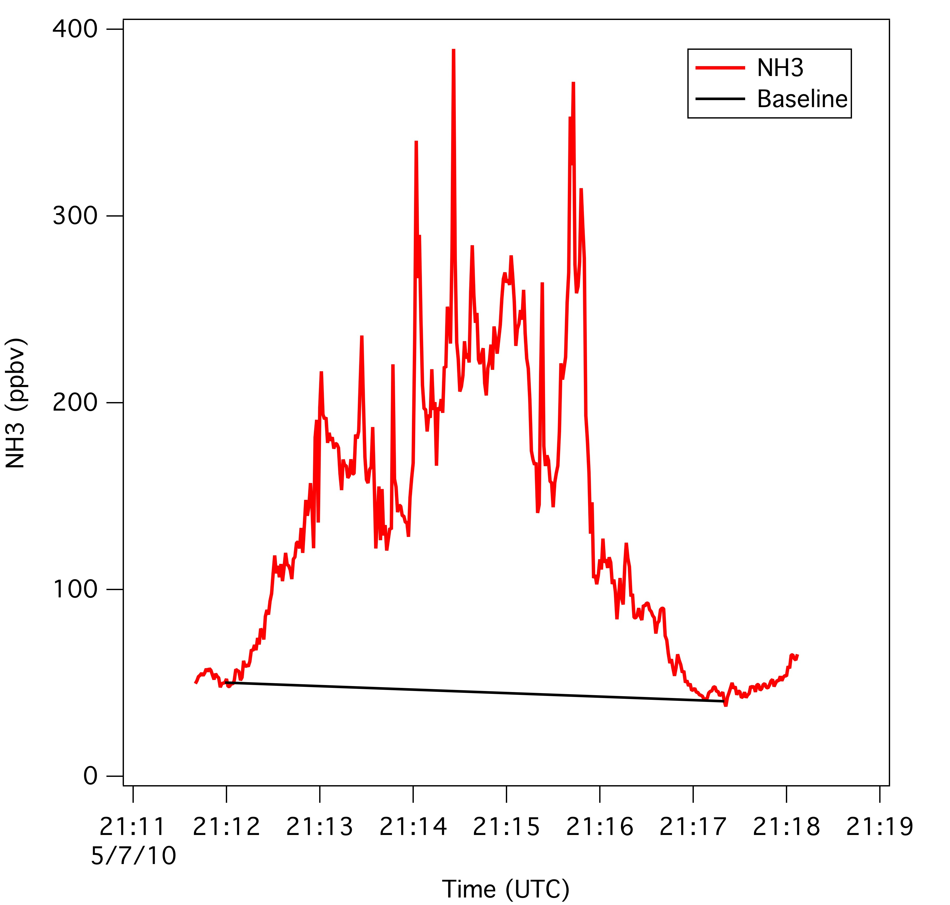
Central Valley NH₃ Dairy Farm Flux
Same flux calculation
636 metric tons/day
~6-20 times greater than SoCAB dairies
Higher density of cows
Notes:
Winds lighter than in SoCAB, ~ 3 m/s compared to 6 m/s.

Slide 18
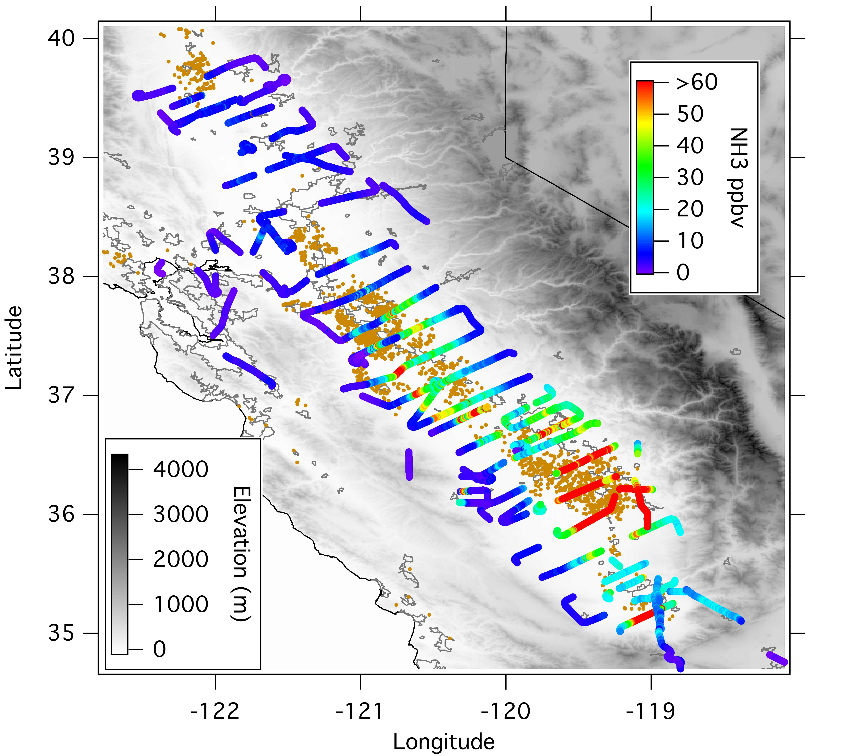
Central Valley NH₃ Observations
May 7, 11, 12
NH₃ peaks at 963 ppbv
Notes:
7th – Southern SJV
11th – Sacramento, Rice
12th – Northern SJV

Slide 19
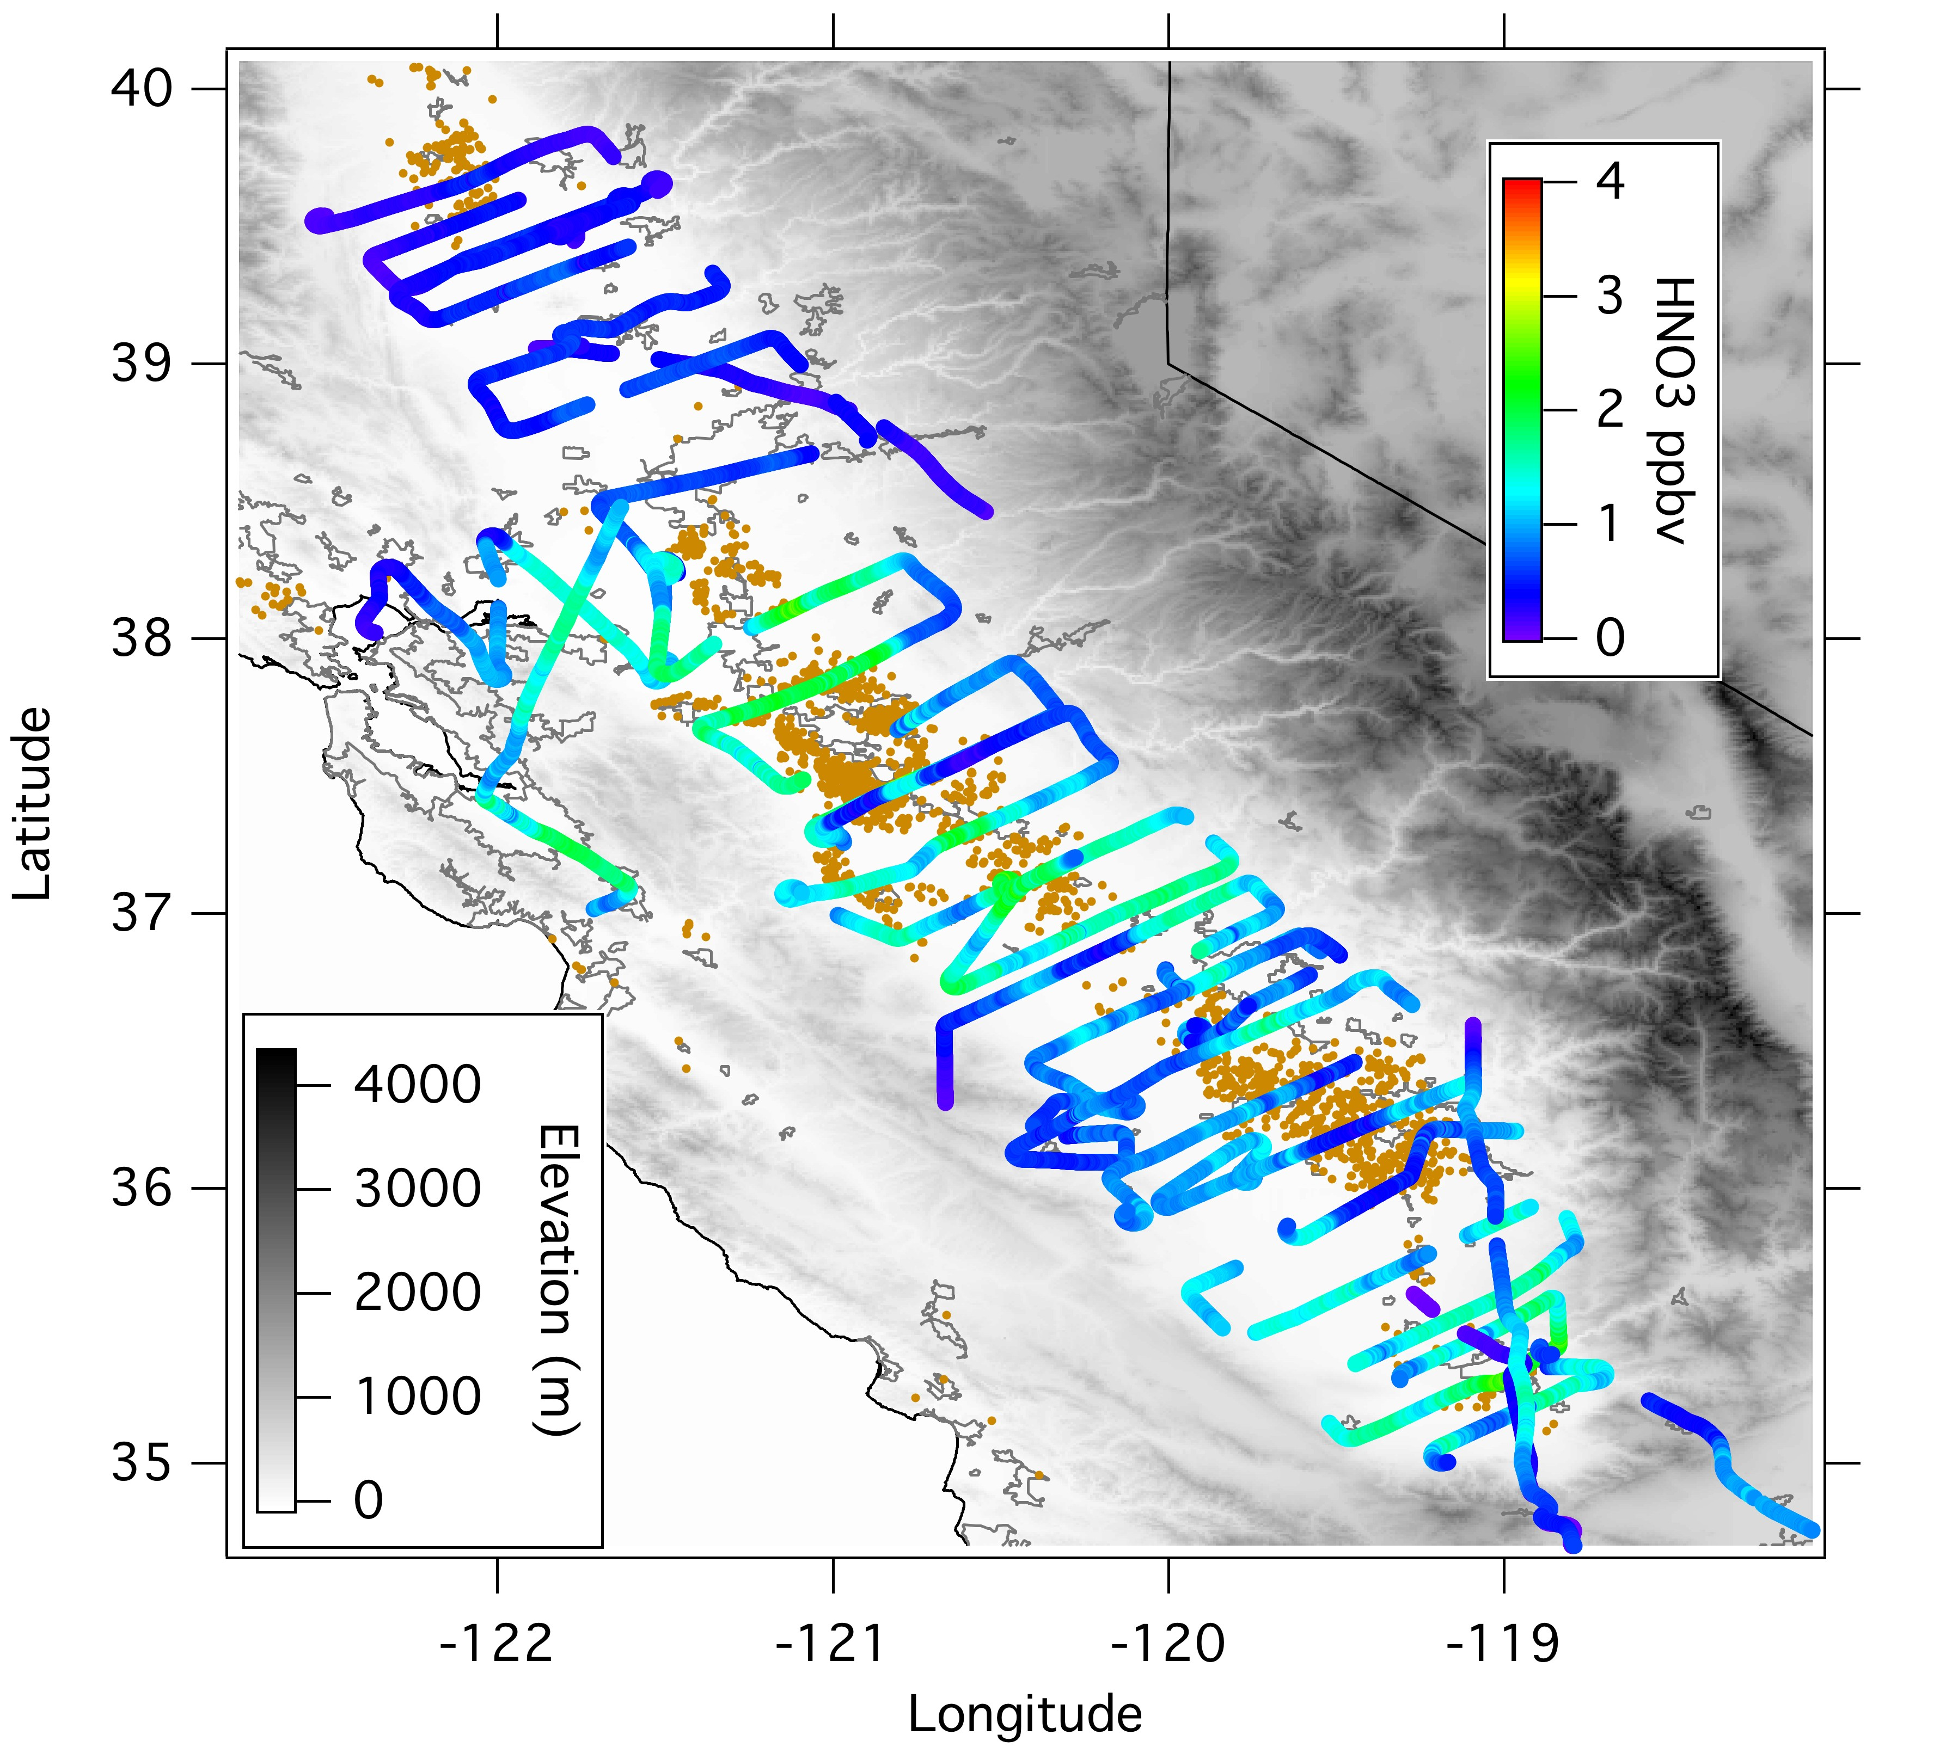
Central Valley HNO₃ Observations
May 7, 11, 12
HNO₃ peaks at 3 ppbv
Notes:
Point out low spot on 7th with high NH3 and high NO3-
Similar observations from June 14th,16th,18th flights

Slide 20
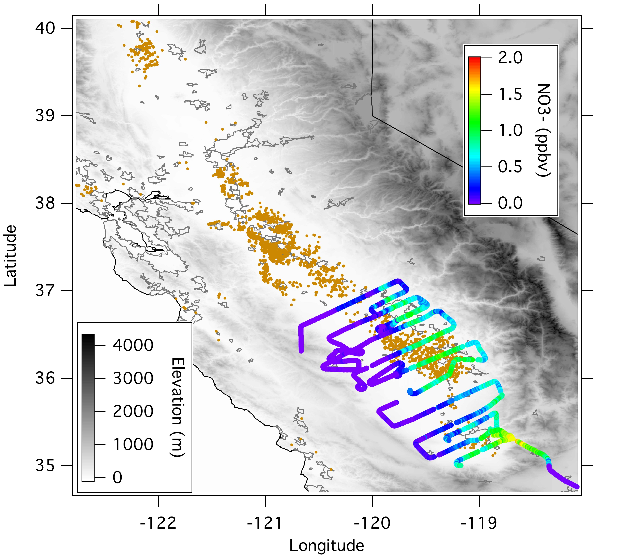
Central Valley NO₃⁻ Observations
May 7
NO₃⁻ peaks at <2 ppbv
Despite abundance of NH₃, NO₃⁻ loading relatively small due to lack of HNO₃
Notes:
And summer time conditions HNO3 limiting seen before.
Different from winter, with lots of NO3- due to temperature shifting equilibrium and accumulation.

Slide 21
Summary
NH₃ mixing ratios high frequently over 10 ppbv, plumes up to 963 ppbv
Estimated SoCAB automobile source 67 to 101 metric tons/day
Estimated SoCAB dairy farm flux ~ 33 to 115 metric tons/day
In South Coast Air Basin:
  Automobile ≈ Dairy farm (within factor of 2)
Central Valley dairy farm flux up to 636 metric tons/day
Despite abundance of NH₃ in the Central Valley, observed NO₃⁻ levels are low due to the lack of HNO₃

Slide 22
The End

Slide 23
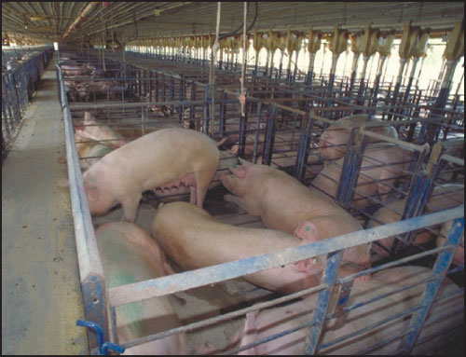
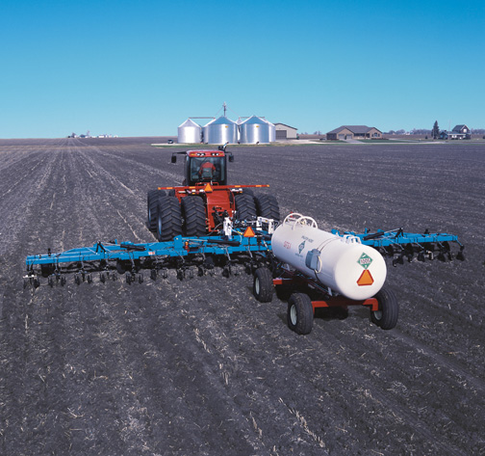
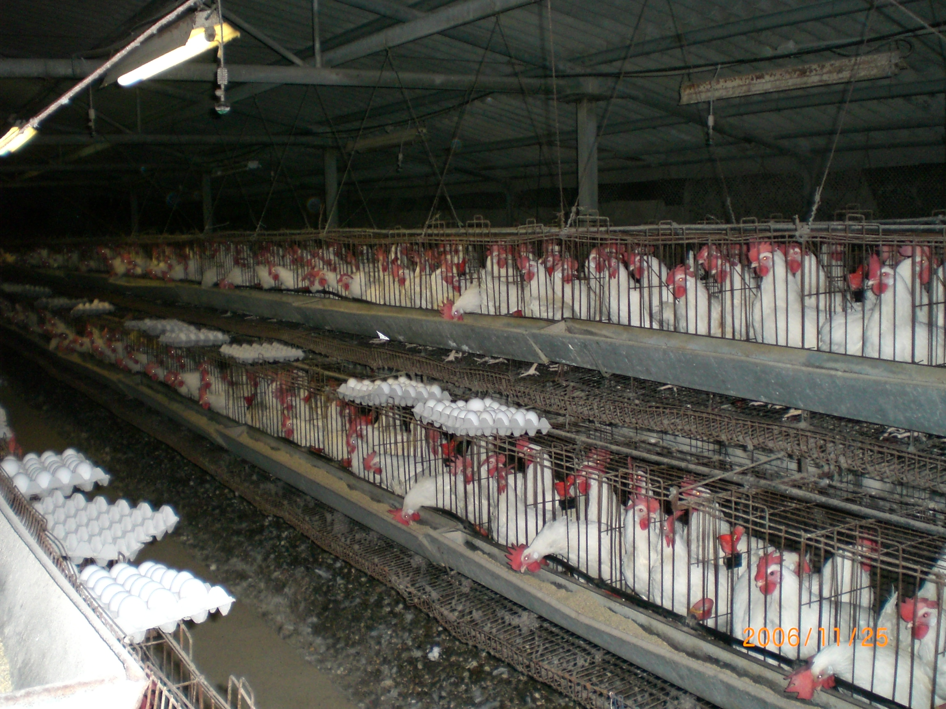
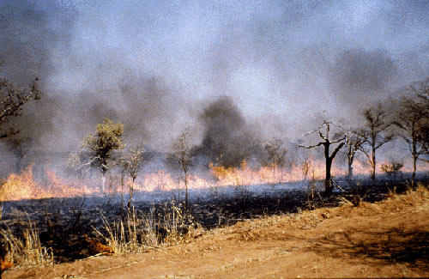
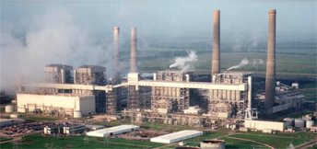
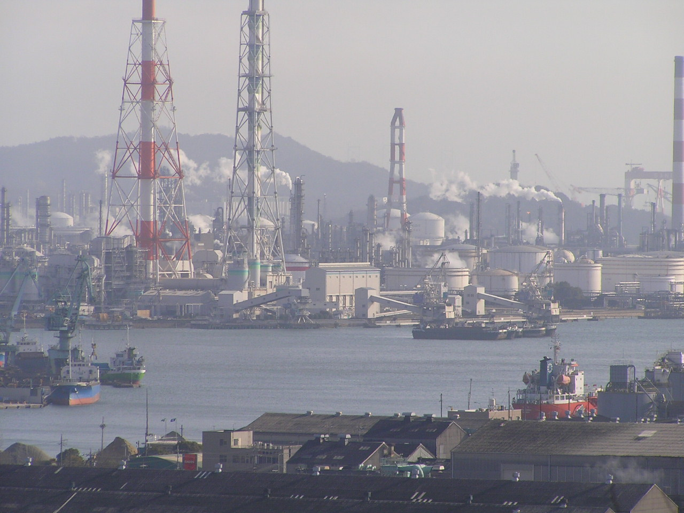
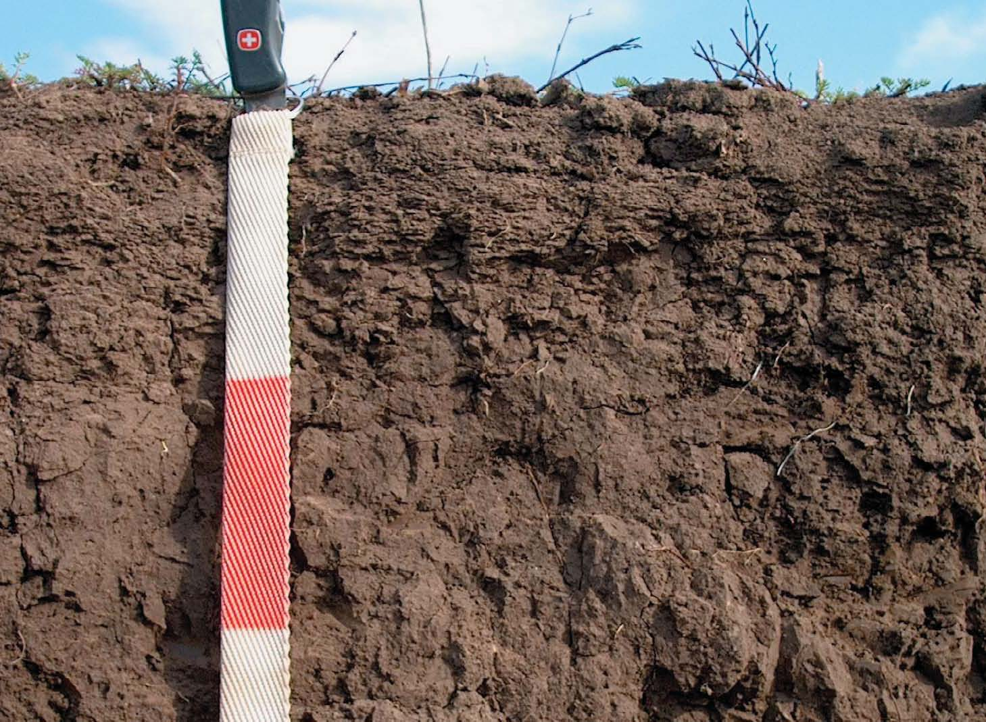
Sources of Ammonia
Animal Husbandry
Fertilizer Application
Biomass Burning, Soil Emissions
Cars, Industry
Notes:
Don’t forget Selective catalytic reduction in cars and power plants

Slide 24
Measurement Techniques
NH₃ - Chemical Ionization Mass Spectrometry (CIMS)
HNO₃ - Chemical Ionization Mass Spectrometry (CIMS)
Aerosol Composition - Compact Time of Flight Aerosol Mass Spectrometer (C-ToF-AMS)
Aerosol Size Distributions -
    5-Channel Condensation Particle Counter (CPC)
    Ultra-High Sensitivity Aerosol Spectrometer (UHSAS)
    White Light Optical Particle Counter (White Light-OPC)
CO - Vacuum UV Resonance Fluorescence
http://www.esrl.noaa.gov/csd/calnex/
Notes:
Don’t dwell~ mention instruments fast time resolution, calibrated, zeroed

Slide 25
Importance of Ammonia in the Atmosphere
NH₃ typically most abundant atmospheric gas-phase base
Water soluble and readily absorbed to surfaces, i.e., vegetation and soil
Often major component of tropospheric aerosol as NH₄⁺
NH₃ + HNO₃↔NH₄NO₃ Ammonium Nitrate
2NH₃ + H₂SO₄→(NH₄)₂SO₄ Ammonium Sulfate
NH₃ + HCl→NH₄Cl Ammonium Chloride
Notes:
Also comes off of surfaces.

