Slide 1


Airborne lidar measurements of horizontal and vertical ozone transport in southern California during CalNex 2010
C. J. Senff, R. J. Alvarez II, R. M. Hardesty, A. O. Langford, R. M. Banta, W. A. Brewer, F. Davies, S. P. Sandberg, R. D. Marchbanks, A. M. Weickmann
CalNex Data Analysis Workshop
18 May 2011
Notes:
I am going to continue with the theme of O3 transport over Southern California, but my focus will be mostly horizontal and vertical transport processes that are responsible for exporting ozone from the LA area into adjacent air basins and – in one case – as far away as the Intermountain West.

Slide 2
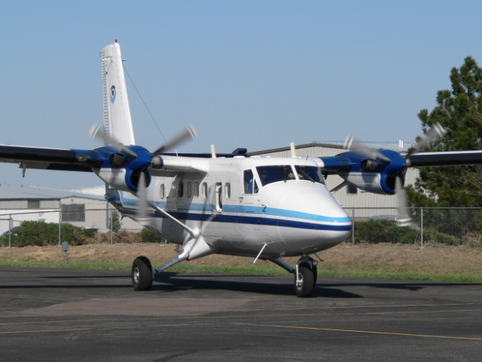
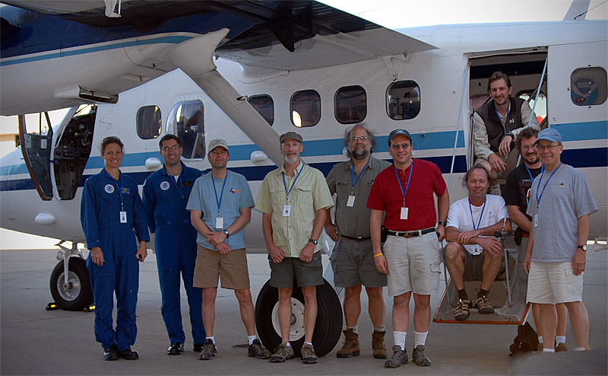
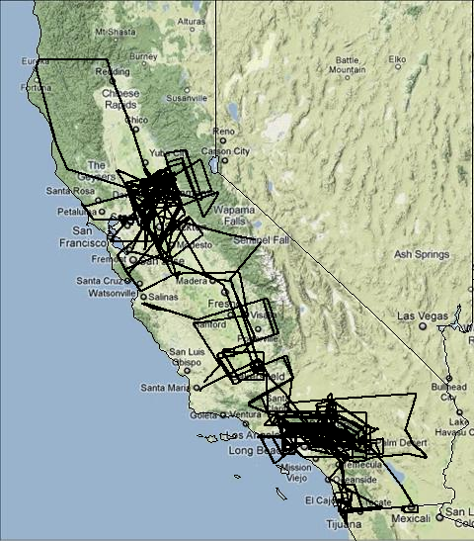
CalNex 2010 - NOAA Twin Otter
Optical remote sensing aircraft
19 May – 19 July, 2010
52 flights, 207 flight hours
Twin Otter CalNex operating parameters:
  Speed: ~ 60 m s⁻¹
  Endurance: up to 4 hours
  Flight altitude: 500 - 17500 ft MSL
Sacramento
15 – 28 June
Ontario
19 May – 14 June
29 June – 19 July
Notes:
2
To characterize these transport processes, I am going to use airborne lidar measurements taken onboard the NOAA Twin Otter. In his talk yesterday, Rainer has already introduced the Twin Otter platform, so I will run thru this quickly. The NOAA Twin Otter arrived at CalNex in mid May, but stayed about a month longer than most everybody else, which allowed us to capture some of the strong pollution episodes that occurred later in the season. We flew 52 flights totaling 207 flight hours and we pretty much covererd the entire state of California with an emphasis on the LA Basin and Sacramento areas.

Slide 3
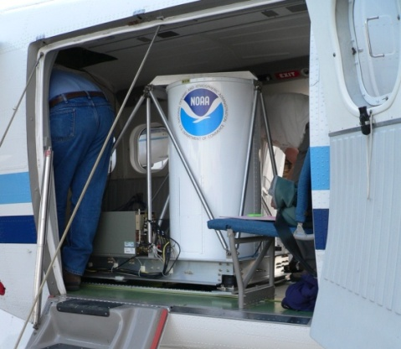
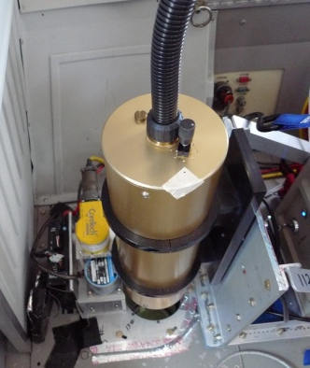
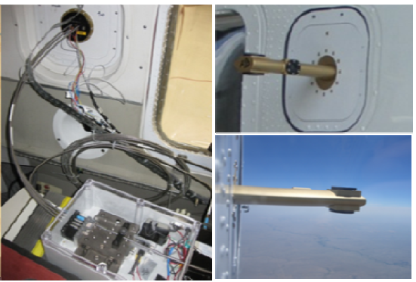
NOAA Twin Otter Instrumentation
Primary instruments:
  Downward-looking ozone and aerosol lidar (TOPAZ = Tunable Optical Profiler for Aerosols and oZone)
  University of Leeds scanning Doppler wind lidar
  Airborne Multi-Axes Differential Optical Absorption Spectroscopy (AMAX-DOAS) Instrument (R. Volkamer et al, CU Boulder)
Additional instruments:
  In situ O₃, temperature, pressure
  Radiometers (surface temp, albedo)
Notes:
3
[This was the biggest payload that we have deployed on the Twin Otter so far and the instruments complement each other well to look at a range of important science objectives related to CalNex.] We were especially excited about having – for the first time - the scanning Doppler lidar on board, which provides wind profiles beneath the plane that will help greatly in interpreting the ozone lidar and AMAX-DOAS measurements.

Slide 4
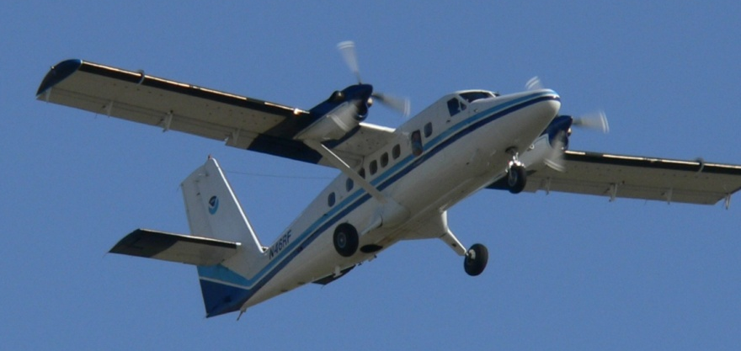
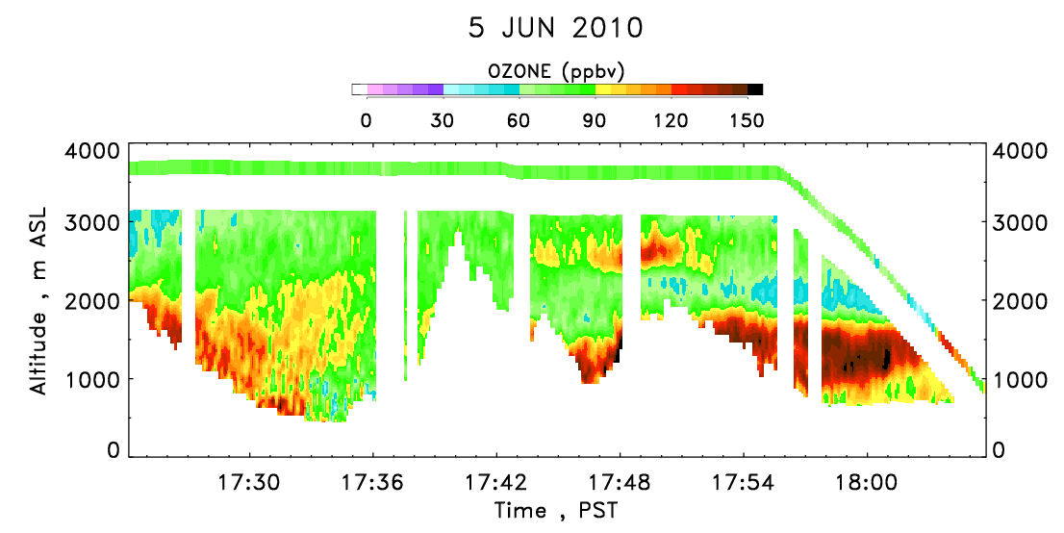
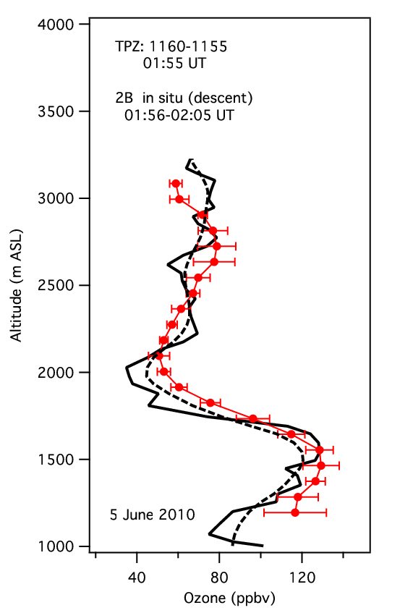
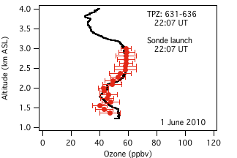
TOPAZ Lidar (19 May – 19 July)
Ozone & aerosol backscatter profiles
Min / Max Range: 400 m / 3 – 5 km
Resolution (O₃): Δx = 600 m, Δz = 90 m

Slide 5
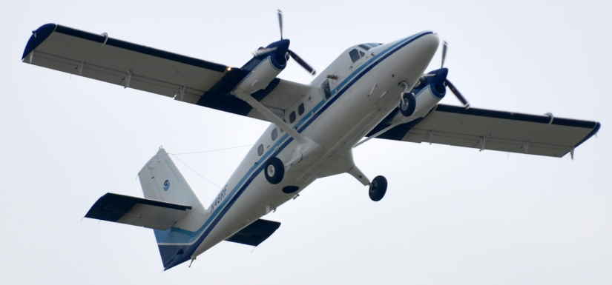
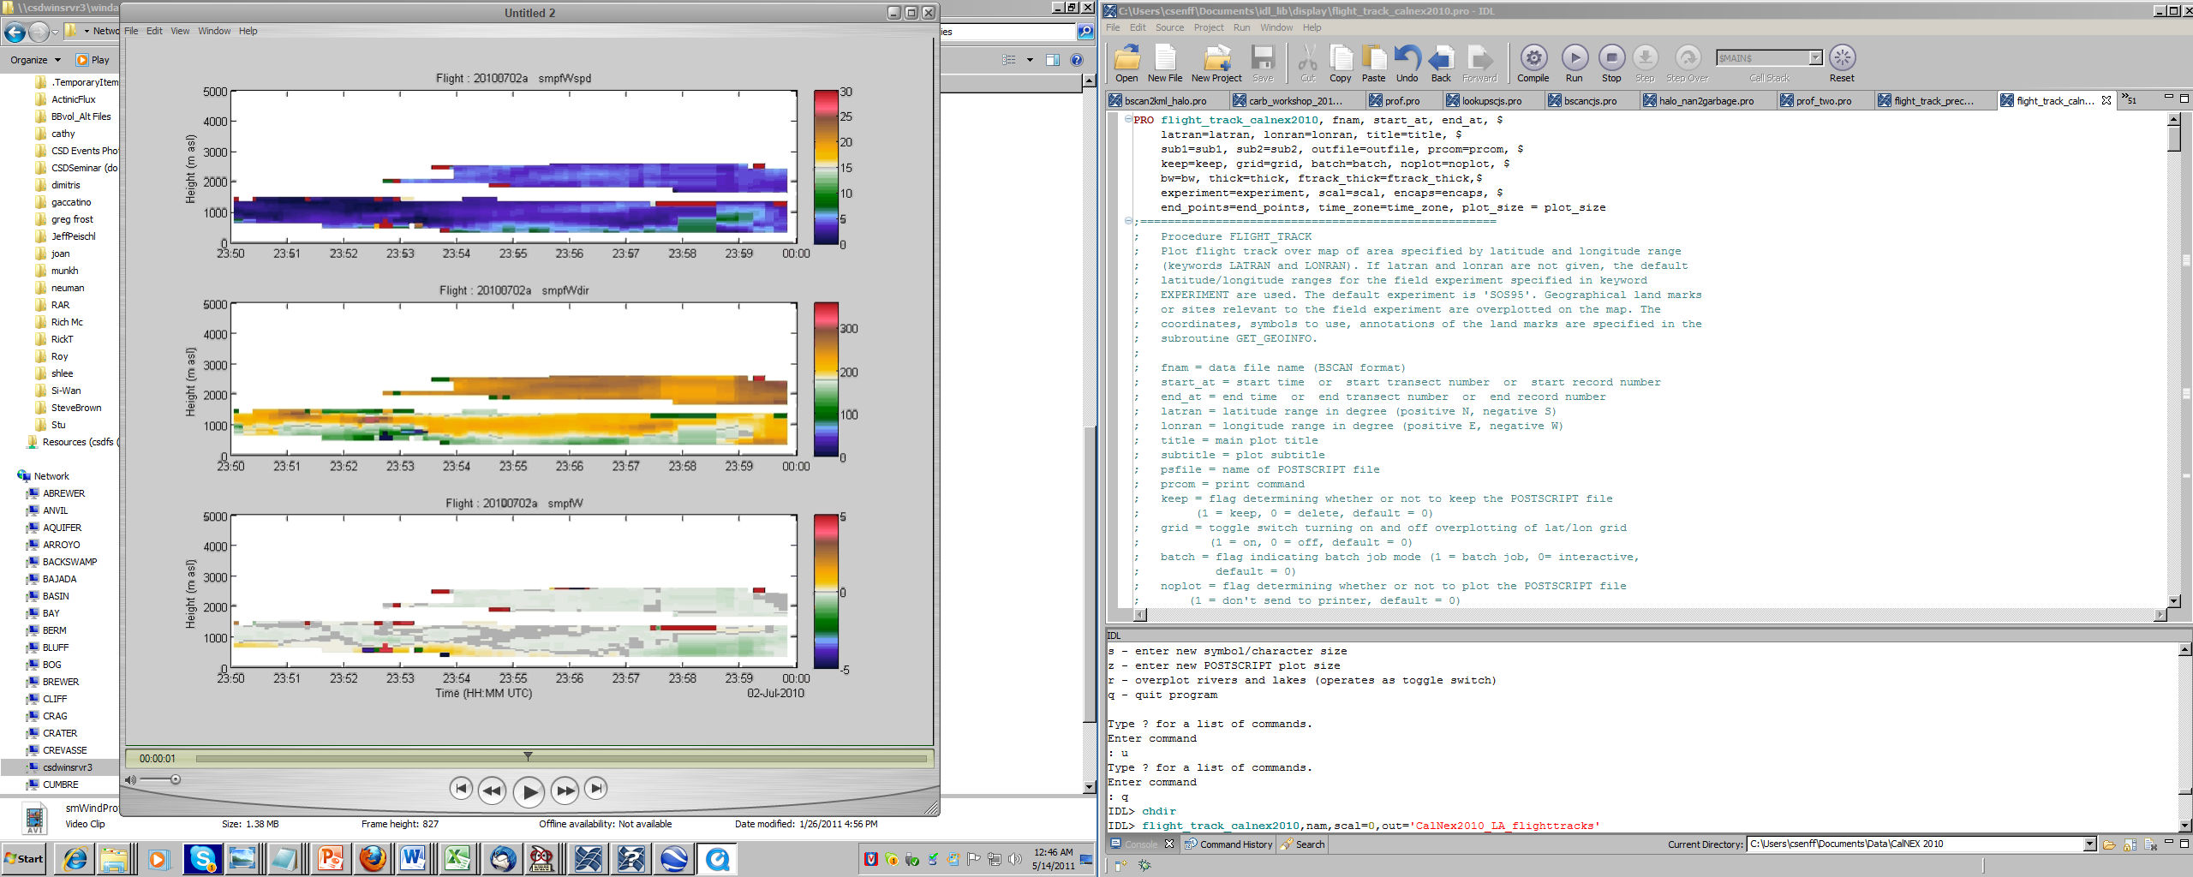
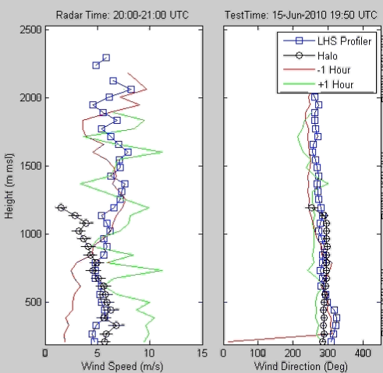
U of Leeds Doppler lidar (7 June – 18 July)
Horizontal wind speed and direction profiles
Vertical wind speed profiles
Min / Max Range: 50 m / up to 3 km
Resolution: Δx = 500 – 800 m, Δz = 50 m
12.5 deg
off nadir
Track

Slide 6
NOAA Twin Otter CalNex Science Objectives
Distribution of pollutants
3-dimensional distribution of ozone and aerosols over different regions of California
Horizontal transport
Flow of ozone and aerosol between different air basins in California
Import and export of ozone into/out of California
Vertical transport
Topographic forcing (Mountain Chimney effect)
Boundary layer detrainment
Ozone layers aloft
    Stratospheric intrusions (Andy Langford, talk)
    Pollution layers transported from Asia (Andy Langford, poster)
Air Quality model validation
Synergies between AMAX-DOAS and LIDAR
Constrain O_{x} budget (O_{x} = NO₂ + O₃)
Notes:
6

Slide 7
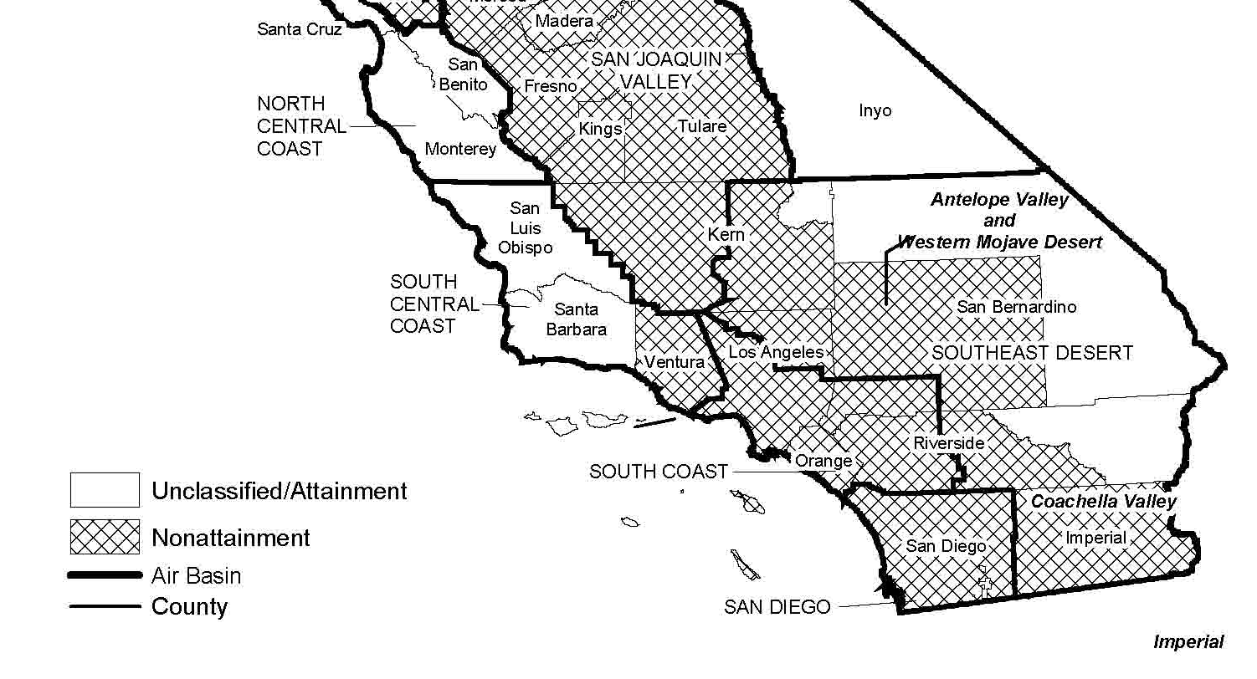
Regional Pollution in Southern California
California Area Designations for 8-hour Ozone NAAQS

Slide 8
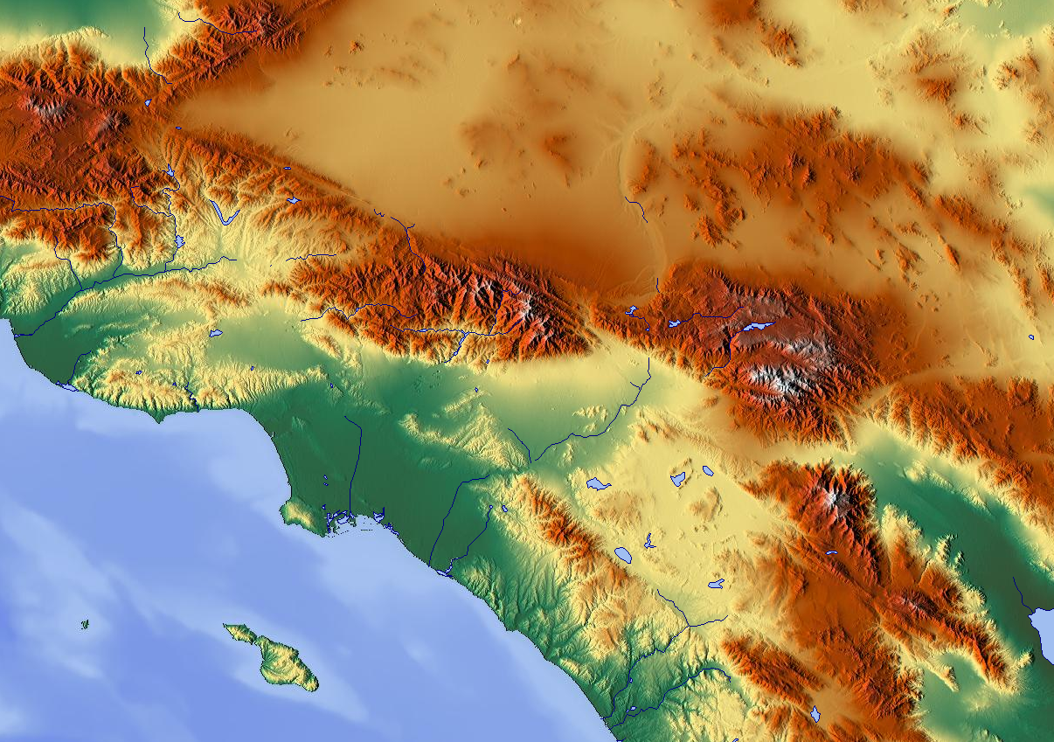
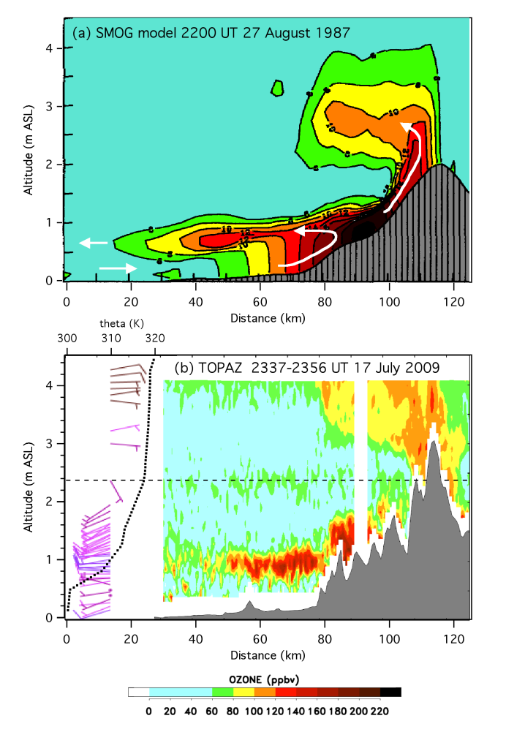
Pollution export pathways from the L A Basin
Mojave Desert
Cajon Pass
Newhall Pass
San Gabriel Mtns
San Bernardino
Mtns
Banning Pass
Land-Sea breeze
Mountain Chimney Effect

Slide 9
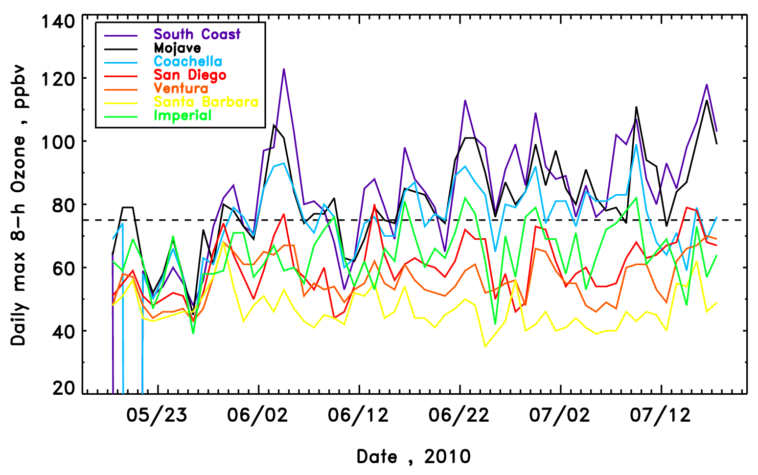
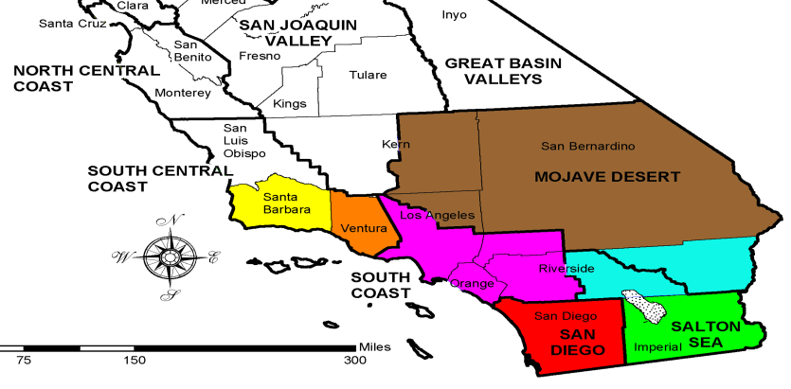
Daily maximum 8-hour surface O₃ concentration
Southern California: May 19 – July 19
Highest 8-h O₃ value in CA in 2010

Slide 10
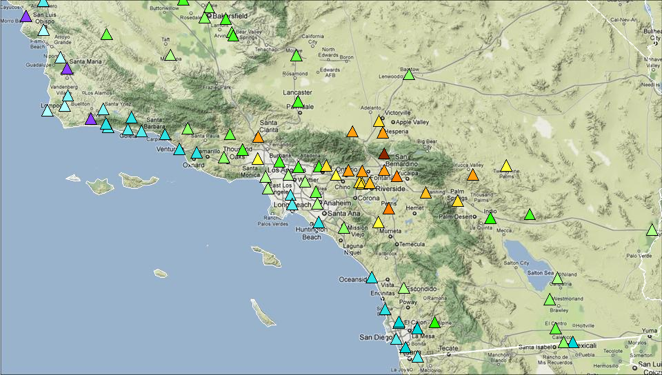
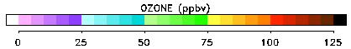
Daily maximum 8-h O₃ concentration averaged for
5 June, 23 June, and 17 July 2010

Slide 11
NOAA Twin Otter CalNex flights in Southern California
2 July 2010

Slide 12
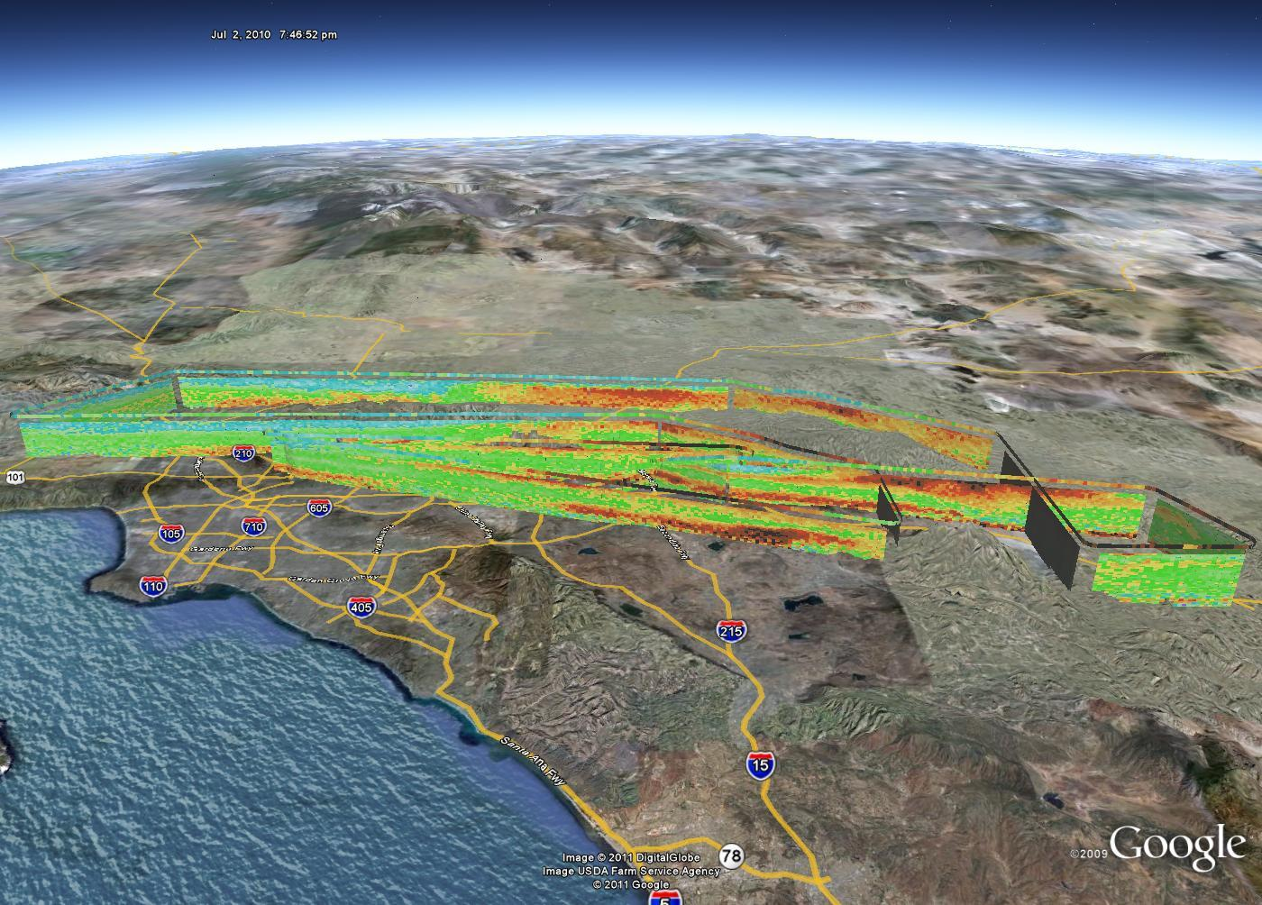
2 July 2010: O₃ distribution over L A Basin and Mojave Desert
FL 11500 – 13500 MSL
14:06 – 17:47 PST

Slide 13
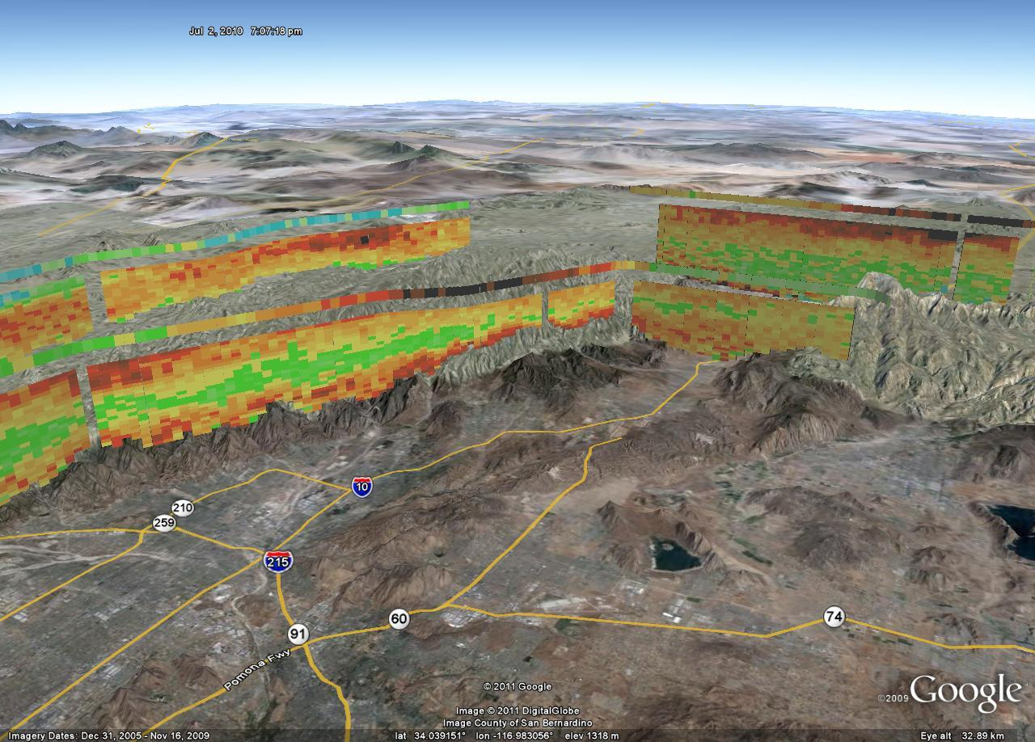
2 July 2010: Transport thru Banning Pass and
along/over San Gabriel Mtns

Slide 14
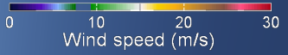
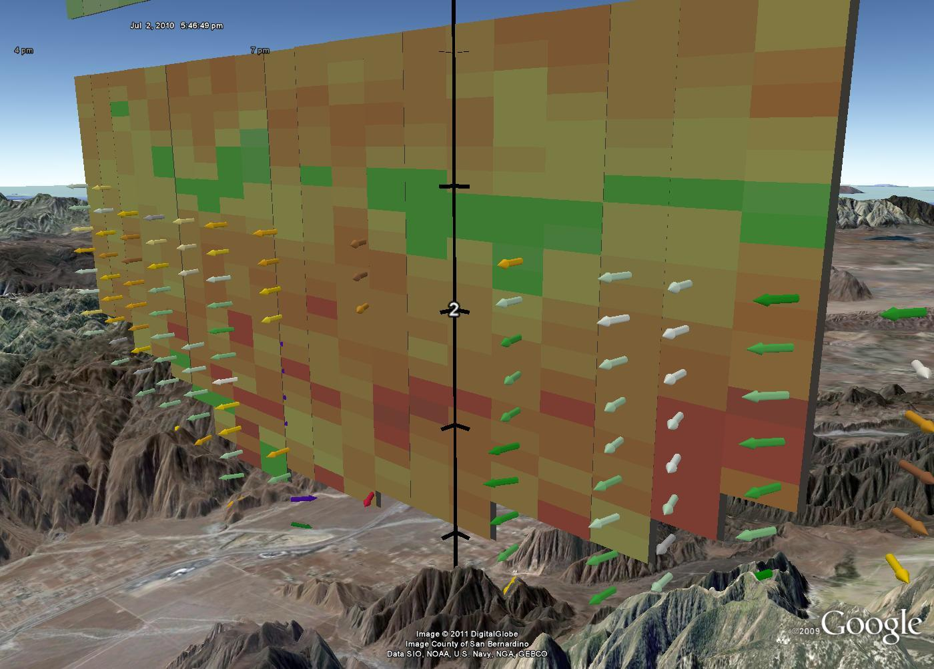
2 July 2010: Transport thru Banning Pass
Combination of lidar remote ozone and wind measurements allows to quantify horizontal ozone flux

Slide 15
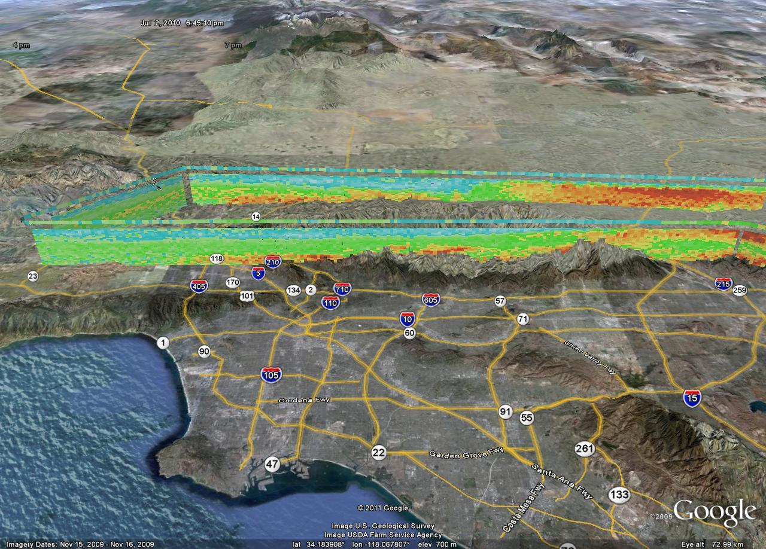

2 July 2010
Upslope transport along/over the San Gabriel Mtns
Transport into Mojave Desert via Newhall Pass

Slide 16
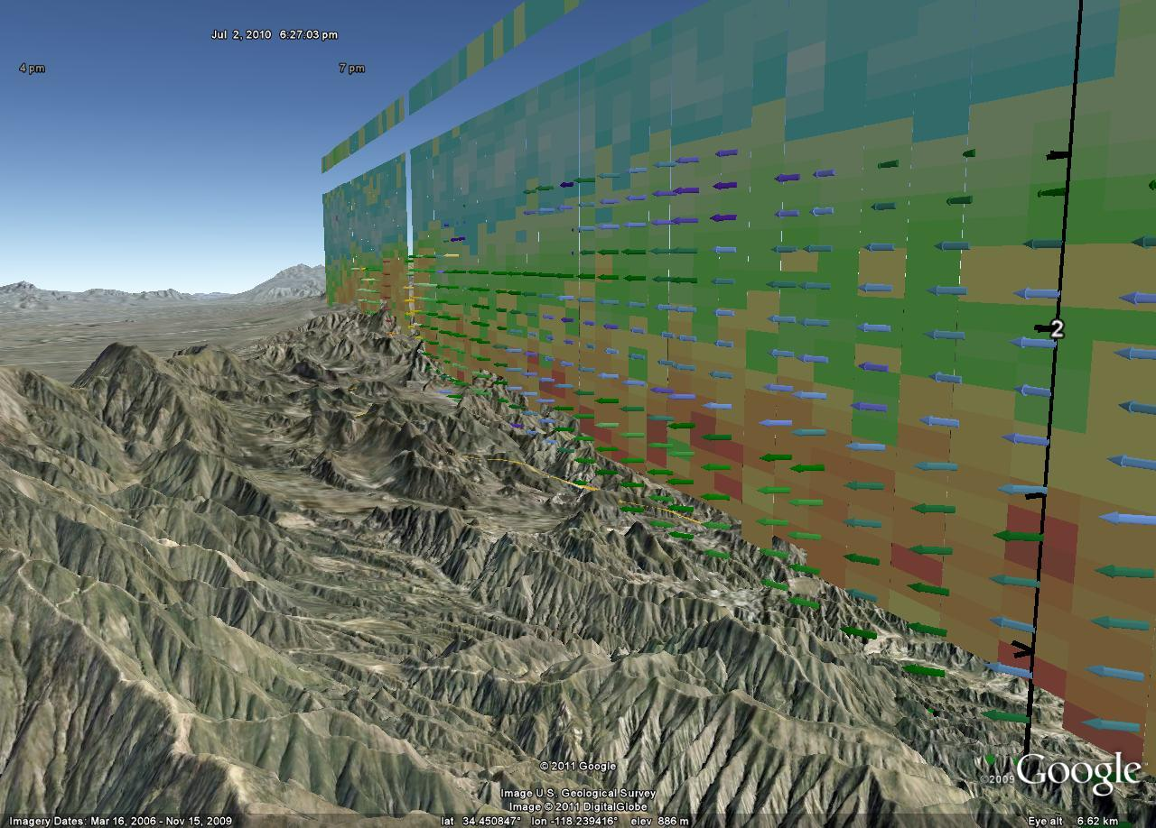
2 July 2010: Transport to Western Mojave Desert
via Newhall Pass / Santa Clarita
Lancaster
Soledad
Canyon

Slide 17
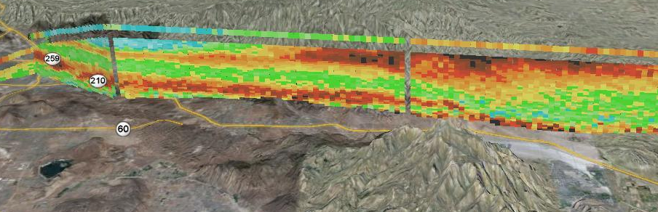
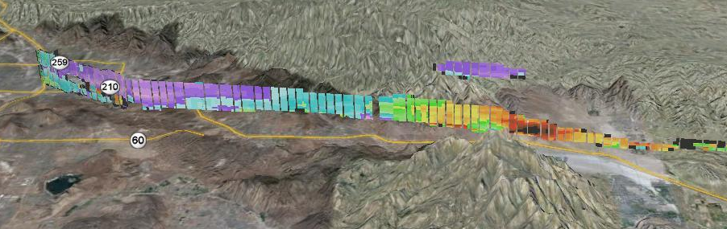
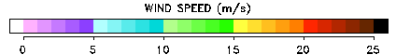
2 July 2010: Transport thru Banning Pass
Ozone, ppbv
Horizontal wind speed , m/s

Slide 18
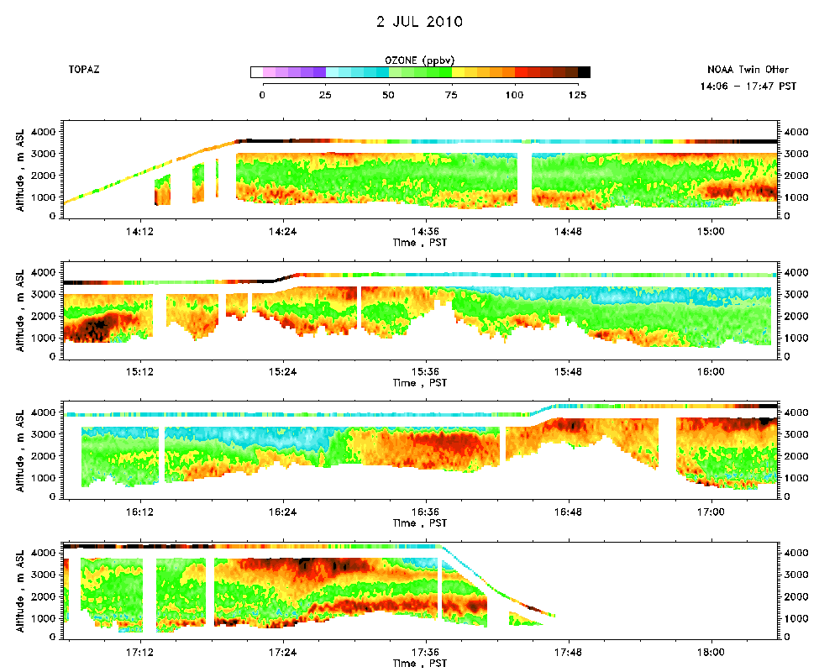
2 July 2010: Orographic Lifting of O₃?

Slide 19
FLEXPART trajectories
01UT 3 July 2010 (3 km MSL)
(Jerome Brioude)

Slide 20
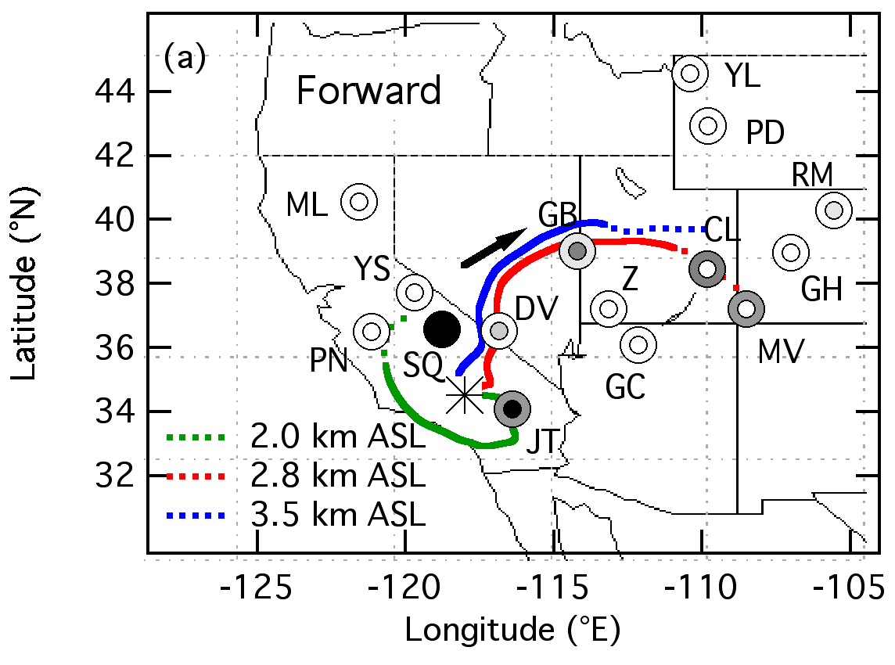
Pre-CalNex: 17 July 2009
HYSPLIT forward trajectories
Langford et al, 2010: Long-range transport of ozone from the Los Angeles Basin: A case study, Geophys. Res. Lett., doi:10.1029/2010GL042507.

Slide 21
Summary & Outlook
Characterized ozone export processes from the L A Basin using airborne lidar and surface ozone data
Demonstrated capability to remotely measure ozone and horizontal wind speed/direction from an airborne platform
Next steps:
Retrieve fluxes and quantify ozone transport
Expand analysis to include other regions in CA

Slide 22
Acknowledgement
R. J. Alvarez, R. M. Hardesty, A. O. Langford, R. M. Banta, W. A. Brewer, F. Davies, S. P. Sandberg, R. D. Marchbanks, A. M. Weickmann, J. G. George
NOAA Twin Otter flight crews & NOAA Aircraft Operations Center
NOAA Health of the Atmosphere Program

Slide 23
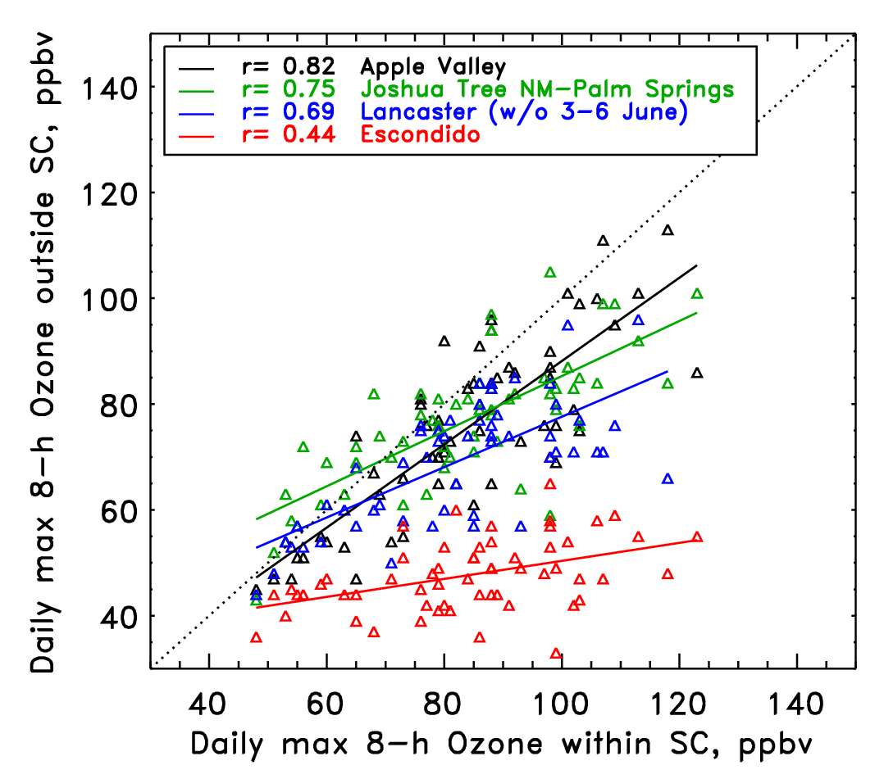
Correlation between daily max. 8-h surface O₃ within and outside
of South Coast Air Basin (SC) for 5/19 – 7/19/2010

Slide 24
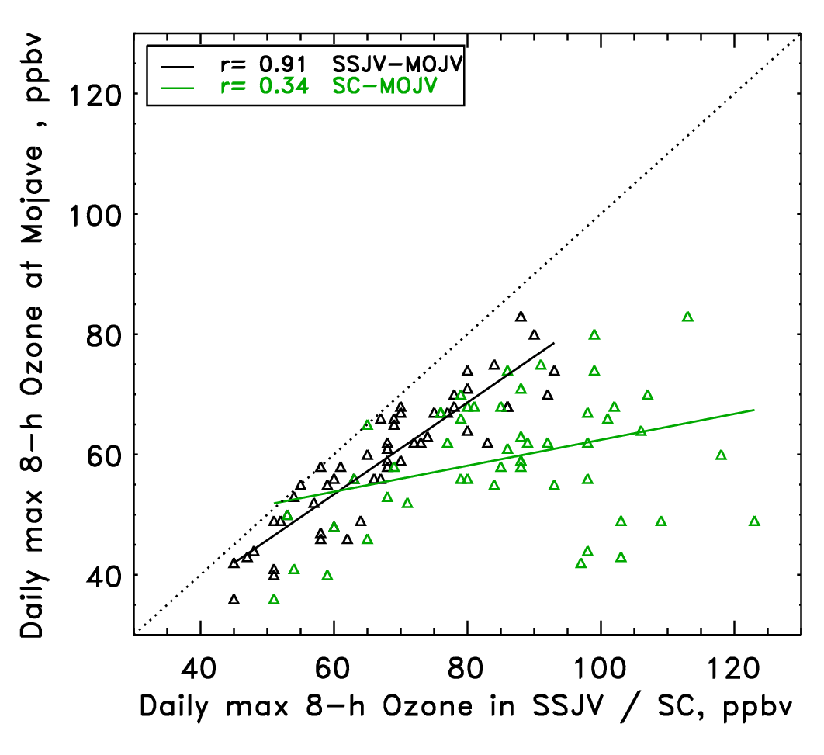
Correlation between daily max. 8-h surf. O₃ at Mojave and
Southern San Joaquin Valley (SSJV) or SC for 5/19 – 7/19/2010

